Slide 1
Carnot's Theorem

Slide 2
Statement
From the second law of thermodynamics two important results are derived
"No engine can be more efficient than a perfectly reversible engine working between the same two temperature.
The efficiency (செயல்திறன்) of all reversible engines, working between the same two temperatures is the same, whatever the working substance.

Slide 3
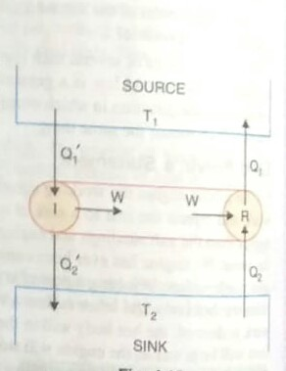

Slide 4
First Part: To prove the first part of the theorem,
we consider two engines R and I working between the temperatures T₁ and T₂ where T₁ > T₂.
Of these two engines R is reversible and I is irreversible,
Suppose I is more efficient than R.
Suppose in each cycle,
R absorbs the quantity of heat Q₁ from the source at T₁ and rejects the quantity of heat Q₂ to the sink at T₂.

Slide 5

Suppose in each cycle I absorbs the quantity of heat Q₁ ˈ from the source at T₁ and gives up the quantity of heat Q₂ˈ to the sink at T₂.
Let the two engines do the same amount of work W in each cycle.
According to the assumption I is more efficient than R.

Slide 6
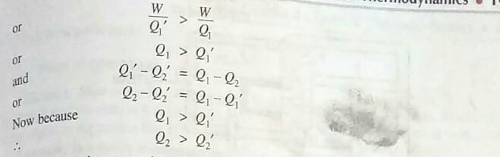

Slide 7
Suppose the two engines are coupled together so that I drives R backwards they use the same source and sink.
The combination forms a self-acting machine in which I supplies external work W and R absorbs this amount of work in its reverse cycle.
I in its cycle absorbs heat Q₁ˈ from the source and gives up heat Q₂ˈ to the sink.
R in its reverse cycle, absorbs heat Q₂ˈ from the sink and gives up heat Q, to the source.

Slide 8
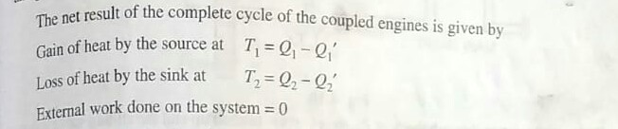
Thus the coupled engines forming a self-acting machine unaided by any external agency transfer heat continuously from a body at low temperature to a body at a higher temperature.

Slide 9
This conclusion is contrary (எதிரானது) to the second law of thermodynamics,
According to which in a cyclic process heat cannot be transferred from one body to another at a higher temperature by a self-acting machine.
Hence our assumption is incorrect and we conclude that no engine can be more efficient than a perfectly reversible engine working between the same temperatures.

Slide 10
Second Part:
The second part of the theorem may be proved by the same arguments as before.
For this purpose, we consider two reversible engines R₁ and R₂ and assume that R₂ is more efficient than R₁.
Proceeding in the same way we can show that R₂ cannot be more efficient than R₁ .

Slide 11
Therefore, all reversible engines working between the same two temperatures have the same efficiency.
Thus, the efficiency of a perfectly reversible engine depends only on the temperatures between which the engine work, and is independent of the nature of the working substance.

