Slide 1
THERMAL AND STATISTICAL PHYSICS
UNIT I: THERMODYNAMICS
வெப்ப இயக்கவியல்

Slide 2
UNIT I: THERMODYNAMICS
Zeroth law of thermodynamics – First law of thermodynamics - Work done in an isothermal and adiabatic processes-Heat engines - Reversible and irreversible processes - isobaric, isochoric process - Carnot’s theorem -Second law of method thermodynamics - Thermodynamic scale of temperature - Maxwell’s Thermo dynamical relations - derivations.

Slide 3
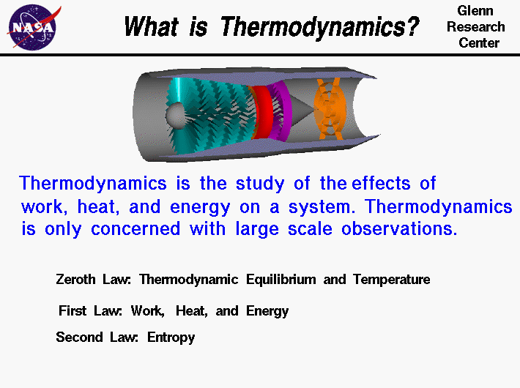
Thermodynamics is a branch of physics that deals with heat, work, and temperature, and their relation to energy, radiation, and properties of matter.

Slide 4
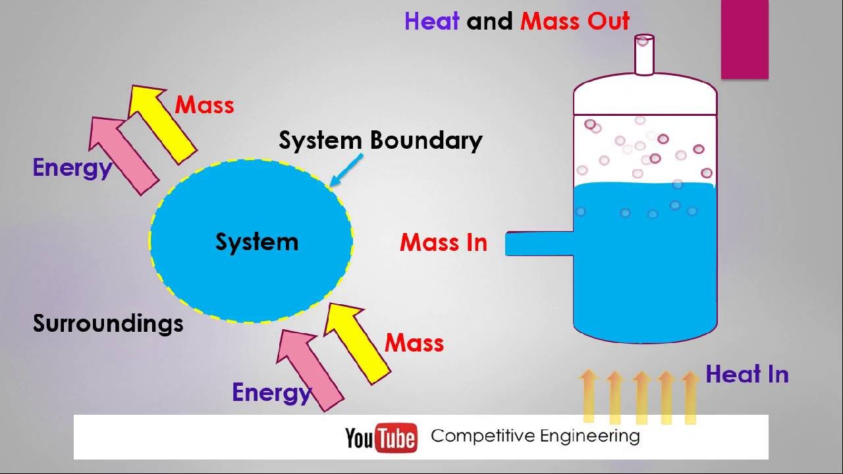
Thermodynamic system
Any space or matter or group of matter where the energy transfer or energy conversions are studied.

Slide 5
Classification
It may be classified into three types.
(a) Open system (or) control volume system
(b) Closed system (or) control mass system
(c) Isolated system

Slide 6
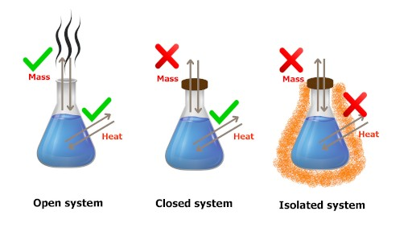
Closed system
When a system has only heat and work transfer, but there is no mass transfer, it is called as closed system.
Example: Piston and cylinder arrangement.

Slide 7
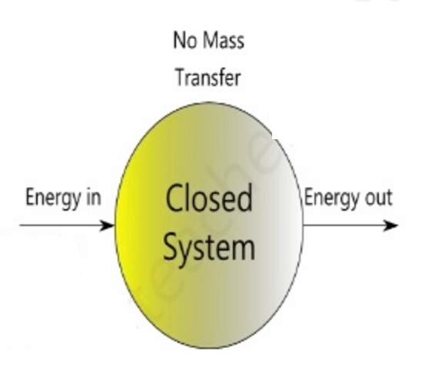

Slide 8
open system
When a system has both mass and energy transfer it is called as open system.
Example: Air Compressor.

Slide 9
Difference between closed and open system
Closed System
1. There is no mass transfer. Only heat and work will transfer.
2. System boundary is fixed one
3. Ex: Piston & cylinder arrangement, Thermal power plant
Open System
1. Mass transfer will take place, in addition to the heat and work transfer.
2. System boundary may or may not change.
3. Air compressor, boiler

Slide 10
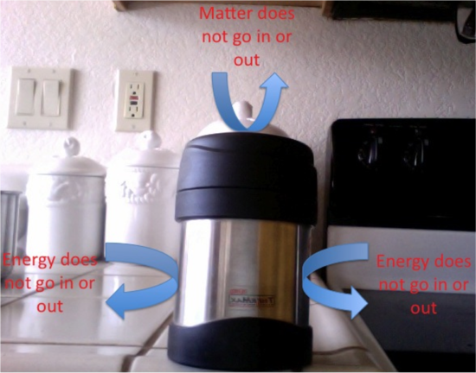
Isolated system
Isolated system is not affected by surroundings. There is no heat, work and mass transfer take place. In this system total energy remains constant.
Example: Entire Universe

Slide 11
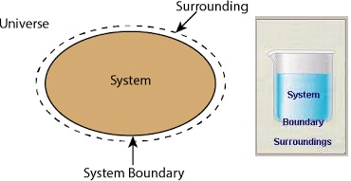
Surroundings
Any other matter out side the system boundary is called as surroundings

Slide 12
Boundary
System and surroundings are separated by an imaginary line is called boundary.
Types
Real Boundary
Imaginary Boundary

Slide 13
Property
Property is defined as any measurable characteristics of the substance when the system remains in a equilibrium state.

Slide 14
Classify the property
Property is defined as any measurable characteristics of the substance when the system remains in a equilibrium state.
Thermodynamic property can be classified into two types.
1. Intensive or Intrinsic and
2. Extensive and Extrinsic property

Slide 15
Intensive or Intrinsic property
The properties which are independent on the mass of the system is called intensive properties.
e.g., Pressure, Temperature, Specific Volume etc.,

Slide 16
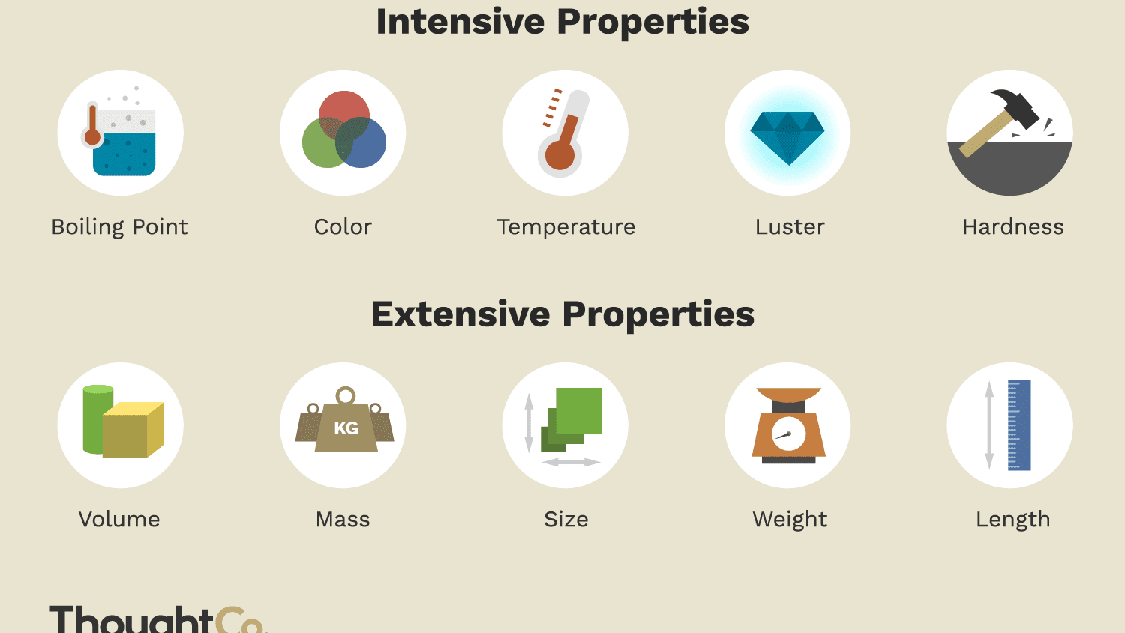
Intensive and Extensive Property

Slide 17
Extensive properties
The properties which are dependent on the mass of the system is called extensive properties.
e.g., Total energy, Total volume, weight etc.

Slide 18
Differentiate Intensive and Extensive properties
Intensive Properties
Extensive Properties
1. Independent on the mass of the system
2. If we consider part of the system these properties remain same.
e.g. pressure, Temperature specific volume etc.,
Dependent on the mass of the system.
If we consider part of the system it will have a lesser value.
e.g., Total energy, Total volume, weight etc.,

Slide 19
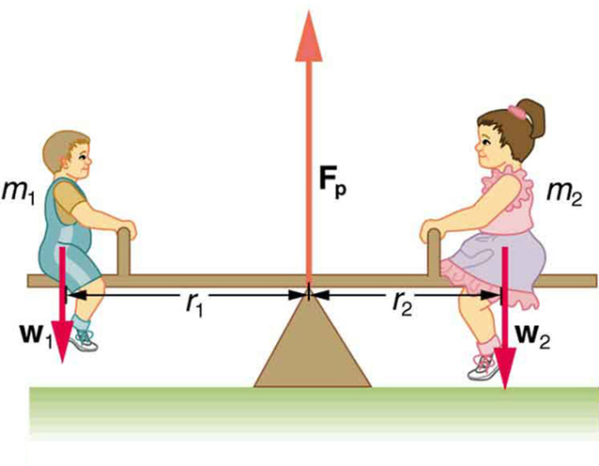
Equilibrium of a system
When a system remains in equilibrium state, it should not undergo any changes to its own accord.

Slide 20
Equilibrium of a system
When there is no change in macroscopic property such as Temperature, Pressure etc., in a system, then such a system is said to be in the state of thermodynamic equilibrium.

Slide 21
Thermodynamic equilibrium
When a system is in thermodynamic equilibrium, it should satisfy the following three conditions.
(a) Mechanical Equilibrium :- Pressure remains constant (There is no change in pressure (or) force with time in the system)
(b) Thermal equilibrium :- Temperature remains constant (There is no change in temperature with time in the system)
(c) Chemical equilibrium : There is no chemical reaction. ( All posible chemical reaction taken place & there is no change in phase.)

Slide 22
Thermodynamic Cycle
When a system undergoes a series of processes and return to its initial condition, it is known as Thermodynamic cycle.
Any process (or) series of process in which the system return to the original condition (or) state is called cyclic process

Slide 23
Open and closed cycle
In a closed cycle, the same working substance will recirculate again and again.
In a open cycle, the same working substance will be exhausted to the surroundings after expansion.

Slide 24
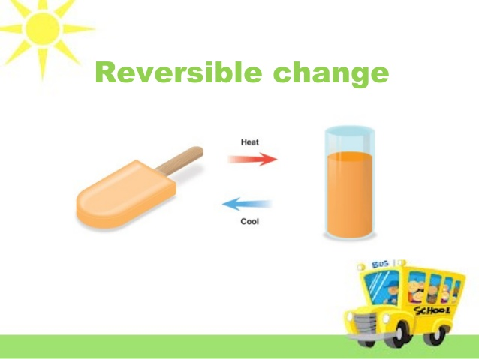
Reversible process (மீளக்கூடிய செயல்முறை)
A process is said to be reversible, it should trace the same path in the reverse direction when the process is reversed.
It is possible only when the system passes through a continuous series of equilibrium state.

Slide 25
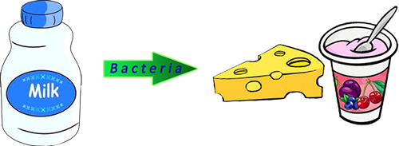
Irreversible process (மாற்ற முடியாத செயல்முறை)
If a system does not pass through continuous equilibrium state, then the process is said to be irreversible.

Slide 26
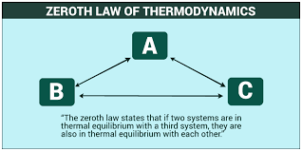
Zeroth Law of thermodynamics
when two systems are separately in thermal equilibrium with a third system, then they themselves are in thermal equilibrium with each other.

Slide 27
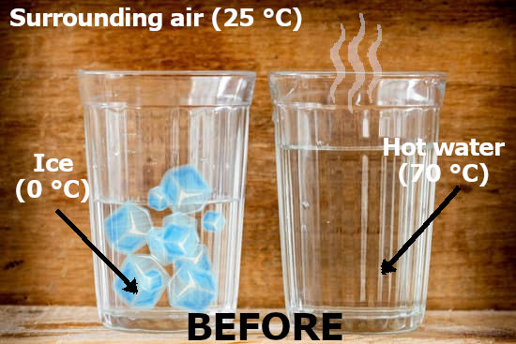
Zeroth Law of thermodynamics

Slide 28
Heat (வெப்பம்)
Heat is the energy crossing the boundary due to the temperature difference between the system and surroundings.

Slide 29
Enthalpy (அடக்கவெப்பம்)
The Combination of internal energy and flow energy is known as enthalpy of the system.
It may also be defined as the total heat of the substance.

Slide 30
Internal energy (உள் ஆற்றல்)
Internal energy of a gas is the energy stored in a gas due to its molecular interactions.
It is also defined as the energy possessed by a gas at a given temperature.

Slide 31
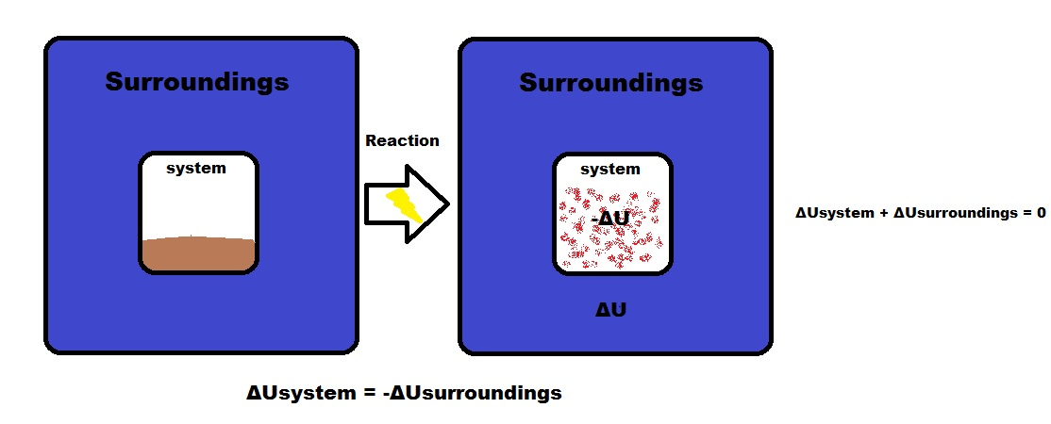

Slide 32
Thermodynamic work
It is the work done by the system when the energy transferred across the boundary of the system.
It is mainly due to intensive property difference between the system and surroundings.

Slide 33
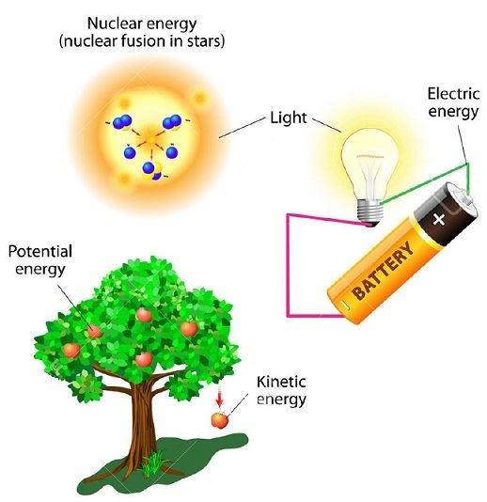
Law of conservation of energy
Energy can neither be created nor destroyed, but it can be transferred from one form to another.

