Slide 1
Thermodynamics
Dr. T. Thilagavathi
Assistant Professor of Physics
Government college for women (A)
Kumbakonam

Slide 2
Specific heat capacity (வெப்ப ஏற்பு திறன்)
Specific heat capacity of a substance is defined as the quantity of heat required to raise the temperature of 1 kg of the substance through 1K.
Its unit is J kg^{–1}K^{–1}.

Slide 3
Specific heat capacity of constant volume (Cv)
C_{v} is defined as the quantity of heat required to raise the temperature of 1 mole of a gas through 1 Kelvin by keeping the volume constant.

Slide 4
Specific heat capacity of constant Pressure (Cp)
Cp is defined as the quantity of heat required to raise the temperature of 1 mole of a gas through 1 kelvin by keeping the pressure is constant.

Slide 5
  First law of thermodynamics
Let us consider a gas inside a cylinder fitted with a movable frictionless piston.
The walls of the cylinder are made up of non- conducting material and the bottom is made up of conducting material.

Slide 6
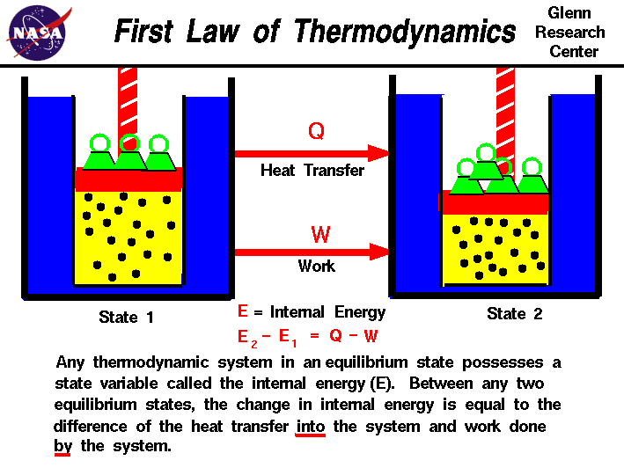
First law of thermodynamics

Slide 7
Let the bottom of the cylinder be brought in contact with a hot body like burner.
The entire heat energy given to the gas is not converted into work.
A part of the heat energy is used up in increasing the temperature of the gas
(i.e) in increasing its internal energy and the remaining energy is used up in pushing the piston upwards (i.e.) in doing work

Slide 8
If ΔQ is the heat energy supplied to the gas,
U₁ and U₂ are initial and final internal energies and
Δ W is the work done by the system,
then
Δ Q = Δ W + (U2 - U1)
Δ Q = Δ W + Δ U
where Δ U is the change in the internal energy of the system.
Hence, the first law of thermodynamics states that the amount of heat energy supplied to a system is equal to the sum of the change in internal energy of the system and the work done by the system. This law is in accordance with the law of conservation of energy.

Slide 9
    Workdone in an isothermal process
Consider one mole of an ideal gas enclosed in a cylinder with perfectly conducting walls .
And fitted with a perfectly frictionless and conducting piston.
Let P1, V1 and T be the initial pressure, volume and temperature of the gas.
Let the gas expand to a volume V2 when pressure reduces to P2, at constant temperature T.
At any instant during expansion let the pressure of the gas be P.

Slide 10
If A is the area of cross section of the piston, then force F = P × A.
Let us assume that the pressure of the gas remains constant during an infinitesimally (மிகச் சிறிய அளவை) small outward displacement dx of the piston.
Work done
dW = Fdx = PAdx = PdV
Total work done by the gas in expansion from initial volume V₁ to final volume V₂ is

Slide 11
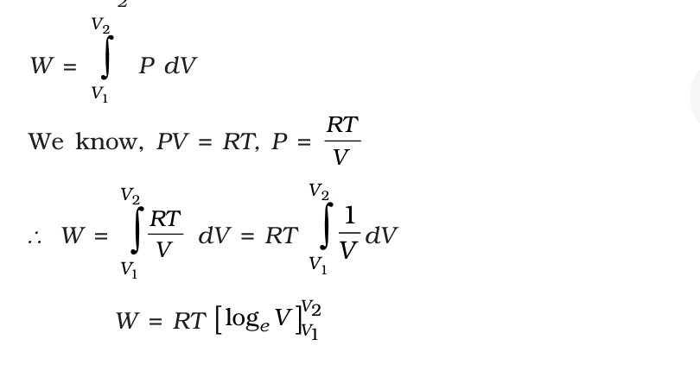
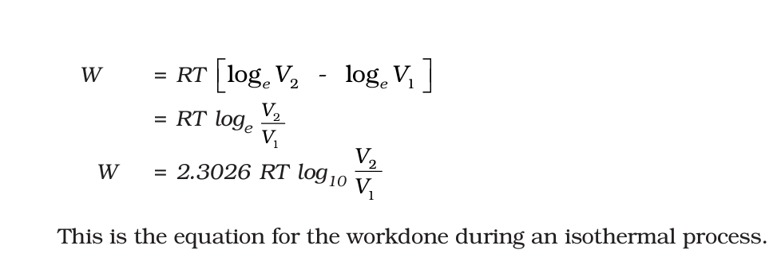

Slide 12
    Work done in an adiabatic expansion
Consider one mole of an ideal gas enclosed in a cylinder with perfectly non conducting walls and fitted with a perfectly frictionless, non conducting piston.
Let P1, V1 and T1 be the initial pressure, volume and temperature of the gas.
If A is the area of cross section of the piston, then force exerted by the gas on the piston is

Slide 13
F = P × A, where P is pressure of the gas at any instant during expansion.
If we assume that pressure of the gas remains constant during an infinitesimally small outward displacement dx of the piston,
then work done dW = F × dx = P × A dx dW = P dV

Slide 14
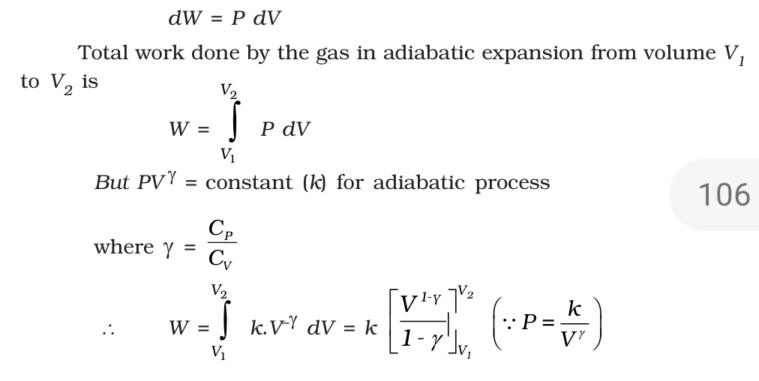

Slide 15
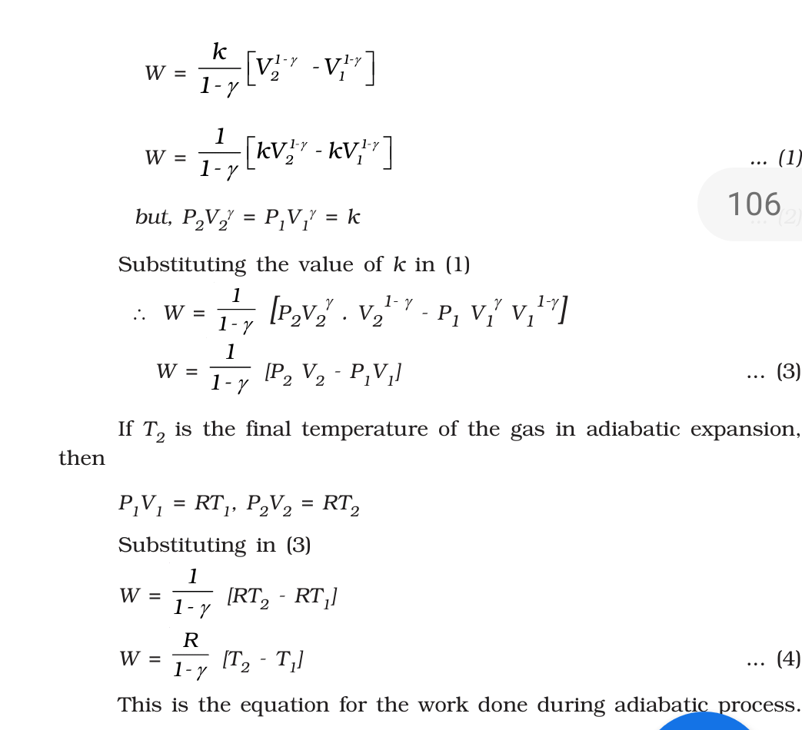

Slide 16
Second law of thermodynamics
The first law of thermodynamics is a general statement of equivalence between work and heat.
The second law of thermodynamics enables us to know whether a process which is allowed by first law of thermodynamics can actually occur or not.
The second law of thermodynamics tells about the extent and direction of energy transformation.
Different scientists have stated this law in different ways to bring out its salient features.

Slide 17
Kelvin’s statement
Kelvin’s statement of second law is based on his experience about the performance of heat engine.
It is impossible to obtain a continuous supply of work from a body by cooling it to a temperature below the coldest of its surroundings.

Slide 18
Clausius statement
It is impossible for a self acting machine unaided by any external agency to transfer heat from a body at a lower temperature to another body at a higher temperature.

Slide 19
கிளாசியஸ் கூற்று
எத்தகைய வேலையும் செய்யாமல் வெப்பத்தைக் குளிர்ந்த பொருளிலிருந்து சூடான பொருளுக்கு மாற்றுவது இயலாது.
என்ட்ரோபியை அதிகரிக்கூடிய செயல்முறையானது தன்னிச்சையானதாகும். இக்கூற்று என்ட்ரோபி கூற்று எனப்படும். என்ட்ரோபி என்பது ஒழுங்கற்ற தன்மையை குறிக்கிறது.ஒர் இயந்திரத்தின் திறன் எப்பொழுதும் 100% அடையாது.
ஓர் இயந்திரத்தின் திறன் என்பது வெளிப்படுத்திய ஆற்றலுக்கும் உறிஞ்சப்பட்ட ஆற்றலுக்கும் உள்ள விகிதத்தின் மதிப்பாகும். எனவே 100% திறனை ஒரு பொதும் அடைய இயலாது.

Slide 20
Kelvin - Planck’s statement
It is impossible to construct a heat engine operating in a cycle, that will extract heat from a reservoir and perform an equivalent amount of work.
கெல்வின் பிளாங்க் கூற்று ஒரு முழுமையான சுற்றில் ஒரு பொருளிலிருந்து வெப்பத்தை உறிஞ்சி, அந்த அமைப்பில் எத்தகைய சிறு மாற்றத்தையும் ஏற்படுத்தாமல், முழுவதுமாக வேலையாக மாற்றக் கூடிய இயந்திரத்தை வடிவமைக்க இயலாது

Slide 21
  Carnot engine
Heat engine is a device which converts heat energy into mechanical energy.
In the year 1824, Carnot devised an ideal cycle of operation for a heat engine.
The machine used for realising this ideal cycle of
operation is called an ideal heat engine or carnot heat engine

Slide 22
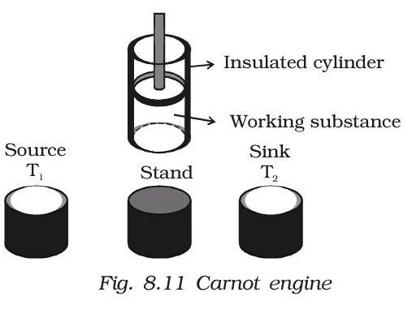
The essential parts of a Carnot engine

Slide 23
Source
It is a hot body which is kept at a constant temperature T1.
It has infinite thermal capacity (
எல்லையற்ற வெப்ப திறன்).
Any amount of heat can be drawn from it at a constant temperature T1
(i.e) its temperature will remain the same even after drawing any amount of heat from it.

Slide 24
Sink
It is a cold body which is kept at a constant lower temperature T2.
Its thermal capacity is also infinite that any amount of heat added to it will not increase its temperature.

Slide 25
Cylinder
Cylinder is made up of non-conducting walls and conducting bottom.
A perfect gas is used as a working substance.
The cylinder is fitted with a perfectly non-conducting and frictionless piston

Slide 26
Insulating stand
It is made up of non conducting material so as to perform adiabatic operations.
Working : The Carnot engine has the following four stages of operations.
  1.Isothermal expansion
  2. Adiabatic expansion
  3. Isothermal compression
  4. Adiabatic compression.

Slide 27
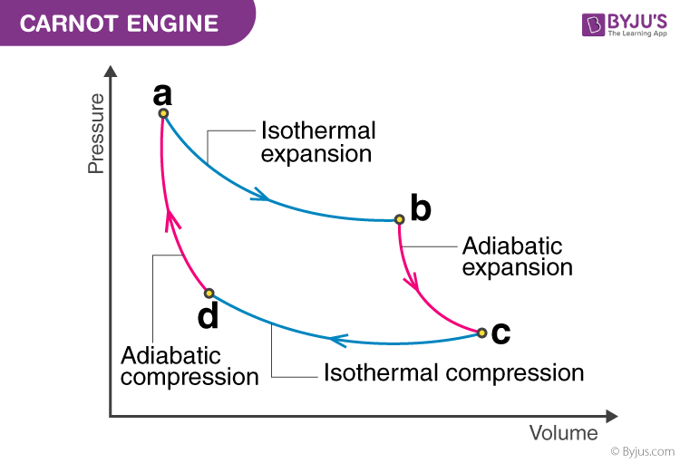

Slide 28
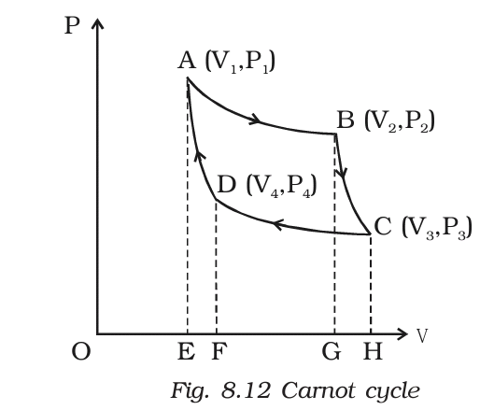

Slide 29
Isothermal expansion
Let us consider one mole of an ideal gas enclosed in the cylinder.
Let V1, P1 be the initial volume and pressure of the gas respectively.
The initial state of the gas is represented by the point A on the P–V diagram.
The cylinder is placed over the source which is at the temperature T1.
The piston is allowed to move slowly outwards, so that the gas expands.
Heat is gained from the source and the process is isothermal at constant temperature T1.

Slide 30
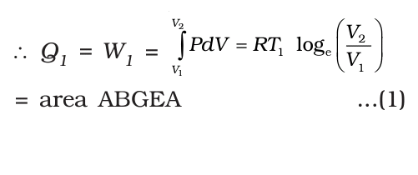
In this process the volume of the gas changes from V1 to V2 and the pressure changes from P1 to P2.
This process is represented by AB in the
indicator diagram .
During this process, the quantity of heat absorbed from the source is Q1 and W1 is the corresponding amount of work done by the gas.

Slide 31
Adiabatic expansion
The cylinder is taken from the source and is placed on the insulting stand and the piston is moved further .
so that the volume of the gas changes from V2 to V3 and the pressure changes from P2 to P3.
This adiabatic expansion is represented by BC. Since the gas is thermally insulated from all sides no heat can be gained from the surroundings.
The temperature of the gas falls from T1 to T2.

Slide 32
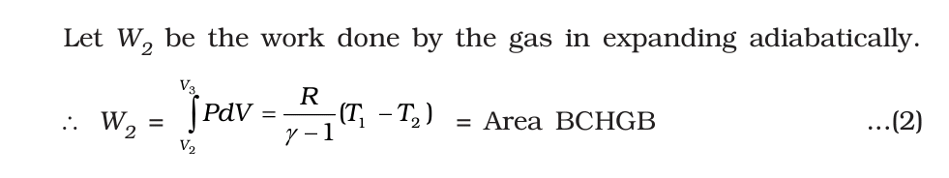

Slide 33
Isothermal compression
The cylinder is now placed on the sink at a temperature T2.
The piston is moved slowly downward to compress the gas isothermally.
This is represented by CD.
Let (V4, P4) be the volume and pressure corresponding to the point D.
Since the base of the cylinder is conducting the heat produced during compression will pass to the sink so that, the temperature of the gas remains constant at T2.

Slide 34
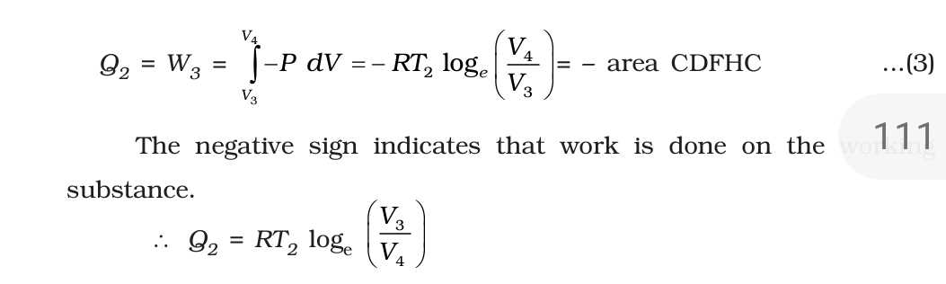
Let Q₂ be the amount of heat rejected to the sink and W₃ be the amount of work done on the gas in compressing it isothermally.

Slide 35
Adiabatic compression
The cylinder is now placed on the insulating stand and the piston is further moved down in such a way that the gas is compressed adiabatically to its initial volume V1 and pressure P1.
As the gas is insulated from all sides heat produced raises the temperature of the gas to T1.

Slide 36
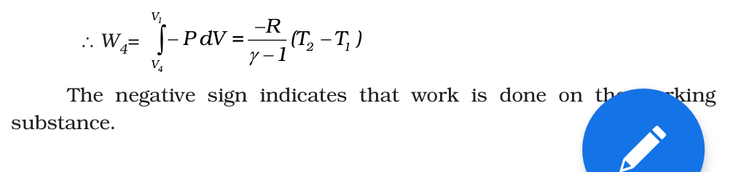

This change is adiabatic and is represented by DA.
Let W₄ be the work done on the gas in compressing it adiabatically from a state D (V₄ , P₄) to the initial state A (V₁, P₁).

Slide 37
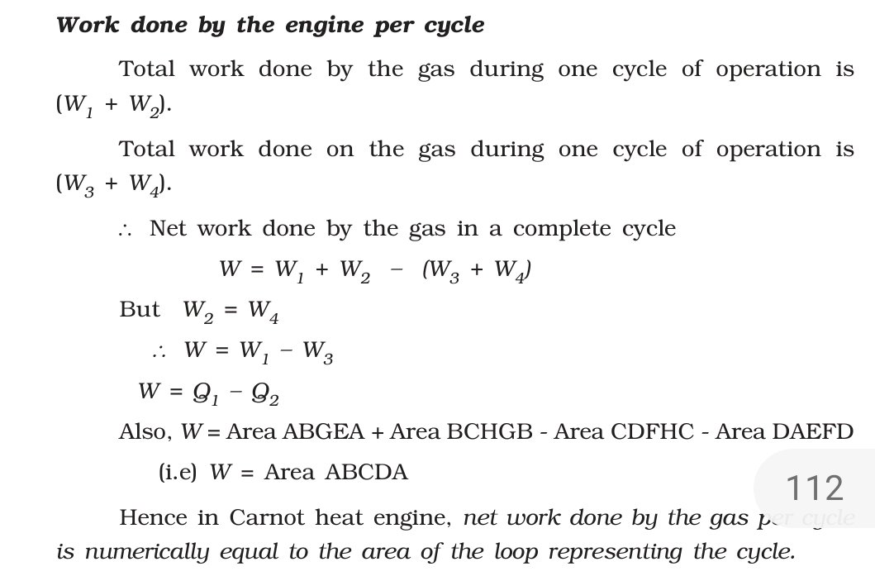

Slide 38
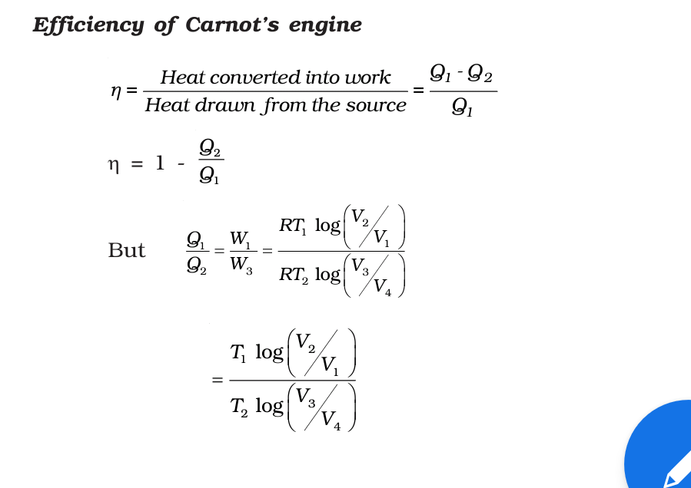

Slide 39
