Slide 1
electron theory of magnetism

Slide 2
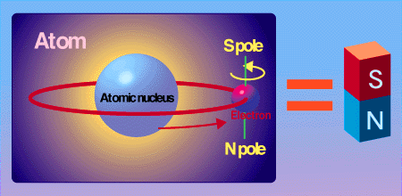
Theory of magnetism was laid by Weber.
According to Weber each atom of a magnetic substance is itself a permanent magnet
In an atom, magnetism arises from the spin and orbital momentum of its electron.

Slide 3
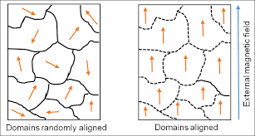
Under ordinary conditions the molecular magnets are distributed at random or in small groups and they form elementary magnetic circuits and the resultant magnetic field exhibited outside is zero.

Slide 4
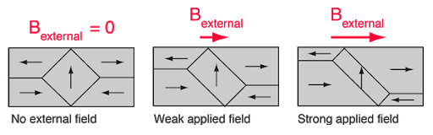
During the process of magnetisation the molecular magnets are reoriented in the direction of the magnetising field.

Slide 5
When all the N-poles of the molecular magnets are oriented in the same direction the magnetic property of the specimen is maximum.
This is the stage of saturation.
The main concern of the later theories had been to account for the magnetic property of the molecules and to understand the nature of the force experienced by them.
It has been suggested by Ampere that the magnetic property of the molecule is due to the current circulating in the atom.

Slide 6
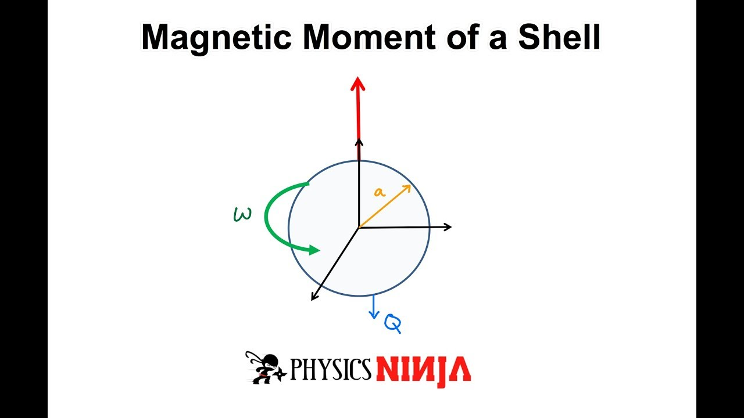
From the analogy (comparison between) of a magnetic shell and a current carrying circuit.

Slide 7
The magnetic moment of a coil of area A,
It carrying a current I = Al.
The electrons revolving round the nucleus in different orbits constitute electric current, which produces a magnetic field.
Let the radius of the electron orbit be r сm
Charge on each electron e emu
angular velocity ω

Slide 8
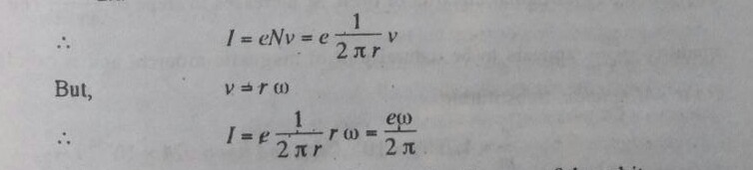
Then current = charge flowing per second,
I = eNν
here v is the distance moved by the electron per second
N is the number of electrons per unit length
But the effective number of electrons per cm = N= 1/2πr
Where 2πr is the circumference of the orbit.

Slide 9
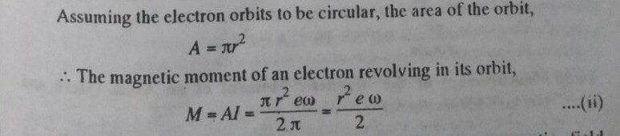
Now, imagine the electron to be subjected to a magnetic field perpendicular to the plane of its orbit.
The incidence of the magnetic field perpendicular to the plane

Slide 10
It produces an induced current in the electron circuit which tends to go external magnetic field.
Thus, the susceptibility is negative and if this were only effect present, all substances will behave as diamagnetic materials.
Beside the above, the resultant magnetic moment of a molecule is largely dependent on the electron spin about an axis passing through its centre.
The ferromagnetic property of a material appears to be largely due to the electron spin.

