Slide 1
The importance of hysteresis curves

Slide 2
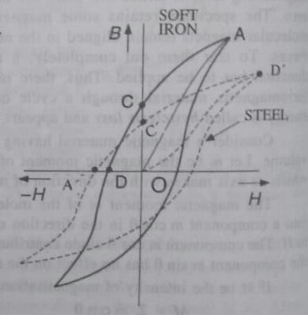
The magnetic properties of a ferromagnetic substance can be obtained from the size and shape of the hysteresis loop.
Fig. shows the hysteresis loops for soft iron and steel.

Slide 4
The retentivity of soft iron (OC) is greater than that of steel (OC').
i.e., soft iron retains more magnetism than steel, when the magnetizing force is totally removed.
The coercive force for soft iron (OD) is smaller than that for steel (OD’).
ie. iron is more readily demagnetised than steel.

Slide 5
the permeability µ = (BIH) for soft iron is greater than that for steel.
The susceptibility χ = (MIH) for soft iron is greater than that for steel.
The area of the B-H loop for steel is much larger than that for soft iron.
Thus the energy loss per unit volume per cycle of magnetisation is greater for steel than that for soft iron.

Slide 6
Choice of Magnetic materials.
Permanent Magnets. Materials used for making magnets are never taken through a cycle.
So hysteresis loss is a minor consideration in these cases.
These materials should have high retentivity and high coercivity.
So steel is a suitable material for permanent magnets.
.

Slide 7
Recently a number of alloys, having large values of coercivity have been developed for the purpose of construction of permanent magnets.
The very suitable alloy of highest coercivity is named as vicalloy (vanadium, iron and alloy cobalt).

Slide 8
Electro-magnets
The material for the cores of electromagnets should have maximum flux density with comparatively small magnetising field and low hysteresis loss.
Soft-iron is an ideal material for electromagnets.

Slide 9
Transformer cores
Materials for transformer cores, telephone diaphragms and chokes etc.. (which are meant for obtaining high magnetic flux) are frequently subjected to many cycles of magnetisation in one second.
So the material selected for the purpose must be associated with high magnetic induction and low hysteresis loss.

Slide 10
Soft-iron is better than steel for these purposes.
By alloying soft-iron with 4% silicon, “transformer steel” is produced.
It has a higher initial permeability and is an ideal material for cores of transformers.
Alloys of iron and nickel, called permalloys have also very large initial permeabilities

Slide 11
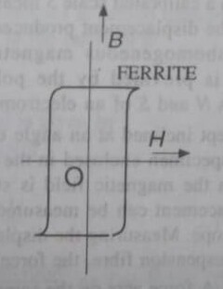
Ferrites
Their permeability is very high.
Ferrites are made by sintering powders consisting of a mixture of ferric oxide and the oxides of other metals like lithium, nickel and manganese.

Slide 12
Their hysteresis loop is almost rectangular [Fig.) which enables these to be used for memory circuit in computers.
These have a high electrical resistivity unlike the ferromagnetic materials which are very good conductors.
So ferrites are widely used in the manufacture of components for Radio and electrical communication

