Slide 1
MAGNETIC PROPERTIES OF MATERIALS
Dr. T. Thilagavathi
Assistant Professor of Physics
Government college for women (A)
Kumbakonam

Slide 2
Unit II
Basic definitions – Electron theory of magnetism – Dia, Para, Ferro magnetic materials –Hysteresis – B-H curve using Ballistic Galvanometer – Energy loss due hysteresis and its importance.

Slide 3
Electricity and Magnetism
Electromagnetism is a branch of physics involving the study of the electromagnetic force
A type of physical interaction that occurs between electrically charged particles.

Slide 4
Magnetic properties of material
The magnetic properties of a material are those which determine the ability of material to be suitable for a particular magnetic Application.
Some of the typical magnetic properties of engineering materials are listed below-
Permeability.
Retentively or Magnetic Hysteresis.
Coercive force.

Slide 5
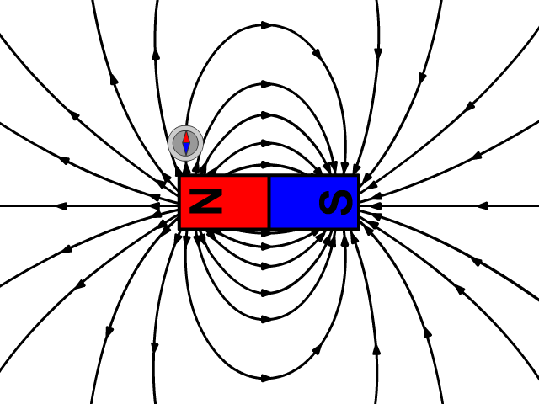
Magnetic Field (காந்த புலம்)
Magnetic field is defined as the space around the magnet (or) the current carrying conductor where the magnetic effect is felt.

Slide 6
Magnetic lines of Forces
Magnetic field consists of a number of imaginary lines of magnetic forces.
These lines of forces travel externally from north pole to south pole.
The magnetic lines of force is defined as the continuous curve in a magnetic field.
The tangent drawn at any point on the curve gives the direction of the resultant magnetic intensity at that point.

Slide 7

Magnetic lines of Forces

Slide 8
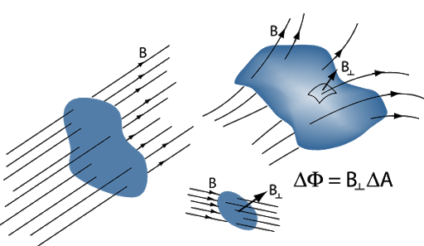
Magnetic Flux (φ ) (காந்தப் பாய்வு)
The total number of magntic lines of force passing through a surface is known as magnetic flux.
It is represented by the symbol (φ )
Its unit is weber.

Slide 9
Magnetic flux density (or) Magnetic induction (B) காந்த தூண்டல்
It is defined as the number of magnetic lines of force ( φ) passing perpendicularly through a unit area of a cross section (A).
It is denoted by the symbol (B) and its unit is Weber/m2 (or) tesla.
Magnetic flux density is given by
B=fi/A weber/m2
It is also equal to the magnetic force experienced by a unit north pole placed in that magnetic filed.

Slide 10
Magnetic Dipole (காந்த இருமுனை)
Any two equal and opposite magnetic poles seperated by a small distance (d) constitute a magnetic dipole (or)
A system having two opposite magnetic poles seperated by a distance (d) is called as a magnetic dipole.

Slide 11
Magnetic dipole moment (M)
A system having two opposite magnetic poles seperated by distance (d) is called as a magnetic dipole.
If (m) is the magnetic pole strength and (l) is the length of the magnet, its dipole moment is given by the product (ml).
It is expressed in Am².
It is a vector quantity
Dipole moment M = ml

Slide 12
Bohr Magneton
The orbital magnetic moment and the spin magnetic moment of an electron in an atom can be expressed in terms of atomic unit of magnetic moment called Bohr magnetron.
One Bohr Magnetron eђ/2m
(or) µb=eh/4πm
Where ђ = h/2π
µB = 9.27 * 10⁻²⁴Am²

Slide 13
Magnetic field intensity (or) Magnetic field strength (H)
It is defined as the force experienced by a unit north pole placed at the given point in a magnetic field.
It is denoted by H and its unit is Am⁻¹.
Magnetic field intensity is the ratio between the magnetic induction (B) and permeability ( µ) of the medium in which the magnetic field exists.
H = B/µ Am⁻¹

Slide 14
Magnetization (or) Intensity of magnetisation (I)
The term magnetisation means the process of converting non-magnetic material into magnetic material.
It is also defined as the magnetic moment per unit volume.
It is expressed in
I=M/V Am⁻¹

Slide 15
Magnetic Susceptibiltiy (χm )
Magnetic susceptibility is the ratio between the intensity of magnetisation and the magnetic field intensity (H).
It has no unit.
Thus it measures the amount of magnetisation produced in the sample during the application of magnetic field
Χm = I/H

Slide 16
Magnetic Permeability (µ )
Magnetic permeability is the measure of magnetic lines of force penetrating through the material.
It is defined as the ratio between the magnetic flux density (B) and the magnetic field intensity (H). It is expressed in Hentry m⁻¹.
µ = B/H Henry m⁻¹
µ = µ_{o}µ_{r}
µ_{o} – is the permeability of air medium 4π*10⁻⁷ Henry m⁻¹)
µ_{r} – is the relative permeability

Slide 17
Relative permeability (µr)
It is the ratio between the permeability of the medium to the permeability of free space.
It has no unit.
µr = µ/µo

