Slide 1
BASIC ELECTRONICS
BY DR.S.AKILANDESWARI

Slide 2
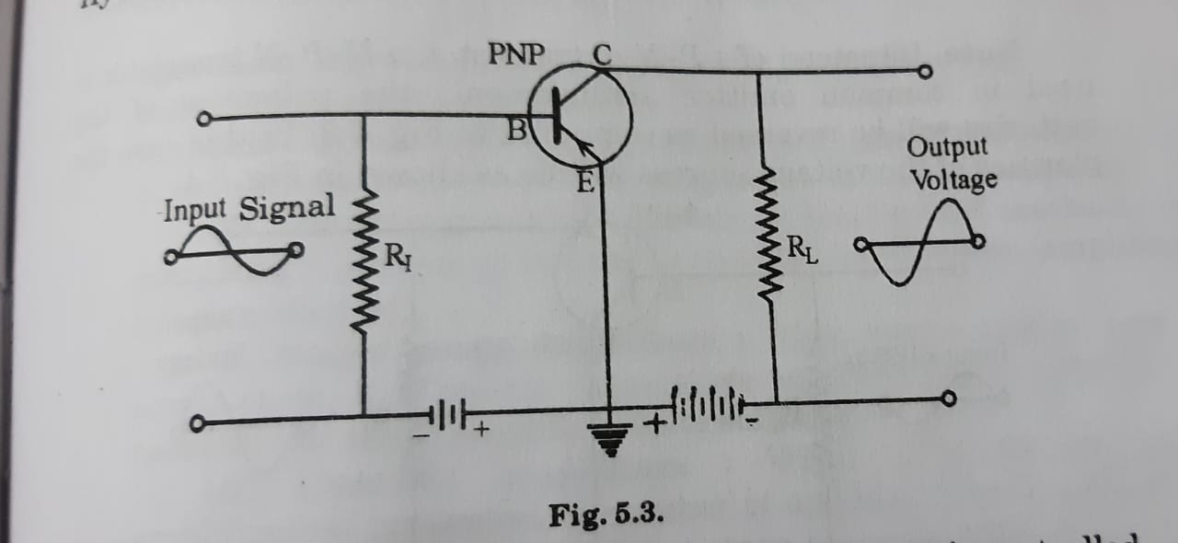
TRANSISTOR AMPLIFIER

Slide 3
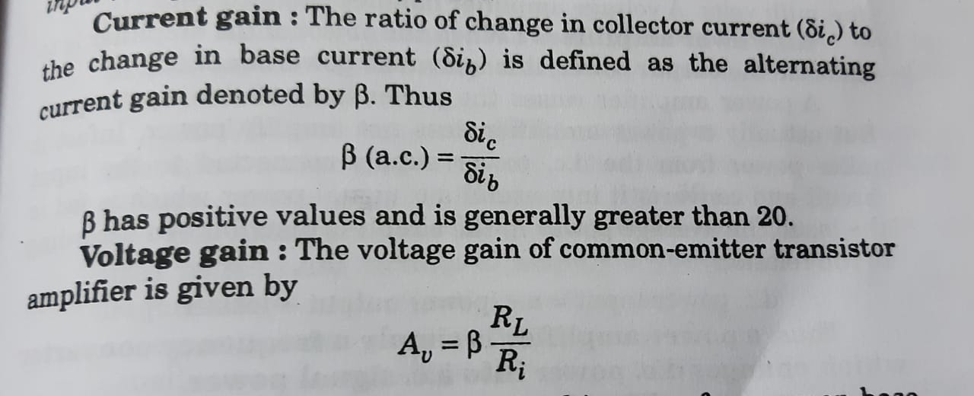
CURRENT GAIN AND VOLTAGE GAIN

Slide 4
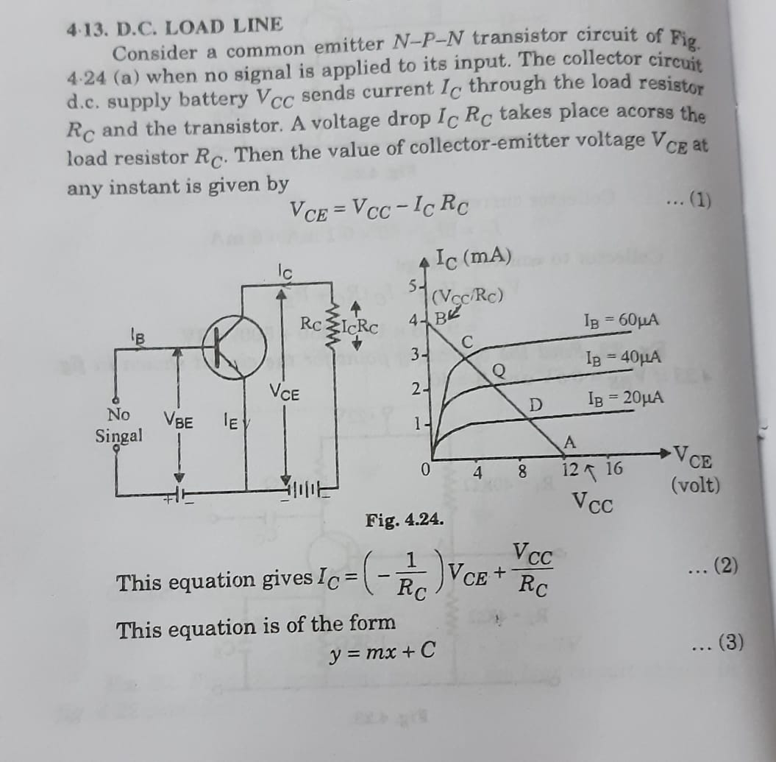
LOAD LINE ANALYSIS - 1 (D.C.LOADLINE)

Slide 5
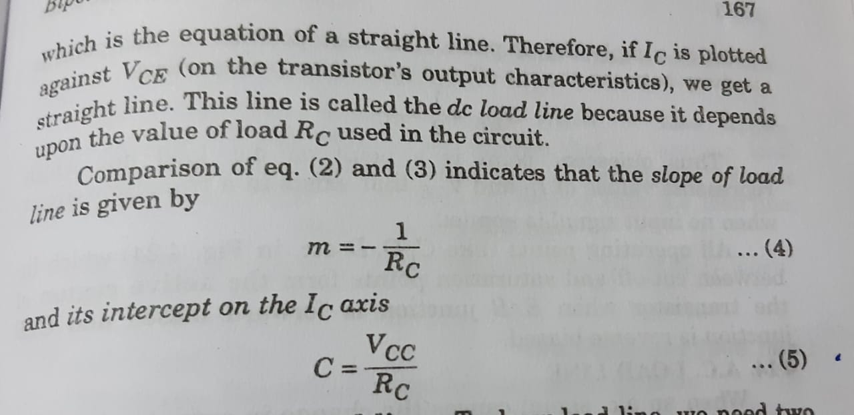
D.C LOAD LINE CONTINUATION

Slide 6
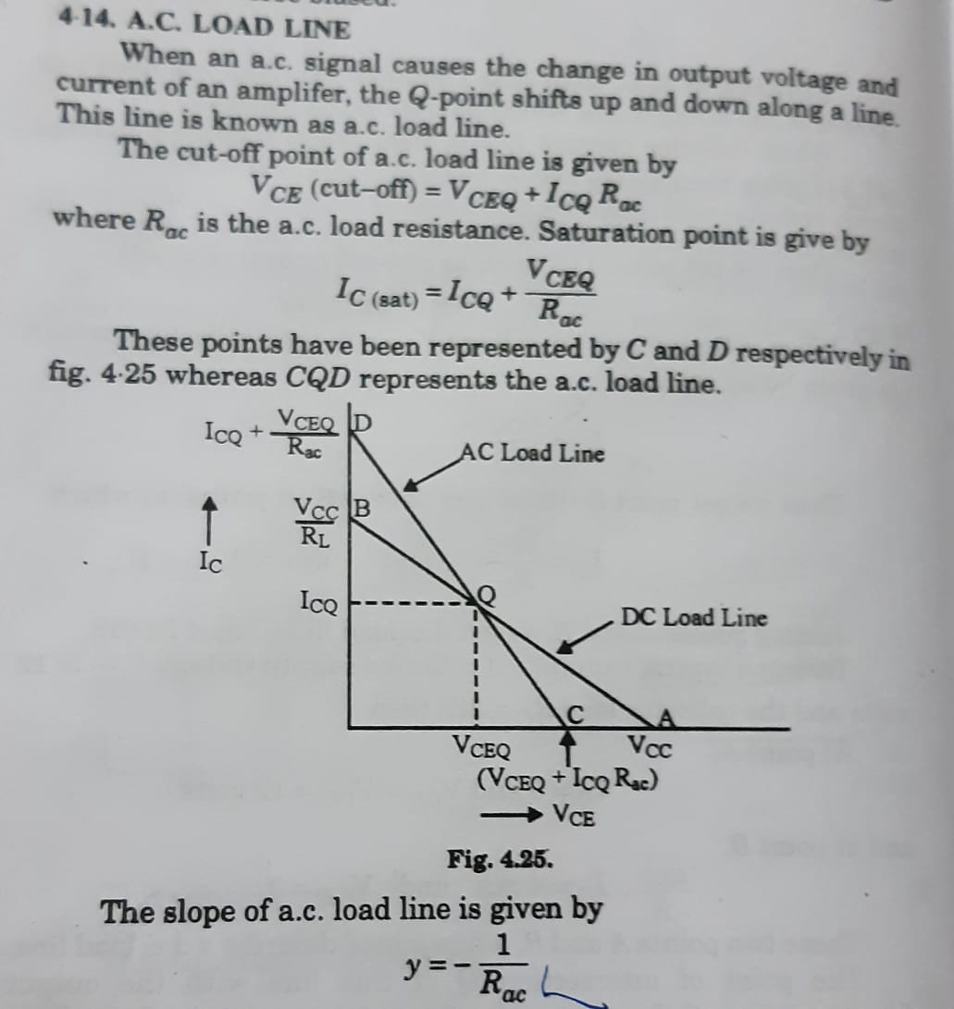
LOAD LINE ANALYSIS – 2 A.C.LOAD LINE

