Slide 1
ADVANCED ELECTRONICS
UNIT 5:Interfacing Devices
DONE BY:
T.RATHNA
DEPARTMENT OF PHYSICS
GCWK

Slide 2
CONTENT :
Memory mapped I/O
Types of interfacing devices
Data transfer schemes
Programmed and DMA data transfer schemes
Programmable peripheral interface (8255A)
8253 Timer interface
DMA controller
Programmable interrupt controller (8259)
Programmable communication interface (8251)

Slide 4
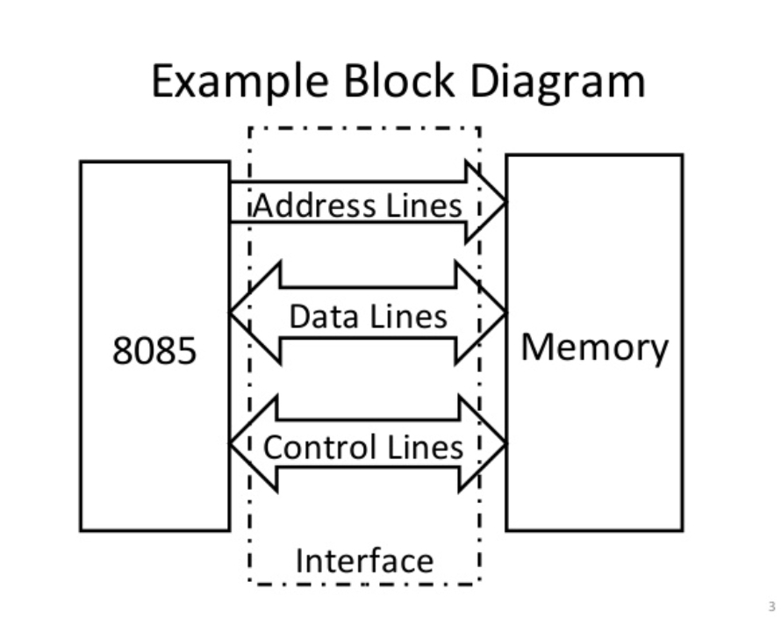

Slide 6
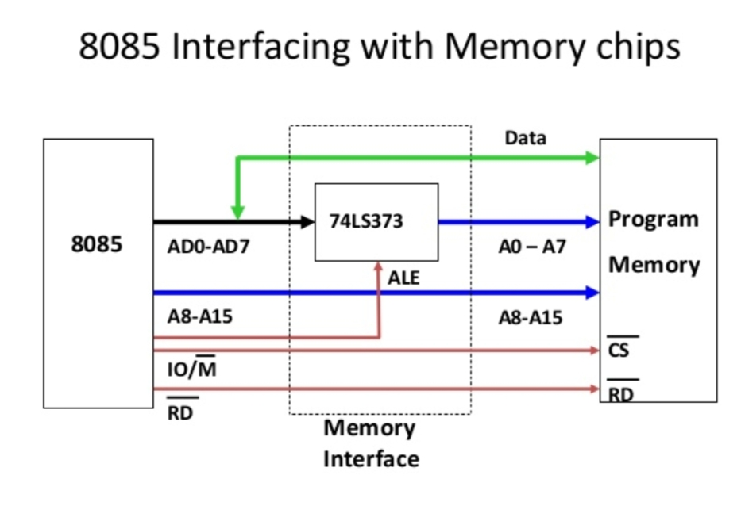

Slide 10
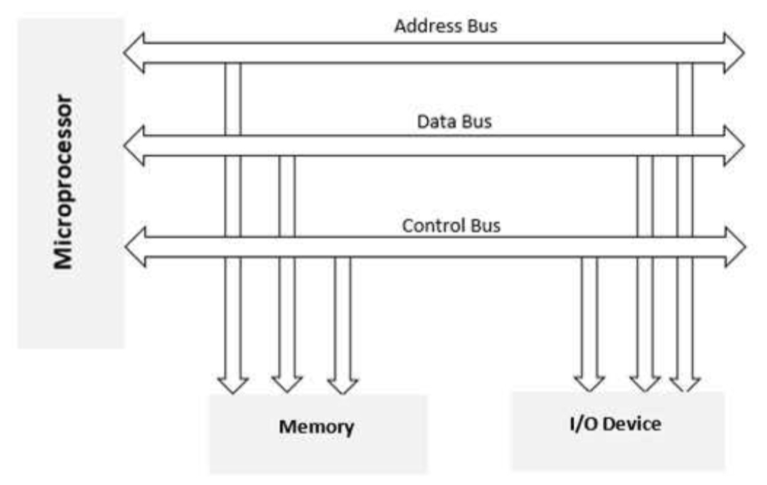

Slide 11
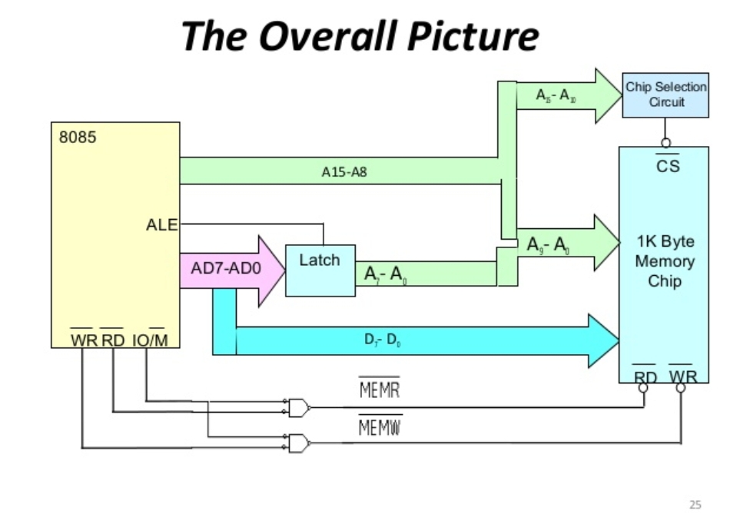

Slide 18
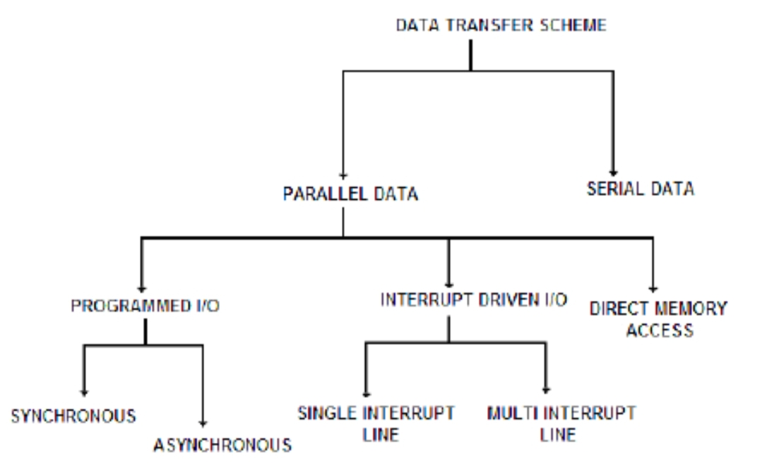

Slide 20
