Slide 1
ERROR IN CHEMICAL ANALYSIS Mrs. K.PUNITHA VALLI M.Sc., M.Phil.,(Ph.d.,)

Slide 2
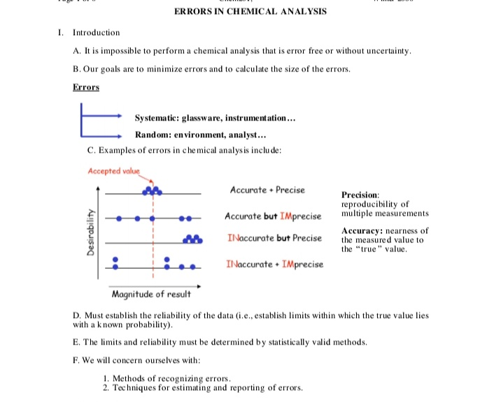

Slide 8
THANK YOU

