Slide 1
FACTORS AFFECTING ADSORPTION
K.PUNITHA VALLI M.Sc.,M.Phil., (Ph.d.,)

Slide 2
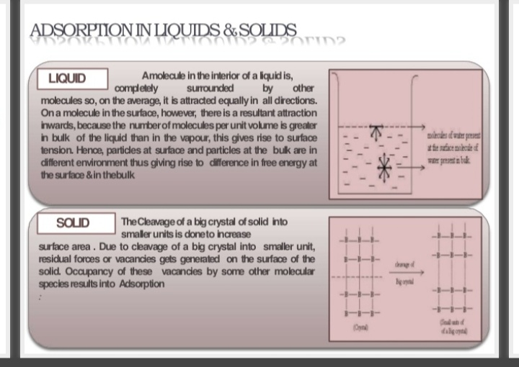

Slide 3
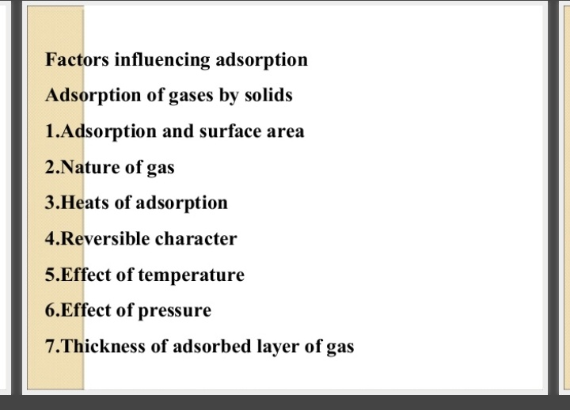

Slide 4
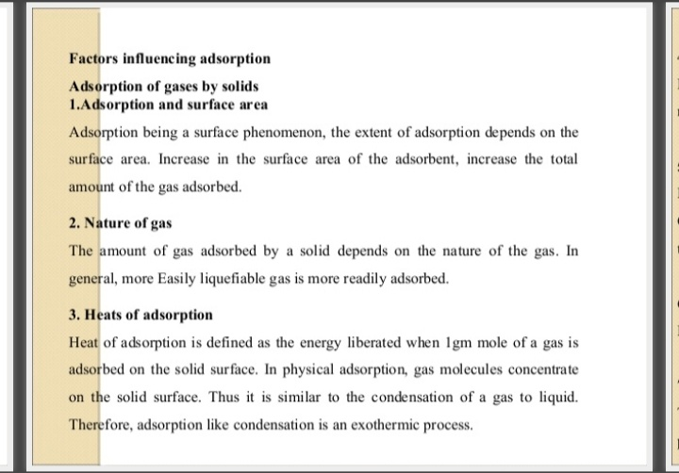

Slide 5
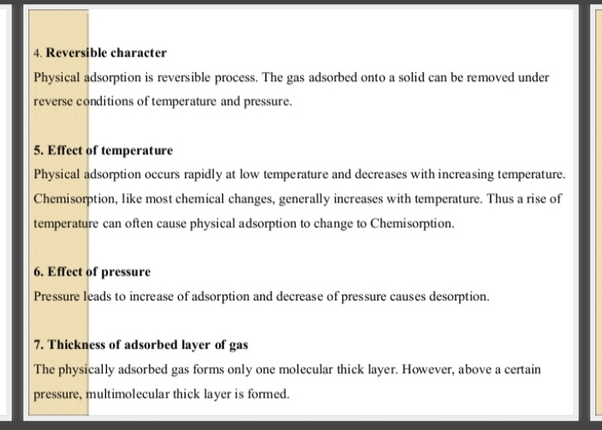

Slide 6
THANK YOU

