Slide 1
STEREOCHEMISTRY
NAME OF INSTRUCTOR: P.SRIMATHI.M.Sc., M.Phil.,B.Ed.,(Ph.D)

Slide 2
STEREOCHEMISTRY
Branch of chemistry deals with 3-D arrangements of atoms and molecules.
And their effect on chemical reaction
“CHEMISTRY OF SPACE”➔ it is deals with the spatial arrangements of atoms and groups in a molecule

Slide 3
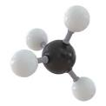
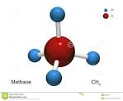
3-D Image of Methane

Slide 4
ISOMERS
Each of two or more compounds with the same molecular formula but a different arrangement of atoms in the molecule and different properties.

Slide 5
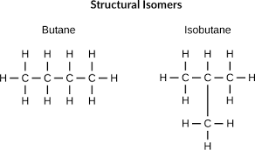
Examples of isomers

Slide 6
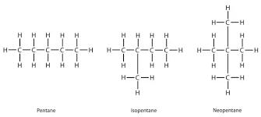
EXAMPLE 2

Slide 7
STEREOISOMERS
Same molecular formula
Same sequence of bonded atoms
But “differs in the 3-d orientation of their atoms in space”
Differs in spatial arrangements

Slide 8
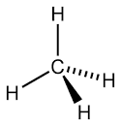
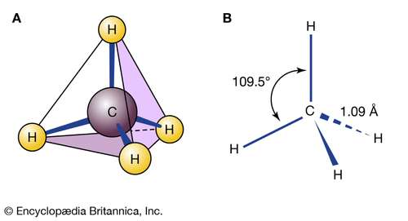
2-d & 3-d structure
Lewis structure
3-d methane

Slide 9
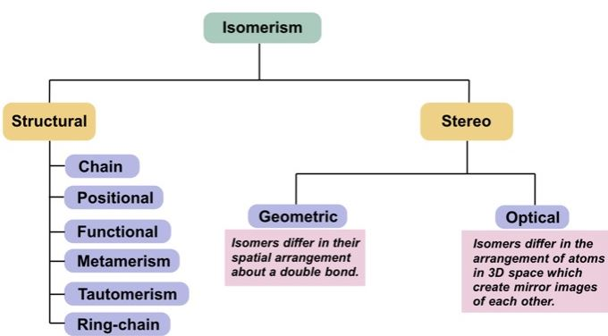
Classification of isomers

Slide 10
Conformational isomers
Isomers which have restricted rotation about single bond
Eclipse, gauge, anti form
It can be inter-converted into one another by rotation around a single bond.

Slide 11
Inter conversion
Eclipsed ➔ gauge (by rotating 60°)
Into anti butane by rotating 180°
Gauge form can be made into anti form by rotating 120°

Slide 12
Classification of isomers

Slide 13
Important terms
Chiral
Achiral
Enantiomers
Diastereoisomers

Slide 14
“CHIRAL” carbon
Carbon atom that is attached to four different types of atoms or groups of atoms.
Also called as asymmetric carbon

Slide 15
Chirality
The existence of these molecules are determined by concept known as chirality.
The word "chiral" was derived from the Greek word for hand, because our hands display a good example of chirality since they are non-superimposable mirror images of each other.

Slide 16
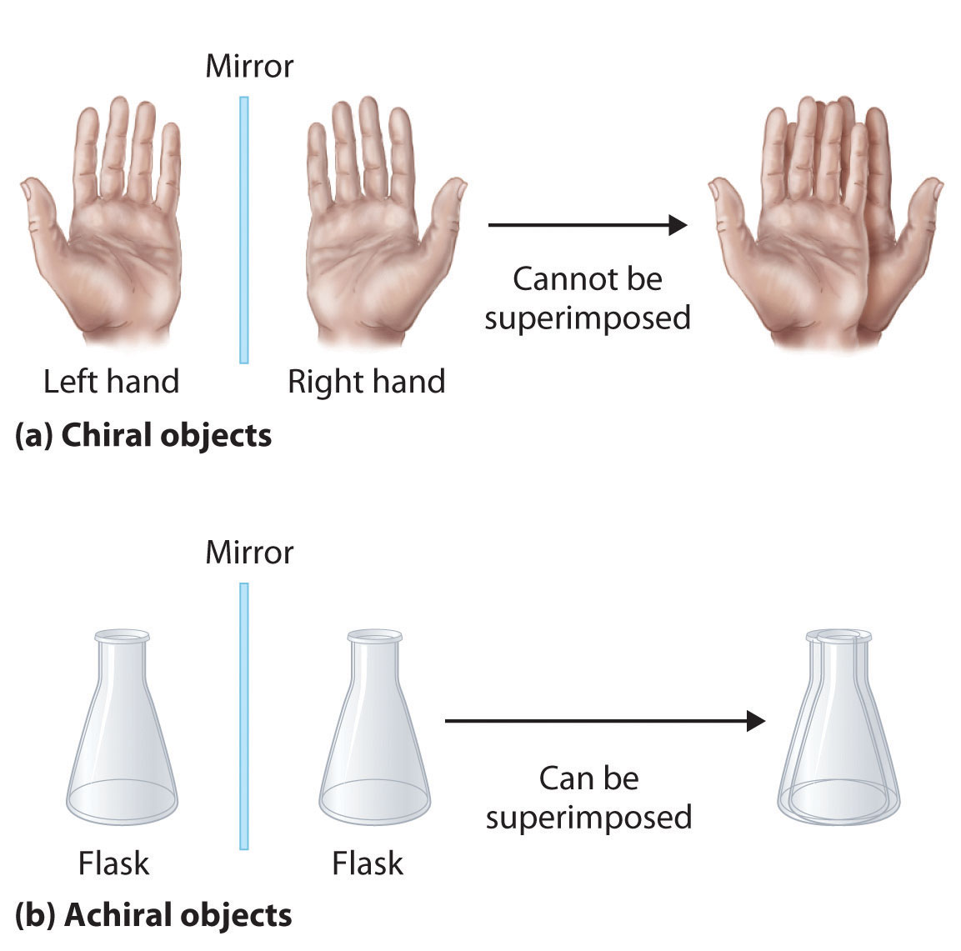
EXAMPLES OF CHIRAL

Slide 17
CHIRAL –MIRROR IMAGE
A chiral object is not identical in all respects (i.e. superimposable) with its mirror image.
Chiral objects have a "handedness", for example, golf clubs, scissors, shoes and a corkscrew.

Slide 18
COMMON EXAMPLES OF CHIRAL OBJECT
Chiral objects have a "handedness",
golf clubs,
scissors,
shoes and a
Corkscrew,
gloves and shoes come in pairs, a right and a left.

Slide 19
ACHIRAL
An achiral object is identical with (superimposable on) its mirror image.
Also called as symmetric carbon (identical)

Slide 20
EXAMPLES
The opposite of chiral is achiral. Achiral objects are superimposable with their mirror images.
For example, two pieces of paper are achiral.

Slide 21
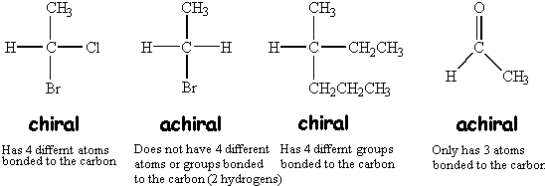
EXAMPLES

Slide 22
Enantiomers
Enantiomers are chiral molecules that are mirror images of one another. Furthermore, the molecules are non-superimposable on one another.
Chiral molecules with one or more stereo centers can be enantiomers.

Slide 23
Diastereoisomers
Stereoisomers that are not mirror images of each other
Cis-trans isomer

Slide 24
THANK YOU

