Slide 1
Nitrogen Family

Slide 2
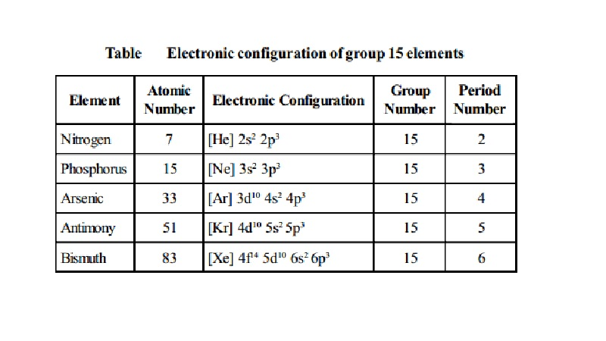

Slide 3
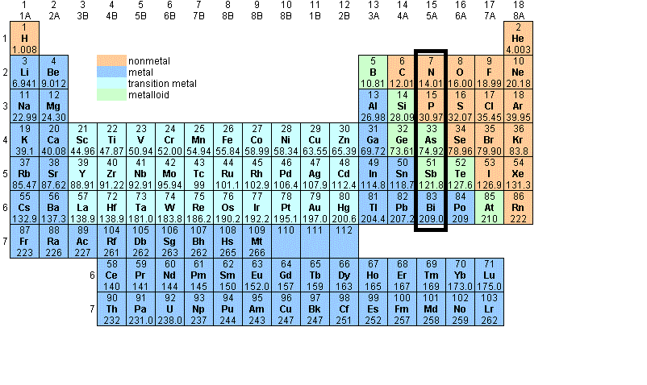
They are located on the right side of the table in group 15 or group 5A.
Since they are on the right side of the periodic table these elements what to gain electrons.

Slide 4
Properties and Characteristics:
Consists of two nonmetals and metalloids and one metal
ranges from very abundant elements to fairly rare
contains five electrons in its outer most energy level
are solids at room temperature (except nitrogen)
most are shiny and metallic looking

Slide 5
Outer shell electron configuration:
ns² np³
N means the energy level
S or P means the shape of the orbital
and the numbers (2 & 3) mean the number of electrons.

Slide 6
Property | Nitrogen | Phosphorus | Arsenic | Antimony | Bismuth
Atomic symbol | N | P | As | Sb | Bi
Atomic number | 7 | 15 | 33 | 51 | 83
Atomic mass (amu) | 14.01 | 30.97 | 74.92 | 121.76 | 209.98
Valence electron configuration | [He]2s² 2p³ | [Ne]3s² 3p³ | [Ar]3d¹⁰ 4s²4p³ | [Kr]4d¹⁰ 5s²5p³ | [Xe]4f¹⁴ 5d¹⁰6s²6p³
Melting point Boiling point (°C) | – 210 -196 | 44.15 281 | 817 603(sublimes) | 631 1587 | 271 1564
Density (g/cm3) at 25°C | 1.15(g/L) | 1.8 | 5.7 | 6.68 | 9.79
Atomic radius (pm) | 56 | 98 | 114 | 133 | 143
First Ionization energy (kJ/mol) | 1402 | 1012 | 947 | 834 | 703
Common Oxidation state(s) | -3 to +5 | +5, +3, -3 | +5, +3 | +5, +3 | +3
Ionic radius (pm) | 146(-3) | 212(-3) | 58(+3) | 76(+3) | 103(+3)
Electronegativity | 3.0 | 2.2 | 2.2 | 2.1 | 1.9

Slide 7
Atomic and Ionic Radii
If you see the electronic configuration of elements in the table above, you will notice that with every step you move downwards, new orbitals are added to the atom.
This addition of new orbitals increases both the Atomic and the Ionic radii of group 15 elements.
However, we see that from Arsenic to Bismuth only a small increase in ionic radius is observed.
This is due to the presence of completely filled d and/or f orbitals in heavier members.

Slide 8
Ionization Enthalpy
Ionization Energy is the amount of energy required to remove an electron from the outermost orbit of the atom.
This is basically a measure of how hard the nucleus is holding on to the electron.
The closer the electron is to the nucleus the stronger its hold and thus the energy required is more.
As we move down the group, the radius of the atom increases and therefore the Ionization energy decreases due to the weaker hold of the nucleus.

Slide 9
Electronegativity
The electronegativity value decreases down the group with increasing atomic size.
This again is due to the increasing distance between the nucleus and the valence shell as we move down the group. Physical Properties
All the elements of the group exist in a polyatomic state.
The first, Nitrogen is gas but as you move down there is a significant increase in the metallic character of the elements.
Nitrogen and Phosphorus are non-metals, Arsenic and Antimony are metalloids and Bismuth is a metal.
These changes can be attributed to the decrease in Ionization enthalpy and increase in atomic size.
Boiling points also, in general, show an increasing trend as you move down.
Except for Nitrogen, all the other elements have allotropes.

Slide 10
Chemical Properties
The valence shells of the p-Block elements have a configuration of ns² np³.
So the elements here can either lose 5 electrons or gain 3.
The common oxidation states of these elements are -3, +3 and +5.
With a decrease in the Ionization enthalpy and electronegativity, due to the increasing atomic radius, the tendency to gain three electrons to create a -3 oxidation state decreases down the group.
In fact, Bismuth hardly forms any compounds with -3 oxidation state.
As we go down, the stability of the +5 state decreases and that of +3 increases due to inert pair effect.

Slide 11
Physical Properties
All the elements of the group exist in a polyatomic state.
The first, Nitrogen is gas but as you move down there is a significant increase in the metallic character of the elements.
Nitrogen and Phosphorus are non-metals, Arsenic and Antimony are metalloids and Bismuth is a metal.
These changes can be attributed to the decrease in Ionization enthalpy and increase in atomic size.
Boiling points also, in general, show an increasing trend as you move down.
Except for Nitrogen, all the other elements have allotropes.

