Slide 1
PRECIPITATION TITRATION
Name of the instructor:U.Nithya M.Sc.,M.Phil.,

Slide 2
PRECIPITATION TITRATION:
It is a titration in which precipitates are formed. One of the reacting species is coverted into a precipitate.
Example:
Estimation of chloride using AgNo₃. Here Agcl is precipitated.
cl-+ AgNO₃--------------→ Agcl + No₃⁻
Explanation:
When chloride solution is titrated against AgNo3chloride ions are precipitated as Agcl. Such a titration is known as precipitation titrations.
Principle:
In precipitation titrations the formation of precipitates is used as the basis of the titration.The point at which as stoichiometric amount of the titrant is added to precipitate completely the ion to be estimated presented in a given volume of the solution is the end point.
Conditions:
1.The precipitation reaction must attain equilibrium very rapidly after each addition of the titrant to the analyte.
2. Co-precipitation,occlusion,adsorption of foreign ions should not interfere with the reaction involved in precipitation titration.
3. A suitable indicator which can indicate the stoichiometric equivalence Point should be available.

Slide 3
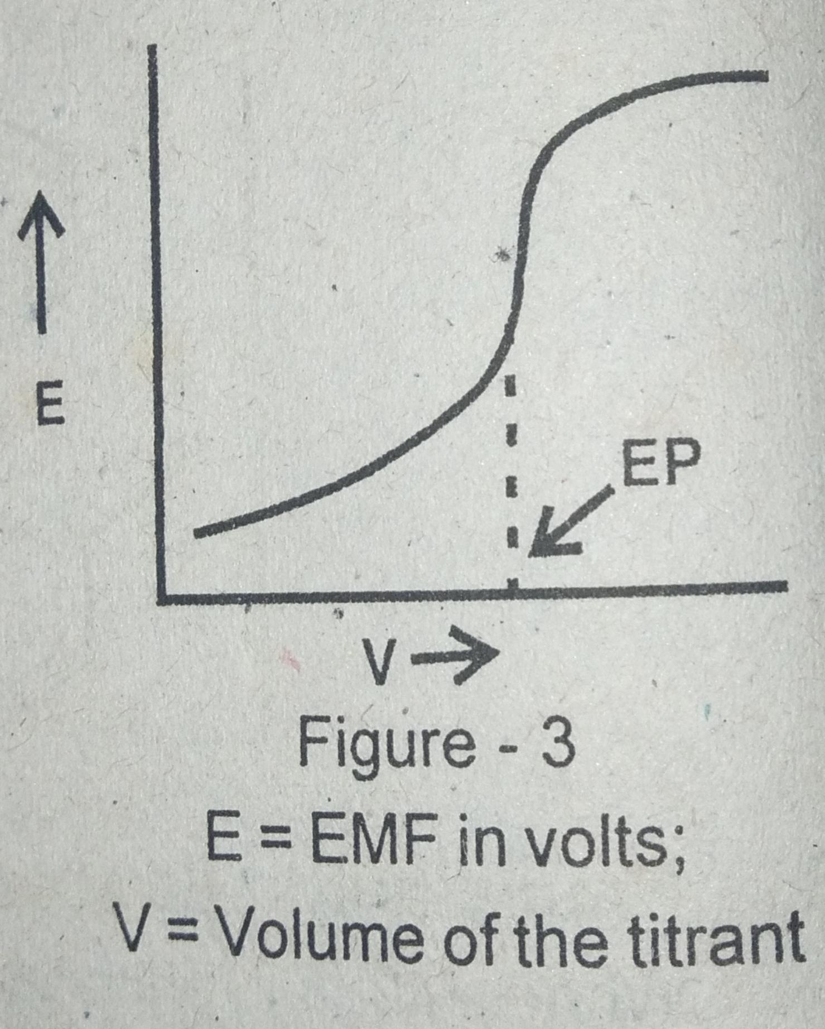
Procedures:
i) Potentiometric method:
when the titrant is added to the analyte the potential of the system changes abruply in the neighbourhood of the equivalence point. If we plot the emf of the system against the volume of the titrant in ml we get a curve as shown in fig. Near the end point there is a sudden change in the potential of the system.

Slide 4
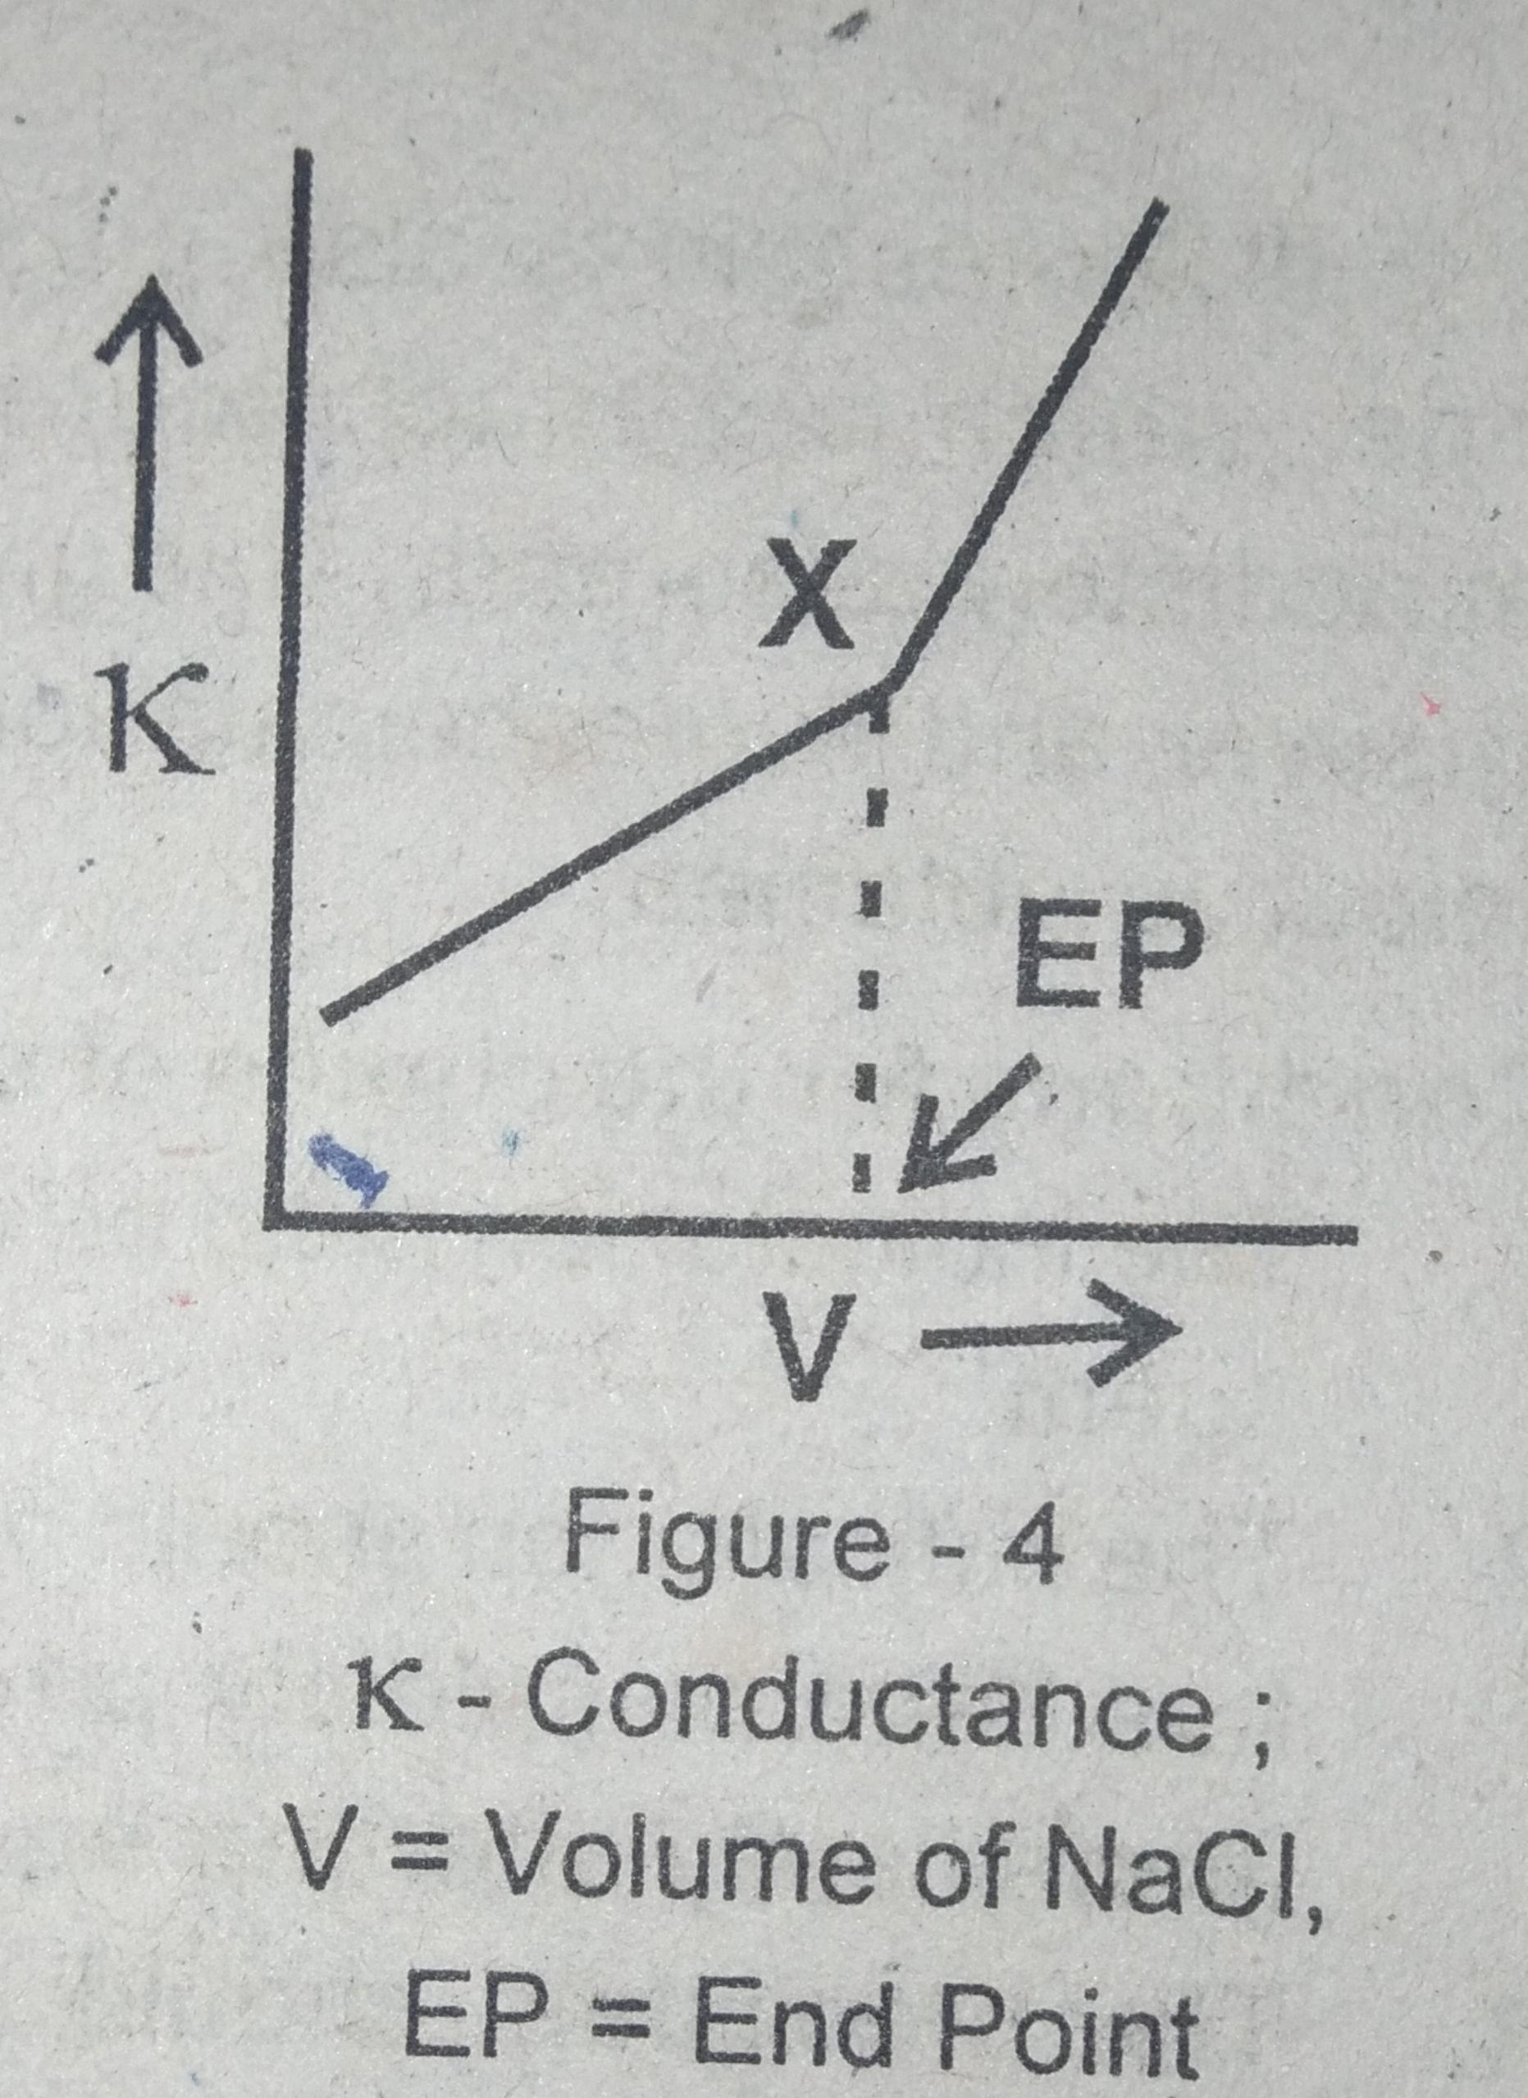
ii) Conductometric method:
when titrant is added to the analyte progressively the ions are removed from the reaction mixture.
Eg: AgNO₃ + Nacl --------------→ Agcl + NaNo₃
Ag⁺ +NO₃ ⁻+ Na⁺ +cl ⁻--------------→ Ag ⁺+cl ⁻+ Na ⁺+No₃⁻
If AgNo₃ is the analyte and Nacl is the titrant then during the titration the less mobile Ag⁺ ions are replaced by more mobile Na⁺ions.

Slide 5
Thus during the titration when more and more of Nacl is added.more and more of Na⁺is introduced and so the conductance increases regularly.
At the end point we have Na⁺and NO₃⁻ only.
if we add any more amount of Nacl conductance increases rapidly. It is because Nacl is a strong electrolyte and the addition of it causes an increase of Na⁺ and cl⁻ ions.
The curve obtained in such a titration is shown in fig.
The end point is given by the break in the curve X.

Slide 6
iii) Using indicators:
The precipitation titrations are also conducted using indicators to fix the end Point. For this purpose we use a special type of indicators called adsorption indicators.
They are indicators which change their colour at the end point because of adsortion.
Eg:
Flurescein is used as indicator during the titration of chloride with AgNO₃.

Slide 7
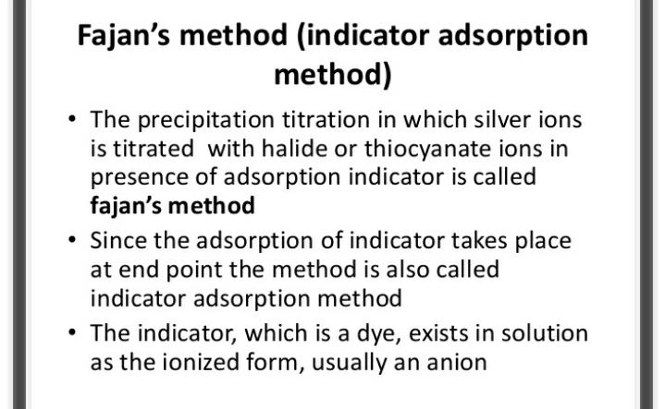

Slide 8
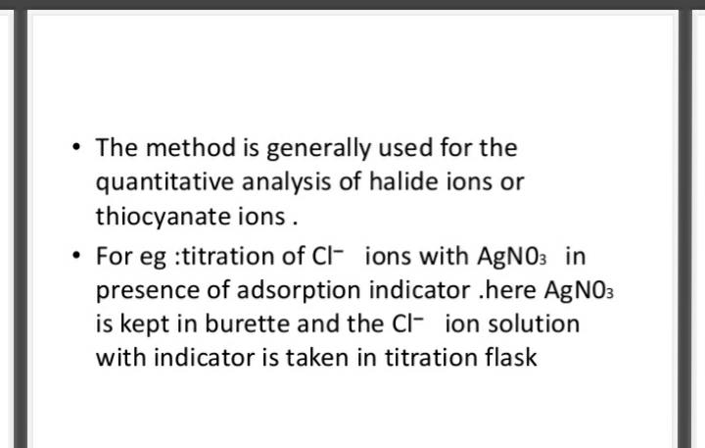

Slide 9
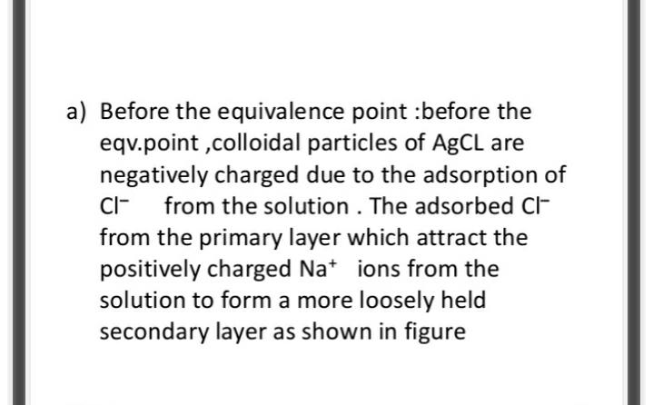

Slide 10
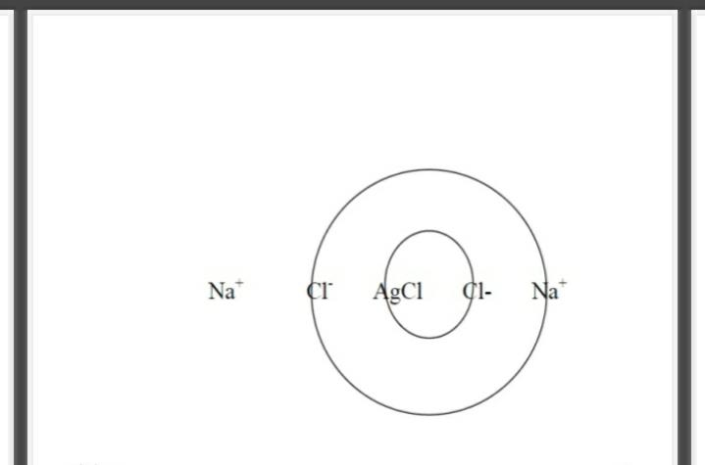

Slide 11
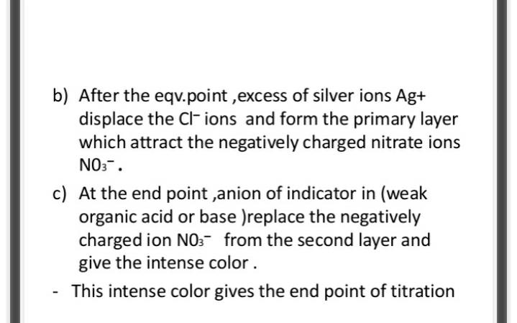

Slide 12
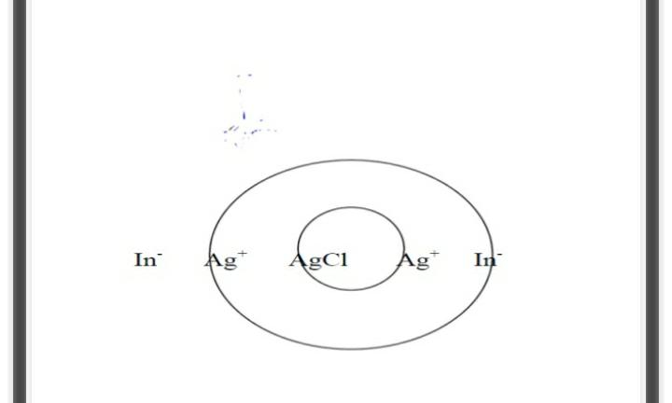

Slide 13
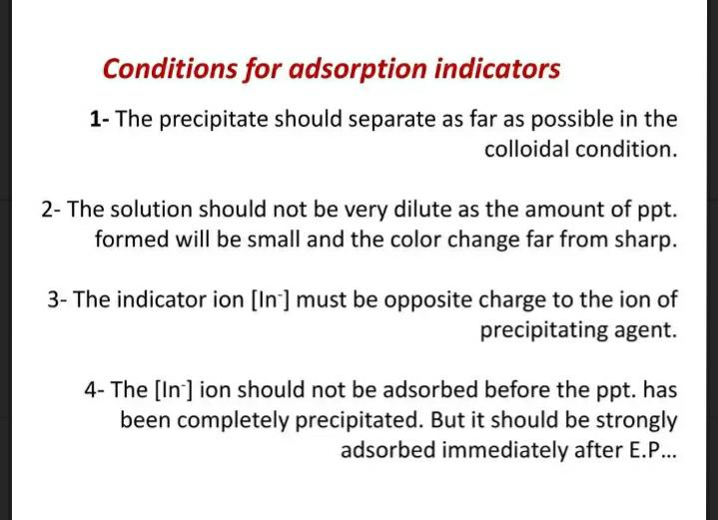

Slide 14
COMPLEXOMETRIC TITRATION:
In these titrations ions are converted into a soluble slightly dissociated ions or compounds.
Principle:
Metal ions can be determined by titrating them with a reagent that complexes them in solution.
The solution to be titrated is buffered at a suitable P^{H} an indicator is added and the metal ion is titrated with a standard solution of the complexing agent.
A sharp colour change marks the end point of the titration.
comoleximetric titrations are convenient and accurate.
They have replaced time consuming gravimetric procedures.
Except for the alkalo metals most metal cations can be determined by titration with a suitable complexing agent.

Slide 15
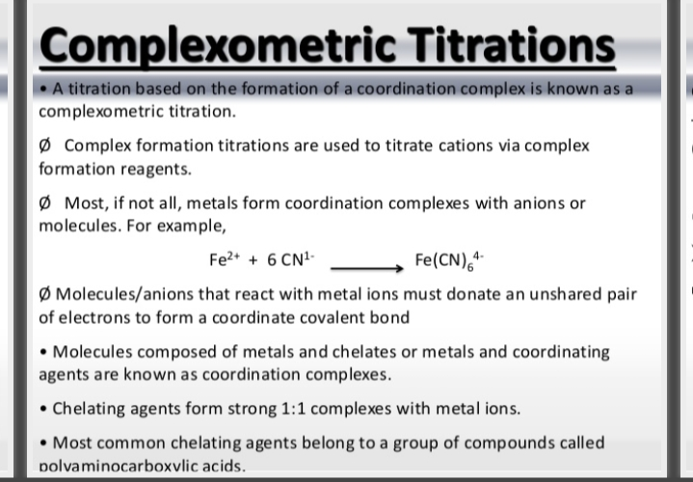

Slide 16
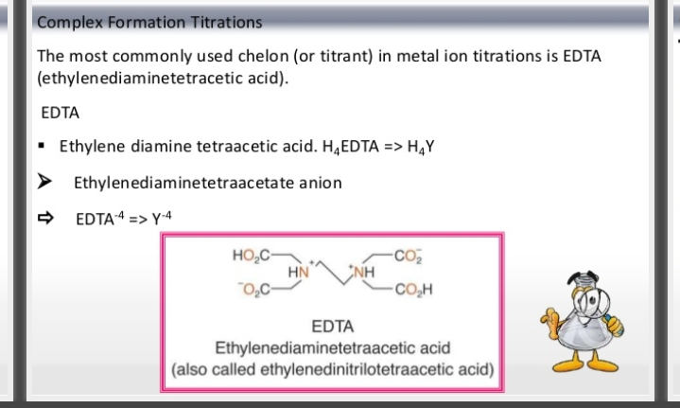

Slide 17
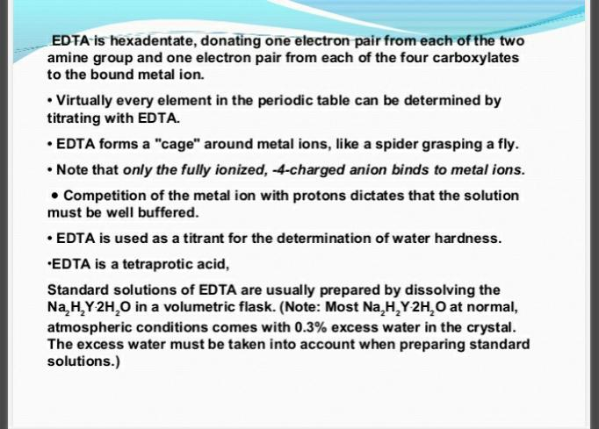

Slide 18
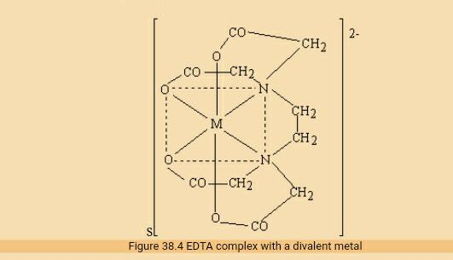


Slide 19
Determination of end points in complexometric titrations:
In complexometric titrations the end points are determined with a help indicators called metal ion indicators.
Metal ion indicators:
They are organic dyes which are used to determine the end point in complexometric titrations.
Eg:
i. Erichrome Black –T (EBT)
ii. Murexide
Principle:
The metal ion indicator exhibits one colour when they are complexed. With the metal ion and a different colour when they are free.

Slide 20
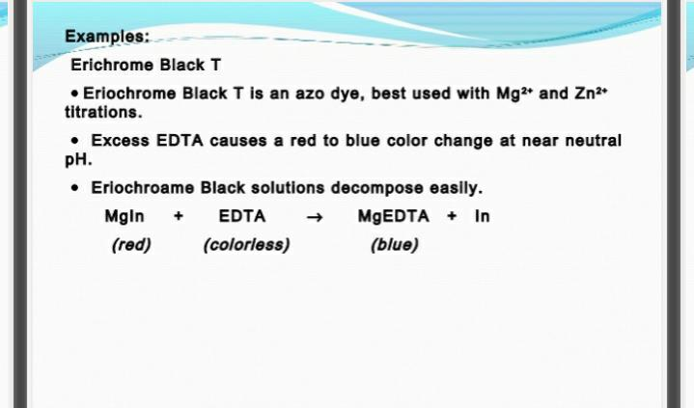

Slide 21
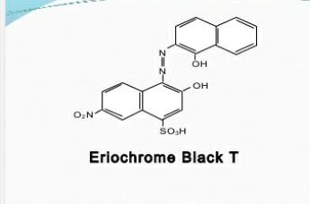
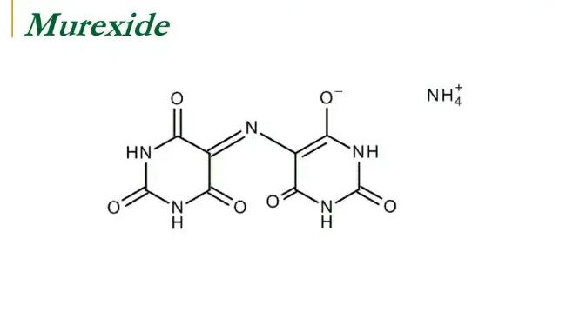

Slide 22
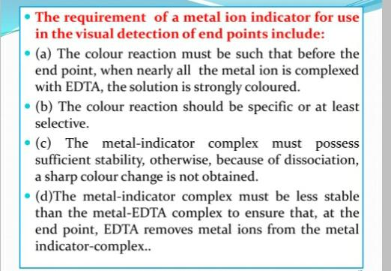

Slide 23
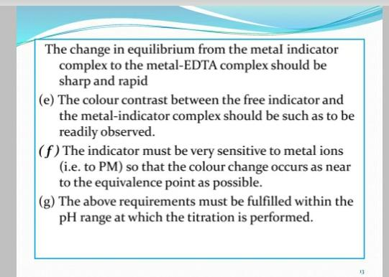

Slide 24
APPLICATIONS:
compleximetric titrations are used to
i. determime hardness of water
ii. Ni and many other ions.
Determination of hardness of water:
* The hardness of water is due to the presence of calcium and magnesium salts.
* To eatimate the total hardness of water the sum of ca²⁺ and Mg²⁺ions present must be known.
* First by titrating a standard EDTA solution against a measured quantity of hard water using EBT the total hardness of water estimated.
* second titration magnesium is converted into its hydroxide and is removed.
* From the second titration the amount of ca²⁺ is determined.
* From these two values the total amount of Mg²⁺ is determined.

Slide 25
Procedure:
40ml of water samples is taken in a conical flask and the 20ml of ammonium buffer is added to keep the p^{H} between 8-10.it is diluted to 100ml distilled water and a pinch of EBT indicator. The solution is warmed to 60°c and it is titrated against standard EDTA (0.01M). The end point is the change of colour from wine red to blue. Let the titre value be x ml.
Another 40ml of the sample is taken in a conical flask and 10 ml of 2M NaOH is added followed by a pinch of murexide indicator. The solution is diluted to 100ml with distilled water and it is titrated against EDTA. The end point is the change of colour from pink of blue. Let the titre value be y ml.

Slide 26
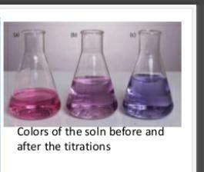

Slide 27
Calculation:
Factor value for calcium F_{ca} is
1 ml of EDTA = 0.4 mg of calcium
Factor value for magnesium F_{mg} is
1ml of EDTA = 0.243 mg of magnesium
ஃ Amount of ca in 1000ml of the
sample= 0.4 x y x 1000/ 40 = A mg = A ppm
Amount of Mg in 1000ml of the
sample = 0.243 x (x-y) x 1000/ 40 =Bmg =B ppm
Total hardness = A+ B ppm

Slide 28
2. Determination of Ni:
Nickel can be estimated by titrating a solution of nickel against standard EDTA. Muroxide is used as indicator for this titration. The P^{H} is to be maintained between 10 and 11. The end point is the xhange of colour from yellow to blue violet.
The same titration can bedone with Eriochrome black T indicator also in that case the end Point is the change of colour from blue to red. The P^{H} range is 7to11.
Titration curve:
These are graphs drawn to find out the end point in a titration.
plots of analogous data for titrations involving redoc precipitation and complexometric titrations also are similar to the one shown in the diagram.

Slide 29
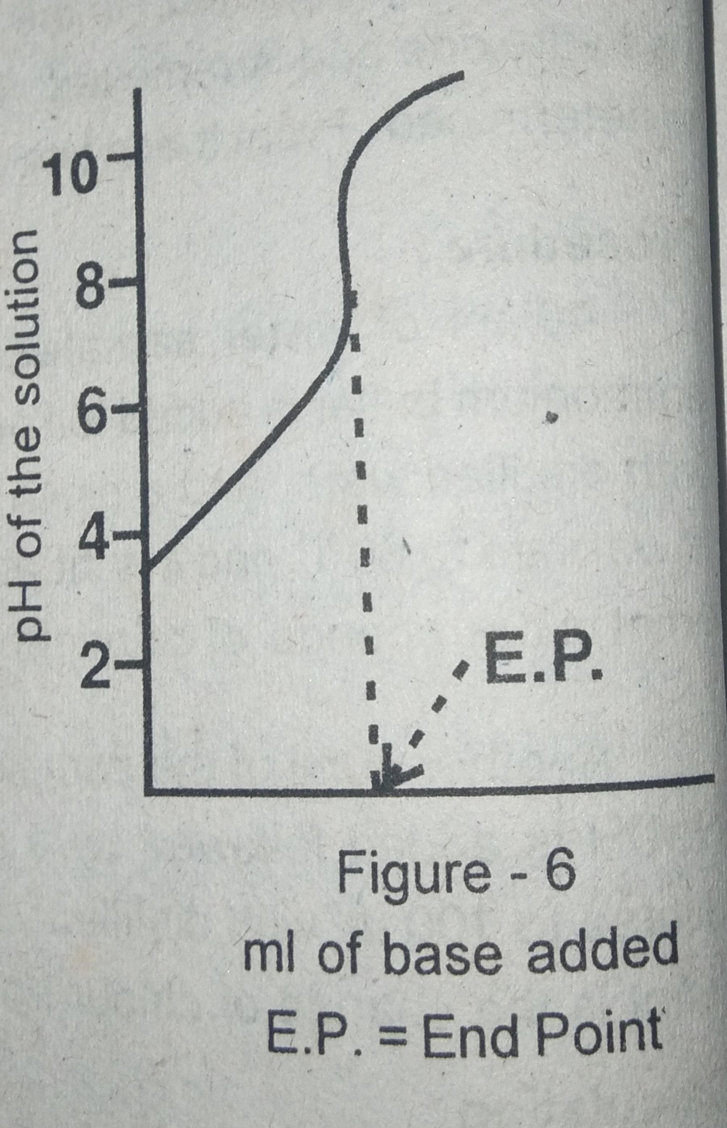

Slide 30
THANK YOU

