Slide 1
ORGANIC REACTIONS
Name of the instructor: U.Nithya M.Sc.,M.Phil.,

Slide 2
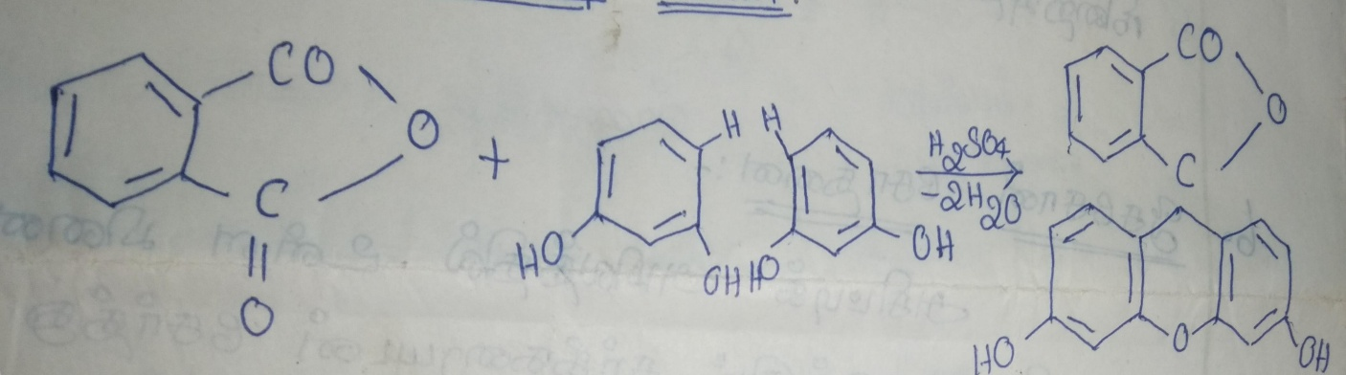
RESORCINOL FUSION TEST:
Resorcinol condenses with phthalic an hydride in the presence of concentrated sulphuric acid to give fluoresein.
Fluorescein dissolves in alkalies to give a reddish brown solution on dilution the solution gives a strong yellowish green fluorescence.
Phthalic unhydride. Resorcinol. Fluoresscein

Slide 3
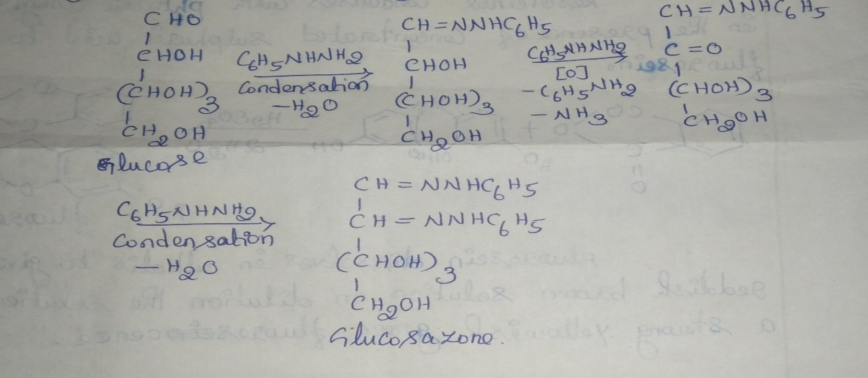
OSAZONE FORMATION:
i)one molecule od phenyl hydrazine condenses with the aldehyde group of glucose and forms the corresponding phenyl hydrazine.
ii) when glucose is warmed with excess phenyl hydrazone a second molecule of the phenyl hydrazine oxidises yhe secondary alcoholic group on the carbon atom next to the aldehyde group. The corresponding ketone is formed.
iii) Now a third molecule of phenyl hydrazine condenses with this newly producted keto group giving the final product glucosazone.

Slide 4
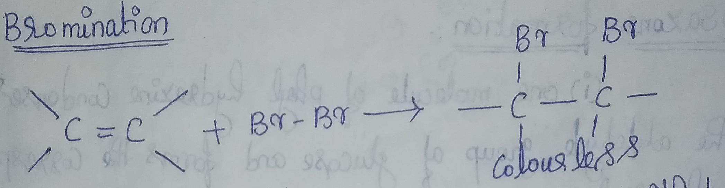
BROMINATION:
Unsaturated compound is react with bromine to get (removal of orange red colour) colourless solution.

Slide 5
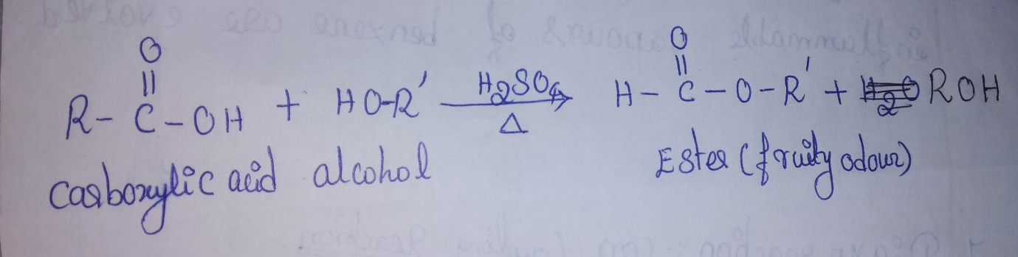
ESTERFICATION:
Alcohol react with carboxylic acid in the presence of sulphuric acid to give ester.

Slide 6
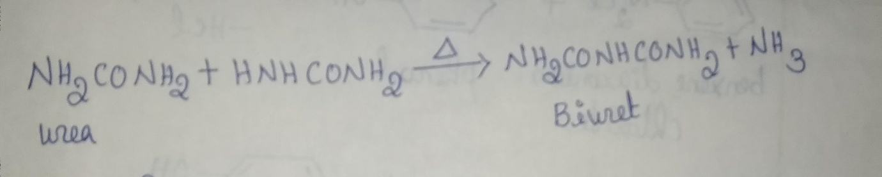
BIURET TEST:
When urea is heated gently it losses ammonia forming a compound called “biuret”.
An alkaline solution of biuret(NaoH)when treated with a drop of Cuso₄ solution produces a violet colour. This biuret test serves as a confirmatory test for urea (a diamide).

Slide 7
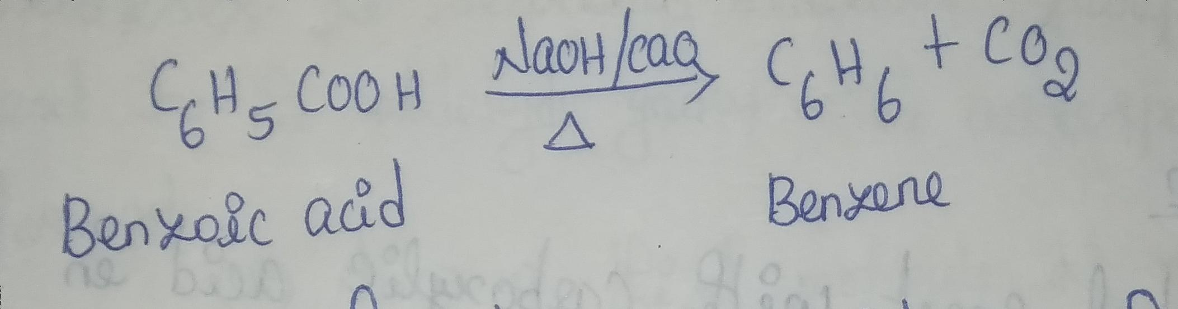
DICARBOXYLATION:
When benzoic acid is heated with sodalime (a mixture of caustic soda and quick lime) inflammable vapours of benzene are evolved.

Slide 8
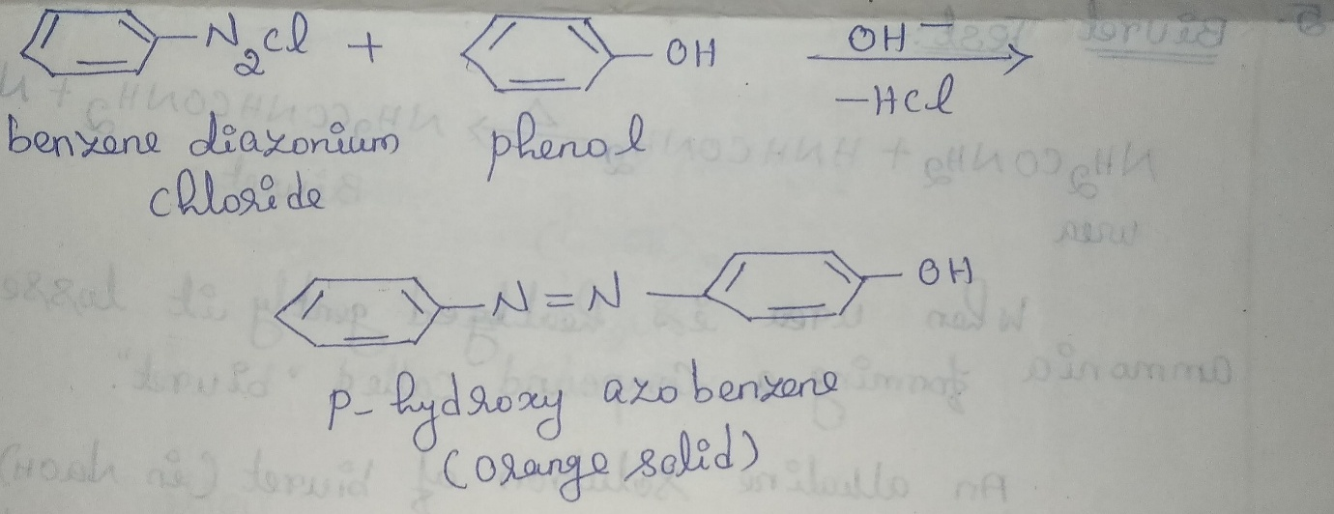
DIAZOREACTION (OR) COUPLING REACTION:
When aniline or phonol is reacted with benzene diazonium chloride diazo coupling takes place to given azodyes.

Slide 9
THANK YOU

