Slide 1
APPLICATIONS OF DIPOLEMOMENT
Name of the instructer : U.Nithya M.Sc.,M.Phil.,

Slide 2
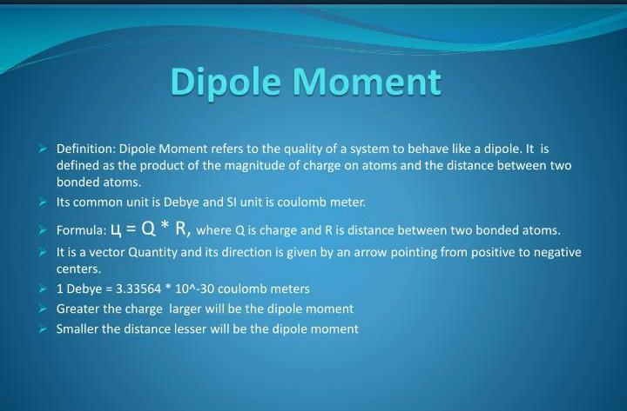

Slide 3
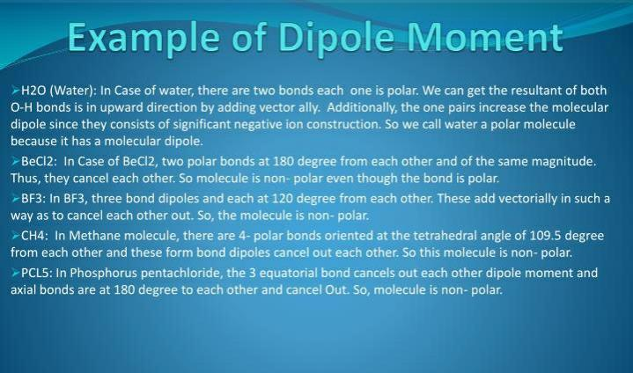

Slide 4
Shape of molecules:
* Dipolemoment of CO₂ is zero. Also HCN, RCl,R-OH,RCN are zero dipolemoment. Because central atoms are symmetrical.
* Dipolemoment of H₂O = 1.85 D
* H₂,N₂,I₂etc., do not have dipolemoments since the bonds in them are non-polar.
* p- dicholoro benzene is zero dipolemoment. Because the two chlorine atoms are symmetrical, but P-dimethoxy,P-dihydroxy functional groups benzenes are not equal to zero. Because the arrangement in not symmetrical.

Slide 5
Distinction between cis and trans isomers:
The dipolemoment of the two groups in the trans positions will cancel each other. So the trans form will have Zero dipolemoment.
The cis from will have considerable dipolemoment.
Dipole moments of linkages:
The dipolemoments of a number of compounds have been analysed.
H-C. C-O. C-Cl. H-O. C=O
0.4. 0.7. 1.5. 1.6. 2.3D

Slide 6
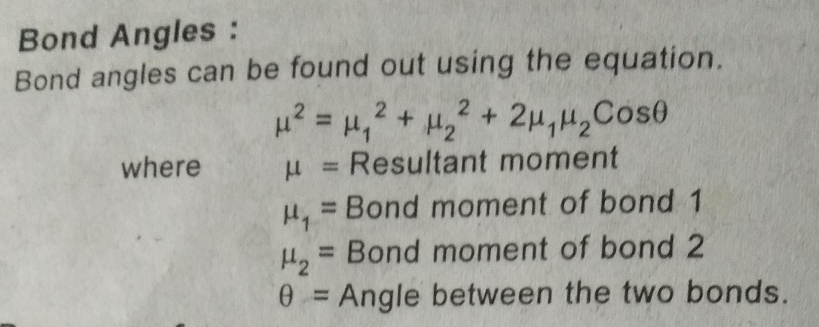
Bond angles:

Slide 7
Presence of resonance:
From the dipole moment values we can establish the presence of resonance or mesomerism in molecules.
Eg. Ortho para directing groups like halogens have smaller moments when substotuted in a benzene ring than when attached to a saturated aliphatic group. This is due to resonance present in the molecule.

Slide 8
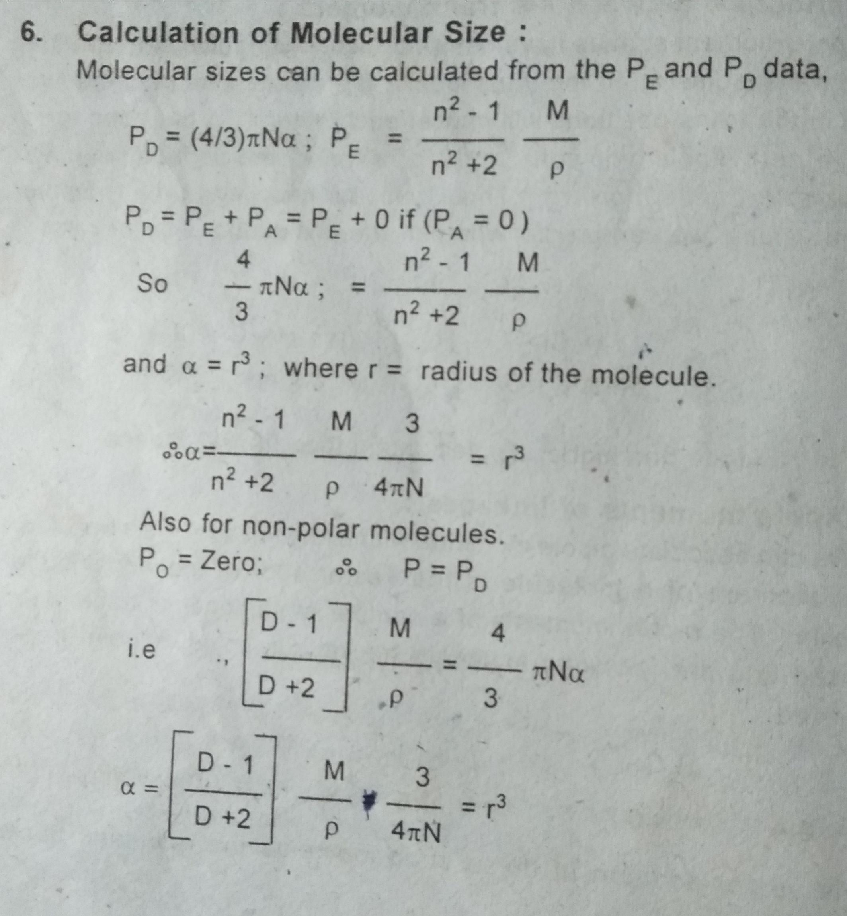

Slide 9
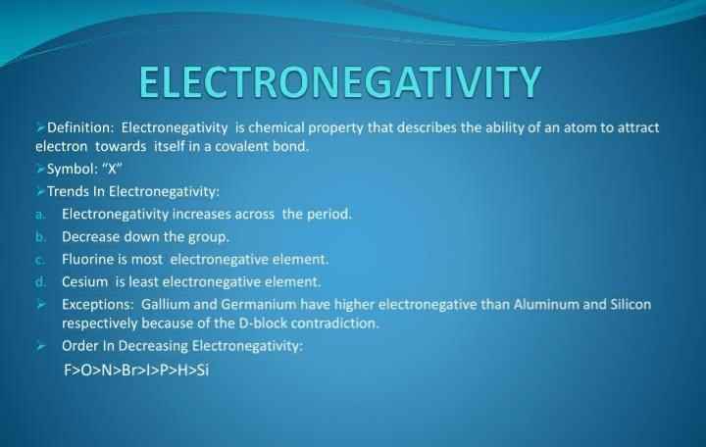

Slide 10
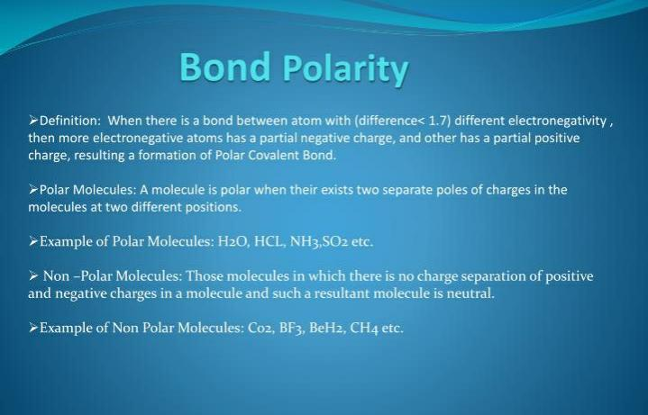

Slide 11
Thank you

