Slide 1
Magnetic properties of matter
Name of the instructor : U.NithyaM.Sc.,M.Phil.,

Slide 2
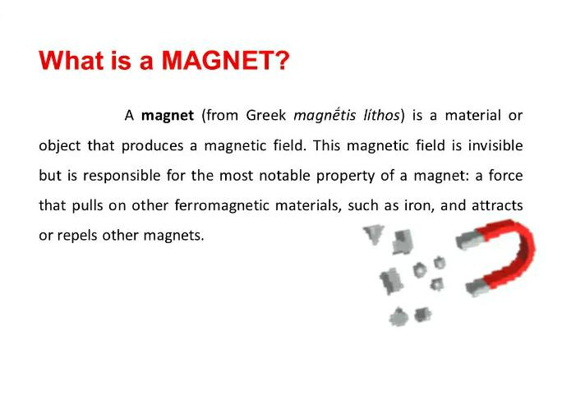

Slide 3
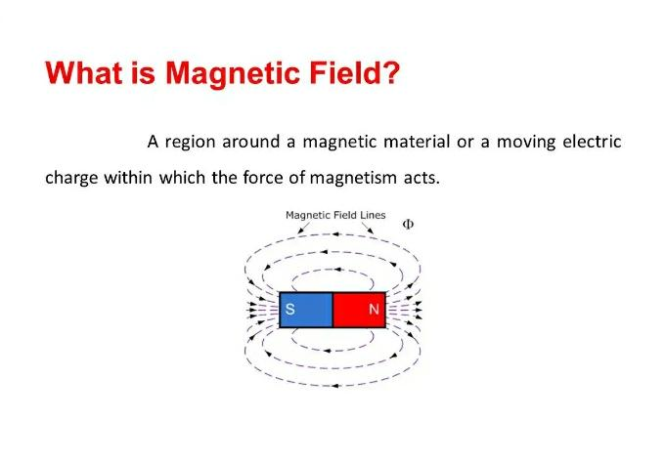

Slide 4
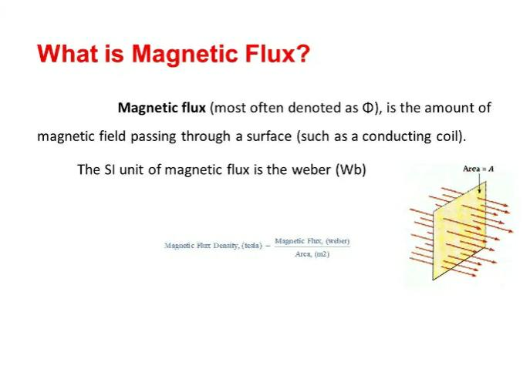

Slide 5
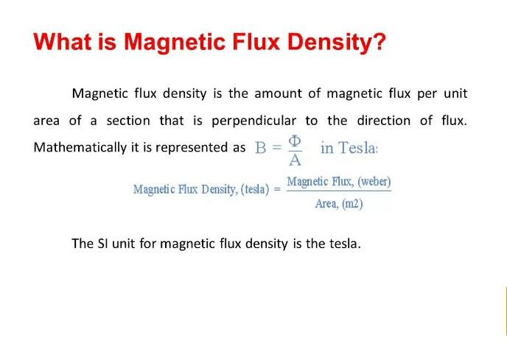

Slide 6
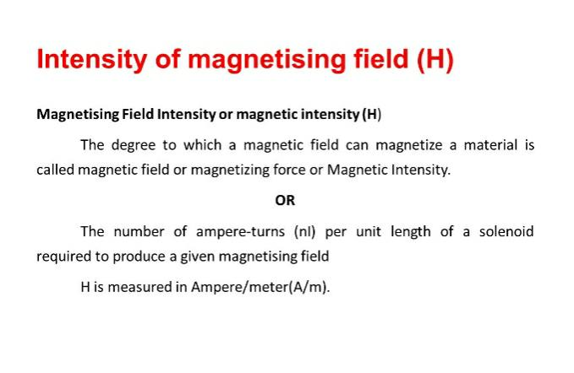

Slide 7
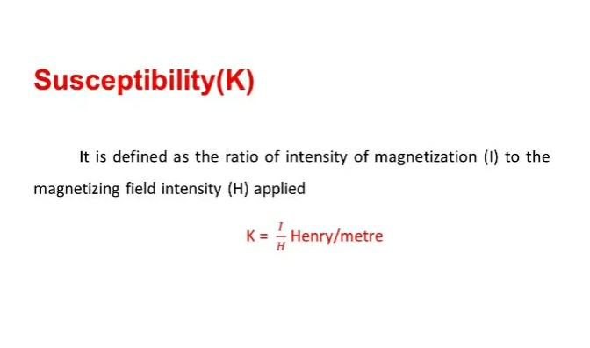

Slide 8
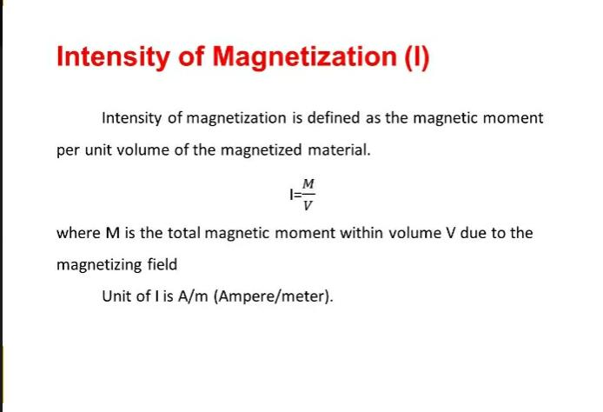

Slide 9
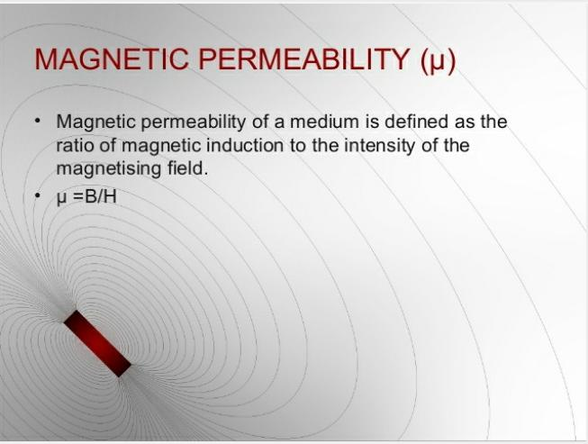

Slide 10
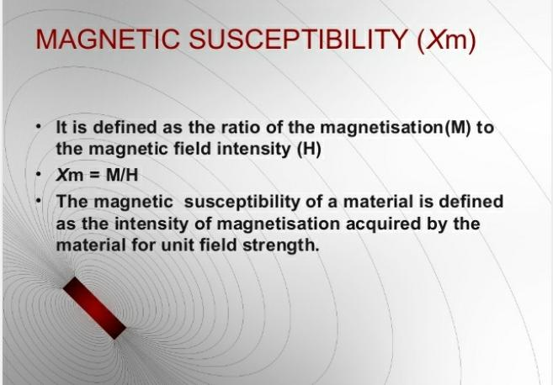

Slide 11
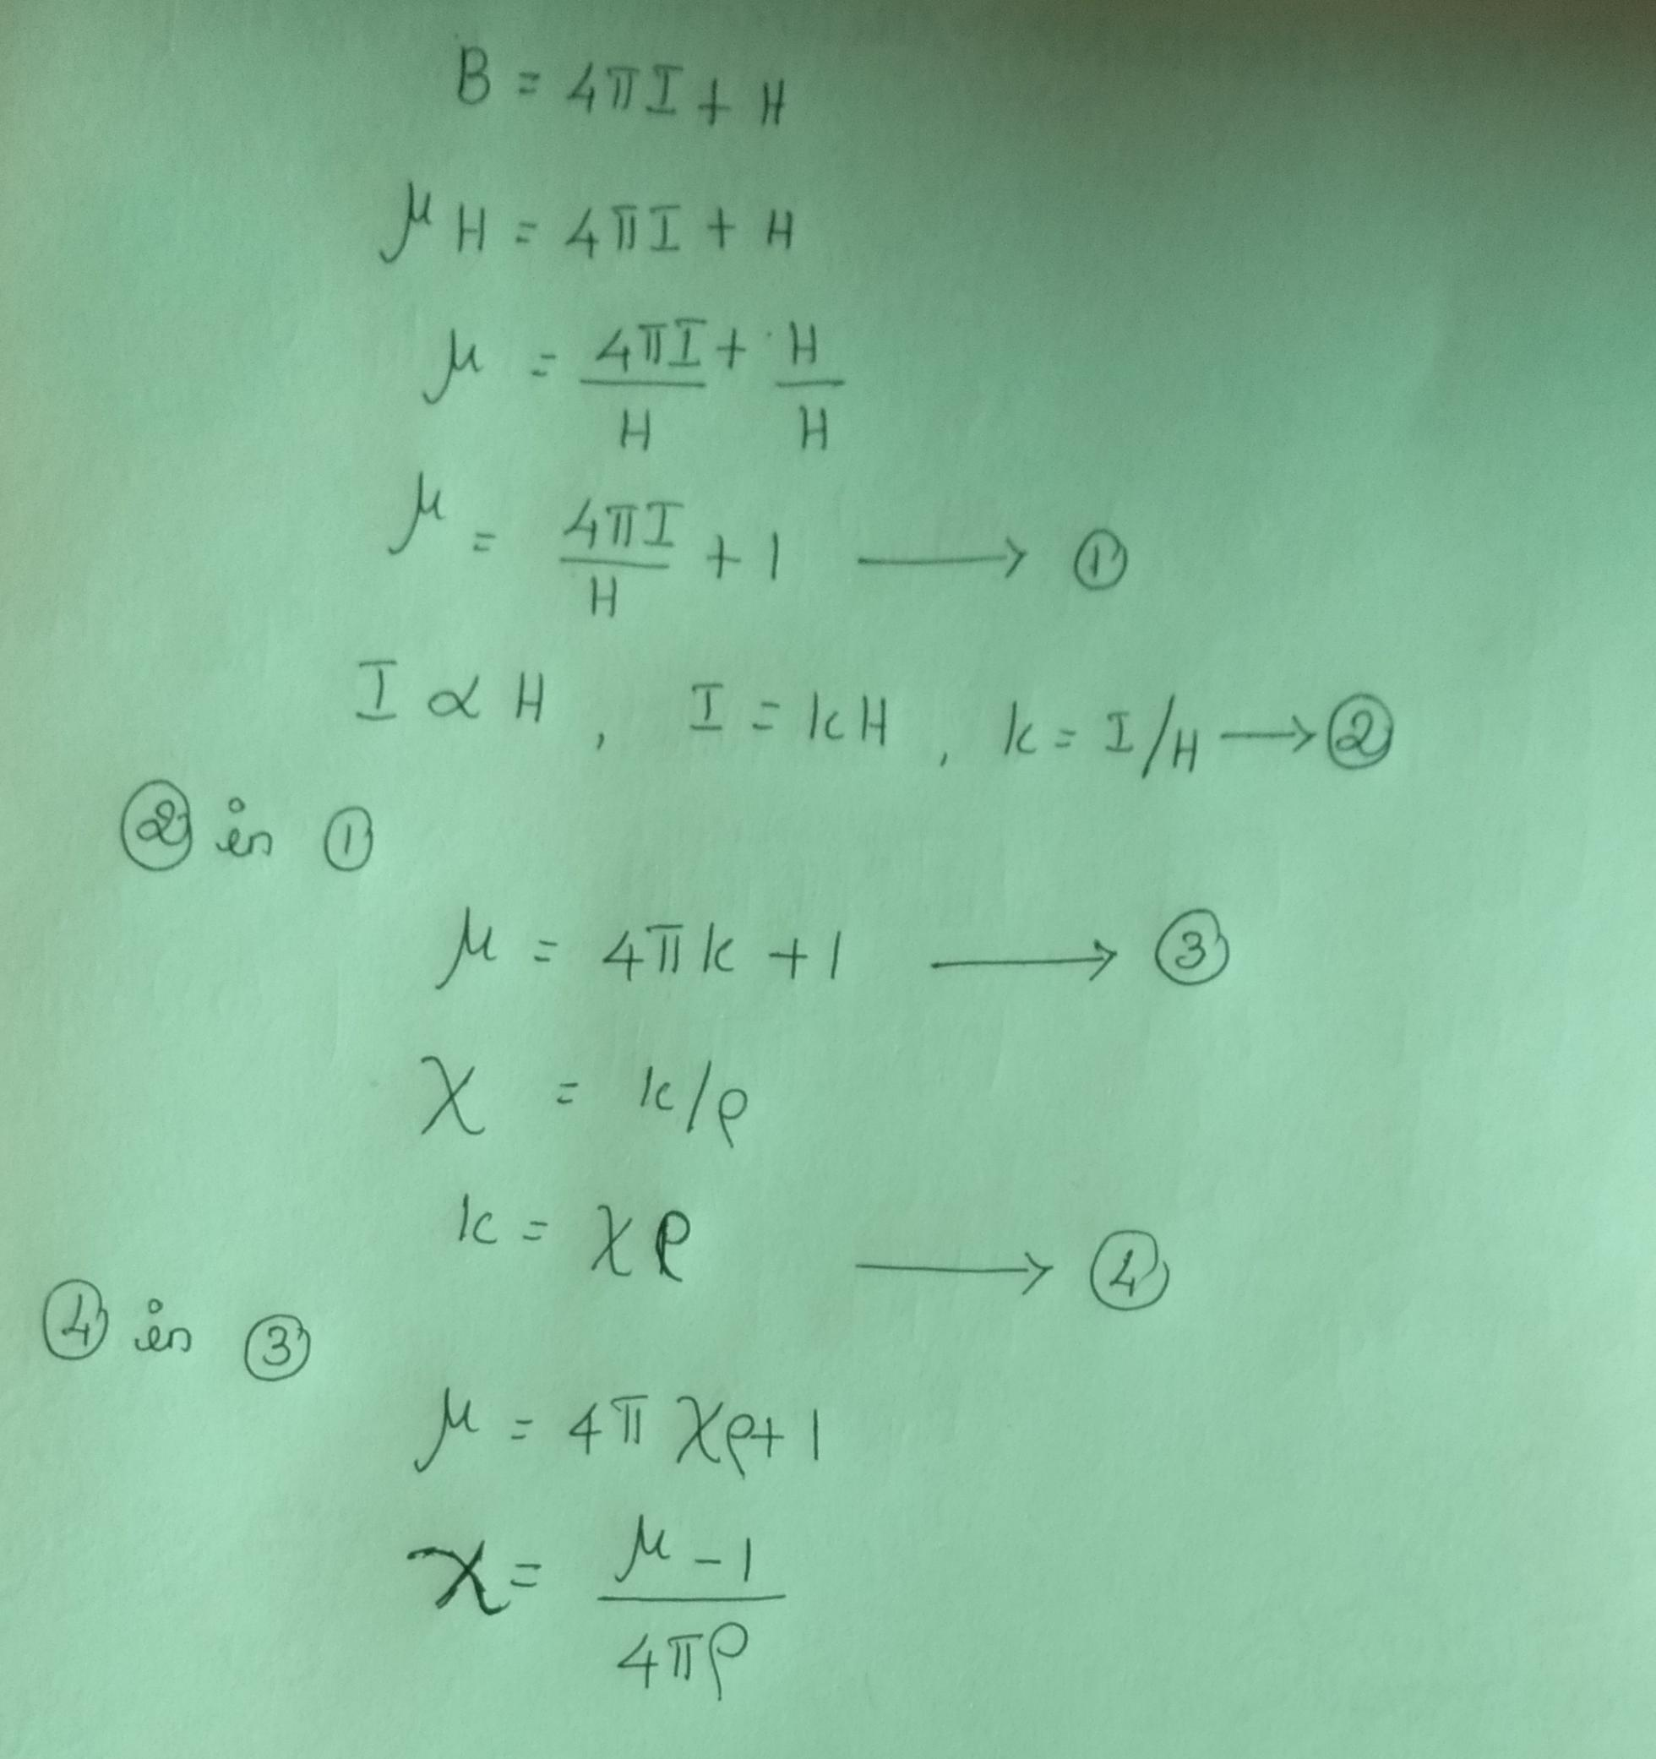

Slide 12
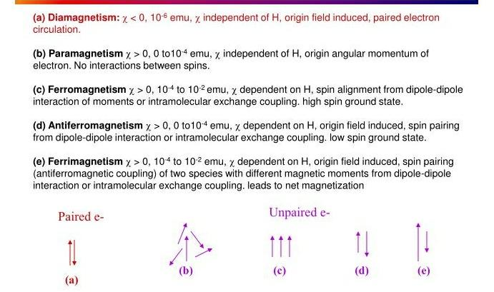
Types of magnetism

Slide 13
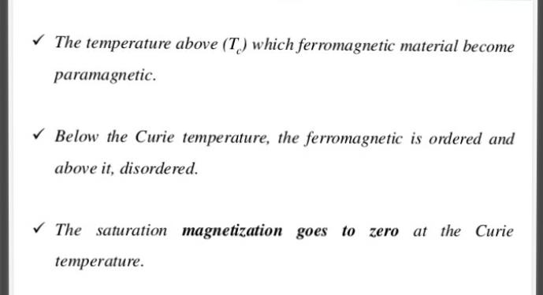
Curie Temperature

Slide 14
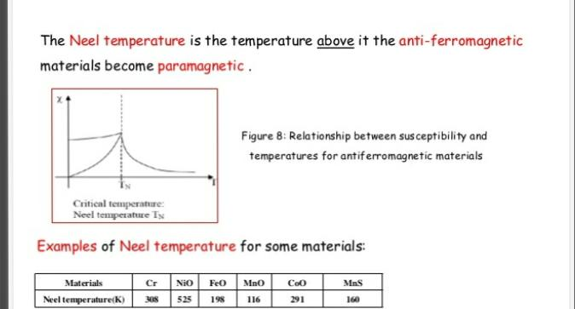
Neel Temperature

Slide 15
Comparision between paramagnetism and diamagnetism
Property | Paramagnetism | Diamagnetism
Similarity Dependance on magnetic field indensity | Independent | Independent
Differences
1. Magnetic permeabilty | > 1 | <1
2. Value of magnetic susceptibility | Large positive | Small negative
3.origin | Angular momentum | Electroc charge
4.Dependance of temperature | Decreases with an increase in temperature | Independent

Slide 16
Comparision between paramagnetism and ferromagnetism
Property | Paramagnetism | Ferromagnetism
Similarities
1. Dependance on temperature | Dependent | Dependent
2. Sign of x | Positive | Positive

Slide 17
Comparision between paramagnetism and ferromagnetism
Differences
1. Value of magnetic susceptibility | Large | Very large
2. Dependance on magnetic field intensity | Independent | dependent
3. Origin | Electronic charge | Dipole exchange

Slide 18
Determination of magnetic susceptibility using Guoy balance method
Paramagnetic substance
when a substance is suspended between the two poles of an electromagnet
The current is switched on,it experiences a force acting along its length.
The substance will be drawn downward by the electromagnetic field if it is paramagnetic.
The weight of the substance will increase in weight the magnetic susceptibility is calculated.

Slide 19
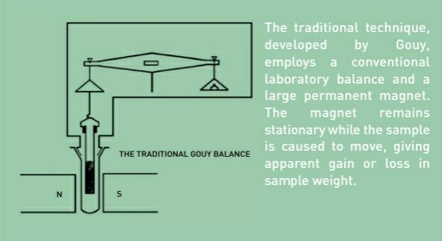

Slide 20
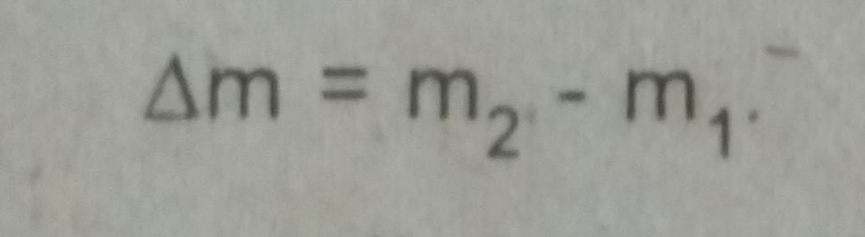
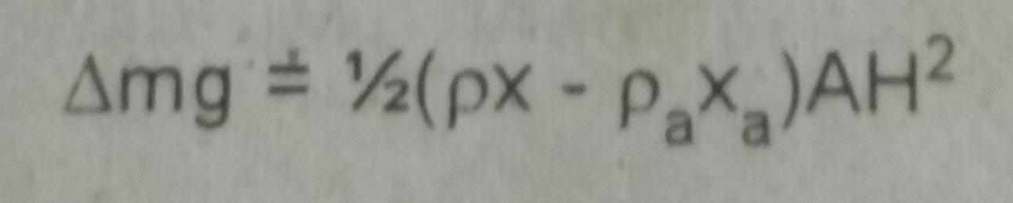
Calculation:
The increase in weight

Slide 21

Calculation of molar magnetic susceptibility
X_{M}= XM
Calculation of effective magnetic moment.
M. = √ 3RTX_{M}

Slide 22
Diamagnetic substance.
In the case of diamagnetic substances the cylinder will be pushed upwards by the electromagnetic field because diamagnetic substances are repelled by the magnetic field.
The weight of the substance will decrease apparently.
weight change of the substance and X can be calculated.
weight change and X will be negative

Slide 23
Application to structural Problems
K₄Fe(CN)₆:
4+x-6=0
x-2=0
x=2
Fe atomic number:26
1s²2s²2p⁶3s²3p⁶3d⁶4s²
No unpaired electron – diamagnetic
d²sp³- octahetral

Slide 24
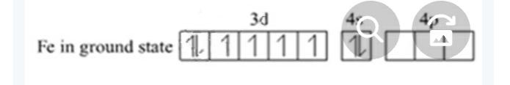
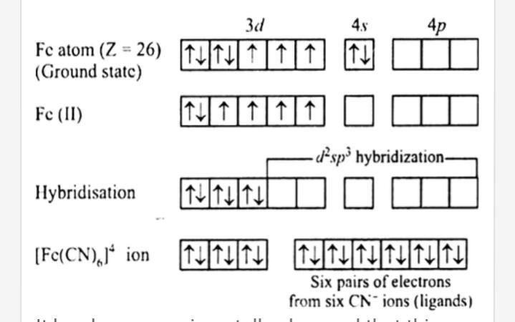

Slide 25
K₃Fe(CN)₆:
3+x-6=0
x-3=0
x=3
Fe atomic number:26
1s²2s²2p⁶3s²3p⁶3d⁶4s²
one unpaired electron – Paramagnetic
d²sp³- octahetral

Slide 26
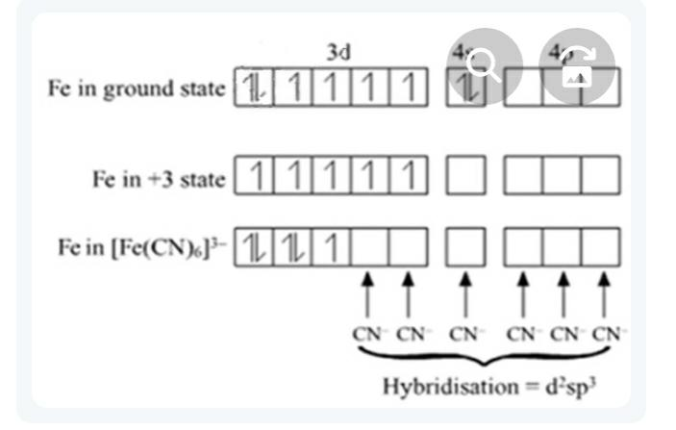

Slide 27
Ni(CO)₄:
x-0=0
x=0
Ni atomic number:28
1s²2s²2p⁶3s²3p⁶3d⁸4s²
No unpaired electron – diamagnetic
sp³- Tetrahetral

Slide 28
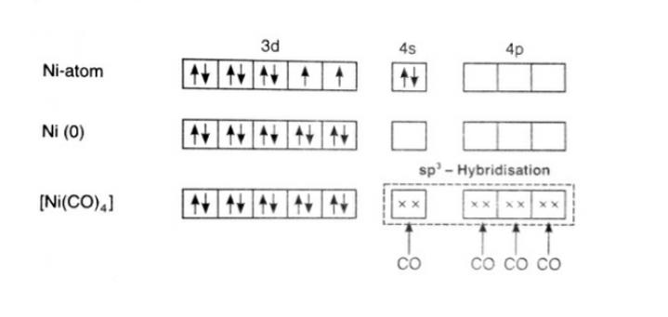

Slide 29
Thank you

