Slide 1
Determination of dipolemoment
Name of the instructor : U.Nithya M.Sc.,M.Phil.,

Slide 2
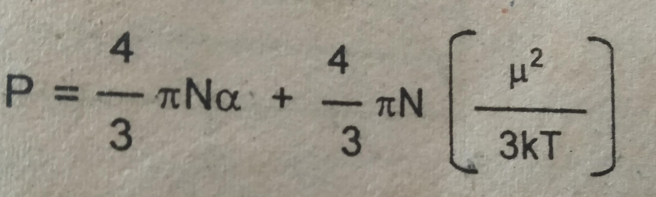
Determination of dipolemoment:
Temperature method (Vapour Density Method)
polar molecules
P=P_{I}+ P_{o}

Slide 3
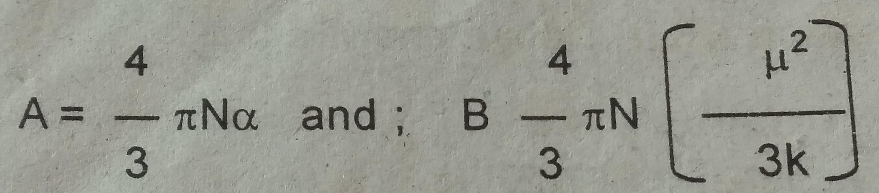
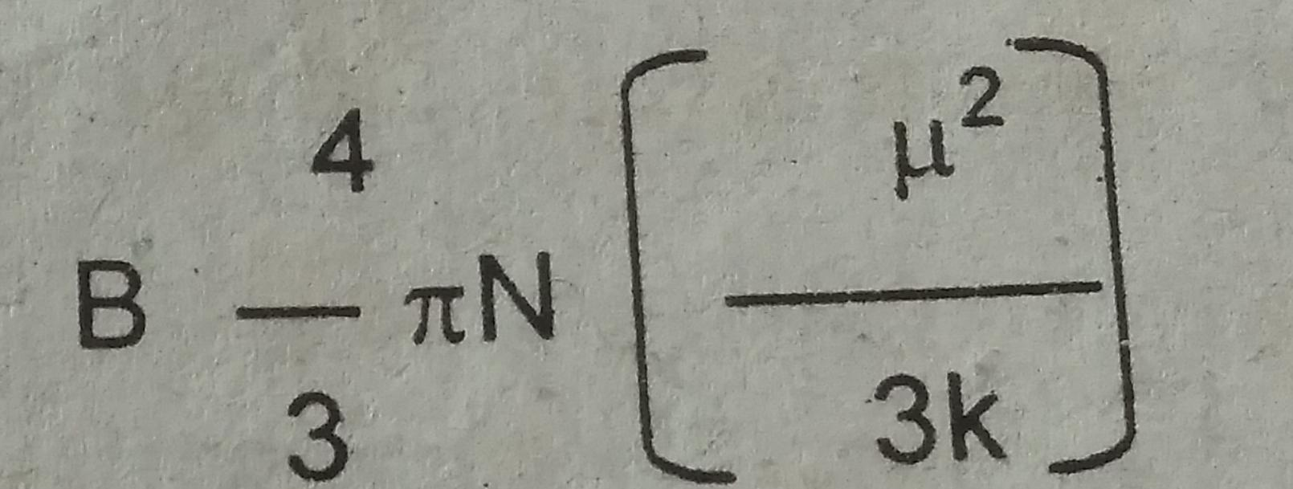
This equation may be written in the form
P= A+ B/T
The slope of the line is given by
from which diPolemoment can be calculated

Slide 4
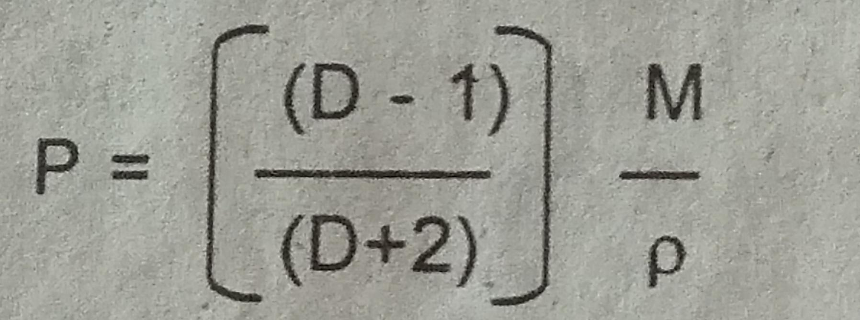
We further know that
Dielectric constant D and the p of a vapour are measured at a series of temperature,P,the total molar olarization is calculated from above equation for various temperature.
Pis plotted against 1/T
We get a straight line.
The slope of the line gives B.

Slide 5
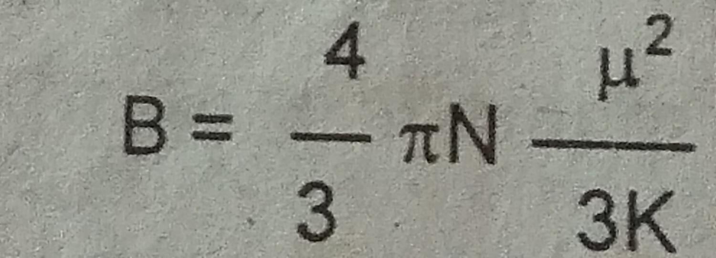
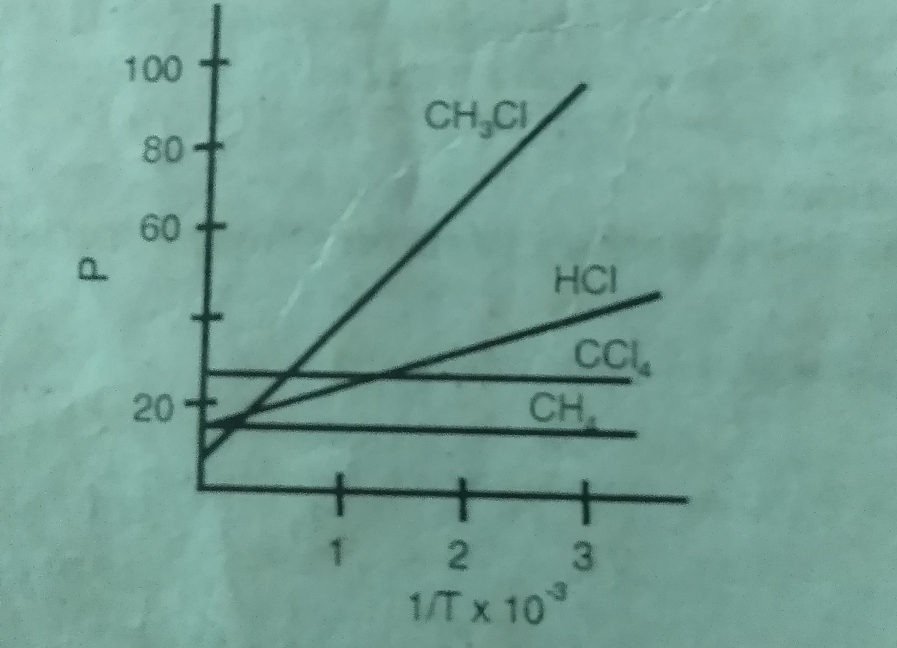
Substituting for π, N,K we get dipolemoment equal to 0.0128√B

Slide 6
For polar molecules we can calculate the dipolemoment from the sloe of the curve eg. CH₃ Cl, HCl
From non – polar molecules dipolemoment equal to zero,soB=0.
Therefore the plot of p against 1/T is parallel to the 1/T axis.ie the total molar polarisation is independent of temperature eg.ccl_{4,}cH_{4.}
LIMITATIONS OF THE METHOD:
The experimental part itself is difficult
For substance which decompose on heating the dipolemoment cannot be measured by this method.

Slide 7
Refractivity method:
The temperature method described above has a restricted use because the temperature range available for making the measurement is limited.
so refractivity method is used.
This method depends upon the behaviour of polar molecules in the alternating field of high frequency.
If an electric field is suddenly turned off or the field is reversed suddenly the polar molecules held in the field will require a finite time to lose their partial allignment and to reach a state of random or new orientations. This time telaxation is called relaxation time.
if this reversal is done at low frequences the molecule can follow the field and total molar polarisation P remains constant.
At higher frequencies the molecule cannot stay in phase with the field.
The totalmolar polarisation decreases due to a decrease in orientation polarisation P₀
This occurs near a frequency range of 10¹⁰-10¹²Hz

Slide 8
At still higher frequencies thus only the induced polarisation P_{I} remains.
This induced polarization results from the displacement of both electrons and nuclei in the alternating field and P_{I} =P_{E}+P_{A.}
At still higher frequencies,as a result total molar polarisation decreases once again.
At higher frequencies direct measurement of capacitance is thus not possible and the only conviently measurable Property to determine dielectric constant is the refractive index which according to the Maxwell’s Theory can be expressed as.
D=n²
Thus the clausius – Mosotti equation then becomes

Slide 9
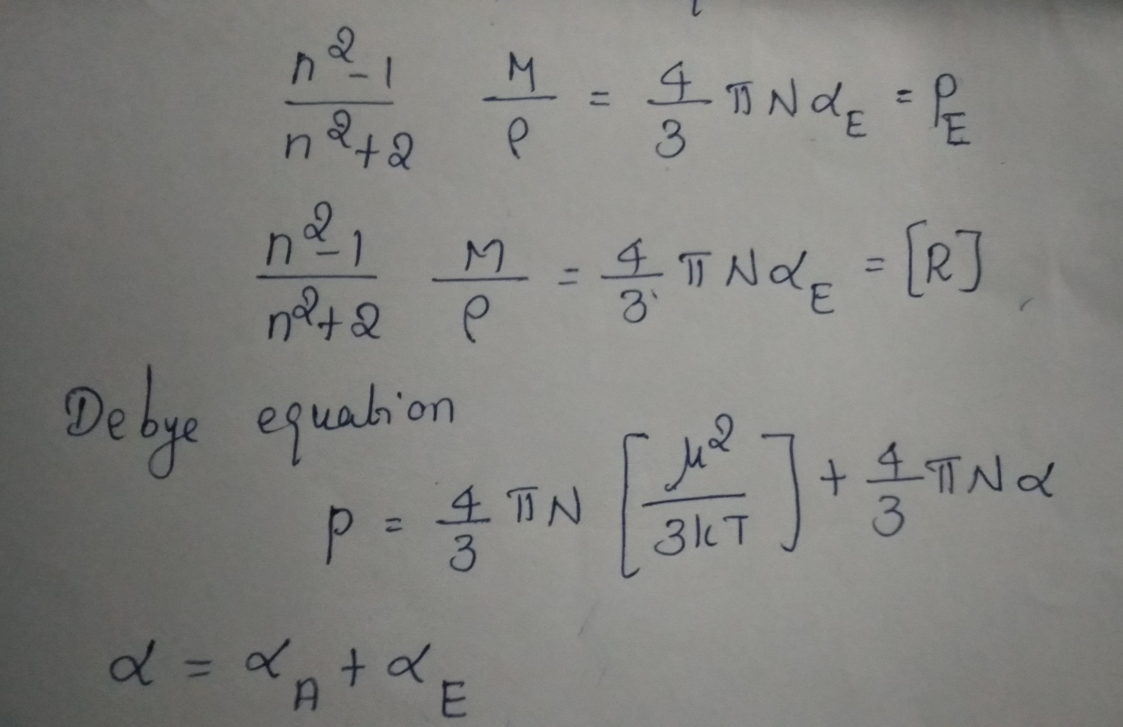

Slide 10
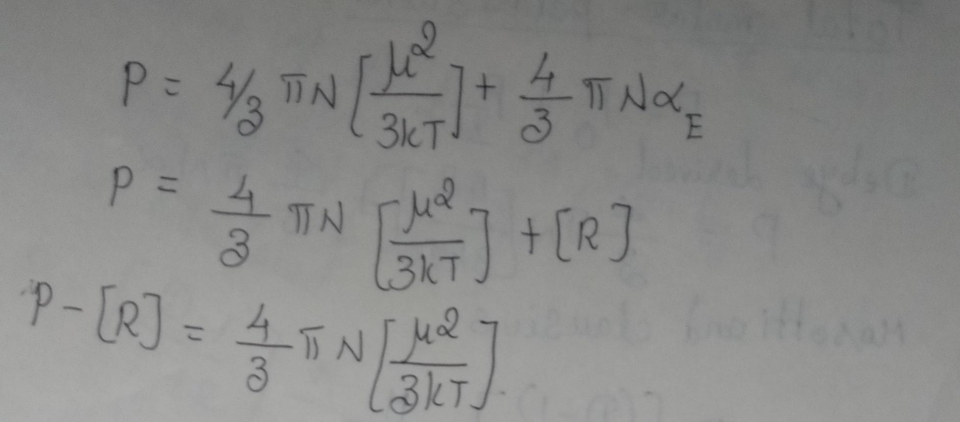

Slide 11
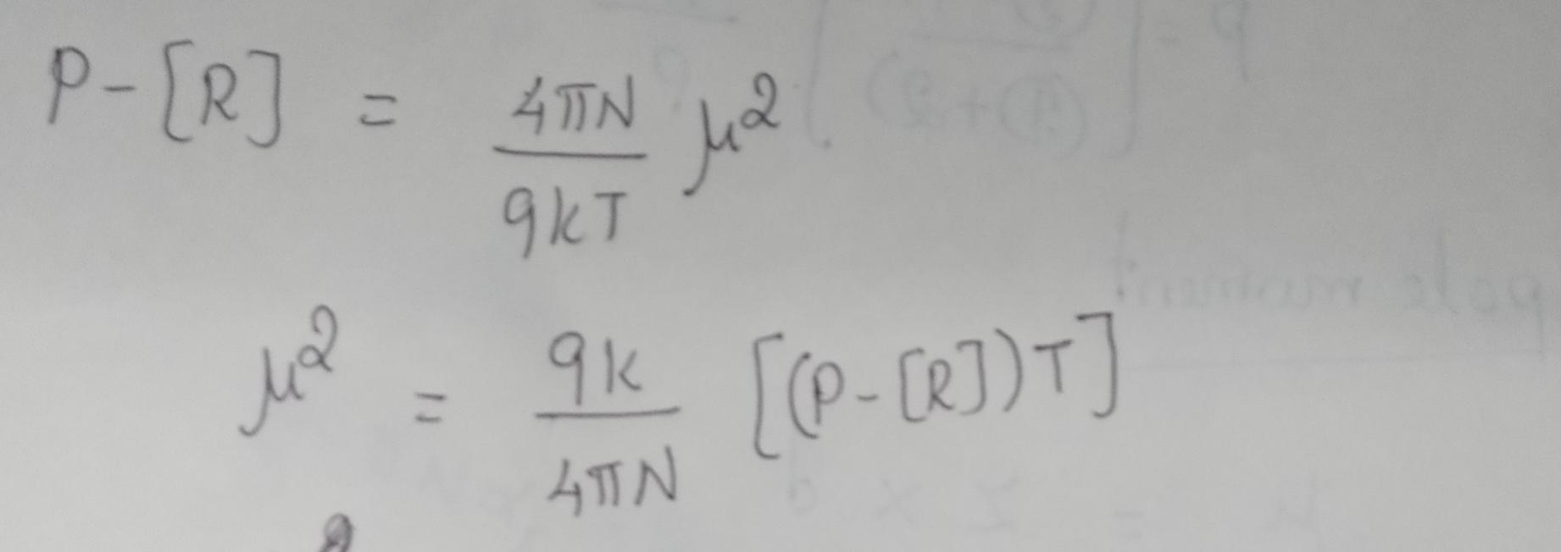

Slide 12
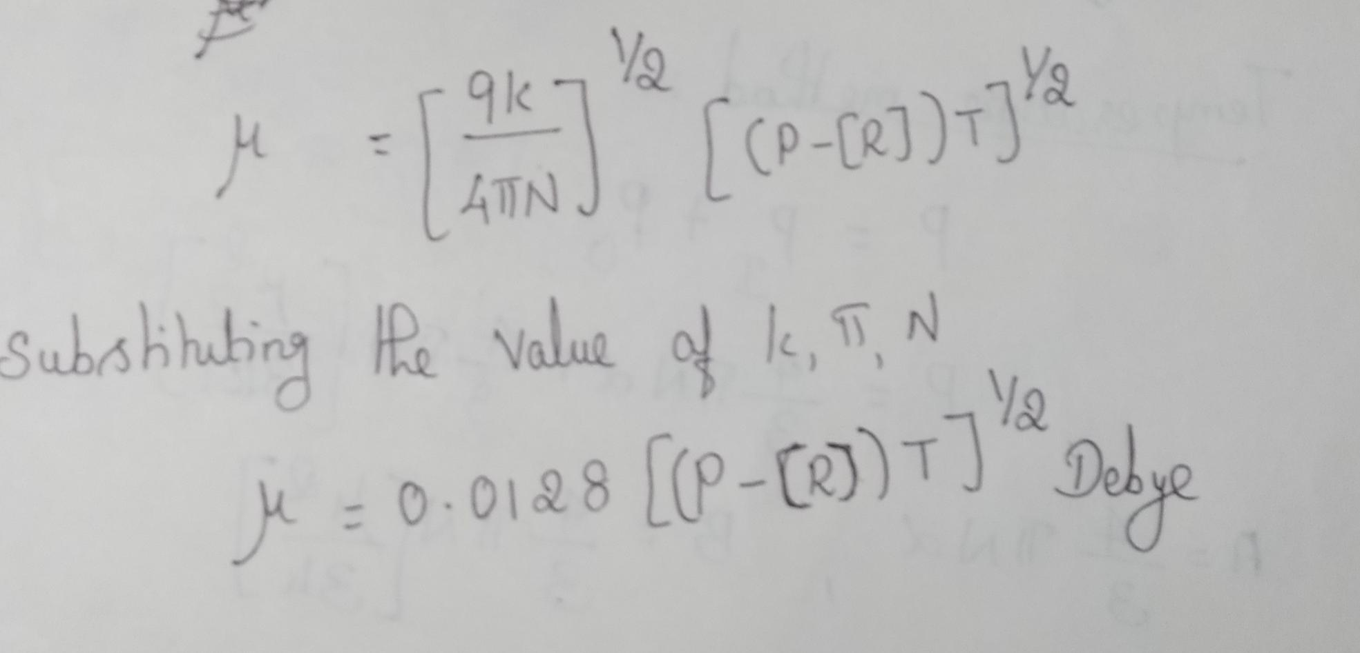

Slide 13
Dilute solution method
This method is based on the assumption that ehen a polar substance is dissolved in a non polar solvent the total polarisation of the dilute solute is equal to the sum of the polarizations of the solvent and the solute. Thus
P_{solu}= x_{A}P_{A}+x_{B}P_{B}
Where x_{A}and x_{B} are the mole fractions of the non polar solvent and solute respectively.
P_{A} and P_{B}are their polarizations.
M_{A}and M_{b}are the molecular weight of the solvent and solute
p is the density of the solutions
P_{solu}= [D-1/D+2] [x_{A}M_{A}+x_{B}M_{B}/p]

Slide 14
By measuring the dielectric constants of the solution and solvent
P_{A} and P_{b}can be measured knowing the composition of the solution we can get the values of X_{A}and X_{B}. From these P_{B} can be calculated using the above equation.

Slide 15
THANK YOU

