Slide 1
Quantum numbers
Name of the instructor : U.Nithya M.Sc.,M.Phil.,

Slide 2
QUANTUM NUMBERS:
In an atom, the electrons are arranged in different energy levels. These electrons not only rotate around the nucleus but also rotate around their own axes.
According to the quantum mechanics three interrelated numbers are required to express the size,shape,and orientation of the orbitals of electrons in an atom.
Moreover,there is a number to express the direction of spin of the electron. These four corelated numbers are called quantum numbers

Slide 3
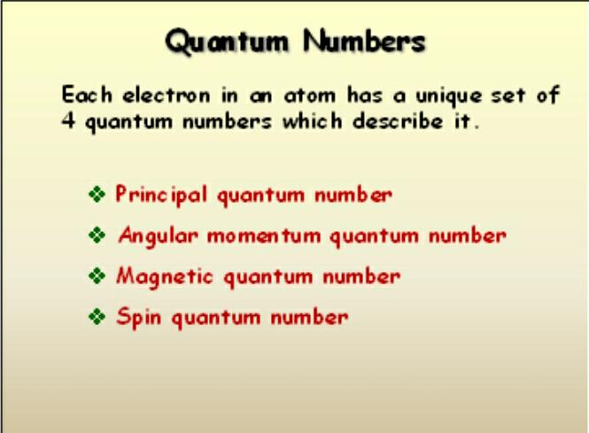

Slide 4
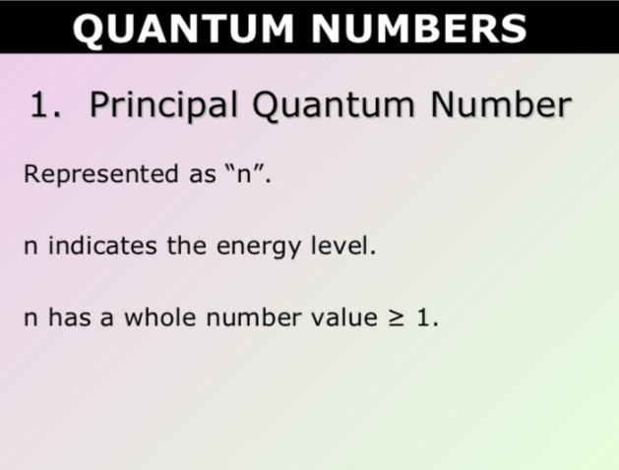

Slide 5


Slide 6
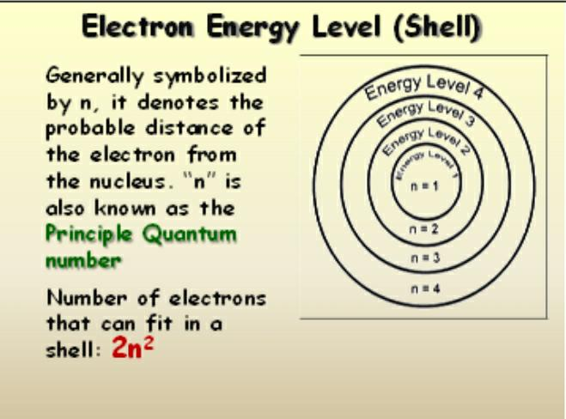

Slide 7
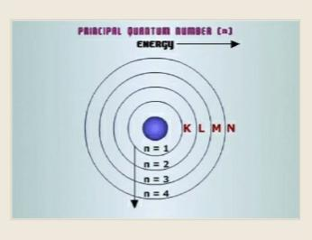

Slide 8
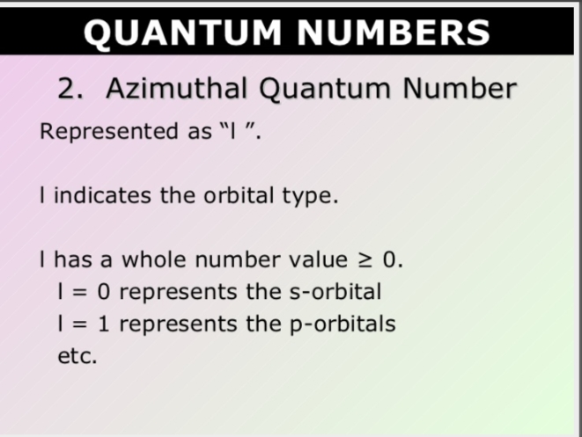

Slide 9
Azimuthal quantum number (l):
It tells us the number of subshells present in the main shell and the orbital to which an electron belongs. Its value is equal to 0 to (n-1).

Slide 10
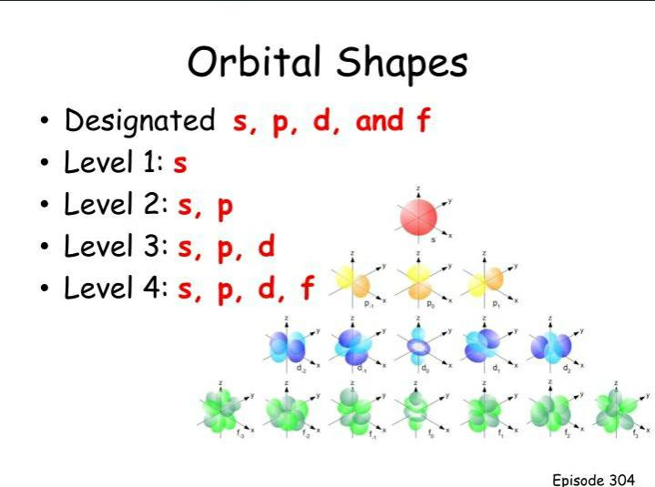

Slide 11
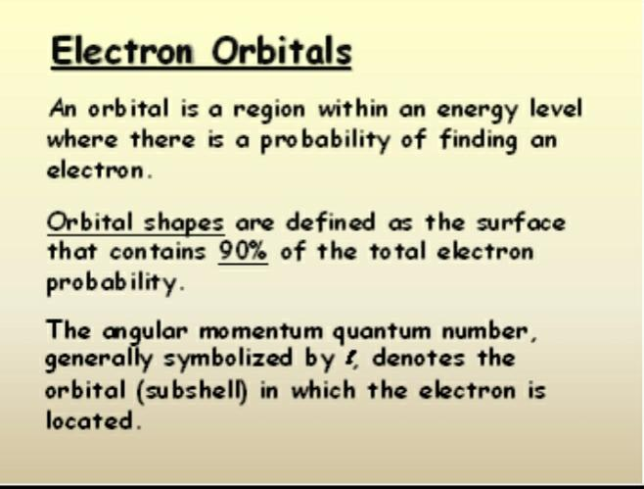

Slide 12
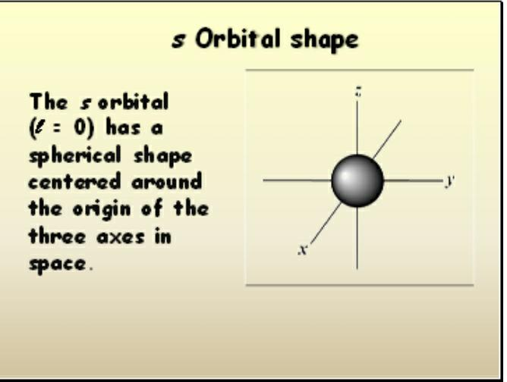

Slide 13
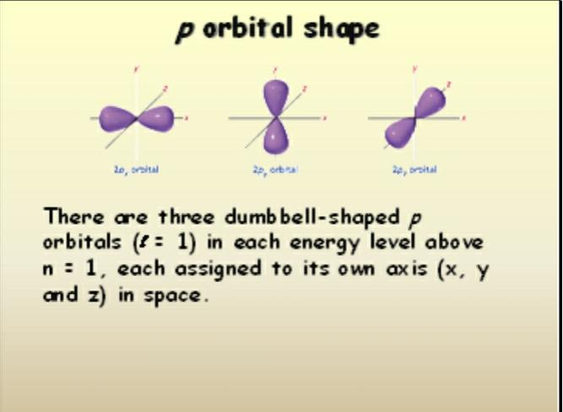

Slide 14
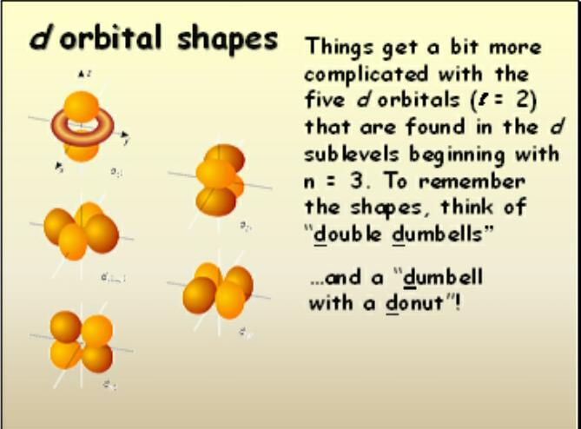

Slide 15
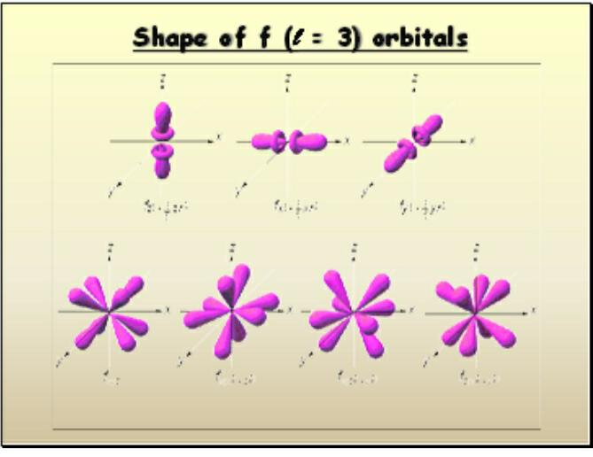

Slide 16
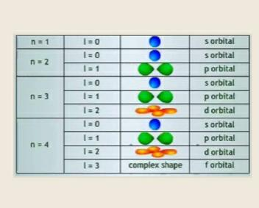

Slide 17
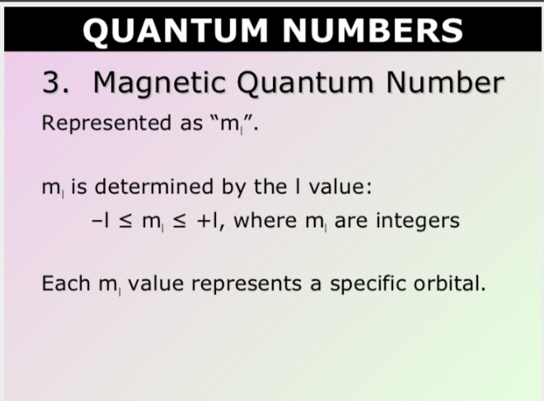

Slide 18
Magnetic quantum number :
It imforms the level of degeneracy of the orbitals. It value is equal to –l, 0 , +l.

Slide 19
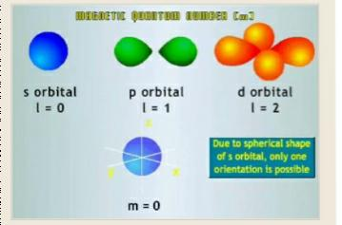

Slide 20
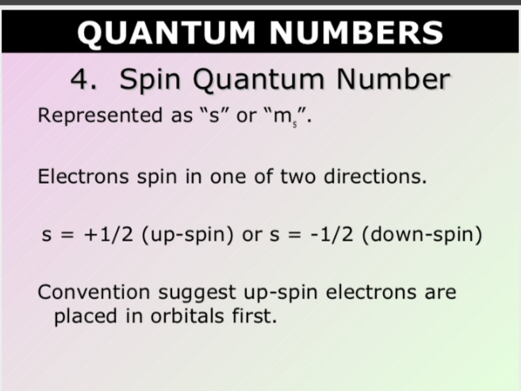

Slide 21
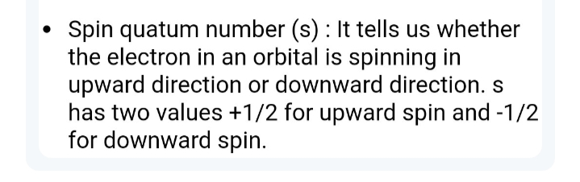

Slide 22
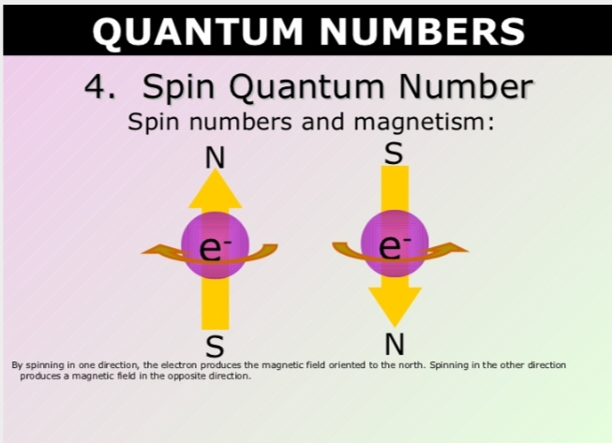

Slide 23
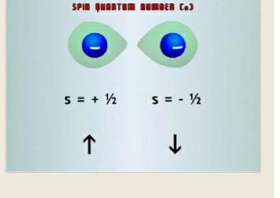

Slide 24
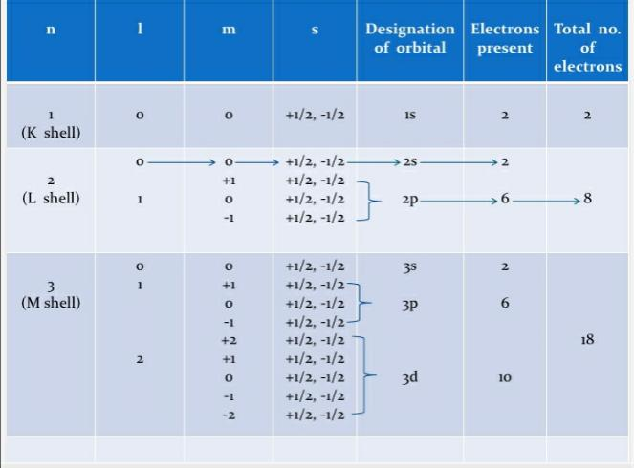

Slide 25
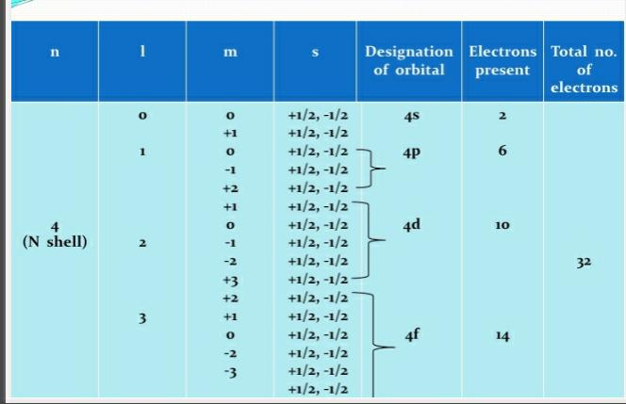

Slide 26
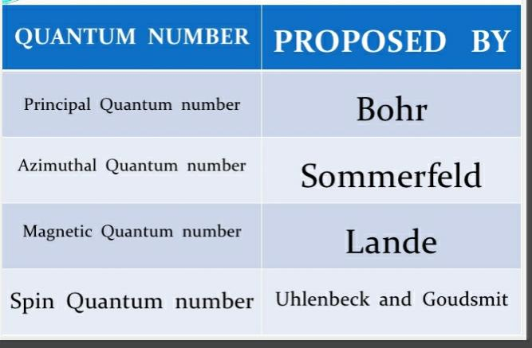

Slide 27
THANK YOU

