Slide 1
JOULE’S LAW
Name of the instructor : U.Nithya M.Sc.,M.Phil.,

Slide 2
Difference between reversible and irreversible work of expansion of an ideal gas:-
S.no | Reversible | Irreversible
1 | Work obtainable will be maximum | Will not be maximum
2. | Very slow | Proceeds in a measurable rate

Slide 3
Differences between isothermal and adiabatic Processes:
Property | Isothermal process | Adiabatic process
Temperature | Constant | Changes
Heat change | Q=W,varies with nature of process | Q=o,varies with nature of the process.
ΔE | ΔE =0, does not vary with nature of process | ΔE = - W = - C_{v}ΔT varies withnature of process
ΔH | ΔH = 0,does not vary with nature of process | ΔH = Cp ΔT varies with nature of Process.
Final pressure | More | Less
Final volume | More | Less
W | More | Less

Slide 4
JOULE’S LAW:
law:
The energy of the gas is a function of temperature only. It is independent of volume.The law may be represented mathematically
As follows
(∂E/∂v)_{T}= 0

Slide 5
Mesurement of (∂E/∂v)_{T :} joule’s experiment

Slide 9
InterPretation of the exeriment:
no work is produced .w=0 this is called free expansion of the gas.
First law dE = q-w
w=0
dE = q
The temperature of the surroundings is unchanged
q=0, hence dE=0
We know dE = (∂E/∂T )_{v} dT+ (∂E/∂v)_{T}dv. ------------------→ 1
The system and water are in thermal equilibrium,the temperature of the system is also unchanged.
So equation 1 becomes.
dE=(∂E/∂v)_{T}dv =0
dv#0, (∂E/∂v)_{T}=0

Slide 10
This means that the energy is independent of the volume.
This means that the energy of the gas is a function of temperature only.
This is called joule’s law.
Limitations:
Joule’s law is not precisely correct for real gases.
The ideal gas obeys joule’s law exactly.

Slide 11
Joule thomson effect:-
Definition:
When a gas is made to expend adiabatically from a region of high pressure to a region of low pressure the temperature of gas changes. This phenomenon is called Joule thomson effect.
Explanation:
if a stream of gas at high Pressure is allowed to expand by passing it through a porous plug into vaccum or low pressure,under adiabatic conditions the temperature of the gas changes appreciably. All the gases expect hydrogen and heliumwere cooled when they were subjected to joule thomson effect.
Helium and hydrogen Were heated under similar circumtances.

Slide 12
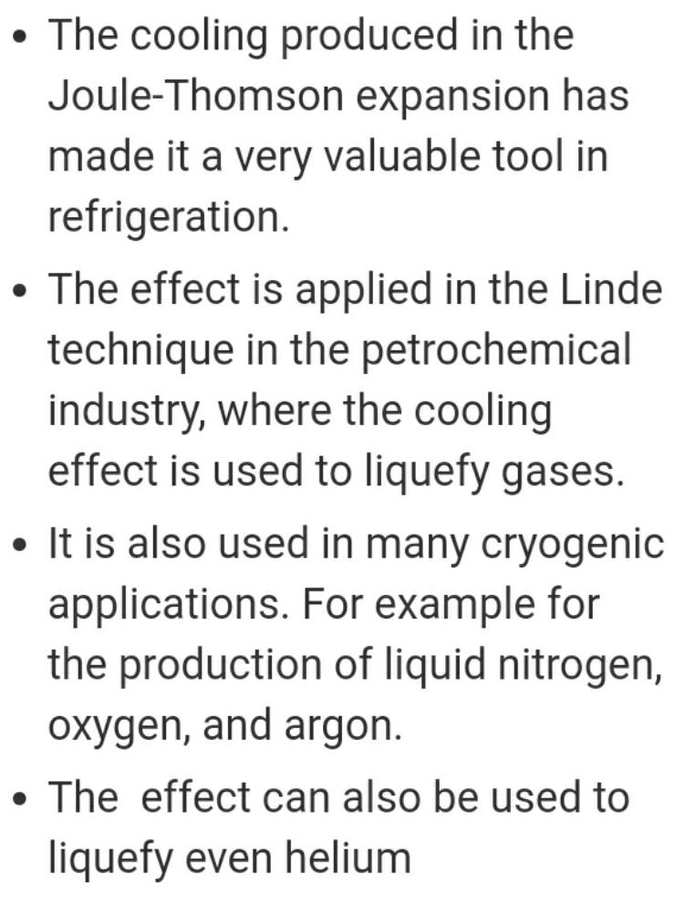
Application:

Slide 13
Limitations:
joule thomson effect can be applied only if the initial temperature of the gas is below its inversion temperature.
INVERSION TEMPERATURE:
Definition:
The temperature below which joule-thomson effect is a cooling effect is called inversion temperature.
The temperature below which a gas gets cooled during an adiabatic expansion is known as its inversion temperature.
Explanation with example:
* When a gas is subjected to joule – thomson effect it gets cooled appreciably.
* when hydrogen and helium were subjected to joule thomson effect they were heated up instead of getting cooled.
* At very low temperature these gases also get cooled.

Slide 14
* For example hydrogen below -80°c and helium below -240°c behaved like this.
* There is a particular temperature below which the joule thomson effect is always a cooling effect.
* This temperature is called the inversion temperature of that gas.
Joule – thomson’s experiment:
The experiment devised by joule and thomson to derive a relation between the lowering of temperature and the fall of pressure of a gas due to exansion is given systematically.

Slide 16
Net workdone on the gas at high pressure = -P₁V₁
Workdone by the gas at low pressure = P ₂V₂
Net workdone by the gas = P₂V₂ – P₁V₁
This expansion of the gas taken place adiabatically.
There will be a fall in E from E₁and E_{2.}
P₂V₂ – P₁V₁= E₁- E₂
E_{2.}+ P₂V₂ = E₁+ P₁V₁
E +PV. = H
H_{2.} = H₁
Or. Δ H. = 0
joule thomson expansion is an isenthalpic process
adiabatic expansion of a real gas occurs at constant enthalpy.

Slide 17
THANK YOU

