Slide 1
NMR SECTROSCOPY
Name of instructor: U.Nithya M.Sc.,M.Phil.,

Slide 2
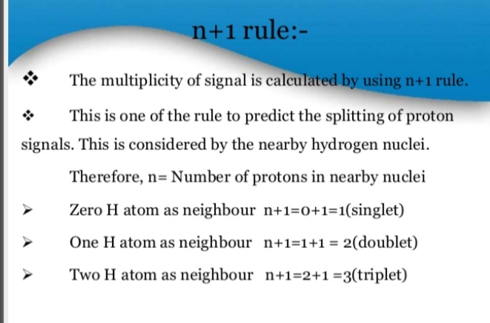

Slide 3
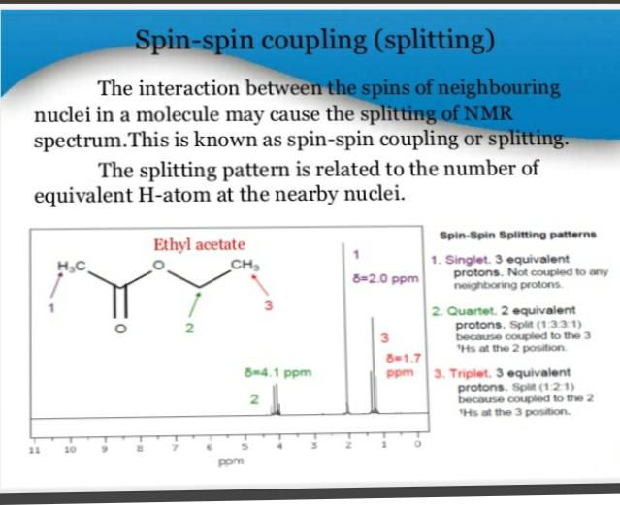

Slide 4
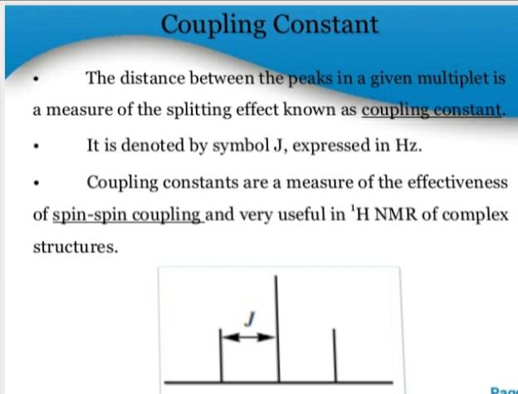
NMR SPECTROSCOPY
Name of Instructor: U.Nithya M.Sc.,M.Phil.,

Slide 5
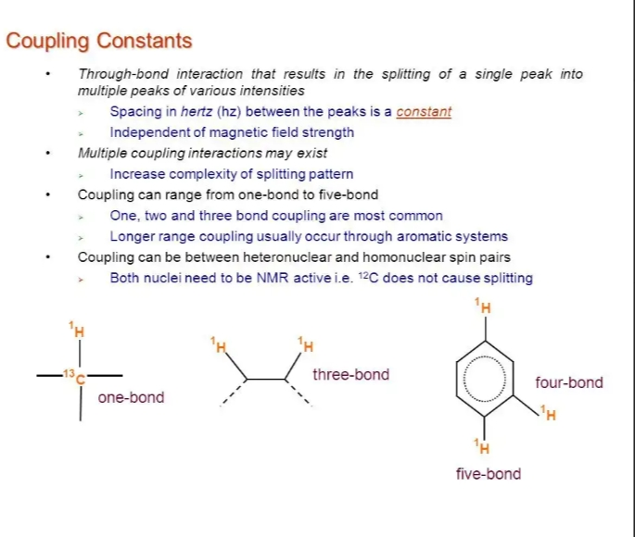

Slide 6
ONE BOND COUPLING:
One bond couplings depend on the amount of s-orbital character in the internuclear bond. This depends on the hybridization of the atoms invoved.
For hydrocarbons ¹J_{CH} for S P ^{3.} 125Hz. 25% s-character.
¹J_{CH}for. SP^{2.} 160Hz. 33% s-character
¹J_{CH}for SP. 250Hz. 50% s-character
coupling constants are used to determine the coordination number of atoms in a molecule.

Slide 7
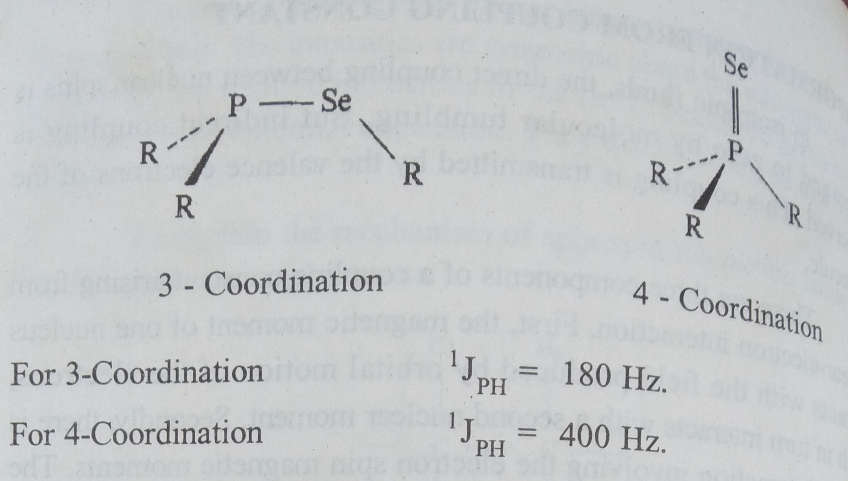

Slide 8
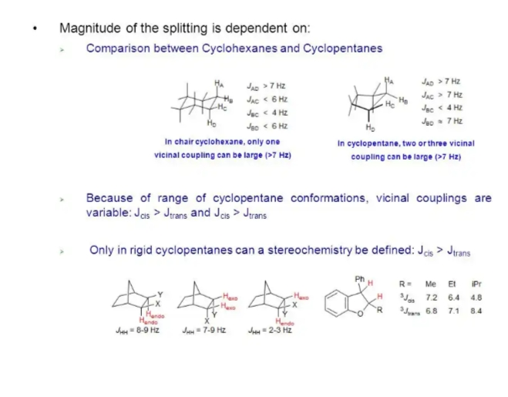
Two bond coupling

Slide 9
COULING OVER THREE OR MORE BOND
Small coupling over four are more bonds are also observed.very long range couplings may be associated with extended π-electron systems.

Slide 10
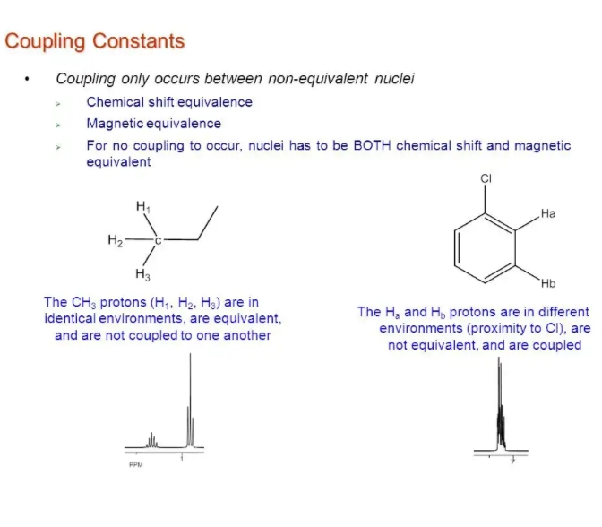

Slide 11
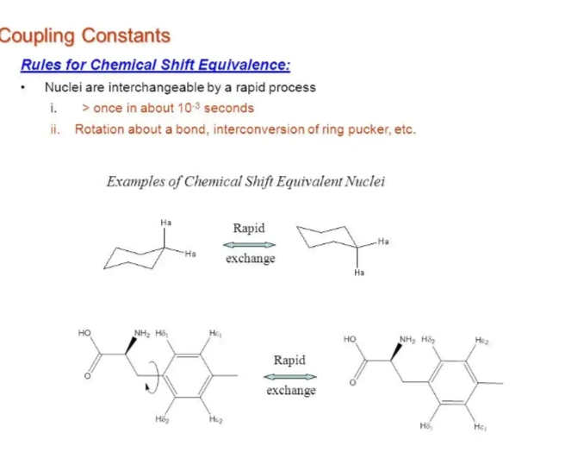

Slide 12
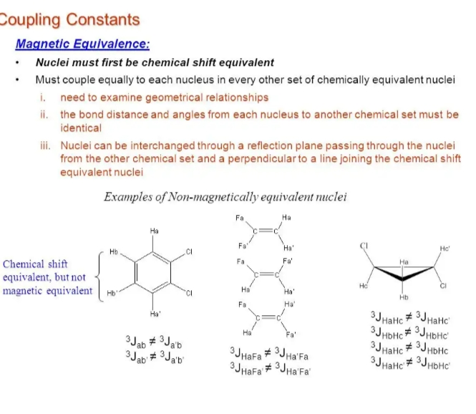

Slide 13
Information from NMR Signal intensities
The intensity of an nmr signal iproportional to the population difference for the two energy levels involved.
For several nuclei Of the same isotope the resonance frequencies differ only by a few ppm.
The total intensities of the lines in a spectrum are proportional to the number of equivalent nucleicontributing to them.
one can determine the relative numbers of nuclei in each distinct environment within asingle compound.

Slide 14
Dilute spins:
* In nmr the spinning nuclei may not have isotopes of 100% abundance.
* samples enriched with their isotopes are often Present.
* Many NMR studies involve isotopes of low natural abundance.
* The isotopes of low natural abundance resent with majority of the molecules are known as dilute spins.

Slide 15
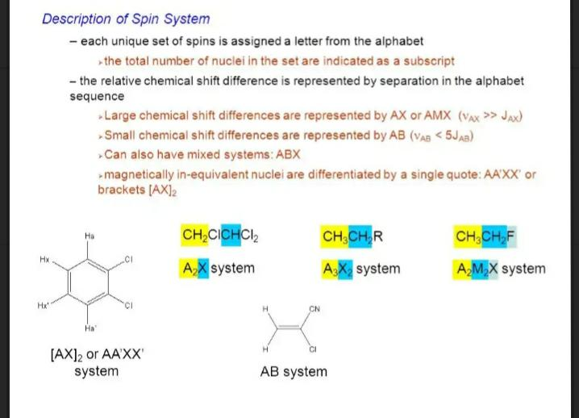
Classfication of the the spinning nuclei

Slide 16
THANK YOU

