Slide 1
ZERO FIELD SPLITTING IN ESR SPECTROSCOY
Name of the instructor: U.Nithya M.Sc.,M.Phil.,

Slide 2
Relaxation times in esr:
let the spin system is subjected to the microwave radiation.
energy level searation takes place and Boltzmann population ratio of spin in the ground and excited states is given as.
N_{u}/N_{I}=exp (- ΔE /kT)
where N_{u}amd N_{I}are the occupancy Number of spins in the upper and lower levels ΔE the energy separation at temperature T and k is the Boltzmann constant.
The hot spin(excited state) undergoes interaction with the surroundings and loses energy.
T₁ is the time taken for the energy flow from the spin system into the surroundings and hence T₁ is called spin-lattice relaxation.
if T₁ is large sharp spectrum is observed. The spectral width may be broadened when the relaxation takes place within a very short period of time.
it is explained by Heisenberg uncertainty principle Δv. Δt = constant.

Slide 3
If T₁=10⁻⁹s Δv=108 s⁻¹. It is corresonds to an EPR line width of about 6mT.
The spin lattice relaxation occurs through electron spin flips with the surroundings matter like solvent or lattice.

Slide 4
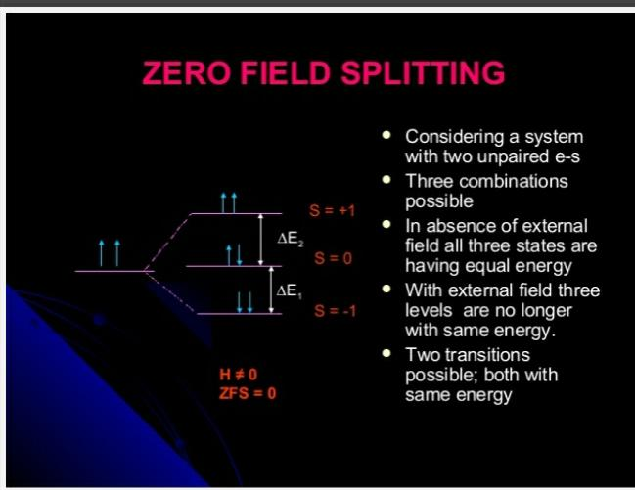

Slide 5
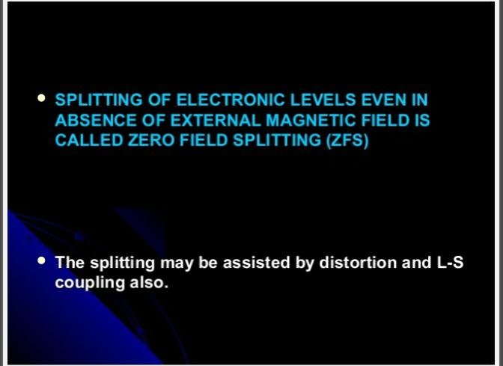

Slide 6
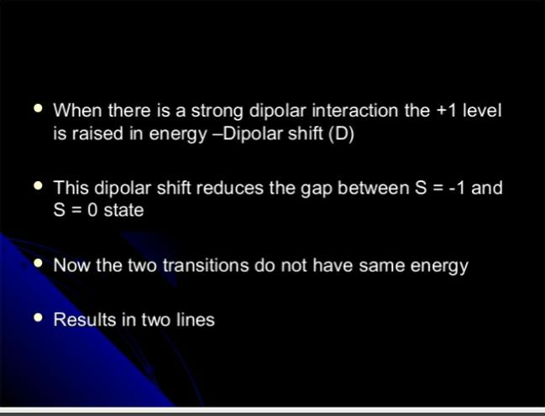

Slide 7
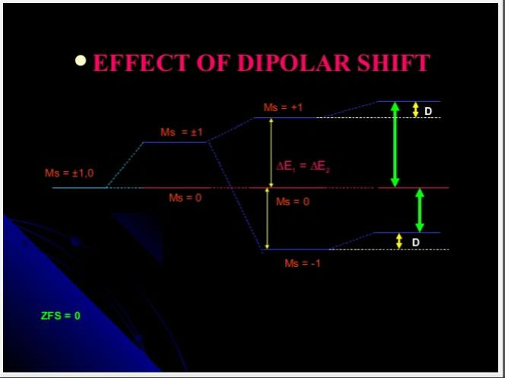

Slide 8
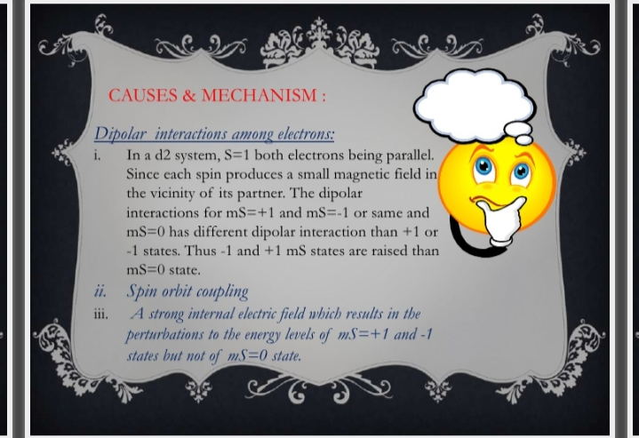

Slide 9
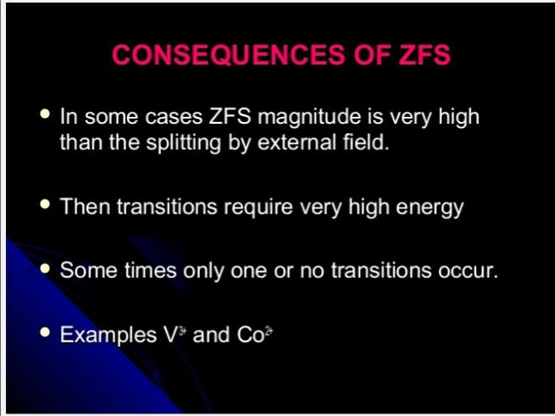

Slide 10
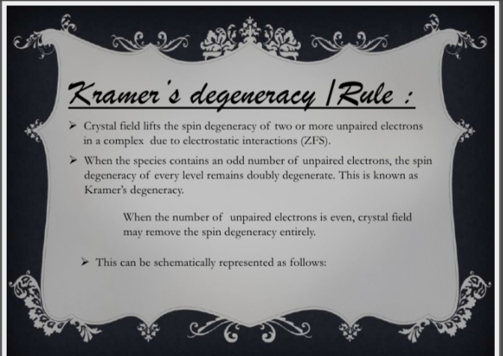

Slide 11
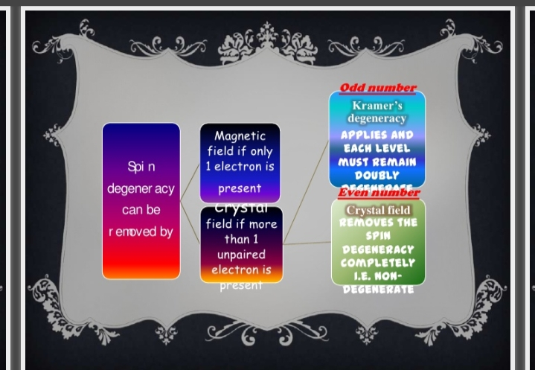

Slide 12
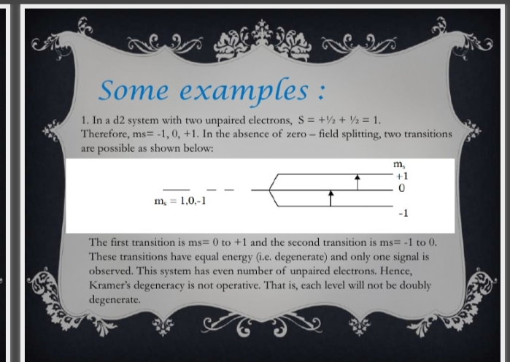

Slide 13
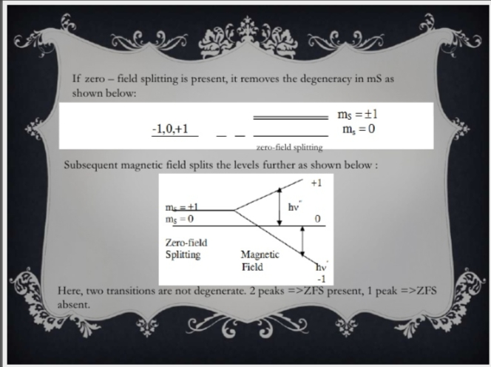

Slide 14
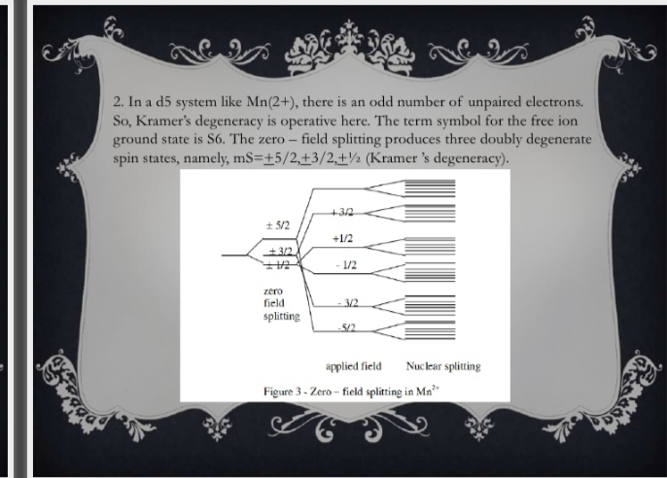

Slide 15
Line widths in ESR:
Line broadening due to spin-lattice relaxation results from the interaction of the paramagnetic ions with the thermal viberations of the lattice.
Relaxation time usually increase as the temperature decreases.
Therefore many salts of the transition metals are cooled to liquid N₂,H₂ or He temperatures for observing well resolved spectrum .
Spin dilution:
spin-spin interaction results from the small magnetic fields that exist on neighbouring paramagnetic ions.
As a result of these fields the total field at the ions is slightly altered and the energy levels are shifted.
A distribution of energies results which produces broadening of the signal.

Slide 16
The broading depends on the direction of the field. This effect is reduced by increasing the distance between the magnetic ions by diluting the salt with an isomorphous diamagnetic material.
rapid chemical processes influences the spectral line widths and appearance.
As the process rate increases separate lines coalesce to give a weighted average single resonance.
signifigant line broading occurs for processes with first order rate contants of 5x10⁷s⁻¹.

Slide 17
Exchange Narrowing:
Electron spin exchange processes are very common in free radicals.
This influences line width and spectral appearance.
In solution it is a bimolecular Process.The two radicals collide and exchange electrons.
During electron spin exchange there is no change in the nuclear spin state.
As the concentraction increases in going from a to e the rate of bimolecular exchange increases and the resonances broaden.
As the solution becomes more concentrated the single line resonance sharpens.
This sharpening is reffered to s exchange narrowing.

Slide 18
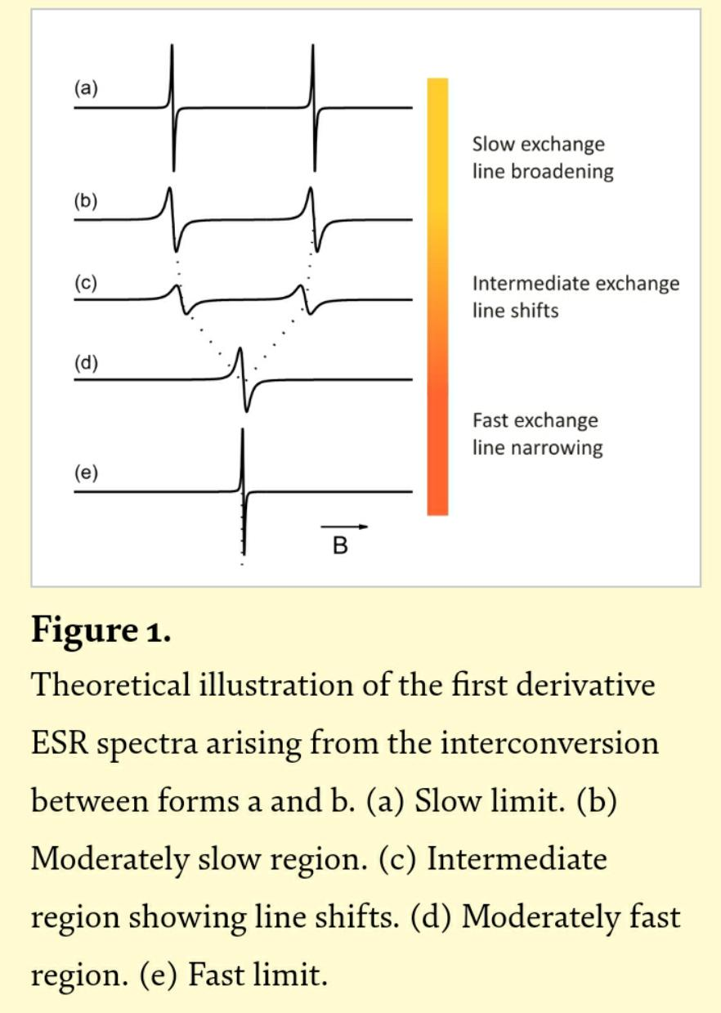

Slide 19
Election transfer between a radical and a diamagnetic species can occur at a rate that causes line broading.
Eg: Electron exchange between naphthalene and nahthalene negative ions.A second order electron transfer rate constant of 6x10⁷1 mol⁻¹s⁻¹ was found in the solvent THF.
Many effects cause the line widths of one band to differ from those of another in a given spectrum.
The spin density on the methyl proton of ethylamine is conformation dependent.
The time dependency of this type of process can influence the line widths of different Protons in a molecule differently.
rapid interchange between various configurations of an ion pair with an anion or cation radical can also lead to greater line broadening of certain resonances than of others.

Slide 20
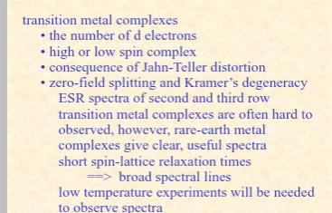

Slide 21
THANK YOU

