Slide 1
MAGNETIC PROPERTIES
Name of the instructor:U.Nithya M.Sc.,M.Phil.,

Slide 2
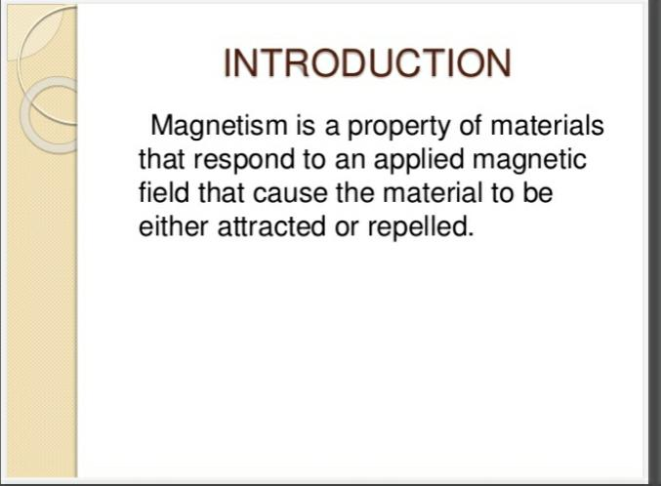

Slide 3
The force ‘f’ between two magnetic poles of strength m₁ and m₂ at a distance r is.
f= m₁m₂ /qr²
q- magnetic permeability,In air and vaccum q=1.
The magnetic permeability is a measure of the tendency of the lines of force to pass through yhe medium in comparision with vaccum.
The magnetic field experienced by a molecule is given by.
B=H+4πI
B-Magnetic induction,H- field strength, I is intensity. In vaccum B=H.
The intensity of magnetism induced by unit field is called the magnetic susceptibility of a substance.
q=1+4πχ
Where χ is specific magnetic susceptibility. The molar magnetic susceptibility is given by χ_{M}= χ M
M – Molecular weight of the substance

Slide 4
TYPES OF MAGNETISM:
I. Diamagnetism
II. Paramagnetism
III. Ferromagnetism
IV. Antiferromagnetism
V. Ferrimagnetism

Slide 5
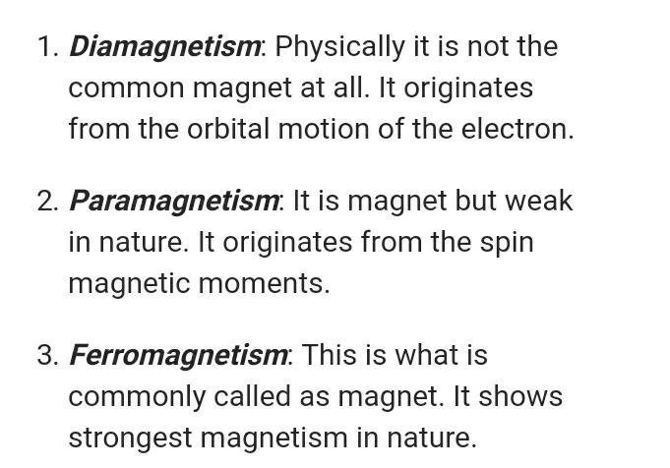

Slide 6
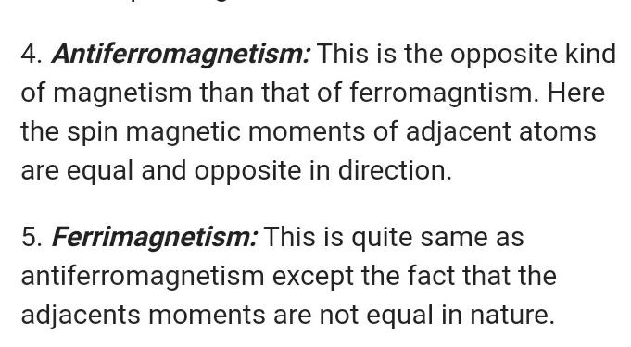

Slide 7
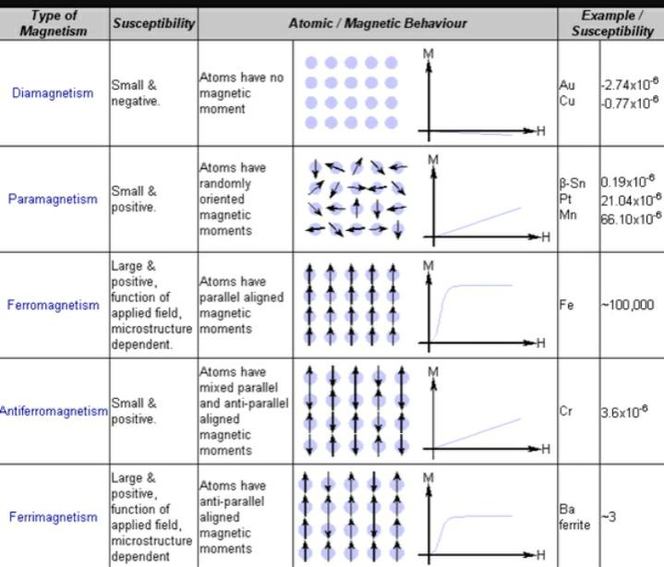

Slide 8
Paramagnetism:
The paramagnetic substances posses a permanent magnetic moment due to the presence of unpaired electrons.
The orientation depends on temperature.
paramagnetism is associated with the orbital angular momentum and spin. The angular momentum can have the quantised values of [l(l+1)]^{1/2}(h/2π).
The orbital magnetic moment of the electron is given by
μ_{z}= m_{l}(eh/4πm)
m_{l}- orbital angular momentum
e-charge
m-mass
The magnetic moment if single electron is given by the Bohr magnetron.
β = eh/4πm_{e}

Slide 9
The spinning electrons have the magnetic moment.
The spin angular momentum is quantised in units of[S(S+1)]^{1/2}(h/2π)
where s=1/2.
In polyatomic system the orbital motions are rigidly oriented.
so the applied field has no effect and the orbital magnetic moment is inoperative.
The magnetic moment is only is only due to the spin angular momentum.
μ = 2[s(s+1)]^{1/2} Bohr magnetrons
Where s-the spin quantum number 1/2,1,3/2,2,……..
The magnetic moment for n unpaired spins is given as.
μ =[n(n+2]^{1/2} Bohr magnetrons

Slide 10
DIAMAGNETISM:
Diamagnetism arises due to the motion of charged electrons in the applied magnetic field.
when the magnetic field is applied the induced magnetic field is changed due to the change of velocity of electrons.
This fieldis opposed to the direction of the applied field leading to negative diamagnetic susceptibility.
It is independent of temperature and is the same for a substance in the gas or liquid phase.
The diamagnetic susceptibility is given by X_{m} = (-Ne²/6mc²) ∑r_{i}²
Where r_{i}²is the mean squre of orbital radius.
N- Avagatro number,e-electron ,m-mass,c-velocity
It is the order of 10⁻⁶per gram.

Slide 11
Magnetic properties of free ions:
The magnetic property of a substance arises due to the presence of permanent magnetic dipoles.
on the application of external magnetic field the dipoles tend to align themselves along the field direction against the temperature.
As a result the total angular momentum levels split symmetrically into lower and upper levels.
This splitting is known as the first order zeeman effect.
The grond and excited states may again be split when some characters are introduced.
The orbitals are distorted before splitting.
It is called second order zeeman effect.

Slide 12
First order zeeman effect:
when a magnetic field is applied to a paramagnetic substance the magnetic dipolestend to align themselves along the field direction.
Temperature has no effect on this kind of alignment.
As a result the M_{J} values are symmetrically split into lower and uppee levels.
This kind of energy level splitting is known as first order zeeman effect.
The energy levels are given by the equation.
W_{i}=W_{i}°+ W_{i}^{I}H+W_{i}^{II}H²
Where W_{i}° - energy of the unperturbed state.
W_{i}^{I} and W_{i}^{II} –first and second order zeeman Coefficients
H- applied magnetic field

Slide 13
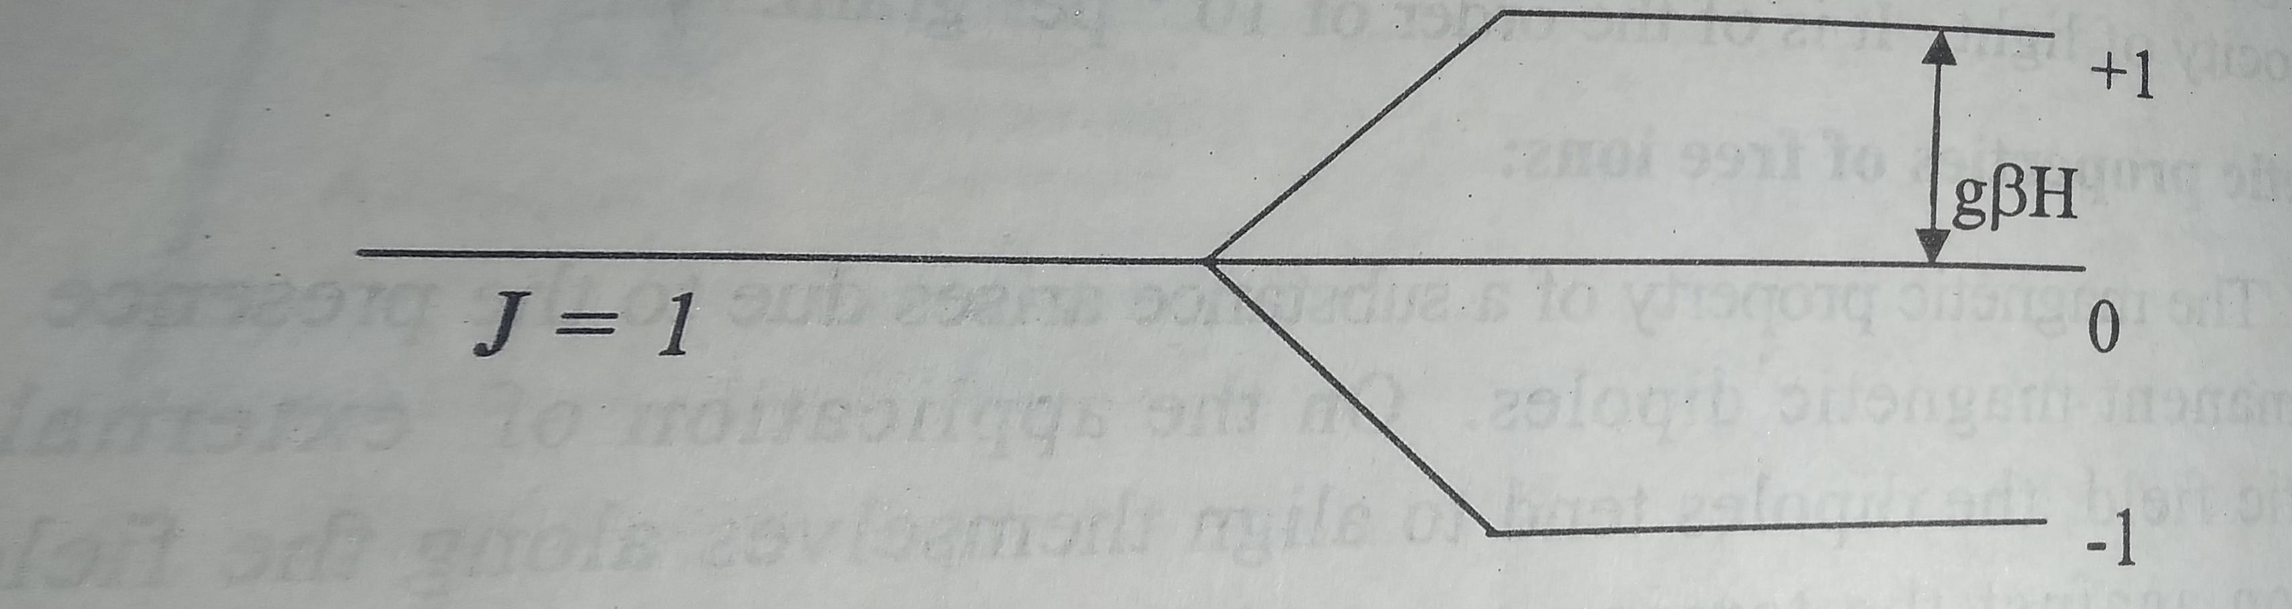
The first order zerman effect for a state with J gives levels at energies.
W_{MJ}=M_{J}g βH
g- lande splitting factor
β – Bohr magnetron
M_{J}- symmetry split into various energy levels
g βH – energy separation between adjeacent levels

Slide 14
The effective magnetic moment μ_{eff} is given by
μ_{eff} = g[J(J+1)]^{1/2}
The g value is given by the equation.
g=1+J(J+1) +S(S+1)-L(L+1)/2J(J+1)
where S and L are the spin and orbital angular momentum quantum numbers.
L=0,J=S,and g=2.00
The effective magnetic moment equation is reduced to
μ_{eff} = 2[ S(S+1)]^{1/2} or μ_{eff} = [n(n+2)]^{1/2}
This rquations give the spin only values for the magnetic moment
The energy states are thermally affected when the spin-orbit coupling constant is of the order of kT.
The first order zeeman effect the magnetic susceptibility will be proportional to the Boltzmann population.

Slide 15
Second order zeeman effect:
The second order zeeman effect is independent of temperature.
It is inversely proportional to the separation of the interacting levels.
When the energy level separation is large the magnetic susceptibility will be very small.
The second order Zeeman effect is very important in acomlex with no spin magnetic moment
Let the energy of the state J=0 is the lowest and that with J=1lies above it with an energy much higher than kT.
For such systems the magnetic susceptibility arises from the secind order zeeman effect alone.
The second order zeeman coefficient F_{J,J+1}is given by van vleck as.
J
F_{J,J+1}= ∑ W^{II}_{MJ} = -(J+L+S+2)(-J+L+S)(J-L+S+1)(J+L-S+1) β²/12(J+1)²λ
M_{J}=-J

Slide 16
Second order zeeman effect us observed for the lanthanide elements Sm³⁺and Eu³⁺.
All the otjet lanthanide ions the ground state is widely separated from the excited state and therefore the second order magnetic susceptibility is neglected.
The magnetic moment of Eu³⁺ is 3.6BM at room temoerature.
according to the equation. μ_{eff} = 2[J(J+1)]^{1/2}the value must be zero.(J=0)
The magnetic moment ofEu³⁺is not independent of temperature.
At low temperature it is proportional to√T.

Slide 17
Zeeman effect for states ~kT:
When the ground and upper energy states are searated by an energy of the order of kT, the total magnetic susceptibility is fue to the girst order zeeman effect.
The second order zeeman effect also contributes to the susceptibility between the adjacent states.
Therefore the magnetic moment is a complicated function of temperature.
Eu³⁺ (f⁶) has this effect at higher temperature when the thermal population of the state J=1 is high.
Sm³⁺(f⁵) also has this effect.
The first order zeeman contribution is from the ground state ⁶H_{5/2}and the second order zeeman contribution is from the upper state ⁶H_{7/2}which lies some hundred cm⁻¹higher.
There is thermal population of the ⁶H_{7/2}state and this contributes for first and second order zeeman effects.
At room temperature the magnetic moment for sm³⁺is 1.54BM and this varies with temperature.
The energy (W₃)of the upper state (J=7/2)relative to the ground state (J=5/2) is given as.
W_{J}= ½[J(J+1)-|L-S|(|L-S|+1) λ

Slide 18
Zeeman effect for states <<kT
Systems with energy level separation much less than kT is rare since there are no systems with very small spin-orbit coupling.
but theoretically the magnetic moment can be deduced as
μ_{eff} = [4S(S+1)+L(L+1)]^{1/2}
if L=0, μ_{eff} = [4S(S+1)]^{1/2}
The magnetic moment from will be for the spin only value.
when L#0,the equation is used yo estimate the orbital contribution to the moment.
The deviation in magnetic moment from the spin-only value occurs when the states are separated by ~kT.

Slide 19
Quenching of orbital angular momentum by ligand fields:
The orbital angular momentum of a free metal ion is lost when it comlexes with comlexes.
The orbital angular momentum is associated with the ability to rotate an orbital about an axis.
This produces degenerate orbitals.
The d_{xy}(t_{2g}) and d_{(x2-y2)}(e_{g}) orbitals are not degenarate and orbital angular momentum arises between them.
For the existence of orbital angular momentum due to rotation the second orbital should not have an electron with yhe same spinas that of the first orbital
For the t_{2g}³and t_{2g}⁶ contributions the orbital angular momentum is quenched.
d orbitals in these cases cannot be transformed since there is no vacant orbital and all are equivalent and degenerate with the same spin.

Slide 20
Quenching of orbital angular momentum for A,Eand T terms:
A is the singlet,E is the doubly degenerate,and T is triply degenerate energy levels.
The orbital angular momentum is zero for the A and E terms.
Hence the A and E terms carry no magnetic momentum.
T term possesses some orbital angular momentum.
But several complexes with A and E ground state terms exhibit magnetic moments higher than the spin-only value.
let the Tterm is above the ground state
T term through spin-orbit coupling. Thus the A and E terms will possess some T character.
The quenching and non-quenching of orbital angular momentum in a cubic ligand field for ground terms are summarized.

Slide 21
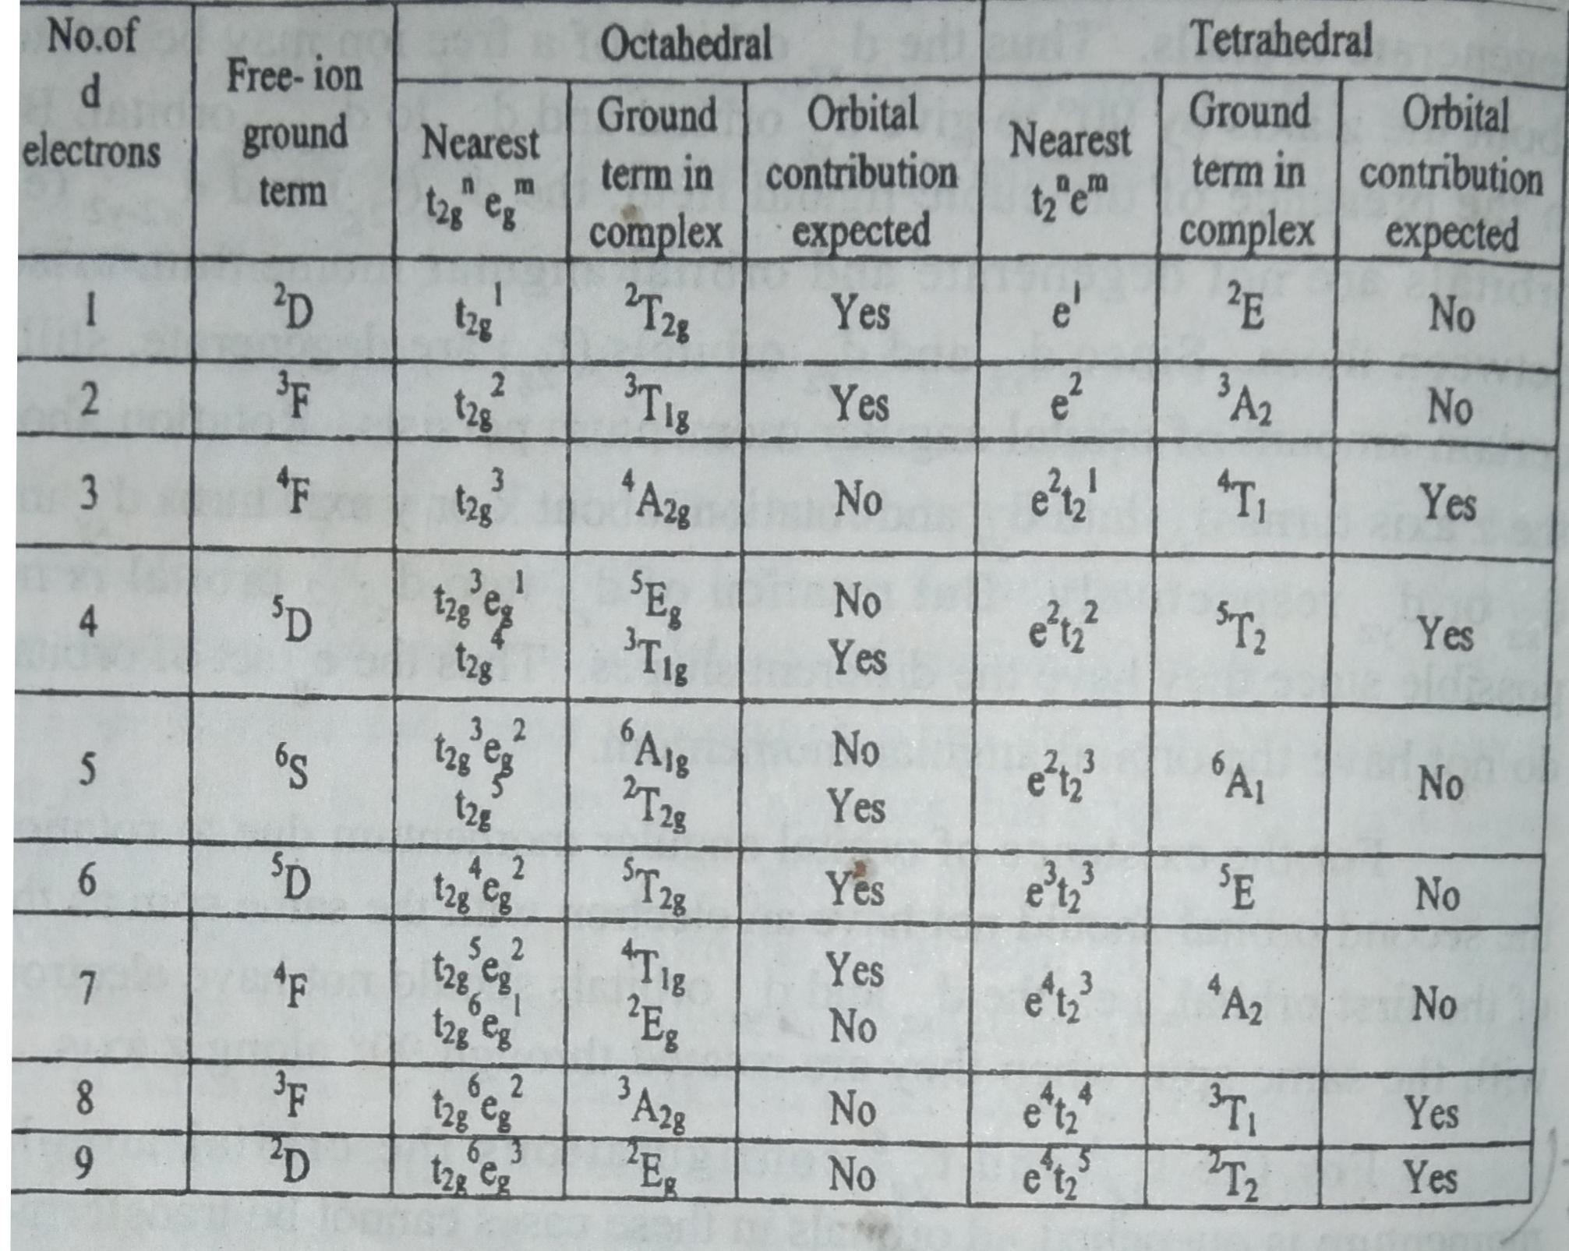

Slide 22
Magnetic properties of A and E terms:
The magnetic moments of comlexes with A_{g}and E_{g}ground terms differ apreciably from the spin-only value.
An F term is split by a ligand field into the lowest A_{2g} and upper T_{2g} terms.
The splitting factor g has a value of.
g=2.00(1-4λ/10Dq)
For a ²A_{2g} term the magnetic moment is due to the first order zeeman effect.
μ_{eff} = (1-4λ/10Dq) μ_{eff} ^{spin-only}
x_{A}= (1-8λ/10Dq) μ_{A}^{spin-only}
For the A_{1g}term there is no mixing orbitals since there is no excited term of the same multiplicity. Therefore μ_{eff} = μ_{eff} ^{spin-only}

Slide 23
For the E_{g}terms g=2.00(1-2λ /10Dq)
μ_{eff} = (1-2λ/10Dq) μ_{eff} ^{spin-only} and x_{A}= (1-4λ/10Dq) x_{A} ^{spin-only}
The second order zeeman effect coefficient for the A_{2g} term is given as.
+s
∑ W^{II}_{A2g}= 4(2S+1) β /10Dq
-S
The magnetic susceptibility is given as.
X_{A}^{TIP}=8N β²/10Dq
For the ⁶ A_{1g} term of d⁵,d⁰,d¹⁰ X_{A}^{TIP} = 0

Slide 24
For the ¹A_{1g} term of d⁶ (t_{2g}⁶) and for A_{2g} terms X_{A}^{TIP}=8N β²/10Dq
For the E_{g}term. X_{A}^{TIP}=4N β²/10Dq
Nβ² = 0.261 cm⁻¹
The magnetic behaviour of xomlexes Possessing A_{g}and E_{g} ground terms are
x_{m}= C/T + Nα
Magnetic properties of T terms :
The magnetic moments for complexes with T ground terms are obtained by summing the first and second order zeeman effects.
The ground state splitting by the spin-orbit coupling.
The number of electrons on Pand d orbitals are same.
Thus, ²T_{2g}(d¹,t¹_{2g}) = ²P ( p⁵) (p⁶⁻¹)
²T_{2g}(d⁵,t⁵_{2g}) = ²P ( p¹)
³T_{1g}(d²,t²_{2g}) = ³P ( p⁴)

Slide 25
The g value when there is splitting of T terms is given as.
g= 1-1/2A +(2+A)[S(S+1)-2]/2J(J+1)
The second order zeeman effect when L=1 is given as.
F_{J,J+1}=[(2+A)²/A]F_{J,J+1}^{free ion p term}
Magnetic moment due to t_{2g}electron delocalization:
Delocalization of electrons of the t_{2g} orbitals of the ion onto the ligand atoms take place when ever the metal and ligand orbitals mix together symmetrically to form the molecular orbitals of the complex.
This reduces the orbital angular momentum of a metal ion by a factor k below those calculated.
The orbital momentum is taken as 2(1-k).

Slide 26
t_{2g} electron delocalization of A and E terms:
A and E terms have the effects of t_{2g} electron delocalization.
The spin –orbit coupling value λ is reduced below the free ion value by a factor k.
For A_{2g} terms
x_{A}= x_{A} ^{spin-only}(1-8k²λ₀/10Dq) and g=2(1-4k²λ₀/10Dq)
μ_{eff} = μ_{eff} ^{spin-only} (1-4k²λ₀/10Dq)
For E_{g} terms
x_{A}= x_{A} ^{spin-only}(1-4k²λ₀/10Dq) and g=2(1-2k²λ₀/10Dq)
μ_{eff} = μ_{eff} ^{spin-only} (1-2k²λ₀/10Dq)
There is also the second order zeeman effect..
For ¹A_{1g.} X_{A} =8k²N β²/10Dq
For E_{g} X_{A} =4k²N β²/10Dq

Slide 27
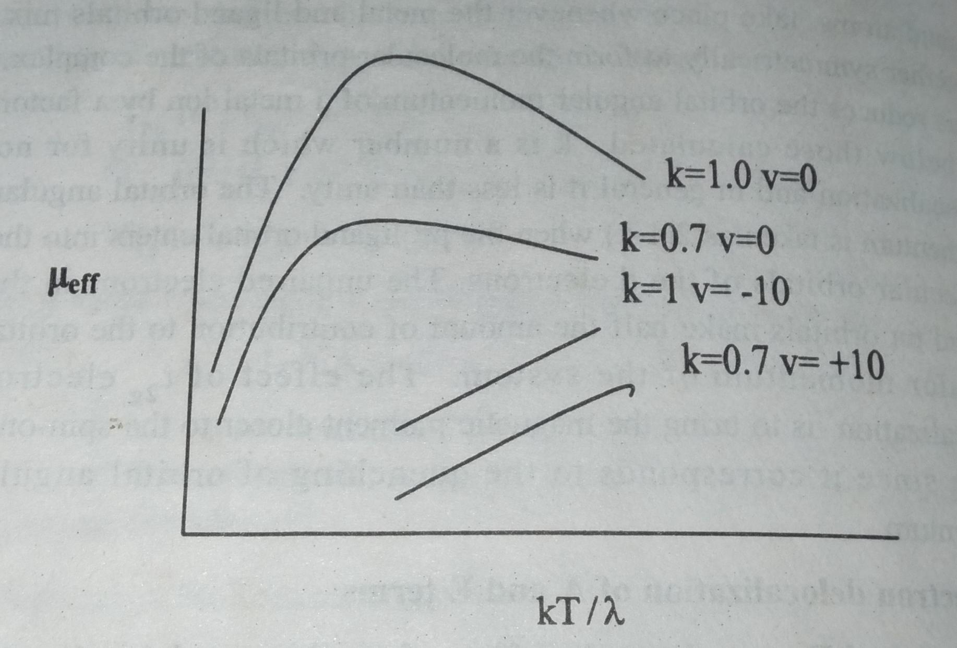
The total susceptibilites for the A_{g} terms are.
X_{A} =X _{A}^{spin –only}(1-8k²λ₀/10Dq) +8k²N β²/10Dq
For E_{g} terms.
X_{A} =X _{A}^{spin –only}(1-4k²λ₀/10Dq) +4k²N β²/10Dq
Effect of t_{2g}electron delocalization on magnetic moment of the ²T_{2g} term λ –ve, cubic symmetry v=0,highly distorted v=-10.

Slide 28
THANK YOU

