Slide 1
³¹ P and ¹⁹F sectroscopy
Name of the instructor: U.Nithya M.Sc.,M.Phil.,

Slide 11
Pt X₂(PR₃)₂:
For cis J_{pt-p. = 3.62Hz}
For trans J _{pt-p = 2.46 H}
when both cis and trans complexes are available the coupling constant can be used to distinguish the two.

Slide 12
HP₂O₅³⁻: Single peak
O. O
| |
[ H - P_{a.} - P_{b} – O ]³⁻
| |
O. O

Slide 13
P₃N₃Cl₄F₂: AB₂X₂spin system

Slide 14
P₄ N₄Cl₆(NHC₆H₅)₂ : cis compound has one peak Trans compound has two peaks.

Slide 15
Rh(PPh₃)₃ Cl₃: axial P – triplet, equatorial P- doublet two bond coupling, axial P-doublet. Equatorial P- triplet, since the doublet is twice that of triplet,the intensity is greater

Slide 21
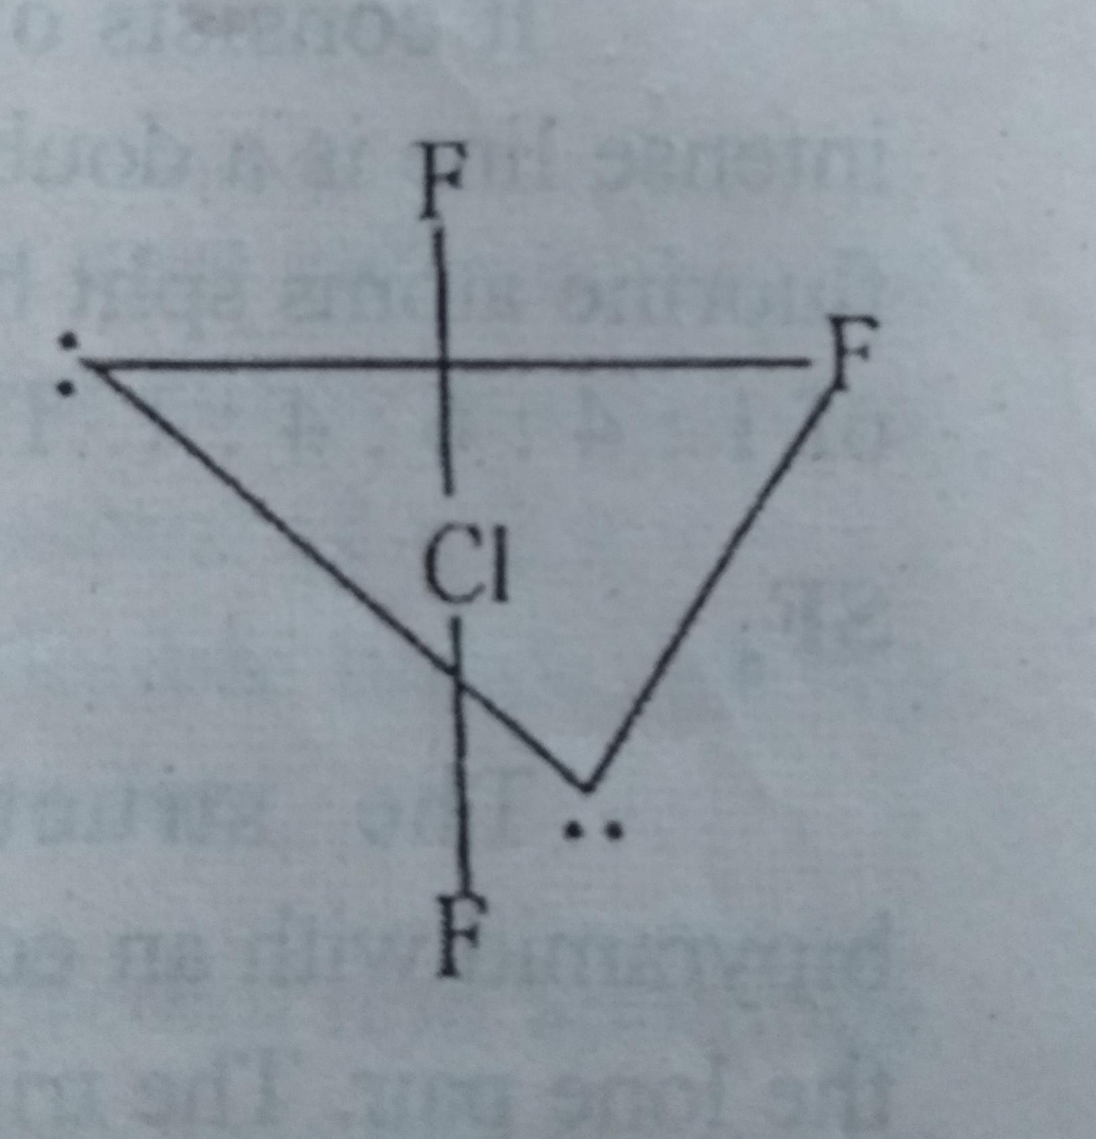
ClF₃:
Trigonal bipyramid structure
doublet for two fluorine atom and triplet for single fluorine atom.

Slide 22
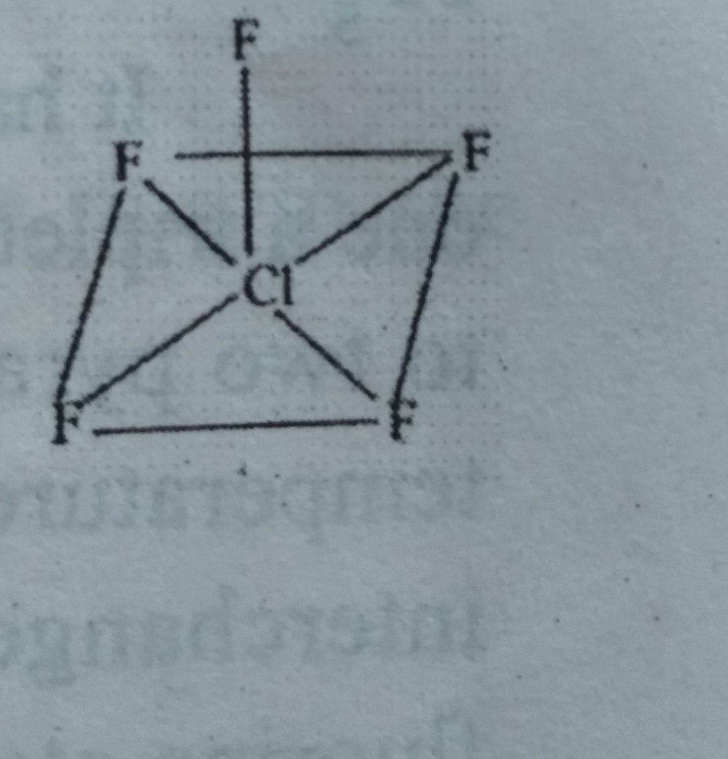
ClF₅:
square pyramidal structure.
axial fluorine atom – quintet
equatorial fluorine atom – doublet

Slide 23
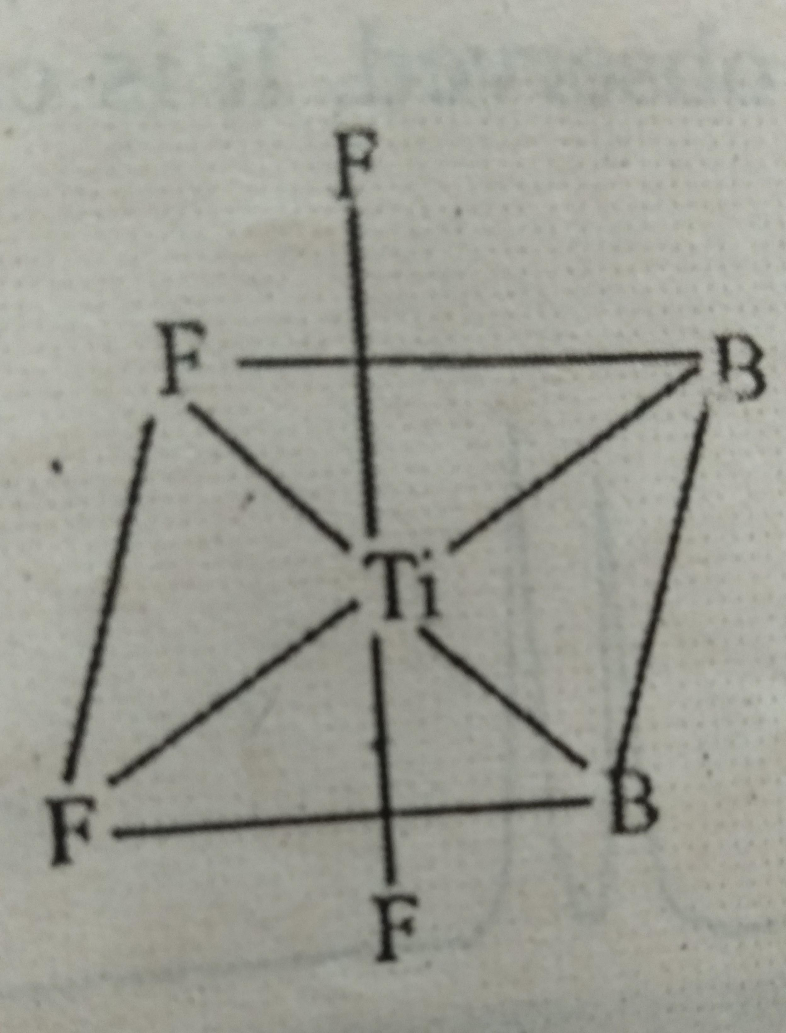
TiF₄:
-30°c. – two triplets
0°c – only a single peak

Slide 24
R₂PF₃:
Trigonal biyramidal structure.
J_{p-F.}for apical florines are 170Hz less than those for equatorial ones.
The most electronegative groups are found in the aical positions.

Slide 26
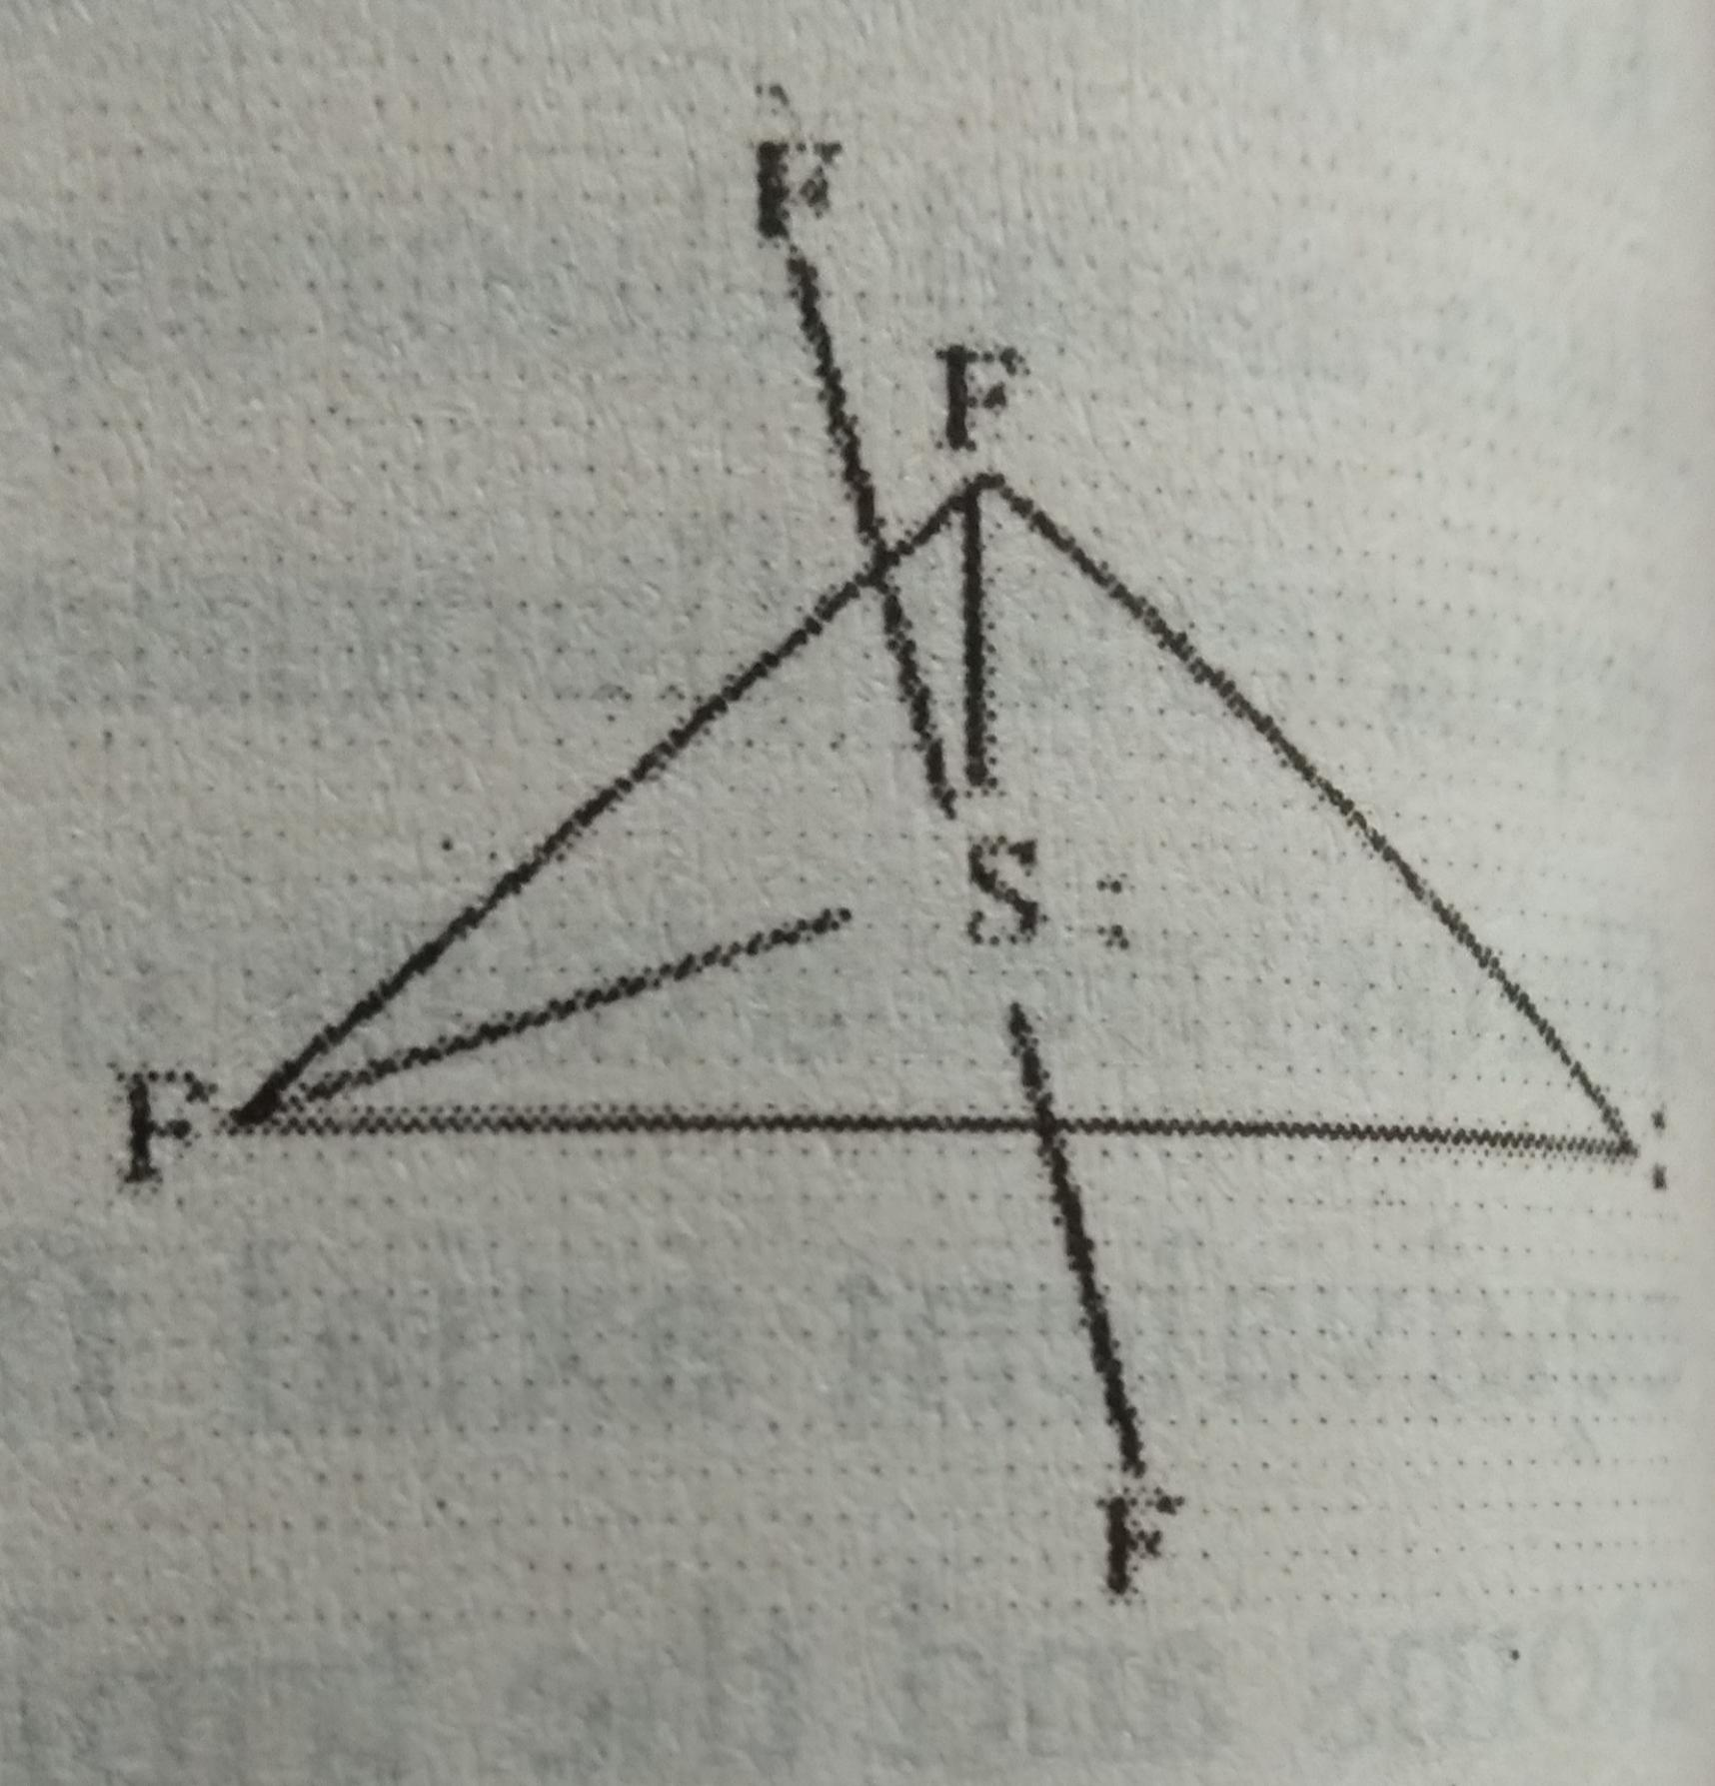
SF₄ :
Trigonal bipyramid structure
The triplets of equal intensity are observed.

Slide 27
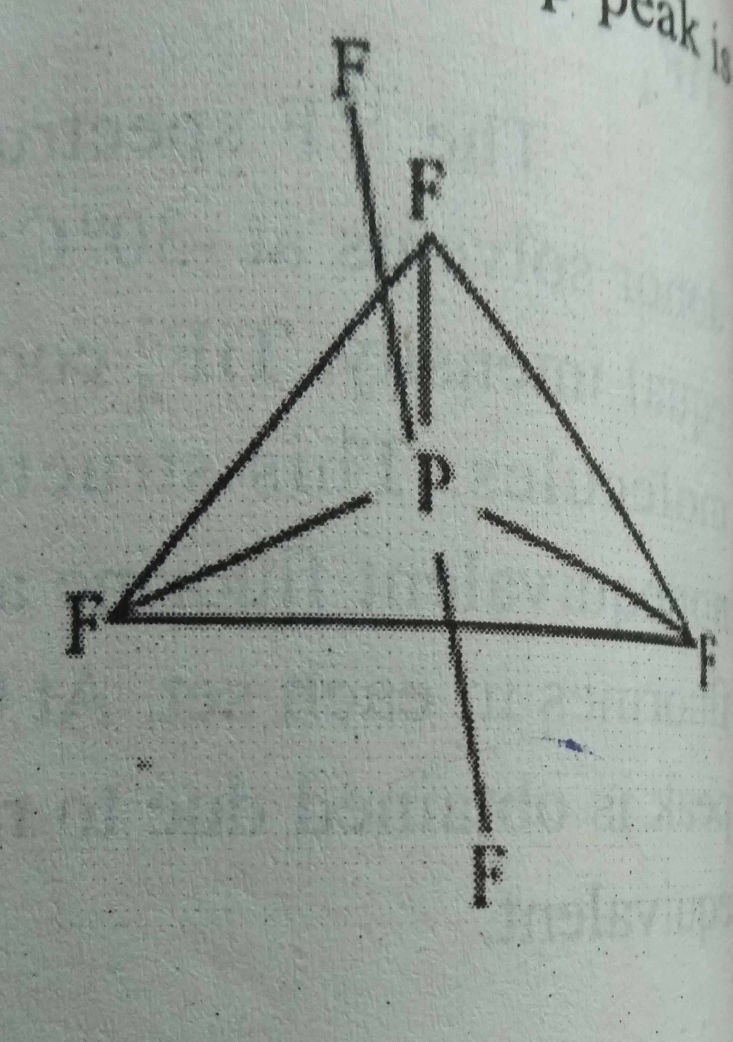
PF₅:
Trigonal bipyramidal structure.
Two peaks are exected. One a triplet and another one a doublet.
but only one sharp peak observed. Due to the fluxional behaviour all the fluorine atoms. It is called pseudorotation process.

Slide 28
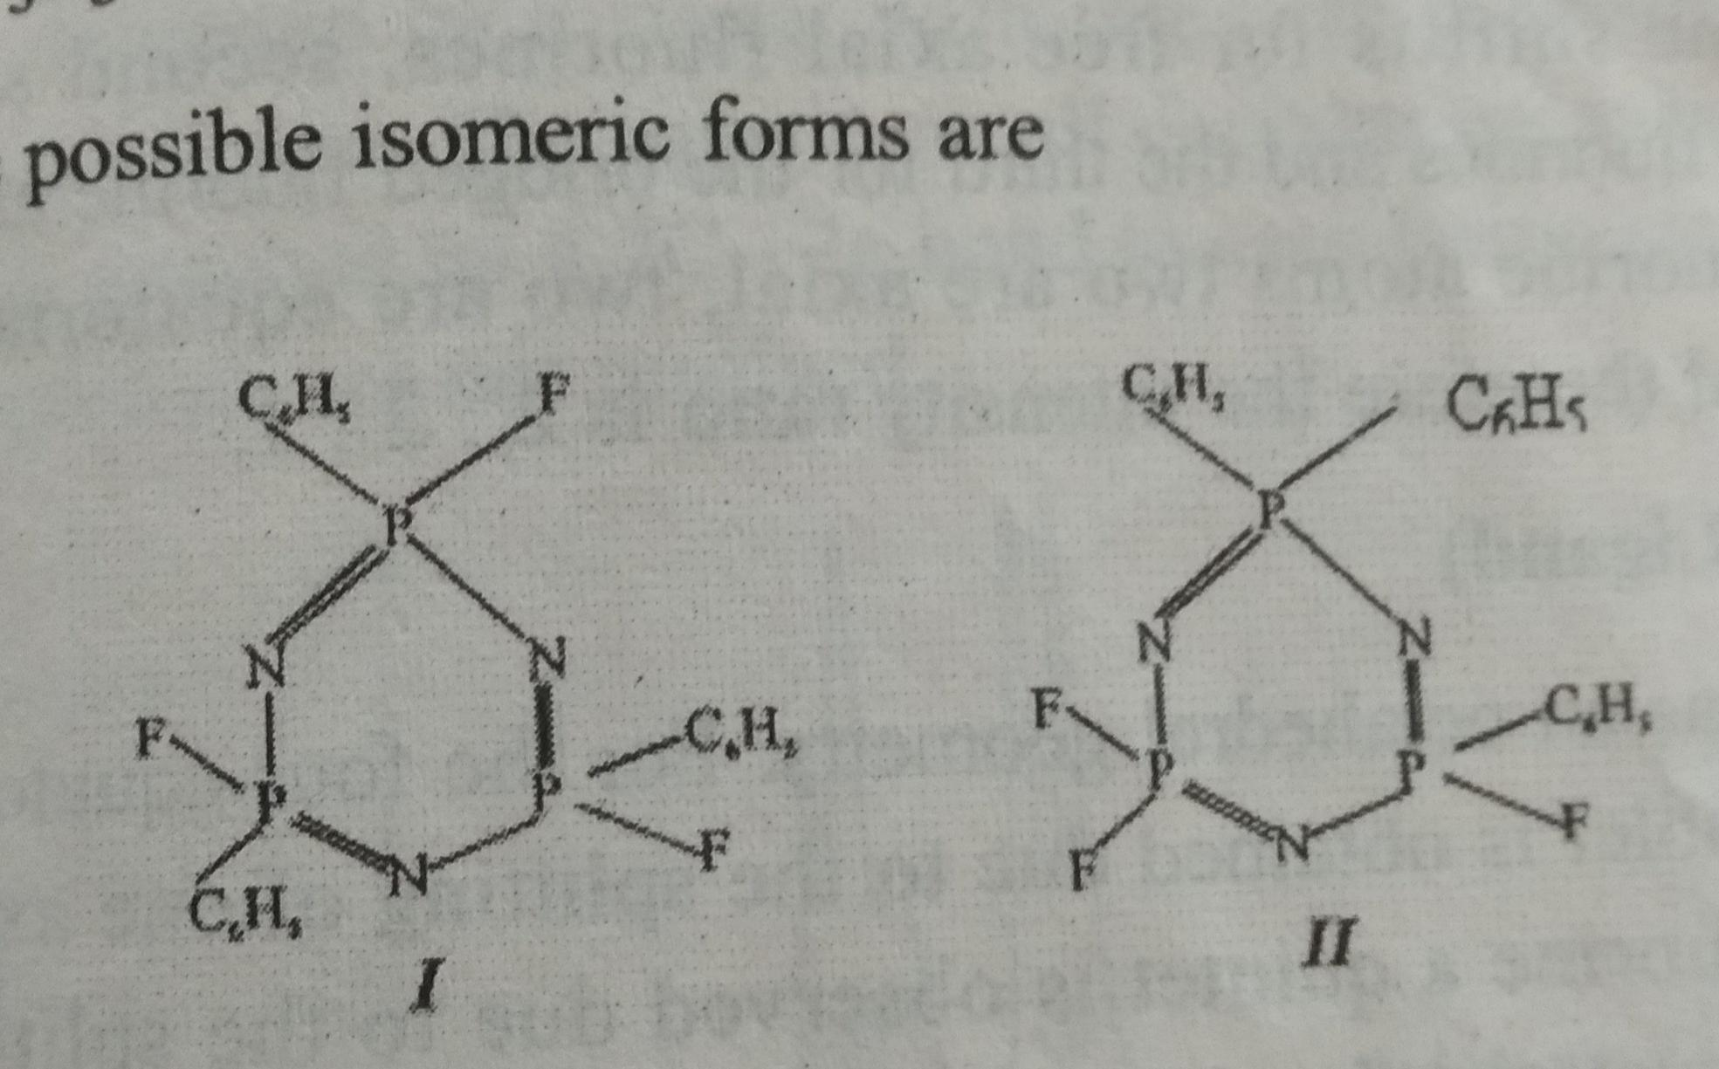
P₃N₃(C₆H₅)₃F₃
Structure I :
¹⁹F - doublet,³¹P- doublet,quintet
Structure II :
¹⁹F – no splitting, phosphorous – doublet,triplet

Slide 29
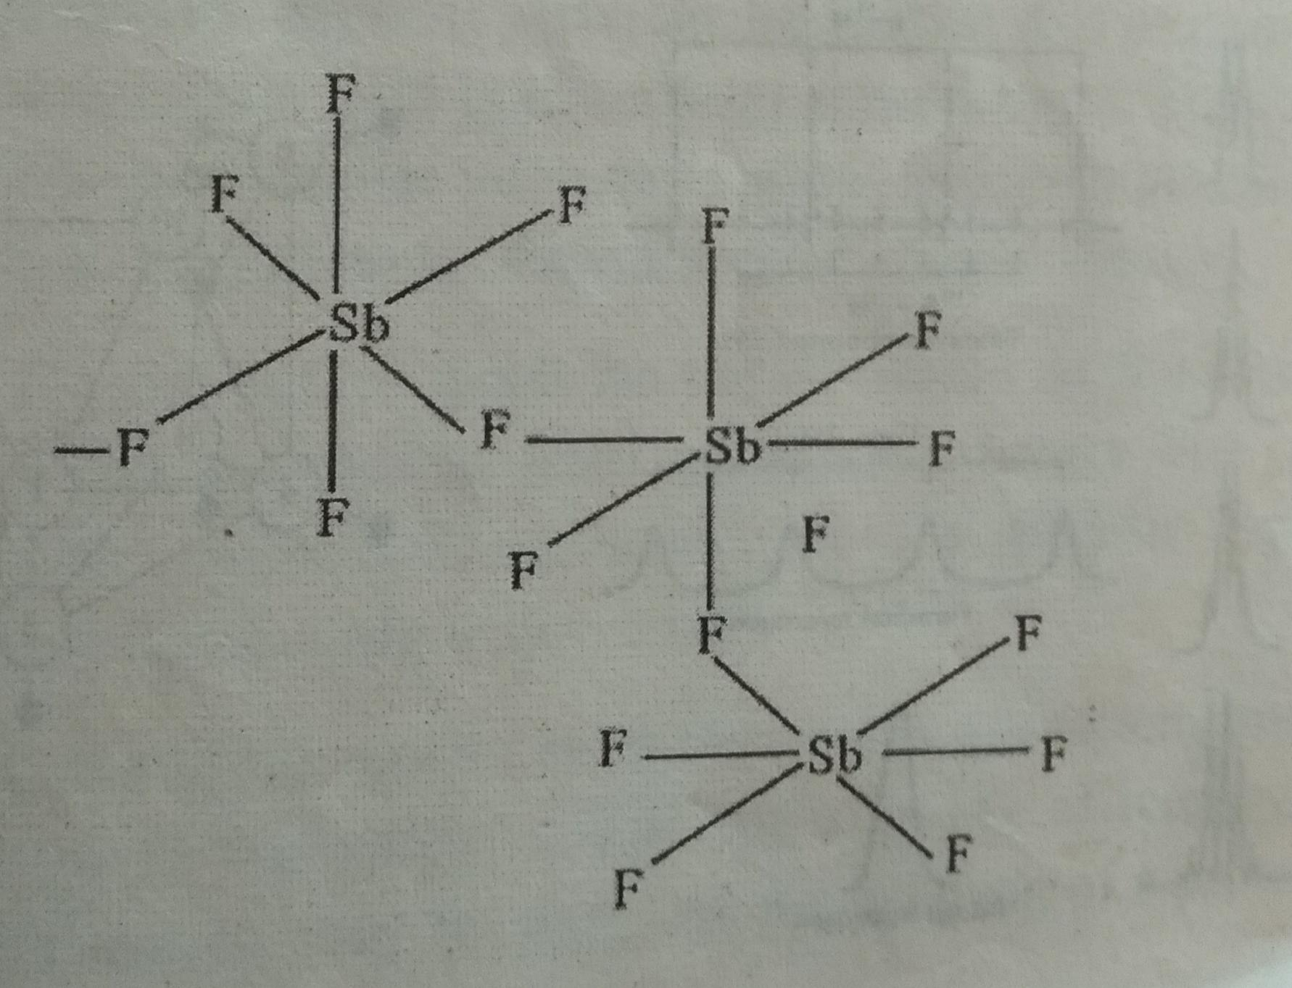
SbF₅:
One shift is for free axial fluorines
second shift for free equational flourines
third for the bridged flourine

Slide 30
WF₅L (L- ligand)
Octahetral geomentry
Equatorial fluorine –doublet
axial fluorine – quintet
¹⁸³W – single line
if L goes to the equatorial position, then the quintet is not expected.
triplet and quadrulet will be observed.

Slide 31
NMR of Boron compounds
It is used to get the structural information of boranes.
¹¹B is studied to recognize the structure
B₁₀H₁₄ are three types of boron atoms.
signals are all doublets
because the proton attached by a 2C -2e bond
Bridged protons are not resolved.

Slide 34
THANK YOU

