Slide 1
NMR OF PARAMAGNETIC MOLECULES
Name of the instructor: U.Nithya M.sc., M.Phil.,

Slide 2
Effect off quadrupolar nuclei on ¹H NMR spectra:
Quadrupolar nuclei are those with spin greater than ½.
A spin of ½ causes a splitting into (n+1) lines.
Quadruolar nuclei are very efficiently relaxed by the flutuating electric fields.
The relaxation mechanism depends Upon the interaction of the quadrupolar nucleus with the electric field gradient (efg) at the nucleus.
The efg is used to describe the deviation of the electronic charge cloud about yhe nucleus from spheriical symmetry.
The gradient is zero for regular tetrahetral,octahetral,cubic or spherical symmetry.
For other geometries the efg is not zero.

Slide 3
The quatrupolar nuclei have short relaxation times.
The time depends upon the magnitude of the efg.
The splitting of proton from the quadrupolar nucleus may not observed.
Rapid quadruole relaxation places the proton on a nucleus whose spin state is rapidly changing..
As a result broading of the lines is observed.
The proton nmr spectrum of ¹⁴NH₃ ( ¹⁴N (I =1) consists of three broad Signals (2x1x1+1).

Slide 4
In the absence of the shift the spectrum of ¹⁵NH₃ ( ¹⁵N I = ½) consists of a sharp doublet ( 2x1x1/2 +1).
¹⁴NH₄⁺ has a spherical distribution of eletron density and hence the efg is zero.
In a molecule with a very large field gradient a broad signal with no fine structure.
The most of the halogens no spectrum is obtained due to rapid relaxation.
Very sharp signals obtained for the halide ions and. Symmetrical comounds.
where the spherical charge distribution gives rise to very small efg and larger relaxatiin time.
coupling to more than one quadrupolar nucleus is rarely observed. Expection is dueterium with I = 1

Slide 5
NMR SPECTRUM OF PARAMAGNETIC MOLECULES:
The NMR spectrum of many paramagnetic compounds can not be obtained because the unpairedelectrons broden the spectrum by both dipolar and electron spin –nuclear spin coupling mechanisms.
The normal chemical shift scale to more than 200 ppm for protons.
The signals from diamagnetic materials may also show these effects in the presence of paramagnetic species even in low concentration.
Eg. ³¹P Spectrum of Ru₂Cl₄( CO) (PPh₃) ₄

Slide 6
It shows two (AB) pattern signals arising from the four chemically non-equivalent triphenyl phophine ligands in the diamagnetic ruthenium complex.
It undergoes a one –eletron oxidation to give a cation in which the unpaired electron is localized on one ruthenium atom.
This shifts the ³¹ P spectrum to nearly 80ppm and it is also very broad. The coupling pattern cannot be understood from broad peak.
The spectrum of the other (AB) pattern is unchanged.
The magnetic moment of an electron is 1000 times larger than nuclear magnetic moment.
The life time of the electron spin state necessary to permit observation of nmr spectrum ranges from 10⁻⁹ to 10 ⁻¹³ s .

Slide 7
The rapid nuclear relaxation causes a broad nmr line but the rapid electron relaxation decreases the efficiency of the nuclear relaxation mechanism lengthening life time for proton nucleus and causing the line to sharpen.
For Mn (II) complex a single very broad line is obtained because the electrons relax slowly.
complex with triply degenerate (T) ground states have short electron Spin life times leading to sharp nmr spectra.
Eg: octahedral complex Of d¹,d²,low spin d⁴,low spin d⁵,high spin d⁶,highspin d⁷. Systems with broad nmr lines include octahedral d³,high spin d⁵and d⁹ configuration.

Slide 8
The paramagnetic shifts can be used to derive important information and are made up of two components.
first there is a through space dipolar interaction between the magnetic moments of the electron and the resonating nucleus. It gives a dipolar shift or pseudo contact shift
second the contact shift arises due to Coupling between electron and nucleus which would give a doublet under conditions of slow electron spin-lattice relaxation.
contact sjifts give a measure of unpaired spin density at the resonating nucleus. Therefore they are useful in studying the spin distribution in organic radicals or in ligands in organometallic compounds.

Slide 9
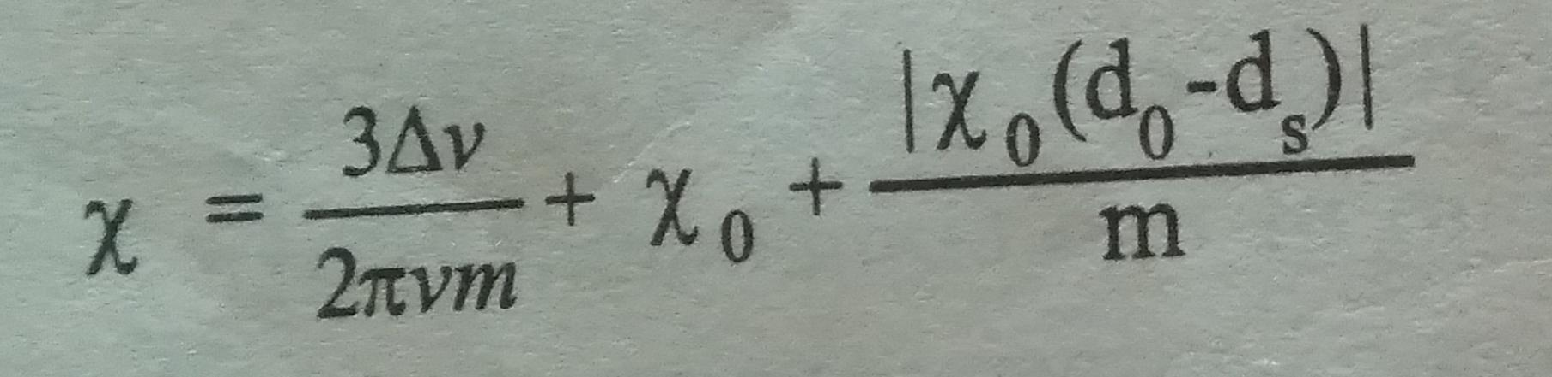
Paramagnetic Compounds are used to induce decoupling by rapid relaxation mechanism. They are also used to eliminate the nuclear overhauser effect.
shift in resonance frequency caused by paramagnetic substances can be used to measure the magnetic susceptibilities.
The mass susceptibility Of the dissoved substance is given by

Slide 10
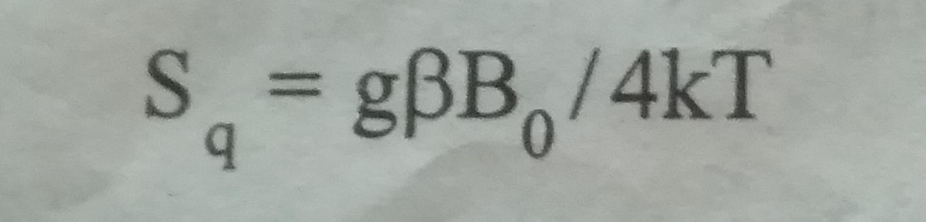
ISOTROPIC SHIFT:-
A large. Chemical shift is observed for paramagnetic complex compared to the diamagnetic complex of the same ligand.
The shift difference between the paramagnetic complex and an analogous diamalgnetic complex is referred to as the isotropic shift.
Each spin may have a chemical shift value but a weighted average of the mole fraction of these two shifts would be observed when the spins are rapidly relaxing It is called average electron spin polarization S_{q .}
Isotropic shift has two components 1) contact shift or scalar shift
ii) Pseudo conduct shift or dipolar shift

Slide 11
Isotropic shift is used in the structure determination of complexes with the help of enhanced signal separation for paramagnetic complexes.
Eg. Five coordinate schiff’s base of Ni (II)
It is also used to study the presence of ion pairs in solution nature of second co ordination sphere in complexes and yo study the equilibrium constant and the rate of chemical reactions.
CONTACT SHIFT:
contact shift occur in NMR spectrum for the paramagnetic molecules
It arises due to the intraction of delocalized unpaired electron spin density onto the nmr nucleus
It is otherwise called as scalar shift.

Slide 12
It is expressed in terms of the eletron spin nuclear spin coupling constant A.
A value gives a very high isotropic shift.
The major effect on the spectrum due to presence of unpaired electrons is to change the magnetic field experienced by the Magnetic nucleus
This causes a very large chemical shift of the resonance. This shift is reffered to as contact shift.
The relation between contact shift change and the electron spin – nuclear spin coupling constant A is given as

Slide 13
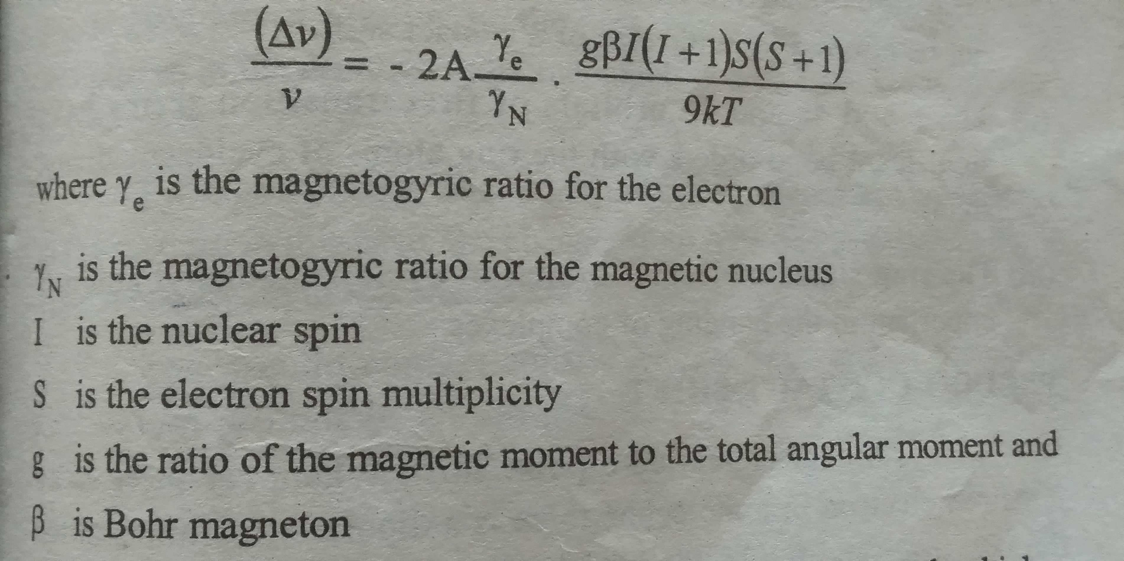

Slide 14
Thus the nmr experiments are used to detect the unpaired spin density at the nucleus.
eg. Contact shift values of metallocenes
PSEUDO – CONTACT SHIFT:
It is otherwise called dipolar shift.
Dipolar effect is averaged to zero by a rapid rotation of the molecule.
g has different values for different orientations this through space contribution need not be averaged to zero by rapid rotation of the molecule.

Slide 15
Perfect cubic symmetry no pseudo –contact contribution
The psedo conduct contribution can be calculated for systems which have same known geometry in both solid state and in solution.
The psedo contact term may also be calculated if the gtensor is known for the system under study.
Pyridine –N-oxide ligand has only pseudo conduct contribution.
Isotropic shifts occurs when there is influence of solvent on ion pair.
Non –anisotropic tetrahedral metal containing anions can produce a pseudo – contact contribution in a non-metallic cation.

Slide 16
LANTHANIDE SHIFT REAGENTS:
The proton shifts lie in the range of 10 ppm
It is very narrow compared to the chemical shift value of other elements for which thr normal ranges are hundreds of ppm.
Therefore in proton spectrum Overlapping of lines may takes place.
The spectral complexity arises due to small relative chemical shifts. This may be removed by adding a amount of a paramagnetic shift reagent. This will induce large differential shifts for the various types of protons present and spread out the spectrum

Slide 17
β
The rare-earth tris –chelates of -- -6P diketonate derivatives are lewis acids and cause large pseudo-conduct shifts inleeis bases that are added to solutions containing these complexes.
The rare earth complexes that exhibit this behaviour are called shift reagents.
The lanthanide complex should be soluble in common nmr solvents.
In general europium complexes produce downfirld shifts while Praseodymium complexes produce upfield shifts.
Ytterbium,erbium and holmium compounds tend to give greater shifts but broadening.
The spining paramagnetic ion also generates magnetic vectors which operate through space and create secondary fields around the protons. This is pseocontact Shift.This ptedominates in the case of lanthanide ions.

Slide 18
Shift reagents are also used to determine the geomentries of molecules in solution.
They are used to differentiate between internal and external phospholipids layers in membranes.
They have also been employed in conformational studies of nucleotides in solution and in other biochemical systems.
optically active shift reagents may be used to determine the optical purity.

Slide 19
THANK YOU

