Slide 1
APPLICATION OF ESR SPECTROSCOPY
Name of the instructor:U.Nithya M.Sc.,M.Phil.,

Slide 3
d⁵ Low spin s=1/2:
For an octahetral symmetry the ground state is ²T_{2g}for the low spin d⁵systems.
It is like a d¹system with a positive hole.
Spin-orbit coupling splits the ²T_{2g}into three closely spaced kramer’s doublet.
Due to large amount of spin-orbit coupling the esr spectrum is recorded at liquidhelium temperature.
Jahn – Teller distortion affects the g-value.

Slide 5
Eg: [Fe(CN)₆]³⁻Iron in +3 oxidation state: g_{II} = 0.915,g_|_=2.2.
low spin ferric haemoglobin (Fe³⁺)has large deviations from octahetral symmetry.
These deviations cause an orbitally non-degenerate excited states.
This increases the electron relaxation time and hence the esr spectra can be observed at higher temperatures.
d⁵High spin S= 5/2:
The high spin complexes have ⁶s ground state.
eg: Mn(II) complexes
The octehedral Mn(II) has a ⁶A_{1g}ground state.
It is split by zero-field effects.
spin- orbit coupling mixing gives rise to a small zero –field splitting.
The excited ⁴T₂ state can mix with ⁶S only by second order spin –orbit effects.

Slide 8
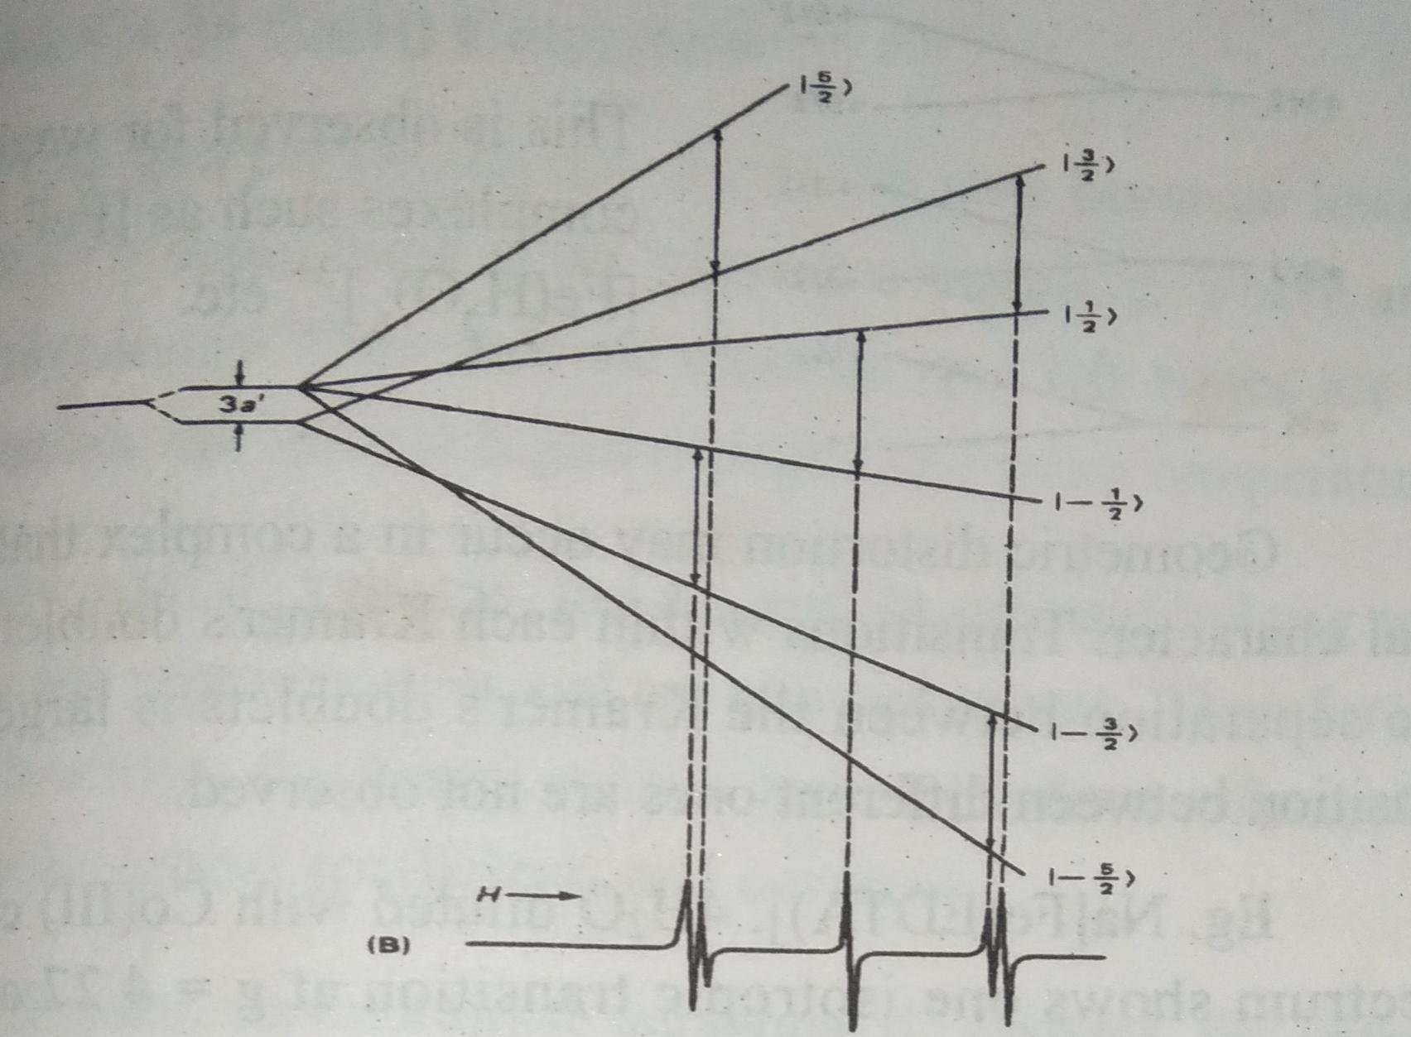
For an undistorted octahetral iron (III) complex the zero field splitting is very small and therefore there are only three transititions.
The two transitions are obtained as doublets and another one as singlet.

Slide 9
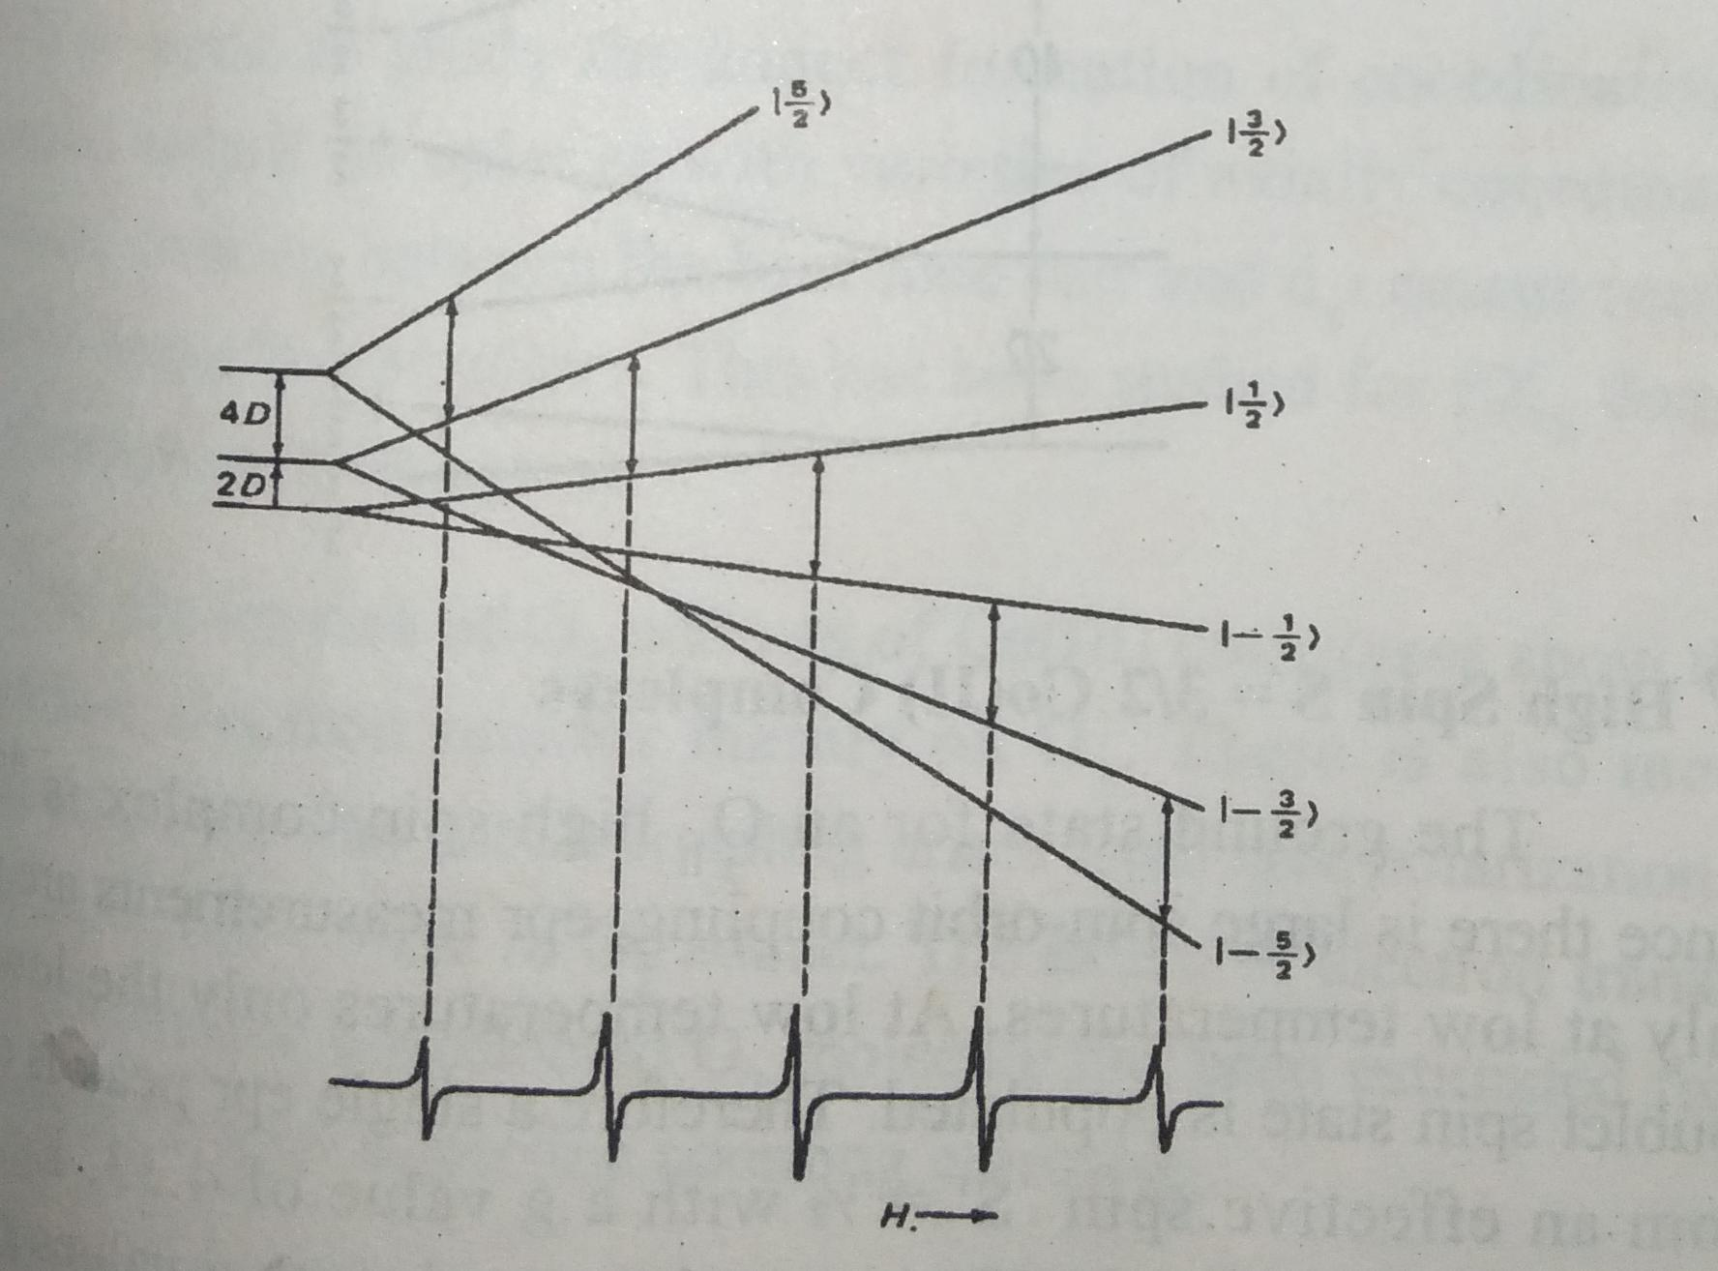
In iron(III) complexes with small tetragonal distortions the zero-field splitting is very small.
The observed g-values are very close to 2.00 because of the extremely small amount of spin-orbit coupling.
Therefore the esr spectrum is observed at room temperature.

Slide 10
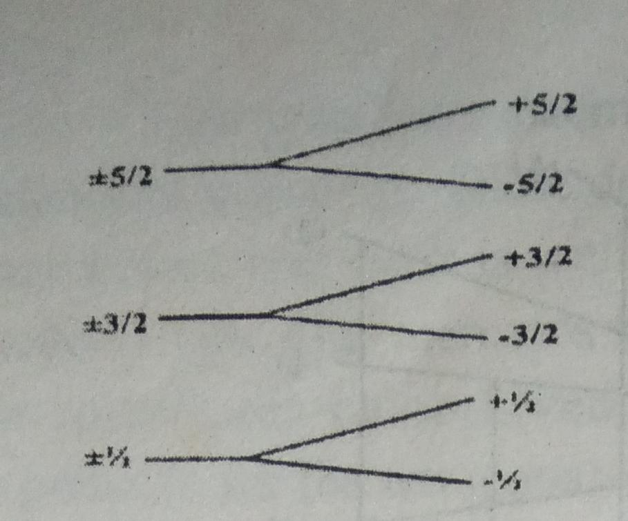
In some iron(III) complexes the zero field splitting parameter is very large and hence only the transitions between +1/2 and -1/2 states will be observed.
The effective spin state s’ = ½.
Therefore only one peak is observed in epr spectrum.
This is observed for weak field ligand complexes such as [FeF₆]³,[Fe(H₂o)]³⁺etc.

Slide 11
d⁷ high spin s= 3/2 co(II) complexes:
The ground state for an O_{h}high spin complex is ⁴T_{1g}(F). Since there is large spin – orbit coupling epr measurements are possible only at low temperatures.
At low temperatures only the low – lying doublet spin state is populated. Therefore a single peak is observed from an effective spin S’ = ½ with a g value of 4.33.
Eg. CoF₆⁴⁻ spectrum recorded at 20k gives a sharp peak with g values g_{x}=2.6,g_{y}=6.05 and g_{z}= 4.1.
In tetrahedral symmetry cobalt (II) complexes with ⁴A₂ ground state is closer in energy with the excited ⁴T₂state.
Due to more spin-orbit coupling broader lines are observed for Co(II).

Slide 12
d⁷low spin S=1/2 co(II) complexes:
For low spin complexes s=1/2 the ²E state becomes lowest in energy.
In the ²E state there is no sin-orbit coupling. There the electron spin life times are long leading to narrow epr lines at liquid nitrogen and room temperature.
In low spin d⁷systems the d_{z}² and 4s orbitals belong to the same irreducible representation and are allowed to mix.
Therefore it is impossible to utilize the fermi contact term to deduce informations about molecular orbital coefficients and covalency.
For five and six coordinate tetragonal d⁷ systems the umpaired electron resides in the d_{z}² orbital. If axial symmetry is assumed.
g_{II}= 2.0023, g_|_ =2.0023 - 6 ξ / ΔE(z²-xz,yz).

Slide 13
It is used to study the adduct formation of coordinatively unsaturated cobalt cobalt complexes with varieties of axially coordinated bases.

Slide 16
CO(III) COMPLEXES:
• The esr spectra of O₂adducts of co(III) complexes show that the unpaired electron resides mainly on O₂. There is also metal hyperfine coupling.
• The cobalt coupling arises from spin polarization of the filled molecular orbital of O₂ adduct.
• The extent of electron transfer from Co(III) into the coordinated O₂molecule has been estimated.
d⁸ systemNi(II):
• The ground state of the gaseous ion is ³F with A_{2g} as the lowest state in an octahetral field.
• The d-shell is more than half filled.

Slide 17
The spin-spin coupling leads to greater g-value than the free electron value.
The zero-field splitting makes it difficult to detect the esr spectra except at low temperature.
The g-values are usually close to isotropic.
eg: g for Ni (H₂O)₆²⁺ is 2.25.
Ni(II) has A_{2g} ground state in an octahetral field.
spin-orbit coupling mixes in excited states which splits the ³A_{2g} configuration.
This is the zero field splitting and it is very anisotropic.
It provides a relaxation mechanism for the electron spin state.
Therefore epr spectra of Ni(II) O_{h}complexes are difficult to detect and if at all studied it is at liquid nitrogen or helium temperature.

Slide 18
The Ni(II) squre planar complexes are diamagnetic in nature.
Therefore epr spectra are not recorded for them.
They are used to dilute the spins if cu(II) complexes
d⁹ system cu(II):
The ground state of an octahetral d⁹ system is ²E_{g}. Since there is large jahn –teller distortion the spectrum is recorded at room temperature.
In tetrahonalcomplexes the ground state is ²A and Sharp epr lines.

Slide 20
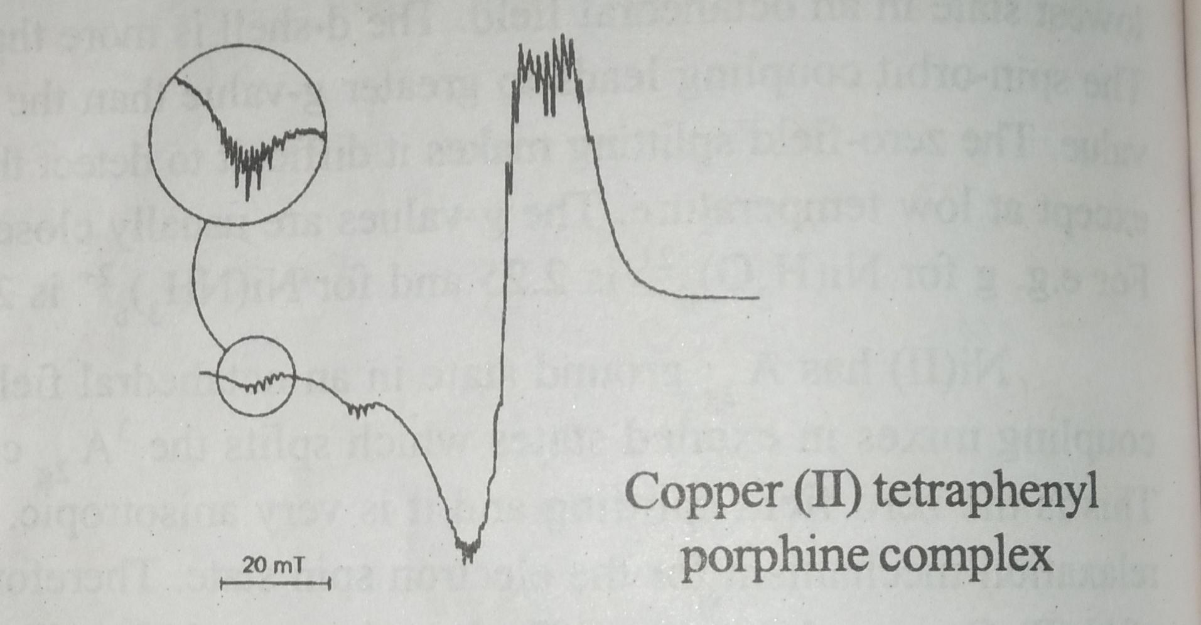
Eg: copper (II) tetraphenylporphine complex.It is squreplanar.
copper has two isotopes of about 70% and 30% abundance both with spin3/2.
There are four groups of parallel resonances three are seen at low field.

Slide 22
The spectrum is recorded in solid state and it is not isotropic.
There are four main groups of lines for cu(I=3/2).
The hyperfine spectrum of each of the four groups consists of eleven peaks of intensity 1:2:3:4:5:6:5:4:3:2:1. These peaks result from splitting by the two equivalent nitrogen and two hydrogens.
The total peaks expected is fifteen.(2x2x1+1)(2x2x1/2+1)=15.
since some of the lines overlap only 11 peaks are observed.
Deuteration of the N-H’’ group produces a compound which gives an identical spectrum.
when C-H’ are replaced by methyl groups the epr spectrum has only four main groups each of which consists of five lines resulting from nitrogen splitting only.

Slide 23
The hyperfine splittng by theN-H” protons and that by the methyl protons are either too small to be detected or non-existent.

Slide 24
THANK YOU

