Slide 1
Determination of magnetic moment
Name of the instructor:U.Nithya M.Sc.,M.Phil.,

Slide 2
Determination of magnetic susceptibility using Guoy balance method:
Paramagnetic substance
when a substance is suspended between the two poles of an electromagnet
The current is switched on,it experiences a force acting along its length.
The substance will be drawn downward by the electromagnetic field if it is paramagnetic.
The weight of the substance will increase in weight the magnetic susceptibility is calculated.

Slide 4
Calculation:
Increase in weight
Δm = m₂-m₁
The paramagnetic susceptibility is calculated from the equation
Δmg = ½ (ρx – ρ_{a}x_{a}) AH²
g= Accelaration due to gravity
ρ = Density of the substance
x= Mass susceptibility of the substance
ρ_{a}= density of air
X_{a}= mass suscetibility of air
A= Area of cross section of the cylinder
H= strength of the magnetic field in gauze
ρ_{a}x_{a} is known to be 0.036x10⁻⁶

Slide 5
If a standard substance is taken for which the specific magnetic susceptibility ‘x’ and ‘ρ’ are known then.
Δm/Δm_{W} = ρx-ρ_{a}x_{a}/ρ_{w}x_{w}-ρ_{a}x_{a}
where Δm = weight change for the substance
Δm_{W} = Weight change for water
ρ. = Density of the substance
ρ_{a} = Density of air
X_{a} = mass susceptibility of air
X = mass susceptibility of the substance
ρ_{w}= density of water
x_{w}= mass susceptibility of water

Slide 6
Diamagnetic substance.
In the case of diamagnetic substances the cylinder will be pushed upwards by the electromagnetic field because diamagnetic substances are repelled by the magnetic field.
The weight of the substance will decrease apparently.
weight change of the substance and X can be calculated.
weight change and X will be negative

Slide 7
FARADAY METHOD:
A very small volume of the magnetic sample is packed in a container made of quatrz.
It is suspended from a balance in the region of strong magnetic field.
The product H(dH/dx) should be constant over the volume of the sample.
H is the field strength and dH/dx is the gradient of the field.
The whole set-up is placed in nitrogen or helium atmosphere.
The region of uniform H(dH/dx) is determined by placing a small quantity of a substance of mass m and the magnetic susceptibility. Χ’
H (dH/dx) =(dF/mχ)
Where dF is the force. It measured by using catheometer.
The magnetic susceptibility is first measured for the standard substance and then for the sample.
χ_{s}= χ₀(d_{s}/d₀)(m₀/m_{s})
where χ_{s}andχ₀ are the magnetic susceptibilities of the sample and the standard, d_{s} and d₀ are the feflections,m_{s}andm₀ are the respective mass.

Slide 11
Calculation of molar magnetic Susceptibility:
molar magnetic susceptibility is obtained by multiplying x of the substance with molecular weight.
X_{M}= XM

Slide 13
Magnetic properties of lanthanides and actinides:
Lanthanides:
The inner transition series lanthanides are trivalent and have eletronic vonfiguration [xe]4f^{n} (n=0 to 14. from La to Lu).
The magnetism arises due to the electrons of 4f level.
It is incomletely filled and is effectively shielded by 5s and 5p orbitals.
They are not influced by the surrounding ligands.
The crystal field effect is very small and there is strong spin-orbit coupling.
The spin orbit coupling is of the order of 1000 cm⁻¹
J is a good quantum number
Therefore the magnetic moments is given by μ_{J} = gβ [J(J+1)]^{1/2}

Slide 14
Where g – magnetogyric ratio.
β – Bohr magnetron
J= L+S to L-S
This equation is applied to all the lanthanides except for those having f⁰,f⁷and f¹⁴ configurations.
The external fields do not either split the free ion term or quench the orbital angular momentum.
For them L=S and therefore μ_{J} = μ_{S}
For such systems μ_{s} = [4s (s+1)] ^{½} or μ_{S} =n(n+2)]^{1/2}
Gd ³⁺ has seven unpaired electrons (f⁷) and μ_{S.} = 7.9 B.M
The only two lanthanides which do not obey the μ_{J} equation are samarium (III) and europium (III).

Slide 16
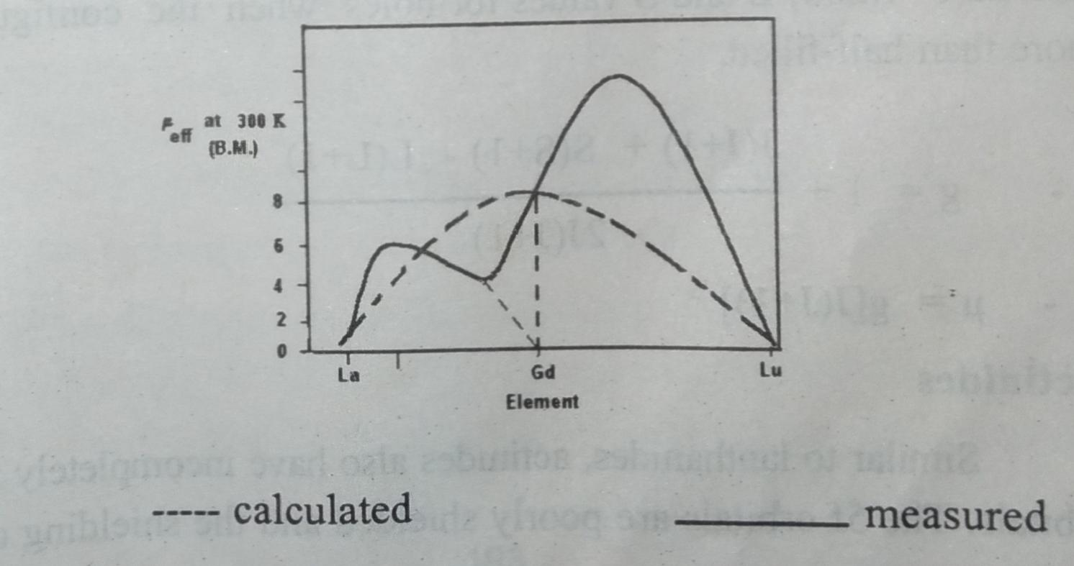
From the graph it is seen that for most of the elements there is excellent agreement between the calculated values using the
spin–orbit coupling formula and experimental values measured at 300k.

Slide 17
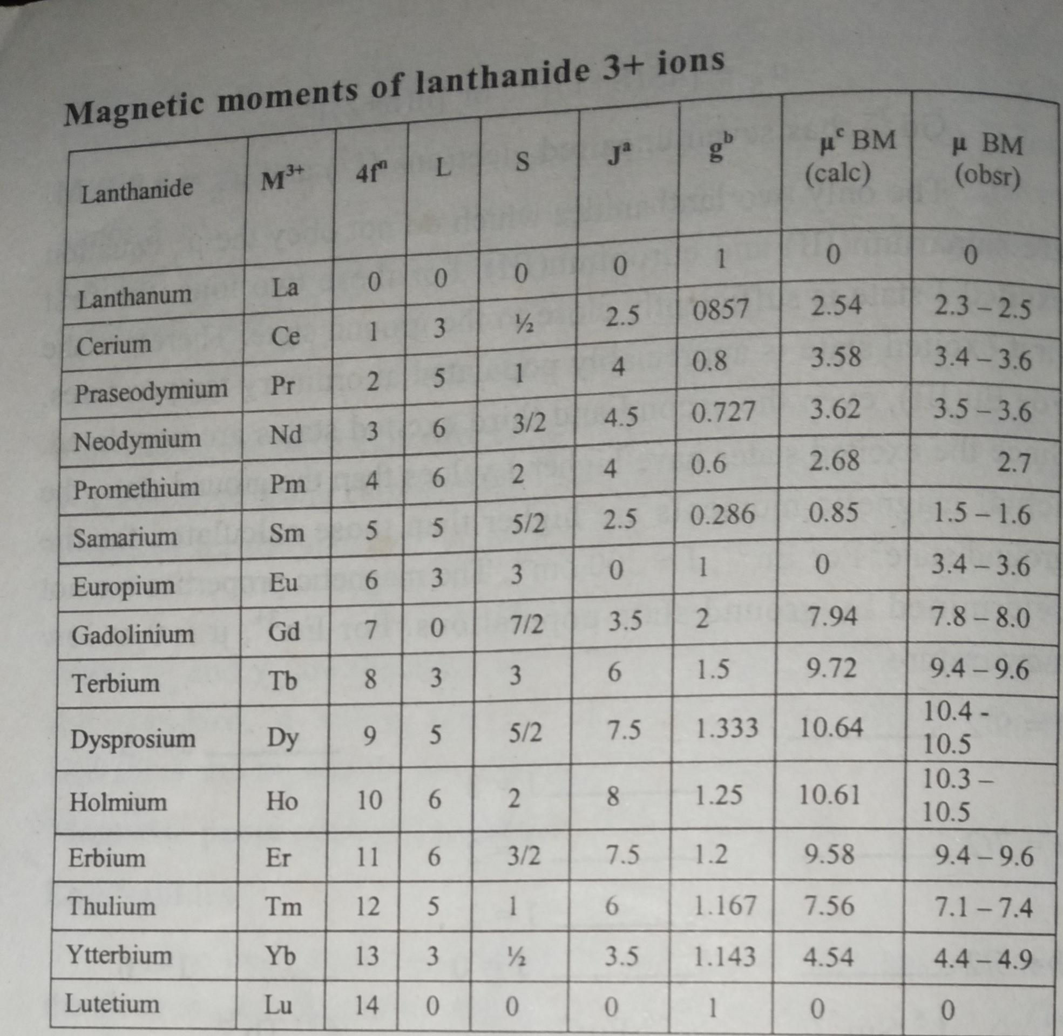

Slide 18
a- J=|L-S| for less than half – filled configuration
J = | L+S| for more than half –filled configuration
L and S values for electrons when the configuration less than half –filled; L and S values for holes when the configuration is more than half –filled.
b. g= 1+ J(J+1) + S(S+1)- L(L+1)/ 2J(J+1)
c. μ= g[J(J+1)]^{1/2}
Actinides:
similar to lanthanides actinides also have incompletely filled 5f orbitals.
The 5f orbitals are poorly shielded and the shielding depends upon the oxidation state.

Slide 19
Since there is poor shielded the actinides have very high crystal field effects than the 4f orbitals of lanthanides.
It is one tenth of the first transition series elements and ten times that of lanthanides.
The actinide complexes have the magnetic exchange phenomenon.
j-j coupling plays major rule in actinide elements.
For the same f^{n} configuration the magnetic moment of actinide is lower than that of a lanthanide.
The 5f^{n} electeons have considerable quenching of orbital magnetic moment.
pu (III) 5f⁵ and Am(III) 5f⁶ have magnetic moments similar to their lanthanide counterparts sm (III) 4f⁵ and Eu (III) 4f⁶.
The spin poulation in the ground state is thermally controlled.

Slide 20
THANK YOU

