Slide 1
coelom evolution
Dr.M.Deivanayaki

Slide 2
The coelom allows for compartmentalization of the body parts, so that different organ systems can evolve and nutrient transport is possible. Additionally, because the coelom is a fluid-filled cavity, it protects the organs from shock and compression. Simple animals, such as worms and jellyfish, do not have a coelom.
The term coelom was suggested by Haeckel in 1872. A coelom (Greek: coel = hollow cavity) is a fluid-filled cavity between the alimentary canal and the body wall lined on all sides by mesoderm. ® Features of a True Coelom ® It is a secondary body cavity formed by the splitting of mesoderm during embryonic development. ® It is also bounded on all sides by a definite coelomic epithelium. ® It consists of colorless coelomic fluid also the excretory organs open into it. ® Reproductive organs arise from its walls.

Slide 3
Acoelomata: Acoelomates do not have a coelom or body cavity. The space between the body wall and gut is filled up by mesenchyme and muscle fibres. ® Eg: phylum Porifera, Coelenterata, Platyhelminthes and Nemertinea
Pseudocoelomata
The space between the body wall and gut encloses a fluid filled cavity which is not lined by mesodermal epithelial cells. It is known as pseudocoel or false coelom and the animals possessing it are known as pseudocoelomates. ® Embryologically, the pseudocoelom is derived from the blastocoel of the embryo. The internal organs are free within the space, as there is no peritoneum bounding the cavity ® Eg: phylum Nematoda, Acanthocephala, Entoprocta, Rotifera, and Gastrotricha

Slide 4
Coelomata
In rest of the bilateria, the body-cavity present between the body wall and gut is lined by a peritoneum. Peritoneum consists of epithelial cells derived by embryonic mesoderm. This type of cavity is known as true coelom and the animals possessing it are known as Eucoelomates ® Eg: phylum Annelida, Arthropoda, Mollusca, Echinodermata, Hemichordata and Chordata. ® True coelomates are of the following types. § Schizocoelomates § Enterocoelomates
Schizocoelomates are true coelomates in which the body cavity originates by splitting of mesodermal tissue at the time of gastrulation. This method of coelom formation is called schizocoelous (Greek: sch izo = split), and occurs in animals like annelids, arthropods and mollusks. Sometimes the schizocoelom is filled with blood and is called haemocoel as in arthropods and mollucs. Evolution of Coelom lecture
Enterocoelomates: In most deuterostomes, such as chordates and echinoderms, the coelom originates by out-pouching of the archenteron during gastrulation. Each pouch then expands and its mesoderm lines the gut on the inner side and body wall on the outer side. This method of coelom formation is called enterocoelous

Slide 5
Significance of Coelom:
The coelomic fluid content facilitates smooth transportation of particles or materials in solution.
® Coelom affords flexibility to the body and extends room for the movement of the gut which remains suspended.
® Gonads which develop from coelomic epithelium are housed in the cavity of the coelom. So also are the nephridial tubules, which connect the coelom to the exterior and in some cases allow the passage of eggs and sperms.
® The coelom filled with incompressible coelomic fluid acts as a hydrostatic skeleton and helps in locomotion

Slide 6
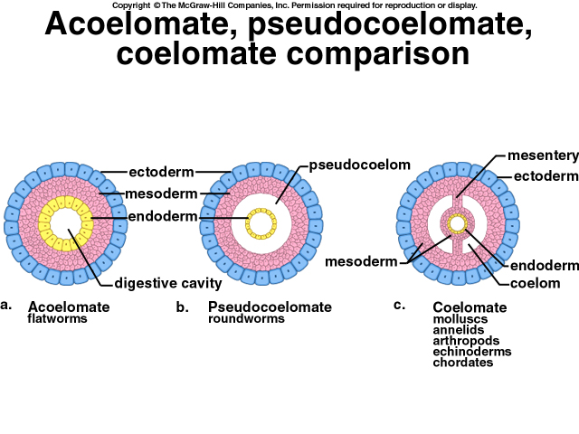

Slide 8
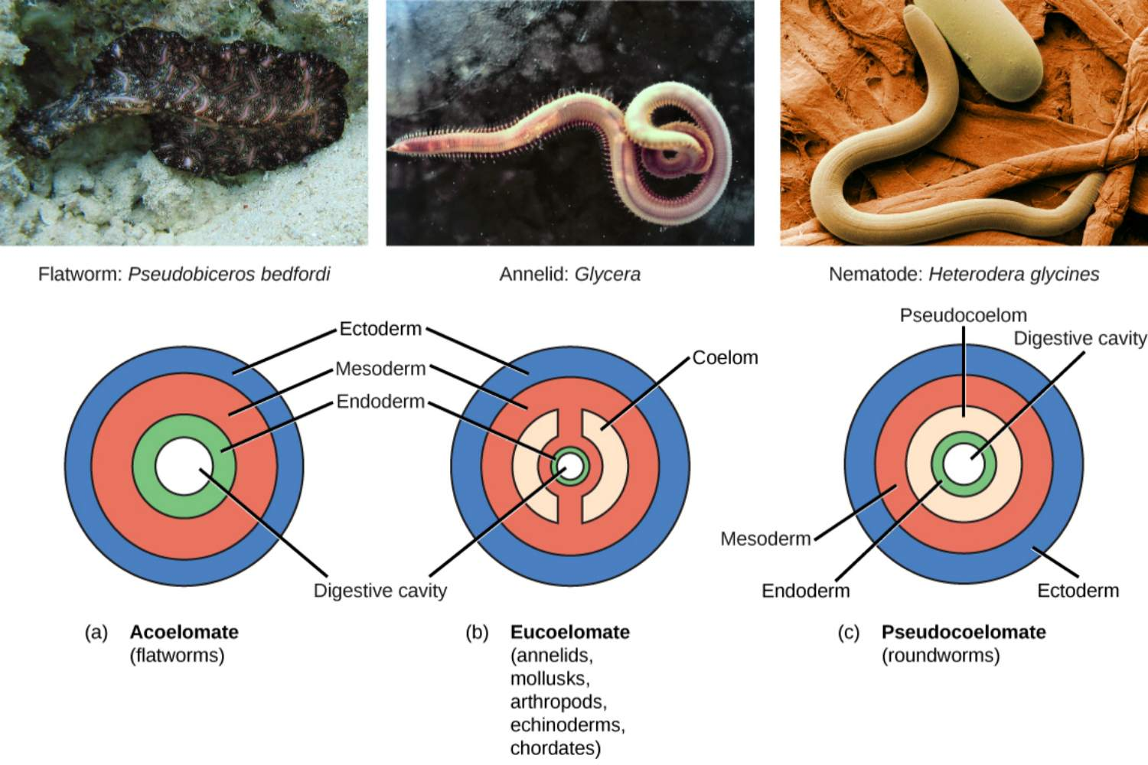

Slide 9
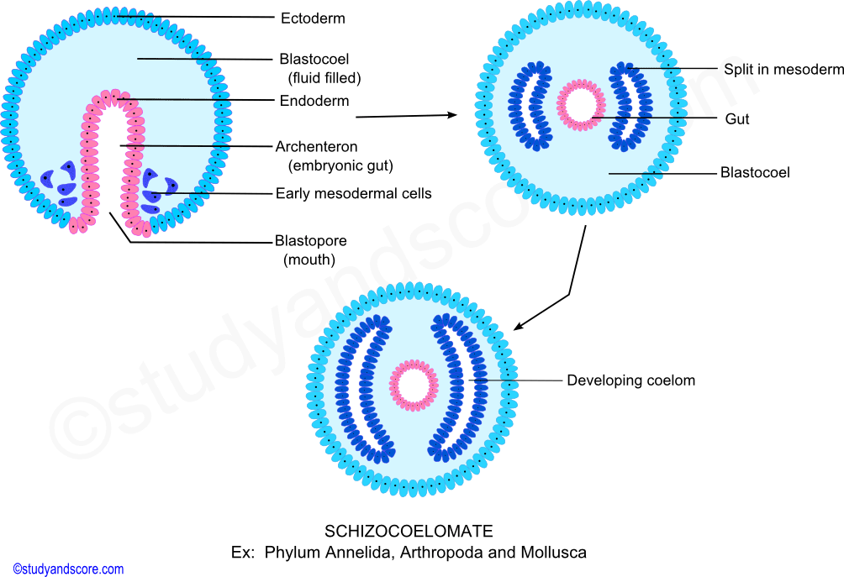

Slide 10
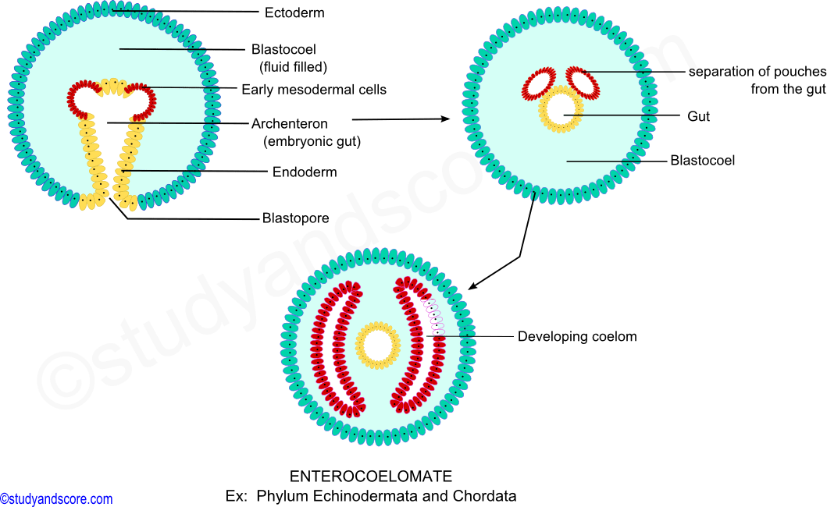
b) Enterocoelomates
In most deuterostomes, such as chordates and echinoderms, the coelom originates by out-pouching of the archenteron during gastrulation. Each pouch then expands and its mesoderm lines the gut on the inner side and body wall on the outer side. This method of coelom formation is called enterocoelous.

