Slide 1
I msc unit lll patternof sexual &asexual reproduction
Dr.M,Deivanayaki

Slide 2
Asexual reproduction includes fission, budding, fragmentation, and parthenogenesis, while sexual reproduction is achieved through the combination of reproductive cells from two individuals.
The ability of a species to reproduce through fragmentation depends on the size of part that breaks off, while in binary fission, an individual splits off and forms two individuals of the same size.
Budding may lead to the production of a completely new adult that forms away from the original body or may remain attached to the original body.
Observed in invertebrates and some vertebrates, parthenogenesis produce offspring that may be either haploid or diploid.
Sexual reproduction, the production of an offspring with a new combination of genes, may also involve hermaphroditism in which an organism can self-fertilize or mate with another individual of the same species.
binary fission: the process whereby a cell divides asexually to produce two daughter cells
hermaphroditism: having sexual organs of both sexes
parthenogenesis: a form of asexual reproduction where growth and development of embryos occur without fertilization

Slide 3
Methods of Reproduction: Asexual & Sexual
Asexual Reproduction
Asexual reproduction produces offspring that are genetically identical to the parent because the offspring are all clones of the original parent. This type of reproduction occurs in prokaryotic microorganisms (bacteria) and in some eukaryotic single-celled and multi-celled organisms. Animals may reproduce asexually through fission, budding, fragmentation, or parthenogenesis.
Fission
Fission, also called binary fission, occurs in prokaryotic microorganisms and in some invertebrate, multi-celled organisms. After a period of growth, an organism splits into two separate organisms. Some unicellular eukaryotic organisms undergo binary fission by mitosis. In other organisms, part of the individual separates, forming a second individual. This process occurs, for example, in many asteroid echinoderms through splitting of the central disk. Some sea anemones and some coral polyps also reproduce through fission.
Budding
Budding is a form of asexual reproduction that results from the outgrowth of a part of a cell or body region leading to a separation from the original organism into two individuals. Budding occurs commonly in some invertebrate animals such as corals and hydras. In hydras, a bud forms that develops into an adult, which breaks away from the main body; whereas in coral budding, the bud does not detach and multiplies as part of a new colony.

Slide 4
Fragmentation
Fragmentation is the breaking of the body into two parts with subsequent regeneration. If the animal is capable of fragmentation, and the part is big enough, a separate individual will regrow.
Many sea stars reproduce asexually by fragmentation. For example, if the arm of an individual sea star is broken off it will regenerate a new sea star. Fishery workers have been known to try to kill the sea stars that eat their clam or oyster beds by cutting them in half and throwing them back into the ocean. Unfortunately for the workers, the two parts can each regenerate a new half, resulting in twice as many sea stars to prey upon the oysters and clams. Fragmentation also occurs in annelid worms, turbellarians, and poriferans.
Parthenogenesis
Parthenogenesis is a form of asexual reproduction where an egg develops into a complete individual without being fertilized. The resulting offspring can be either haploid or diploid, depending on the process and the species. Parthenogenesis occurs in invertebrates such as water fleas, rotifers, aphids, stick insects, some ants, wasps, and bees. Bees use parthenogenesis to produce haploid males (drones) and diploid females (workers). If an egg is fertilized, a queen is produced. The queen bee controls the reproduction of the hive bees to regulate the type of bee produced.
Some vertebrate animals, such as certain reptiles, amphibians, and fish, also reproduce through parthenogenesis. Although more common in plants, parthenogenesis has been observed in animal species that were segregated by sex in terrestrial or marine zoos. Two Komodo dragons, a bonnethead shark, and a blacktip shark have produced parthenogenic young when the females have been isolated from males.

Slide 5
Sexual Reproduction
Sexual reproduction is the combination of (usually haploid, or having a single set of unpaired chromosomes) reproductive cells from two individuals to form a third (usually diploid, or having a pair of each type of chromosome) unique offspring. Sexual reproduction produces offspring with novel combinations of genes. This can be an adaptive advantage in unstable or unpredictable environments. As humans, we are used to thinking of animals as having two separate sexes, male and female, determined at conception. However, in the animal kingdom, there are many variations on this theme.
Hermaphroditism
Hermaphroditism occurs in animals where one individual has both male and female reproductive parts. Invertebrates, such as earthworms, slugs, tapeworms and snails, are often hermaphroditic. Hermaphrodites may self-fertilize or may mate with another of their species, fertilizing each other and both producing offspring. Self fertilization is common in animals that have limited mobility or are not motile, such as barnacles and clams.

Slide 6
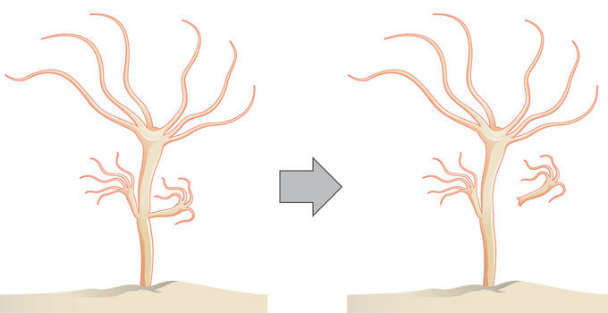
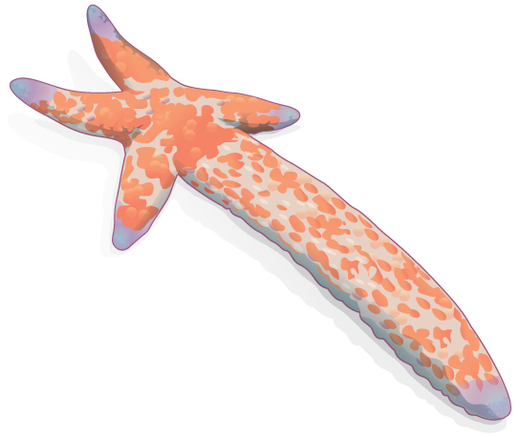
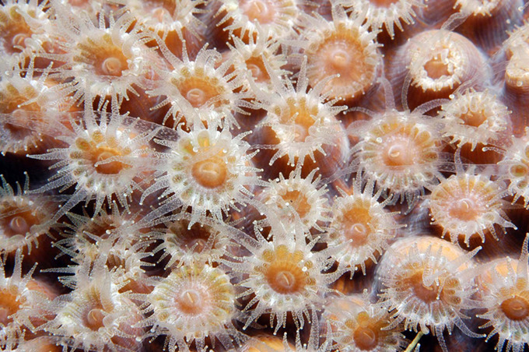
Budding
Fission
Fragmentation

