Slide 1
CDNA and GENOMIC LIBRARY
Dr.M.DEIVANAYAKI

Slide 2
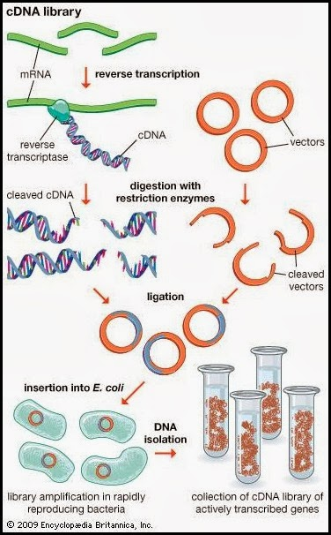

Slide 3
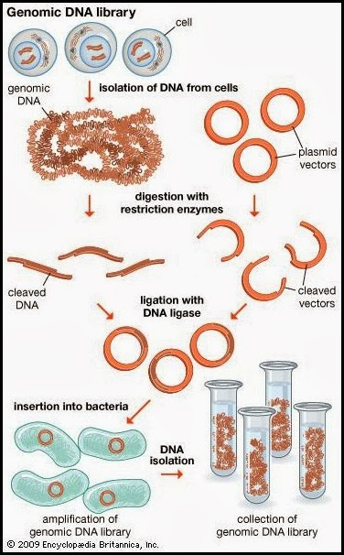

Slide 4
Genomic Library:
1. Genomic Library is prepared directly from the genomic DNA.
2. Genomic Library represents entire genome of the organism
3.Restriction endonucleases and ligases are important for its construction.
4. They carry introns also.
5. They may represent the DNA of both eukaryotic and prokaryotic organisms.
6. They are not capable of expression in prokaryotes (like the bacteria) because they carry introns and prokaryotes do not have machinery to process introns.

Slide 5
cDNA
1. cDNA Library is prepared by using mRNA as template.
2. cDNA Library represents only those genes of genome which express under specific conditions.
3. Reverse transcriptase enzyme plays an important role in its construction.
4. They lack introns.
5. They represent the DNA of only eukaryotic organisms.
6. They are capable of expression in bacteria because they lack introns.

