Slide 1
STEROIDS

Slide 7
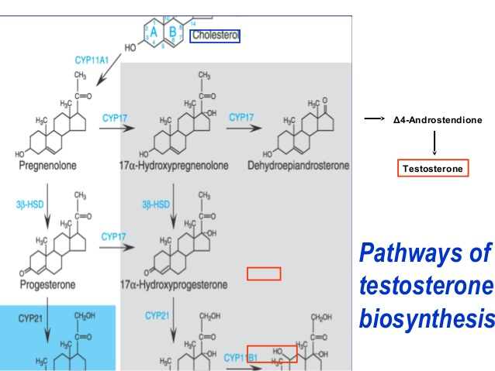

Slide 10
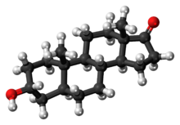
ANDROSTERONE

Slide 13
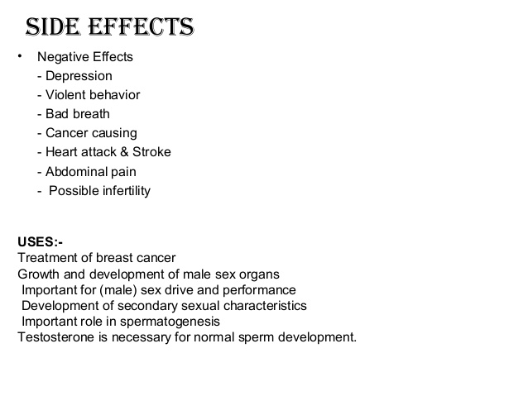

Slide 14
BIOSYNTHESIS OF CHOLESTEROL
THE KEY STEP IN THE BIOSYNTHESIS OF CHOLESTEROL IS THE CONVERSION OF 3-HYDROXY-3-METHYL-GLUTARYL-COENZYME A TO MEVALONATE BY HMG COA REDUCTASE.
THIS IS THE RATE LIMITING STEP IN CHOLESTEROL BIOSYNTHESIS.
CHOLESTEROL IS THE RAW MATERIAL FOR SYNTHESIS OF ALL STEROID HORMONES.

Slide 15
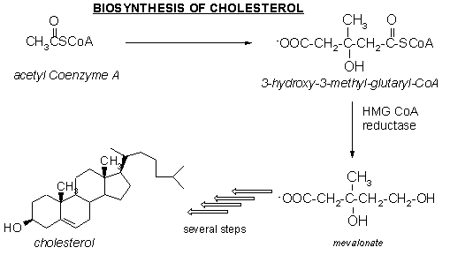

Slide 18
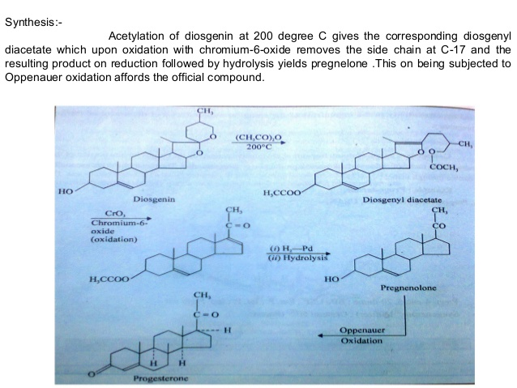

Slide 19
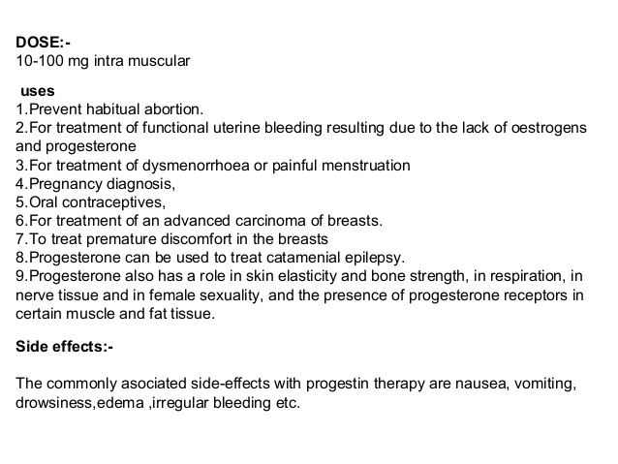

Slide 21
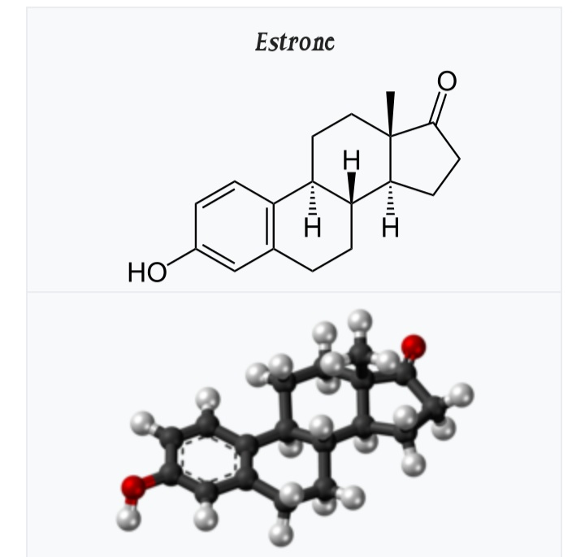

Slide 22
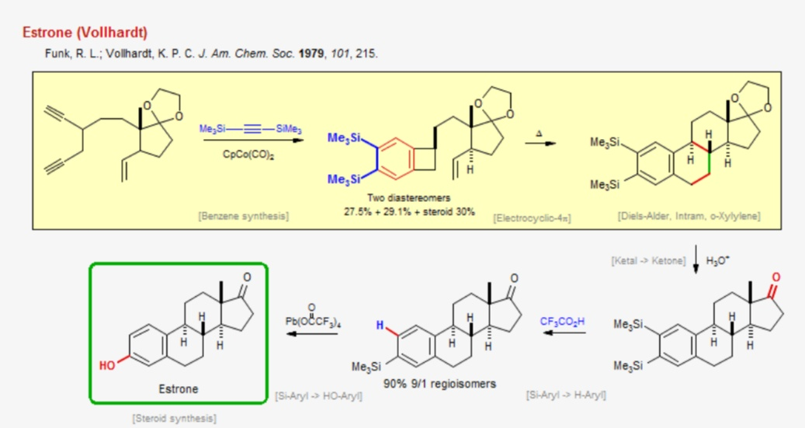

Slide 23
MEDICAL USE:
Estrone Has Been Available As An Injected Estrogen For Medical Use, For Instance In Hormone Therapy For Menopausal Symptoms, But It Is Now Mostly No Longer Marketed.

Slide 24
THANK YOU

