Slide 1



ELECTRON CONFIGURATION
M.Kiruthiga Guset lecturer
Gcwk

Slide 2

OBJECTIVES
1. Define Electron Configuration
2. Discuss the rules in writing electron configuration
3. Write the full and abbreviated electron configuration of the elements from any period of the periodic table.
4. Illustrate the orbital diagram for each atom based on their electron configuration

Slide 3
WHAT DID YOU REMEMBER?
1. How will you describe the location of electrons revolving around the nucleus of an atom?
2. What are quantum numbers?
3. What do these quantum numbers describe?
4. How do we compute for the maximum orbitals per energy level?
5. How do we compute for the maximum number of electrons per energy level?

Slide 4

WHAT CAN YOU SEE?
ladder

Slide 5
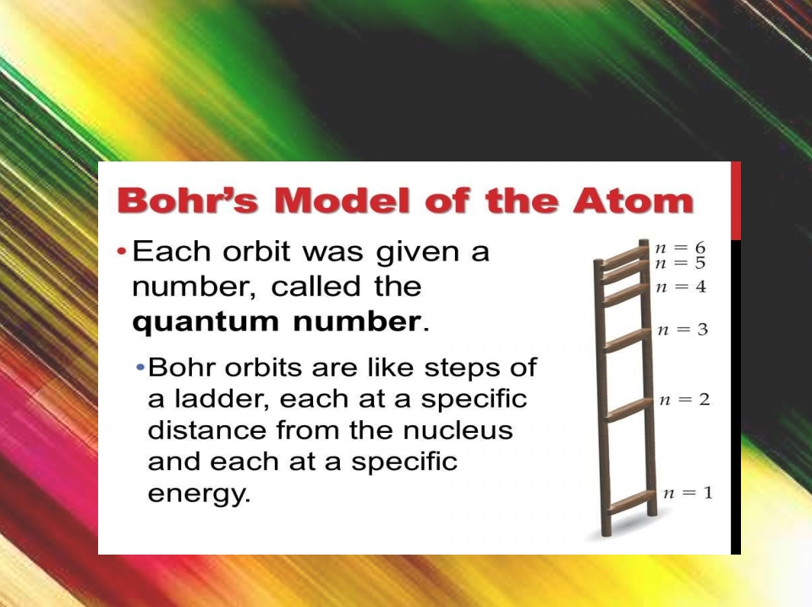
WHAT CAN YOU SEE?

Slide 6

ELECTRONIC CONFIGURATION OF AN ATOM
- the arrangement of electrons in the orbital of an atom.
- described by
a. a number that designates the number of principal shell b. a letter that designates the subshell (orbital)
c. a subscript that designates the number of electrons in that particular subshell (orbital)
Example:
2p4 indicates 4 electrons in the p subshell of the 2nd shell.
3d8 indicates 8 electrons in the d subshell of the 3rd shell.

Slide 7

RULES FOR ELECTRON
CONFIGURATIONS
 In order to write an electron configuration, we need to know the RULES.
 3 rules govern electron configurations.
au Principle
 Pauli Exclusion Principle
 Hund’s Rule
 Using the orbital filling diagram at the right will help you figure out HOW to write them
 Start with the 1s orbital. Fill each orbital completely and then go to the next one, until all of the elements have been acounted for.

Slide 8

a. AUFBAU (BUILDING-UP) PRINCIPLE
“Electrons in an atom occupy first the lowest possible energy levels and/or orbitals.”
Order: 1s 2s 2p 3s 3p 4s 3d 4p 5s 4d 5p 6s 4f 5d 6p 7s 5f 6d 7p

Slide 9

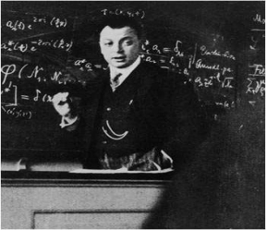












NO MORE THAN 2 ELECTRONS IN ANY ORBITAL…EVER.
 The next rule is the Pauli Exclusion Principle.
 “No two electrons in the same atom can have the same set of four quantum numbers, i.e., the maximum number of electron in an orbital is limited to two.”
 The spins have to be paired.
 We usually represent this with an up arrow and a down arrow.
Wolfgang Pauli, yet
another German Nobel
Prize winner
 Since there is only 1 s orbital per energy level, only 2 electrons fill that orbital.
Quantum numbers describe an electrons position, and no 2 electrons can have the exact same quantum numbers. Because of that, electrons must have opposite spins from each other in order to “share” the same orbital.

Slide 10
b. PAULI’S EXCLUSION PRINCIPLE *For 1s orbital:Max electron = 2
one electron: n=1, l=0, ml=0,ms=+½ one electron: n=1, l=0, ml=0,ms=-½

Slide 11
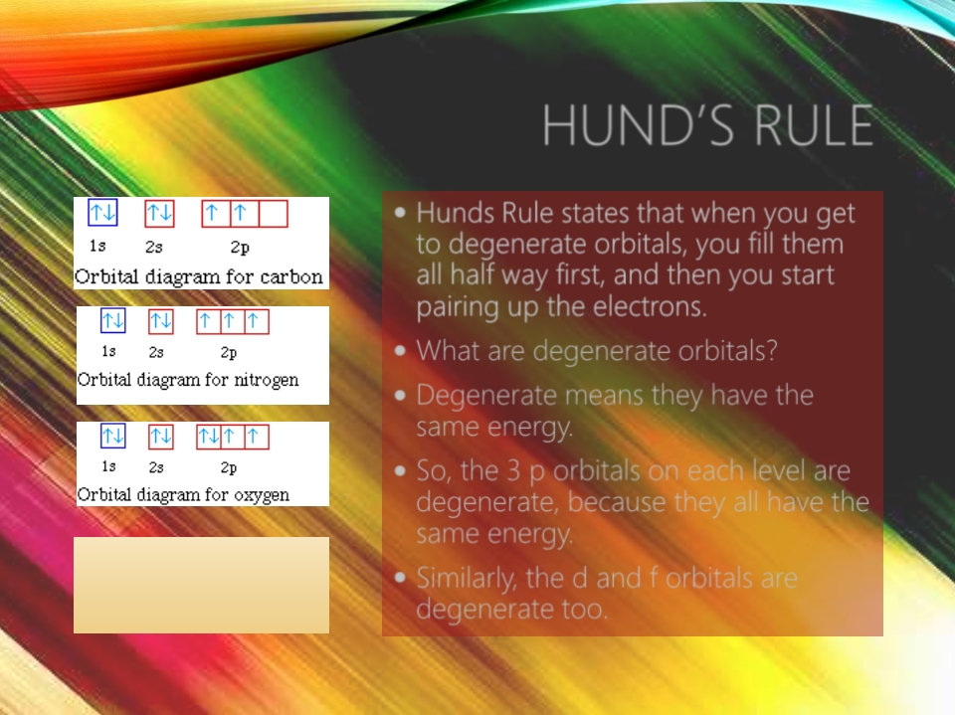
HUND’S RULE
 Hunds Rule states that when you get to degenerate orbitals, you fill them all half way first, and then you start pairing up the electrons.
 What are degenerate orbitals?
 Degenerate means they have the same energy.
 So, the 3 p orbitals on each level are degenerate, because they all have the same energy.
Don’t pair up the 2p electrons until all 3
orbitals are half full.
 Similarly, the d and f orbitals are degenerate too.

Slide 12
EXCEPTION TO THE RULE
• There are two main exceptions to electron configuration: chromium and copper.
• In these cases, a completely full or half full d sub-level is more stable than a partially filled d sub-level, so an electron from the 4s orbital is excited and rises to a 3d orbital.

Slide 13
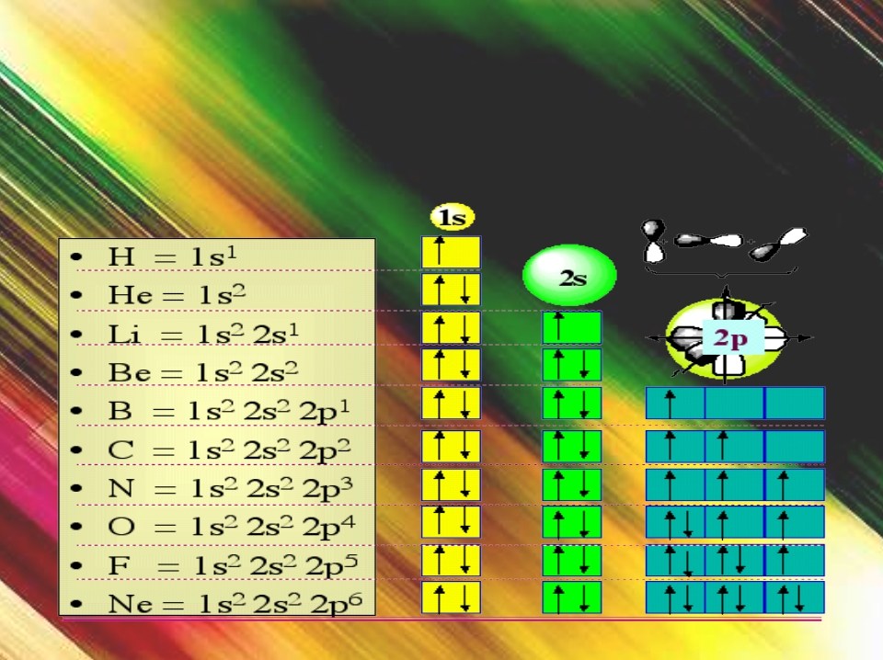
ARRANGEMENT OF ELECTRONS IN THE ATOMS OF THE FIRST
10 ELEMENTS

Slide 14

SAMPLE PROBLEM
Determining Electron Configuration
PROBLEM:
Using the periodic table give the full and condensed electrons configurations, partial orbital diagrams showing valence electrons, and number of inner electrons for the following elements:
(a) potassium (K: Z = 19) (b) molybdenum (Mo: Z = 42) (c) lead (Pb: Z = 82) PLAN:
Use the atomic number for the number of electrons and the periodic table for the order of filling for electron orbitals. Condensed configurations consist of the preceding noble gas and outer electrons.
SOLUTION:
(a) for K (Z = 19)
full configuration
1s 2s 2p 3s 3p 4s
2 2 6 2 6 1
condensed configuration
[Ar] 4s
1
partial orbital diagram
There are 18 inner electrons.
4s
1
3d
4p

Slide 15
(b) for Mo (Z = 42)
full configuration
1s 2s 2p 3s 3p 4s 3d 4p 5s 4d
2 2 6 2 6 2 10 6 1 5
condensed configuration
1 5
[Kr] 5s 4d
partial orbital diagram
There are 36 inner electrons and 6 valence electrons.
5s
1
4d
5
5p
(c) for Pb (Z = 82 )
full configuration
1s 2s 2p 3s 3p 4s 3d 4p 5s 4d 5p 6s 4f 5d 6p [Xe] 6s 4f 5d 6p
2 2 6 2 6 2 10 6 2 10 6 2 14 10 2
condensed configuration
2 14 10 2
partial orbital diagram
There are 78 inner electrons and 4 valence electrons.
6s
2
6p
2

Slide 16

ACTIVITY
a. Write the expanded/full electron configurations of the following elements:
1) Calcium
2) potassium
b. Write the abbreviated electron configurations of the following elements:
3) Aluminum
4)
c. Illustrate the orbital diagram of Rubidium (Rb)

Slide 17
ASSESSMENT
1. Write the electron configurations (FULL & ABBREVIATED) of each of the following atoms.
1. Scandium
2. Gallium
2. Determine what elements are denoted by the following electron configurations:
3. [Kr] 5s 4d 5p ____________________
2 10 3
4. [Xe] 6s 4f 5d ____________________
2 14 6
c. Illustrate the orbital diagram for number #4.

Slide 18

Words to live by….
“ We should rather be an ELECTRON so that we may able absorb and release
energy to be a good and useful particle moving around the earth…”
Thank you

