Slide 1
Laws of Thermodynamics
M.Kiruthiga
Guest Lecturer
GCWK.

Slide 2


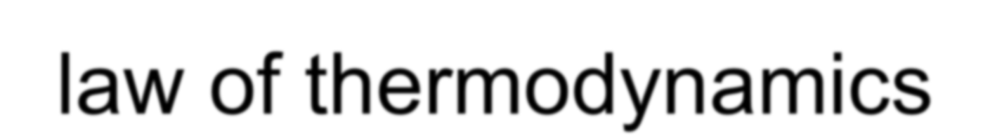


1st law of thermodynamics
The first law of thermodynamics is an extension of the
law of conservation of energy
The change in internal energy of a system is equal to the heat added to the system minus the work done by the system
ΔU = Q - W
If heat added to a system, there are two things that can be done
Change the internal energy of the system, or Cause the system to do work
Combination of the two

Slide 3

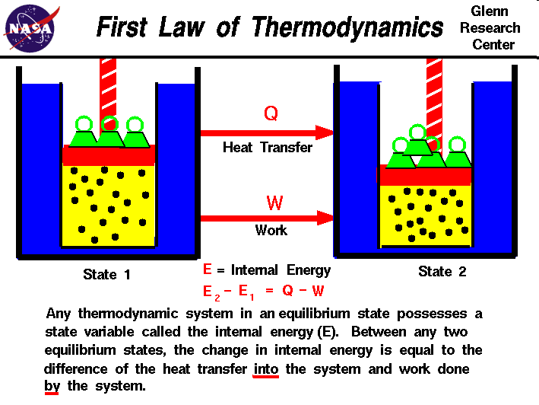
Slide courtesy of NASA

Slide 4

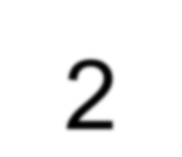
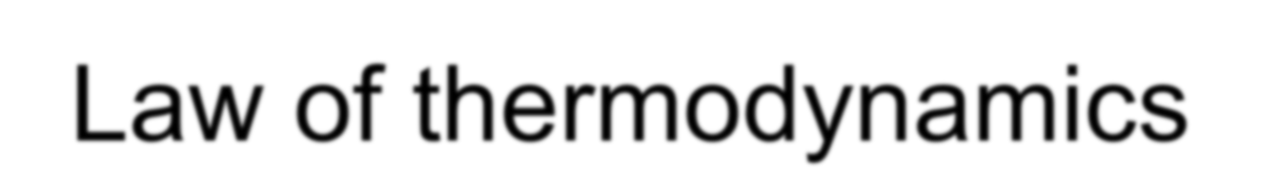
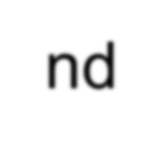
2nd Law of thermodynamics
Concept of temperature gradient as a natural phenomenon.
The 2nd Law can also be stated that heat flows spontaneously from a hot object to a cold object (spontaneously means without the assistance of external work)

Slide 5
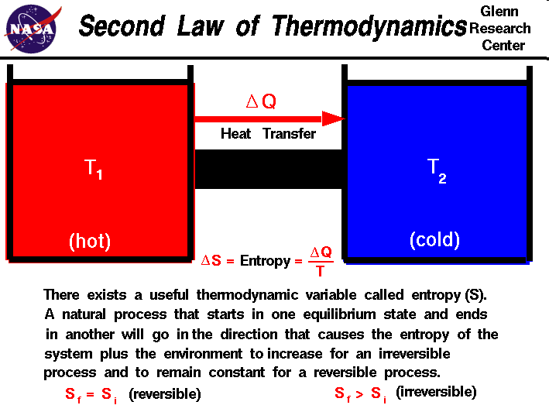
Slide courtesy of NASA

Slide 6
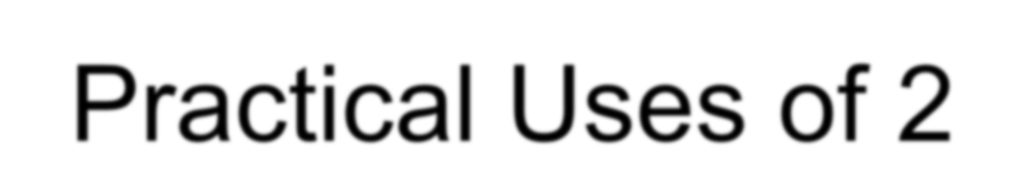
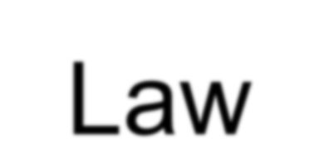
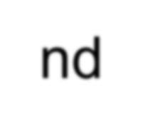
Practical Uses of 2nd Law
Automobile engines, refrigerators, and air conditioners all work on the principles laid out by the 2nd Law of Thermodynamics

Slide 7
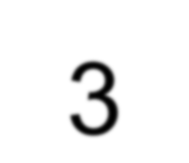


3rd Law of thermodynamics
The entropy of a perfect crystal is zero when the temperature of a the crystal is equal to absolute zero (0 K).
At 0 K, there is no thermal motion, and if the crystal is perfect, there will be no disorder
Once the temperature begins to rise above 0, the particles begin to move and entropy gradually increases
When temperature reaches the melting point of the substance (Tm), there is an abrupt increase in entropy as the substance changes from a solid to a more disordered liquid.

Slide 8
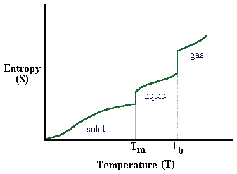
Again the entropy increases gradually as the motion of the particles increases until the temperature reaches the boiling point of the substance (Tb). At this point, there is another drastic increase in entropy as the substance changes from a confined liquid particles to random motion gas particles.
Temperature – Entropy relationship

Slide 9

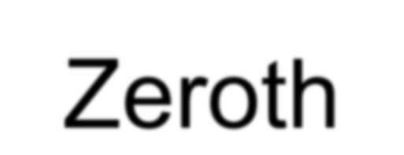

The Zeroth Law
This law is concerned with thermal equilibrium.
It states
if two with a
bodies third
are separately in thermal body then they must be in
thermal equilibrium with each other
If objects A and B are each in thermal equilibrium with object C, then A and B are in thermal equilibrium with each other
equilibrium

Slide 10
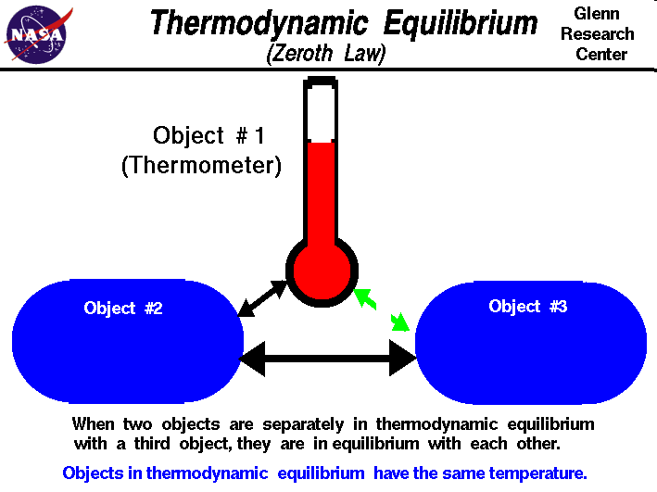
Slide courtesy of NASA

Slide 11
Thank you

