Slide 1
OPERATING SYSTEM-2

Slide 2
History Of OS
Operating systems were first developed in the late 1950s to manage tape storage
The General Motors Research Lab implemented the first OS in the early 1950s for their IBM 701
In the mid-1960s, operating systems started to use disks
In the late 1960s, the first version of the Unix OS was developed
The first OS built by Microsoft was DOS. It was built in 1981 by purchasing the 86-DOS software from a Seattle company
The present-day popular OS Windows first came to existence in 1985 when a GUI was created and paired with MS-DOS.

Slide 3
Evolution of Operating Systems
The evolution of operating systems is directly dependent on the development of computer systems and how users use them. Here is a quick tour of computing systems through the past fifty years in the timeline.
Early Evolution
  1945: ENIAC, Moore School of Engineering, University of Pennsylvania.
  1949: EDSAC and EDVAC
  1949: BINAC - a successor to the ENIAC
  1951: UNIVAC by Remington
  1952: IBM 701
  1956: The interrupt
  1954-1957: FORTRAN was developed

Slide 4
Evolution of Operating Systems…
Operating Systems - Late 1950s
  By the late 1950s Operating systems were well improved and started supporting following usages:
  It was able to perform Single stream batch processing.
  It could use Common, standardized, input/output routines for device access.
  Program transition capabilities to reduce the overhead of starting a new job was added.
  Error recovery to clean up after a job terminated abnormally was added.
  Job control languages that allowed users to specify the job definition and resource requirements were made possible.

Slide 5
Evolution of Operating Systems…
Operating Systems - In 1960s
  1961: The dawn of minicomputers
  1962: Compatible Time-Sharing System (CTSS) from MIT
  1963: Burroughs Master Control Program (MCP) for the B5000 system
  1964: IBM System/360
  1960s: Disks became mainstream
  1966: Minicomputers got cheaper, more powerful, and really useful.
  1967-1968: Mouse was invented.
  1964 and onward: Multics
  1969: The UNIX Time-Sharing System from Bell Telephone Laboratories.

Slide 6
Evolution of Operating Systems…
Supported OS Features by 1970s
Multi User and Multi tasking was introduced.
Dynamic address translation hardware and Virtual machines came into picture.
Modular architectures came into existence.
Personal, interactive systems came into existence.

Slide 7
Evolution of Operating Systems…
Accomplishments after 1970
  1971: Intel announces the microprocessor
  1972: IBM comes out with VM: the Virtual Machine Operating System
  1973: UNIX 4th Edition is published
  1973: Ethernet
  1974 The Personal Computer Age begins
  1974: Gates and Allen wrote BASIC for the Altair
  1976: Apple II

Slide 8
Evolution of Operating Systems…
  August 12, 1981: IBM introduces the IBM PC
  1983 Microsoft begins work on MS-Windows
  1984 Apple Macintosh comes out
  1990 Microsoft Windows 3.0 comes out
  1991 GNU/Linux
  1992 The first Windows virus comes out
  1993 Windows NT
  2007: iOS
  2008: Android OS

Slide 9
Features of Operating System
Here is a list commonly found important features of an Operating System:
Protected and supervisor mode
Allows disk access and file systems Device drivers Networking Security
Program Execution
Memory management Virtual Memory Multitasking
Handling I/O operations
Manipulation of the file system
Error Detection and handling
Resource allocation
Information and Resource Protection

Slide 10
Types of Operating System
Batch Operating System.
Multitasking/Time Sharing OS.
Multiprocessing OS.
Real Time OS.
Distributed OS.
Network OS.
Mobile OS.

Slide 11
Batch Operating System
Some computer processes are very lengthy and time-consuming. To speed the same process, a job with a similar type of needs are batched together and run as a group.
The user of a batch operating system never directly interacts with the computer. In this type of OS, every user prepares his or her job on an offline device like a punch card and submit it to the computer operator.

Slide 12
Batch Operating System…
To speed up processing, jobs with similar needs are batched together and run as a group. The programmers leave their programs with the operator and the operator then sorts the programs with similar requirements into batches.
The problems with Batch Systems are as follows −
Lack of interaction between the user and the job.
CPU is often idle, because the speed of the mechanical I/O devices is slower than the CPU.
Difficult to provide the desired priority.

Slide 13
Multi-Tasking/Time-sharing OS
Time-sharing operating system enables people located at a different terminal(shell) to use a single computer system at the same time. The processor time (CPU) which is shared among multiple users is termed as time sharing. Time-sharing is a technique which enables many people, located at various terminals, to use a particular computer system at the same time. Time-sharing or multitasking is a logical extension of multiprogramming. Processor's time which is shared among multiple users simultaneously is termed as time-sharing.
The main difference between Multiprogrammed Batch Systems and Time-Sharing Systems is that in case of Multiprogrammed batch systems, the objective is to maximize processor use, whereas in Time-Sharing Systems, the objective is to minimize response time.

Slide 14
Multi-Tasking/Time-sharing OS…
Multiple jobs are executed by the CPU by switching between them, but the switches occur so frequently. Thus, the user can receive an immediate response. For example, in a transaction processing, the processor executes each user program in a short burst or quantum of computation. That is, if n users are present, then each user can get a time quantum. When the user submits the command, the response time is in few seconds at most.
The operating system uses CPU scheduling and multiprogramming to provide each user with a small portion of a time. Computer systems that were designed primarily as batch systems have been modified to time-sharing systems.
Advantages of Timesharing operating systems are as follows −
  Provides the advantage of quick response.
  Avoids duplication of software.
  Reduces CPU idle time.
Disadvantages of Time-sharing operating systems are as follows −
  Problem of reliability.
  Question of security and integrity of user programs and data.
  Problem of data communication.

Slide 15
Real time OS
A real time operating system time interval to process and respond to inputs is very small
A real-time system is defined as a data processing system in which the time interval required to process and respond to inputs is so small that it controls the environment. The time taken by the system to respond to an input and display of required updated information is termed as the response time. So in this method, the response time is very less as compared to online processing.

Slide 16
Real time OS…
Real-time systems are used when there are rigid time requirements on the operation of a processor or the flow of data and real-time systems can be used as a control device in a dedicated application.
A real-time operating system must have well-defined, fixed time constraints, otherwise the system will fail.
For example : Military Software Systems, Space Software Systems. Scientific experiments, medical imaging systems, industrial control systems, weapon systems, robots, air traffic control systems, etc.

Slide 17
Real time OS…
There are two types of real-time operating systems.
Hard real-time systems
Hard real-time systems guarantee that critical tasks complete on time. In hard real-time systems, secondary storage is limited or missing and the data is stored in ROM. In these systems, virtual memory is almost never found.
Soft real-time systems
Soft real-time systems are less restrictive. A critical real-time task gets priority over other tasks and retains the priority until it completes. Soft real-time systems have limited utility than hard real-time systems. For example, multimedia, virtual reality, Advanced Scientific Projects like undersea exploration and planetary rovers, etc.

Slide 18
Distributed Operating System
Distributed systems use many processors located in different machines to provide very fast computation to its users.
Distributed systems use multiple central processors to serve multiple real-time applications and multiple users. Data processing jobs are distributed among the processors accordingly.
The processors communicate with one another through various communication lines (such as high-speed buses or telephone lines). These are referred as loosely coupled systems or distributed systems. Processors in a distributed system may vary in size and function. These processors are referred as sites, nodes, computers, and so on.

Slide 19
Distributed Operating System…
The advantages of distributed systems are as follows −
  With resource sharing facility, a user at one site may be able to use the resources available at another.
  Speedup the exchange of data with one another via electronic mail.
  If one site fails in a distributed system, the remaining sites can potentially continue operating.
  Better service to the customers.
  Reduction of the load on the host computer.
  Reduction of delays in data processing.

Slide 20
Network Operating System
A Network Operating System runs on a server. It provides the capability to serve, to manage data, user, groups, security, application, and other networking functions.
The primary purpose of the network operating system is to allow shared file and printer access among multiple computers in a network, typically a local area network (LAN), a private network or to other networks.

Slide 21
Network Operating System…
Examples of network operating systems include Microsoft Windows Server 2003, Microsoft Windows Server 2008, UNIX, Linux, Mac OS X, Novell NetWare, and BSD.
The advantages of network operating systems are as follows −
  Centralized servers are highly stable.
  Security is server managed.
  Upgrades to new technologies and hardware can be easily integrated into the system.
  Remote access to servers is possible from different locations and types of systems.
The disadvantages of network operating systems are as follows −
  High cost of buying and running a server.
  Dependency on a central location for most operations.
  Regular maintenance and updates are required.

Slide 22
Mobile OS
Mobile operating systems are those OS which is especially that are designed to power smartphones, tablets, and wearables devices- Smart watch , smart glasses.
Some most famous mobile operating systems are Android and iOS, but others include BlackBerry, Web, and watchOS.

Slide 23
Difference between Firmware and Operating System
Firmware | Operating System
Firmware is one kind of programming that is embedded on a chip in the device which controls that specific device. | OS provides functionality over and above that which is provided by the firmware.
Firmware programs that been encoded by the manufacture of the IC or something and cannot be changed. | OS is a program that can be installed by the user and can be changed.
It is stored on non-volatile memory. | OS is stored on the hard drive.

Slide 24
Important functions of an OS
Memory Management
Processor Management
Device Management
File Management
Security
Control over system performance
Job accounting
Error detecting aids
Coordination between other software and users

Slide 25
Memory Management
Memory management refers to management of Primary Memory or Main Memory. Main memory is a large array of words or bytes where each word or byte has its own address.
Main memory provides a fast storage that can be accessed directly by the CPU. For a program to be executed, it must in the main memory.
An Operating System does the following activities for memory management:
  Keeps tracks of primary memory, i.e., what part of it are in use by whom, what part are not in use.
  In multiprogramming, the OS decides which process will get memory when and how much.
  Allocates the memory when a process requests it to do so.
  De-allocates the memory when a process no longer needs it or has been terminated.

Slide 26
Processor Management
In multiprogramming environment, the OS decides which process gets the processor when and for how much time. This function is called process scheduling.
An Operating System does the following activities for processor management:
  Keeps tracks of processor and status of process. The program responsible for this task is known as traffic controller.
  Allocates the processor (CPU) to a process.
  De-allocates processor when a process is no longer required.

Slide 27
Device Management
An Operating System manages device communication via their respective drivers. It does the following activities for device management:
Keeps tracks of all devices. The program responsible for this task is known as the I/O controller.
Decides which process gets the device when and for how much time.
Allocates the device in the most efficient way.
De-allocates devices.

Slide 28
File Management
A file system is normally organized into directories for easy navigation and usage. These directories may contain files and other directions.
An Operating System does the following activities for file management:
  Keeps track of information, location, uses, status etc. The collective facilities are often known as file system.
  Decides who gets the resources.
  Allocates the resources.
  De-allocates the resources.

Slide 29
Other Important Activities
Following are some of the important activities that an Operating System performs:
Security -- By means of password and similar other techniques, it prevents unauthorized access to programs and data.
Control over system performance -- Recording delays between request for a service and response from the system.
Job accounting -- Keeping track of time and resources used by various jobs and users.

Slide 30
Other Important Activities…
Error detecting aids -- Production of dumps, traces, error messages, and other debugging and error detecting aids.
Coordination between other software and users -- Coordination and assignment of compilers, interpreters, assemblers and other software to the various users of the computer systems.

Slide 32
Operating Systems-3

Slide 33
Operating System – Different View Points
Process View point
Extended Machine View
Hierarchical Machine View

Slide 34
Process View point
Multiple Processes in a multiprogrammes system
Process 3
Process 1
Process 2
Operating Systems

Slide 35
Process View point…
Submit – A User submits a Job to the system, the system must respond to the user’s request.
Hold/New – The user’s job has been converted into internal machine readable form ,i.e., a process is generated.
Ready – Multiple processes are “ready to run” under a CPU.
Run – The process has been assigned a processor and its programs are presently being executed.
Wait – The process is waiting for some event (I/O).
Complete/Termination – The process has completed its computation and all its assigned and all its resources may be reclaimed.

Slide 36
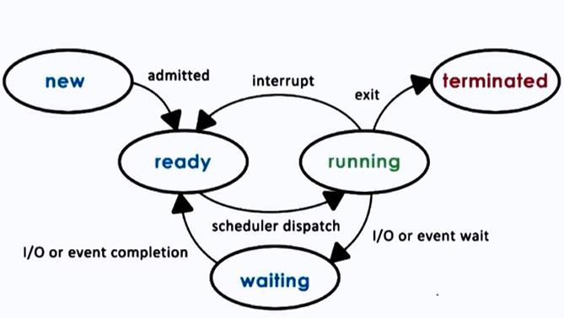
Process View point…

Slide 37
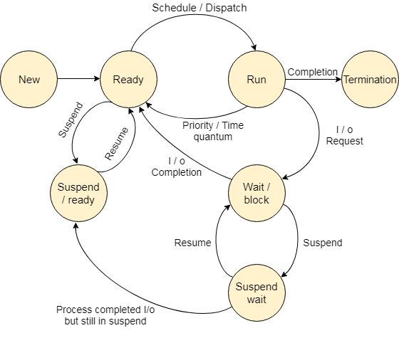
Process View point…

Slide 38
Extended Machine View
Bare Machine – a computer without its software clothing. Eg. program
  MOVE C,B
  FIND-SPACE 80,X
  READ-CARD X
  COMPARE X(2),’/*’
  TRANSFER-MATCH END

Slide 39
Extended Machine View…
Statements 1,4,5 are computer instructions.
Statements 2 and 3 are required tens, hundreds or even thousands of instructions to be correctly and efficiently accomplished on a modern computer – they involve interaction with some of the key system resources, such as memory and I/O.
The instructions to perform these kinds of resource management functions are usually provided by the OS.
The sum of these instructions is called the instruction set of the extended machine

Slide 40
Extended Machine View…
Extended Machine
Process 1
Process 3
Bare Machine
Process 2
Process 4

Slide 41
Hierarchical Machine View…
Key functions needed by many systems modules could be separated into an “inner extended machine”
Certain modules could be separated out and run on the extended machine in essentially the same way as user processes.

Slide 42
Hierarchical Machine View
BareMachine
Outer extended machine
Process 3
n
Process 1
Inner extended machine
Bare machine
Process 4
Process 2

Slide 43
Hierarchical Machine View…
Primitive functions in the various levels of the kernel are
Level 1 : Processor Management Lower level
  The P synchronization primitive
  The V synchronization primitive
  Process scheduling – the mechanism of multiprogramming
Level 2 : Memory Management
  Allocate memory
  Release (free) memory

Slide 44
Hierarchical Machine View…
Level 3 : Processor Management Upper level
  Create/destroy process
  Send/receive messages between processes
  Stop process
  Start process
Level 4 : Device Management
  Keep track of status of all I/O devices
  Schedule I/O
  Initiate I/O process
Level 5 : Information Management
  Create/destroy file
  Open/close file
  Read/write files

Slide 45
I/O Programming
I/O programming
Types of I/O channels
I/O programming concepts
I/O process structure
Communication between the CPU and the channel
I/O Example using Single buffering
I/O Example using Double buffering
Multiple card buffering

Slide 46
I/O Programming…
Memory
Card Reader
Processor
Card Reader
Printer
Mag tape
Mag tape

Slide 47
I/O Programming…
Three basic components – the CPU, main memory, I/O devices.
Speed disparity between CPU and I/O devices motivated the development of I/O channel
I/O channels are directly connected to the memory
the I/O devices connected to the I/O channel

Slide 48
I/O channels
I/O Channel definition: I/O channels or I/O processors provide a path or channel for the data to flow between I/O devices and main memory.
Specialized processing units intended to operate the I/O devices.
I/O operations are executed via the channel, the CPU is free to perform its high speed computations without wasting time for I/O.

Slide 49
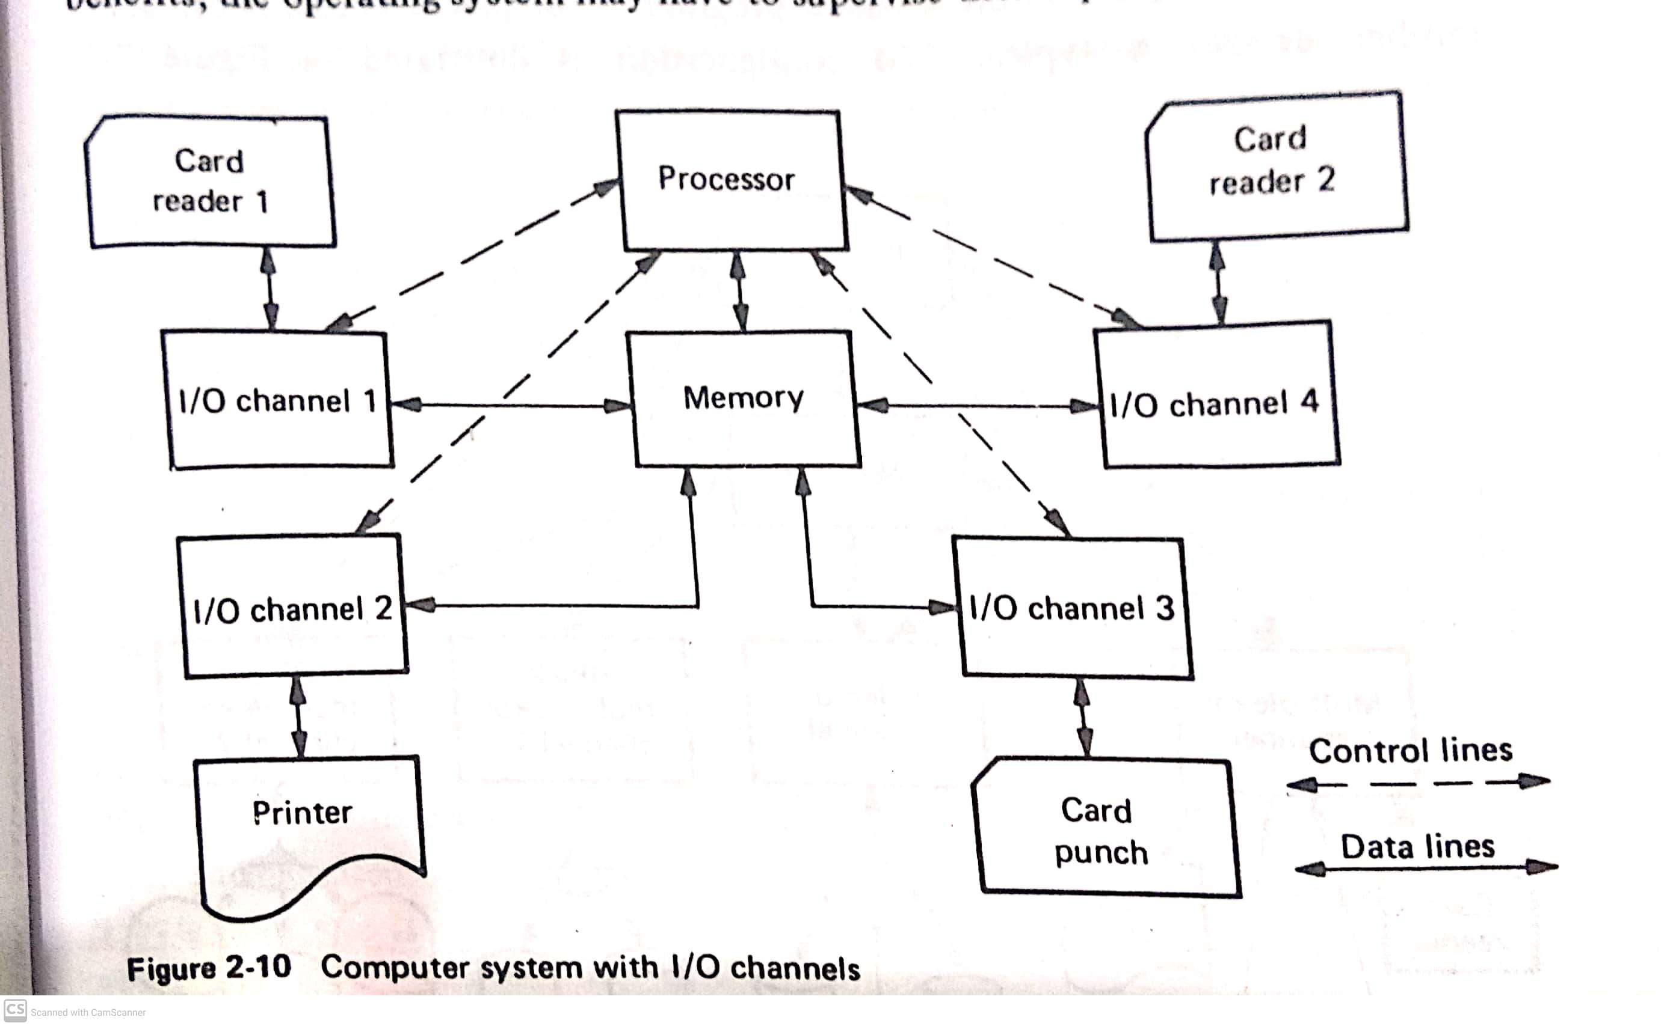
Computer System with I/O channel

Slide 50
Types of I/O channels
Selector Channel
Multiplexor Channel
Block Multiplexor Channel
Selector Channel : can service only one device at a time, i.e., one device is selected for service. These channels used for very high speed devices. eg. Magnetic tapes, disks and drums, each I/O request is usually completed quickly and then another device selected for I/O.

Slide 51
Types of I/O channels…
Multiplexor Channel : simultaneously service many devices (up to 256) for slow devices such as card readers, card punches and printers.
Block Multiplexor Channel : allows multiple channel programs for high speed devices to be active on the same I/O channel.

Slide 52
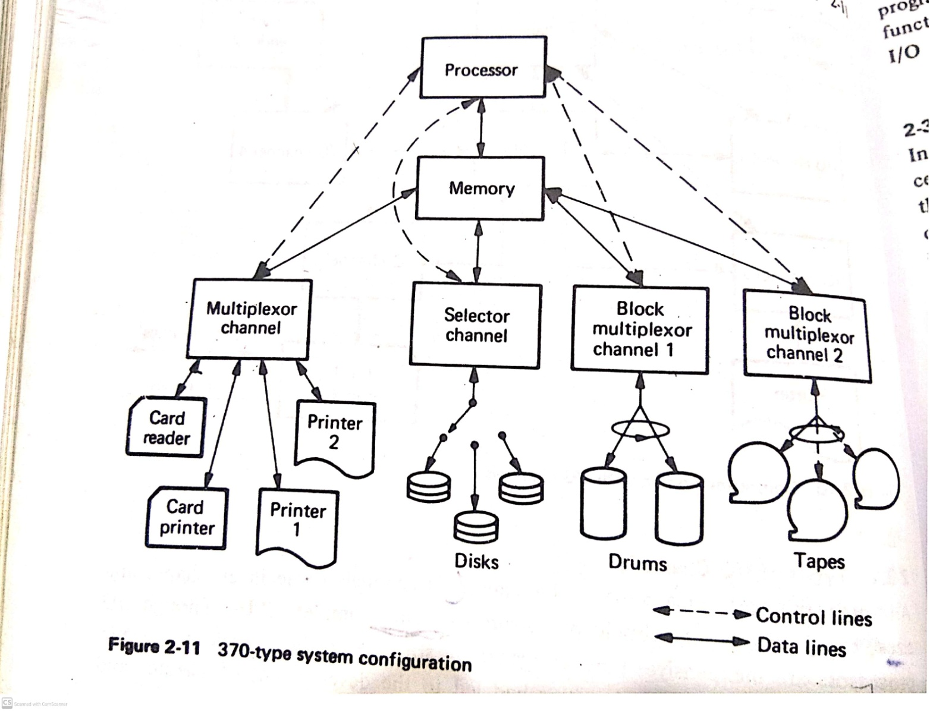
Types of I/O channels…

Slide 53
I/O Programming Concepts
CPU communicates with the I/O processor by START I/O, HALT I/O and TEST I/O .
The I/O processor communicate with the CPU by interrupts
I/O channel instructions are called as I/O commands.
The programs written using sets of I/O commands are known as I/O programs or I/O programming

Slide 54
I/O Processor Structure – 360 and 370
Memory - 2²⁴ Bytes.
Registers – I/O channels has no explicit registers, but some I/O channels have an Instruction Address Register and Data counter similar to CPU working register.
Data - only logical character data handled ( string of consecutive bytes from 1 to 2¹⁶ -1 ) EBCDIC to BCD

Slide 55
I/O Processor Structure – 360 and 370…
Instructions – three basic grouping of I/O commands : Data transfer : read, read backwards, write, sense ( read device status)
Device Control : control ( page eject, tape rewind, etc.)
Branching : transfer of control within the channel program.

Slide 56
I/O Processor Structure – 360 and 370…
The channel fetches the channel commands ( Channel Command Words (CCW)) from memory and decodes them to 64 bit format
0-7 – opcode – command to be performed
8-31 – Data address – beginning location of the data field
32-36 – Flags
37-47 – unused
48-63 - Count

Slide 57
I/O Processor Structure – 360 and 370…
Flags :
Bit 32 – Data chain flag – storage area designed by the next CCW, once the current data area count is exhausted.
Bit 33 – Command Chain Flag – next sequential CCW is to be executed on normal execution of the current command
Bit 34 – Suppress length indication flag - suppresses the indication to the program of an incorrect length
Bit 35 – Skip flag - suppression of transfer of information to storage.
Bit 36 - Programmed Controlled interruption flag - channel to generate an interruption condition when this CCW takes control of the channel.

Slide 58
Special Features
The channel has an internal register acts as Instruction Address Register (IAR)
Multiplexor or block multiplexor has more IAR, one IAR per device
3 specific words of memory are used for status information.
The Channel Address Word (CAW) starts at memory location 72₁₀ .contains the address of the first instruction to be executed by the channel.
The channel refers to the CAW during the execution of the START I/O (SIO) by the CPU.

Slide 59
Special Features…
Channel Status Word (CSW)contains coded information indicating the status of the channel at the location 64₁₀.
The format of CSW is a double word.
0-7 – Protection keys
8-31 – Next CCW address
32-47 – Status
48-63 – Residual count

Slide 60
Special Features…
Key – protection key used by channel
Address – address of next channel command
Status – e.g., building on fire, I/O completed, I/O error
Count – how many bytes of the last CCW were not processed.

Slide 61
Example of an I/O Program
Location | Opcode | Data Address | Flag | Unused | Count | Action
400 | 88 | XXXXXX | 40 | 00 | XXXX | Skip to new page
408 | 01 | 010008 | 60 | 00 | 0008 | Print line
410 | 08 | XXXXXX | 40 | 00 | XXXX | Advance 1 line
418 | 89 | 010010 | 00 | 00 | 0014 | Print 20 Character line Eject to next page and Stop
    010008 “ GOOD DAY”
010010 “YOU ARE NOW ON A 370 “

Slide 62
Communication between the CPU and the Channel
The purpose of I/O channel is to free the CPU.
The CPU and channel in a master/slave relationship
The CPU tells the channel when to start and commands it to stop or change what it is doing.
2 types of communications between CPU and channel
  CPU to channel I/O instructions initiated by the CPU.
  Channel to CPU interrupt initiated by the channel.

Slide 63
Communication between the CPU and the Channel…
CPU instruction format
0-7 – opcode
8-15 – unused
16-19 – B₁
20-31 – D₁
The channel and device number are specified by the sum of the contents of register B₁ and D₁ field.
Bits 16-23 contains the channel address and
Bits 24-31 contains the device on the channel.

Slide 64
CPU instructions
START I/O (SIO) : the channel and device number , the beginning address of the channel program are needed. eg. SIO X’00E’. Channel number 0 & device number 0E. Location 72-75 in memory contain the CAW –specifies the start of the channel program.
TEST I/O (TIO) : The CPU indicates the state of the addressed channel and device by setting the Condition Code (CC) ( busy or not).
HALT I/O (HIO) : Execution of the current I/O operation at the addressed I/O device and channel is abruptly terminated.

Slide 65
CPU instructions…
CC – 8 –OK
  2 – Busy
  1 - not operational
  4 – indicates that there is a lot more to tell us in the CSW

Slide 66
I/O Program
Assuming that I/O interrupts are disabled, the following sequence will start up an I/O program
Label | Opcode | Operand | Action
 | LA | 1,CCWADDR | Set I/O program
 | ST | 1,72 | Address into CAW
 | SIO | X’00E’ | Start I/O on Device X’00E’
 | BC | 4+2+1, ERROR | If not CC=8, then Error
TESTIO | TIO | X,’00E’ | Test if I/O completed yet
 | BC | 4+2, TESTIO | If still Busy, Test again

Slide 67
Single Buffering for card reading and printing
Series of steps 1 to 4 will be continued until reading and printing completed.
Issue SIO for reading a card into BUFFER area
Wait for I/O channel to finish reading
Issue SIO for printing a line out of BUFFER area
Wait for I/O channel to finish printing

Slide 68
Double Buffering for card reading and printing
Series of steps 1 to 8 will be continued until reading and printing completed using two buffers.
Issue SIO for reading a card into BUFF1 area
Wait for reader to finish
Wait for printer ready
SIO print out of BUFF1
SIO read into BUFF2
Wait for reader to finish
Wait for printer ready
SIO printer out of BUFF2
The steps 4 & 5 are performing at the same time
Similarly in the second cycle the 8th and 1st steps are going at same time

Slide 69
Interrupt Structure and Processing
Interrupt
Interrupt types
Interrupt Mechanism
Interrupt Handler Processing
Example of Exceptional Interrupt Processing
Example of Asynchronous Interrupt Processing

Slide 70
Interrupt
An Interrupt is (1) a response to an asynchronous or exceptional event that (2) automatically saves the current CPU status to allow later restart and (3) causes an automatic transfer to a specified routine ( called an interrupt handler)

Slide 71
Figure : Locus of a process through an interrupt
Started here
1
3
Interrupt occurs
Program
Program finishes
2
Interrupt process
starts
Interrupt routine
Interrupt processing
completed

Slide 72
Types of Interrupt
Input / Output Interrupt
Program Interrupt
Supervisor Call Interrupt (SVC Instruction)
External Interrupt
Machine-Check Interrupt ( Possible Hardware failure was detected)

Slide 73
Types of Interrupt…
Input/Output Interrupt
  Invalid I/O Command
  I/O channel end ( Channel finished)
  I/O device end ( Device finished)
Program Interrupt
  Invalid CPU Instruction
  Fixed-point arithmetic overflow
  Storage protection violation

Slide 74
Types of Interrupt…
External Interrupt
  Interval timer going off
  Operators interrupt button
  CPU-to-CPU communication interrupt

Slide 75
Interrupt Mechanism
How CPU status can be saved and control transferred to an interrupt handling routine.
The ‘state’ or current condition of the CPU is stored in a double word register called the Program Status Word (PSW).
PSW is used to control instruction sequencing and to hold and indicate the current status of the system in relation to the program currently being executed.

Slide 76
Interrupt Mechanism…
The active or controlling PSW is the ‘current’ PSW.
By storing the PSW during an interruption, the status of the CPU can be preserved for inspection or reloading.
By loading a new PSW or part of one, the state of the CPU can be changed.

Slide 77
Interrupt Mechanism…
The format of PSW
0
7 8
11 12
15 16
31
System mask
Prot. key
Flags
Interruption Code
ILC
CC
Program mask
Instruction address
32
33 34
35 36
39 40
63

Slide 78
Interrupt Mechanism…
PSW format
System Mask – indicates whether the CPU wishes to accept interrupts from a specific channel,
  Bit 0 turned on - 0th Channel
  Bit 1 turned on – 1st Channel
  Bit 2 turned on – 2nd Channel
  Bit 3 turned on – 3rd Channel
  Bit 4 turned on – 4th Channel
  Bit 5 turned on – 5th Channel
  Bit 6 turned on – 6th or above are allowed through 5 must be turned on if channels 0 through 5 respectively are allowed to interrupt.
  Bit 7 turned on – The external interrupts are allowed.
  If the I/O interrupts are masked and an interrupt occurs, then the hardware automatically suspends that interrupt for later processing.

Slide 79
Interrupt Mechanism…
PSW format…
Protection Key – for protection purpose, main storage is divided into blocks,
Each block of memory is associated with a lock.
Lock may be set and examined by appropriate privileged instruction. Read/Write protect or only write protect.
Flags – (EMWP)- E – extended mode, M – Machine check mode, W-wait state mode, P- problem state mode. P is 0= supervisory or 1= user state, W indicates the processor either is running (W=0) or is stopped (W=1) waiting for an interrupt.

Slide 80
Interrupt Mechanism…
PSW format…
Interrupt code- contains coded information as to the type of interrupt last received.
ILC- Instruction Length Code contains the length of the last instruction executed.- allows the programmer to trace back one instruction.
CC- Condition Code contains the current value of the condition code. Automatically set by certain instructions, such as arithmetic, comparison etc.
Program mask - contain information to mask some other types of interrupt. If such an interrupt is masked and occurs, it is lost.

Slide 81
Interrupt Mechanism…
PSW format…
Instruction Address – contains address of the next instruction to be executed.
Status switching instructions – Load PSW (LPSW), Set Program Mask (SPM), Set System Mask (SSM), Supervisor Call (SVC) and Set Storage Key (SSK) – most of these instructions are executed only in supervisor mode.

Slide 82
Interrupt Mechanism…
5 classes of interrupts – I/O, program, supervisor call, external and machine check – has associated with it two doublewords called ‘old’ and ’new’ PSWs. Stored in the main memory at predetermined storage locations.
When interrupt occurs, the interrupt hardware mechanism (1) stores the current PSW in the old position and (2) loads the current PSW from the new position – the instruction sequence transfers to the interrupt handler routine specified (3) there is usually an LPSW instruction to make the old PSW as current PSW again.

Slide 83
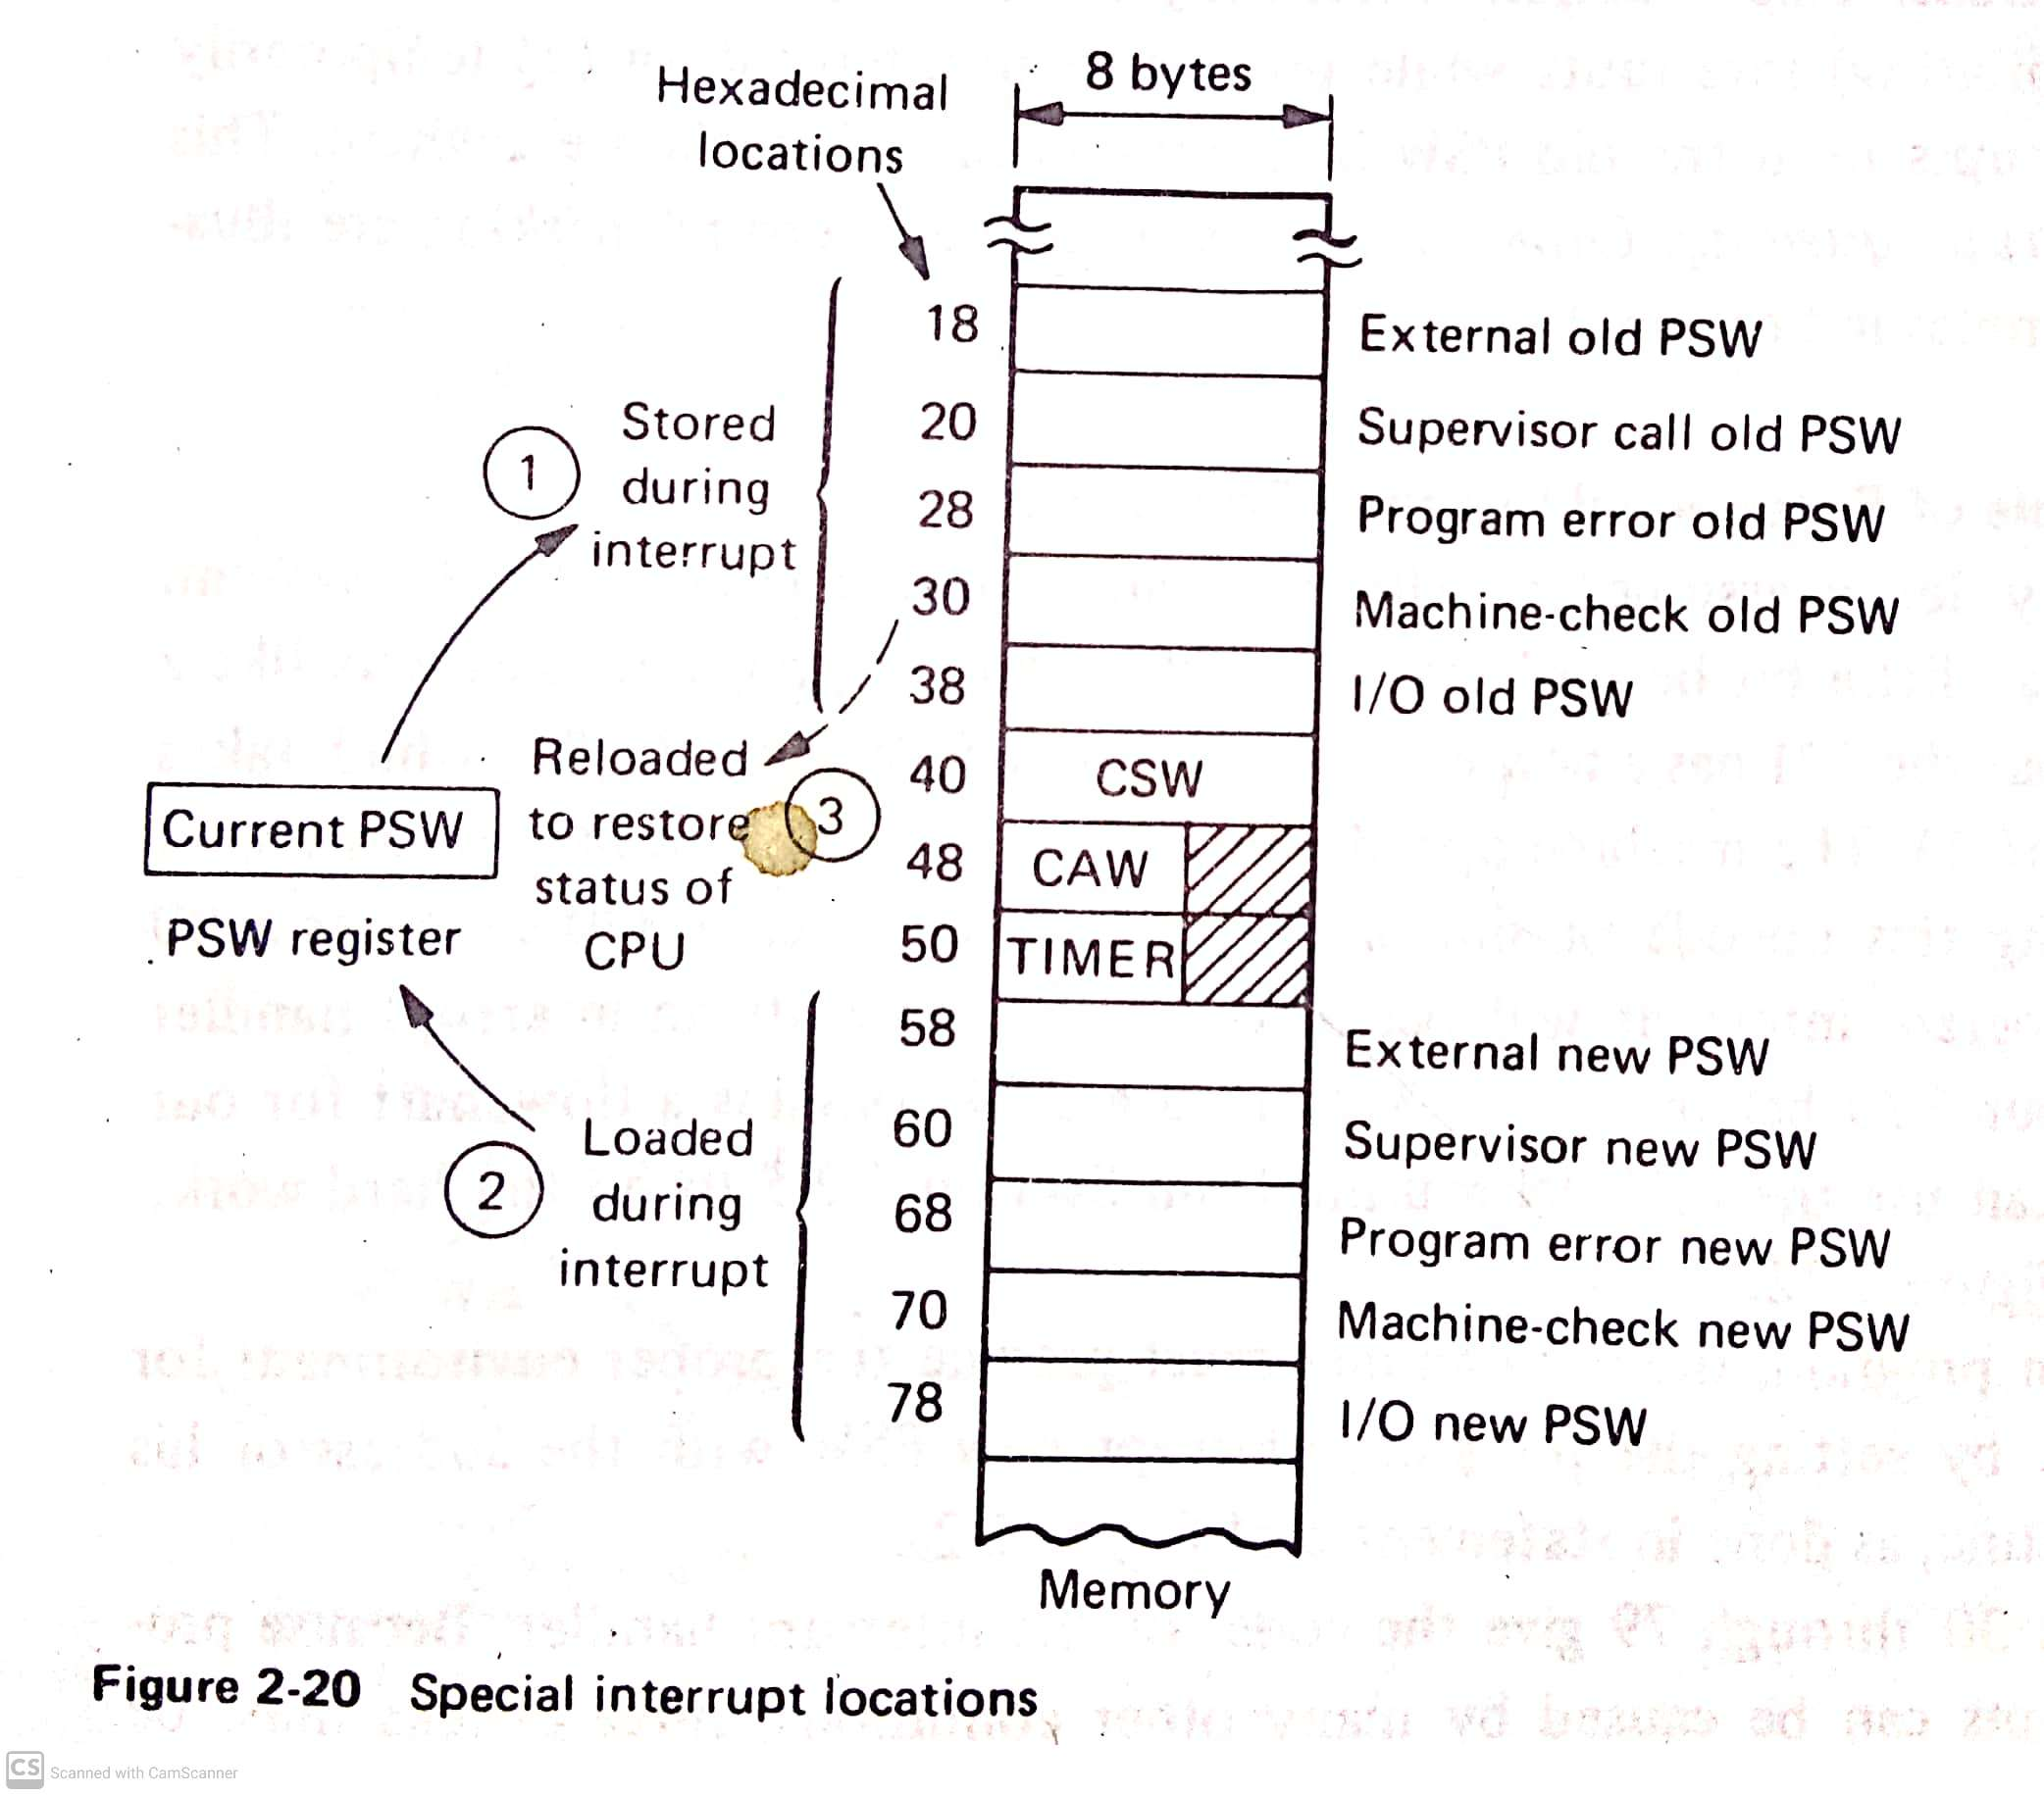
Interrupt Mechanism…

Slide 84
Interrupt Handler Processing
The interrupt routine can access the appropriate old PSW to ascertain the condition that caused the interrupt.
The old PSW contains an interrupt code and the location of the program being executed when the interrupt occurred.
Each interrupt has a unique interrupt code : 01 - invalid operation; 02 – privileged operation; 08 – fixed point overflow, etc. for program interrupts

Slide 85
Interrupt Handler Processing…
When an I/O interrupt occurs, the PSW interrupt code indicates the channel and device causing the interrupt.
The CSW status field automatically set at the same time, contains information that indicates the cause of the interrupt; CSW bit 36=1 means channel end; CSW bit 37 = 1 means device end, etc.
The interrupt code set by an SVC interrupt corresponds to the one-byte immediate data field of the SVC instruction.

Slide 86
Interrupt Handler Processing…
How to prohibit interrupts
  Completely masking (prohibiting) interrupts while processing an interrupt
  Temporarily masking interrupts until the old PSW is safely copied and stacked elsewhere. This is called interrupt queuing

Slide 87
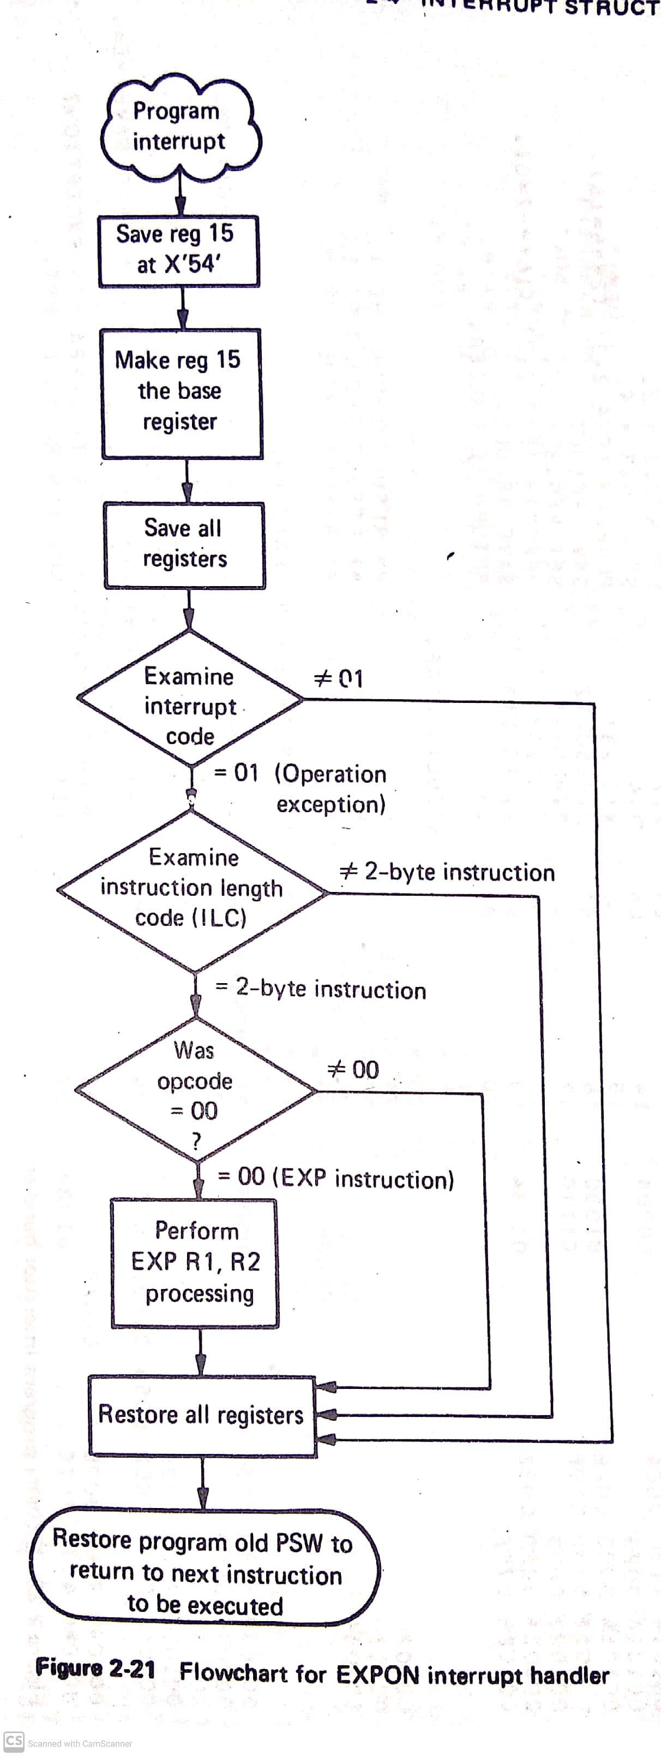
Example of Exceptional Interrupt Processing

Slide 88
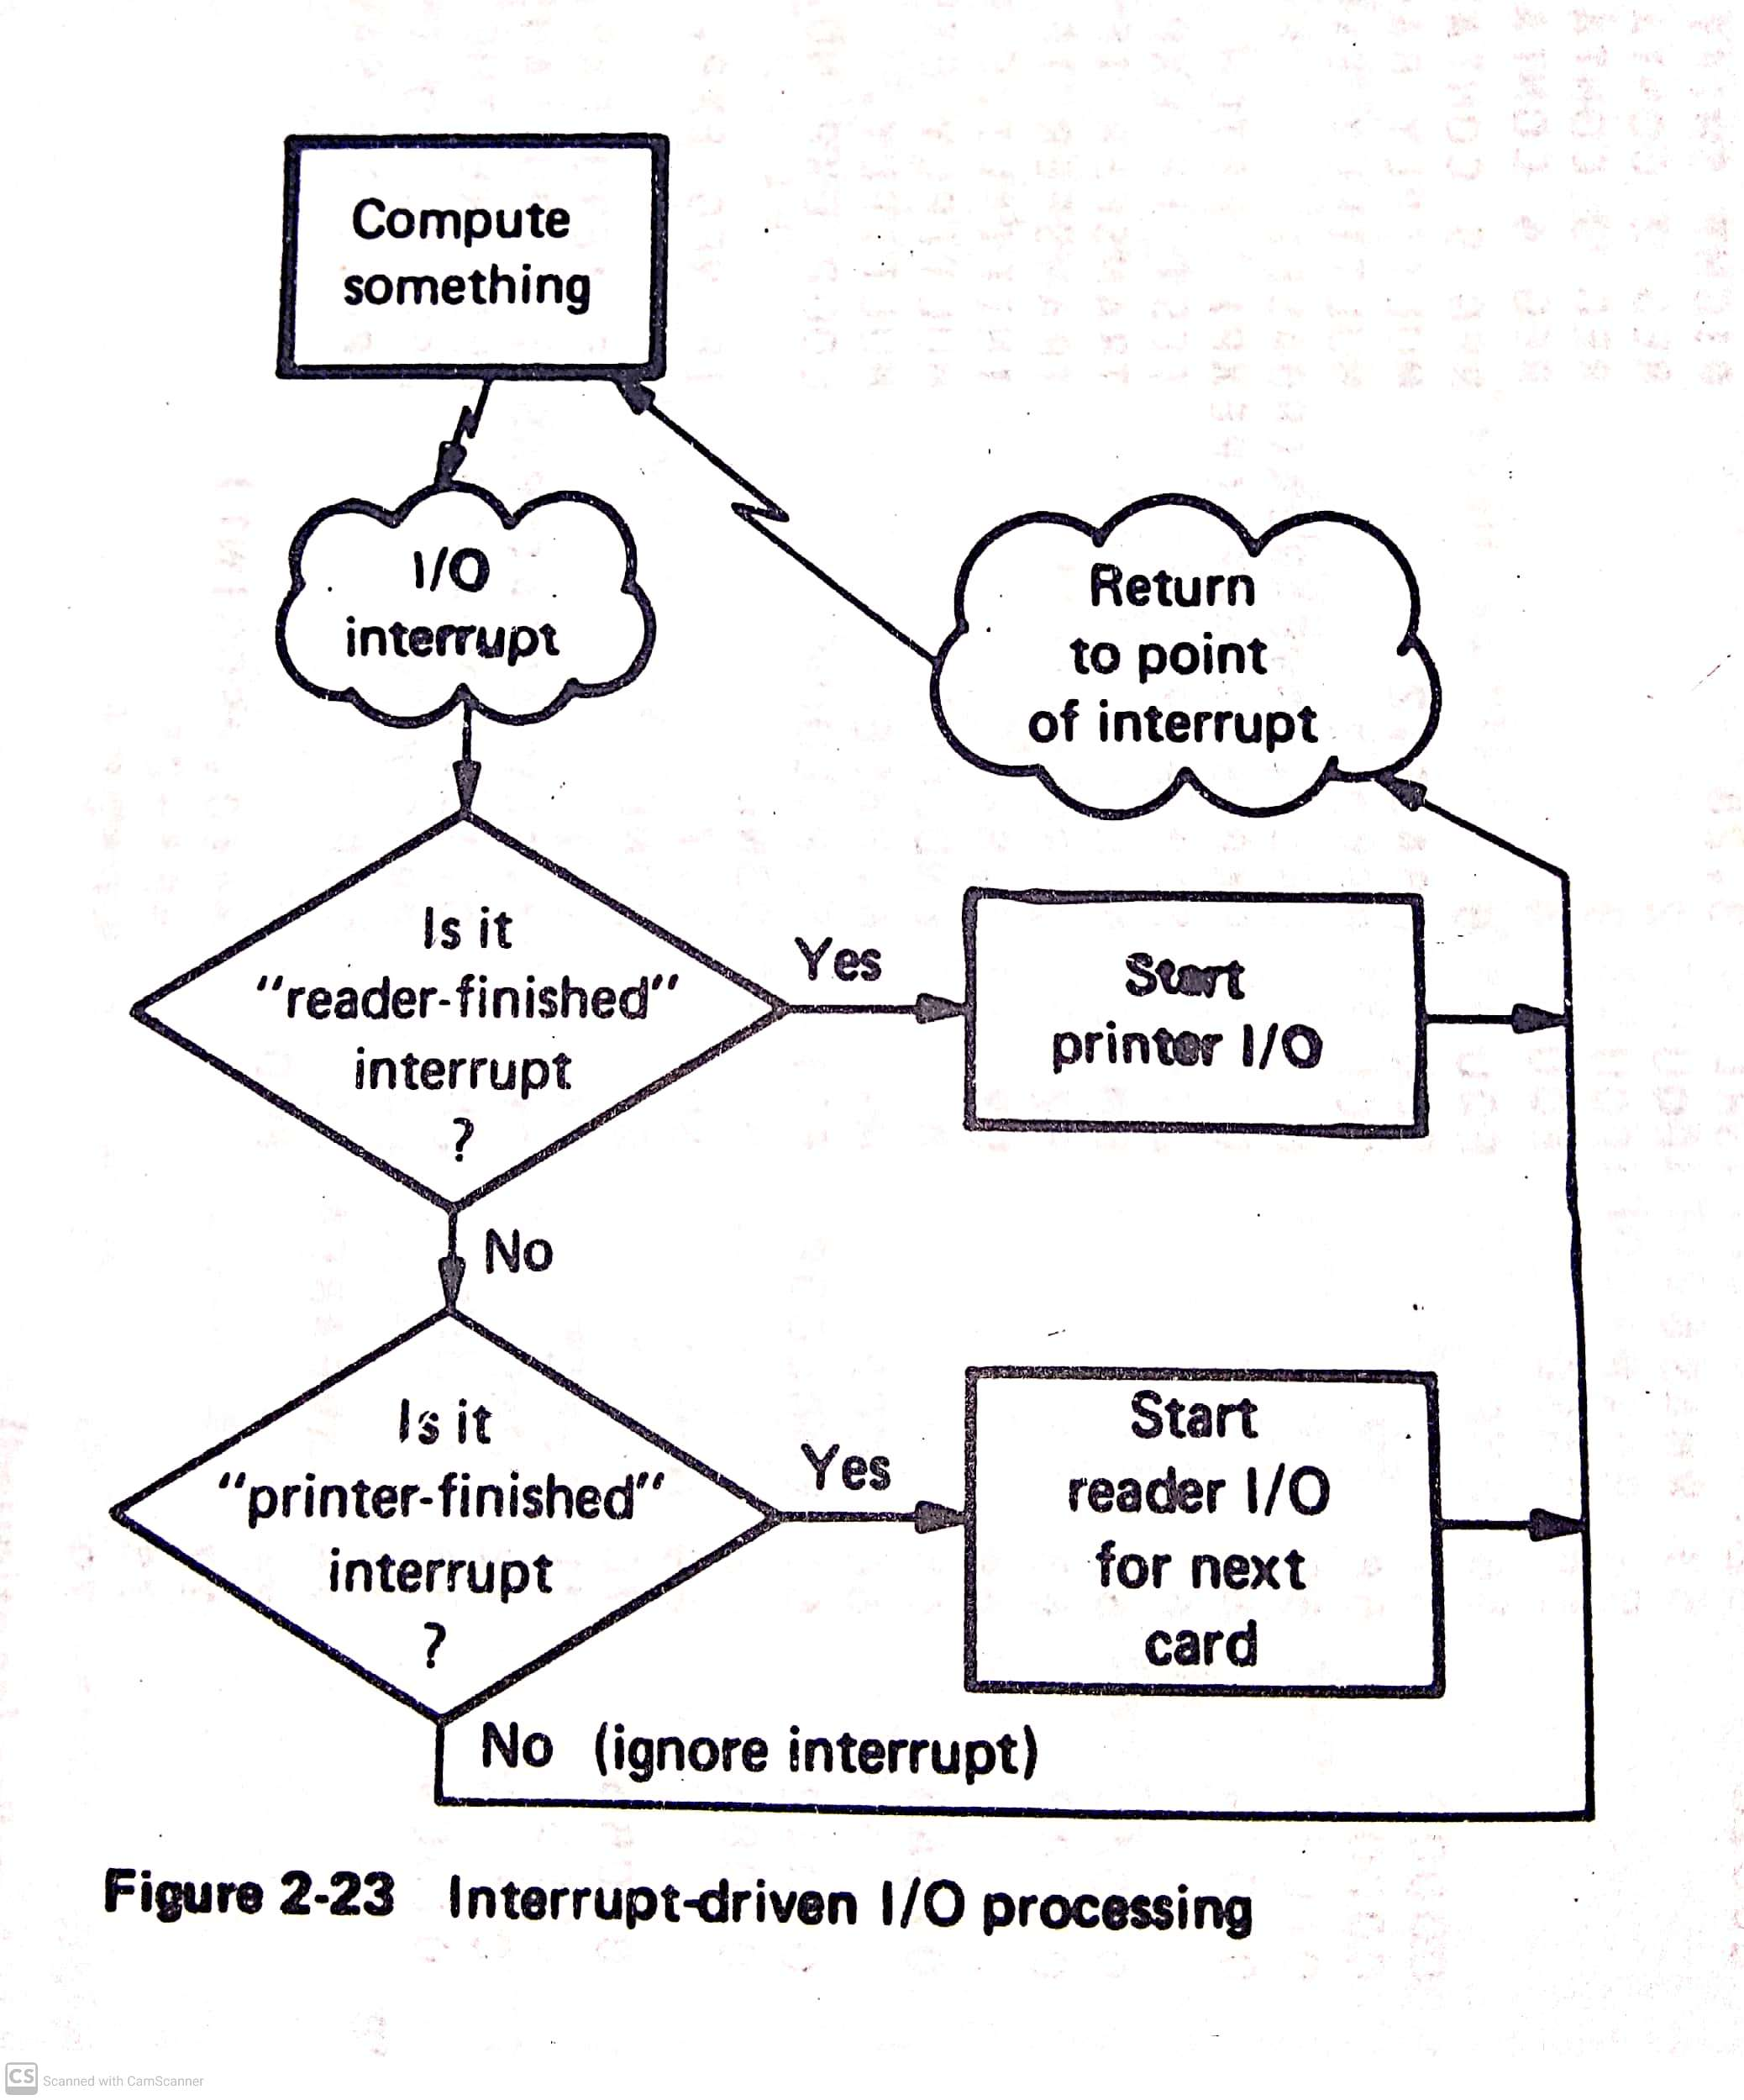
Example of Asynchronous Interrupt Processing

Slide 89
Unit I over

