Slide 1
GOVERNMENT COLLEGE FOR WOMEN(A)
KUMBAKONAM
DEPARTMENT OF COMPUTER SCIENCE
COMPUTER ARCHITECTURE
&
FUNDAMENTALS OF MICROPROCESSOR
STAFF NAME : S.SUNDARESWARI
CLASS : III B.Sc (CS) Shift I & Shift II
DATE : 4/08/2020
TIME : 10.30am to 11.30 am

Slide 2
Computer Organization |
Historically there have been 2 types of Computers:
Fixed Program Computers – Their function is very specific and they couldn’t be programmed, e.g. Calculators.
Stored Program Computers – These can be programmed to carry out many different tasks, applications are stored on them, hence the name.
The modern computers are based on a stored-program concept introduced by John Von Neumann. In this stored-program concept, programs and data are stored in a separate storage unit called memories and are treated the same. This novel idea meant that a computer built with this architecture would be much easier to reprogram.
It is also known as IAS computer and is having three basic units:

Slide 3
Von Neumann and Harvard Architecture
Von Neumann Architecture:
Von Neumann Architecture is a digital computer architecture whose design is based on the concept of stored program computers where program data and instruction data are stored in the same memory. This architecture was designed by the famous mathematician and physicist John Von Neumann in 1945.

Slide 4
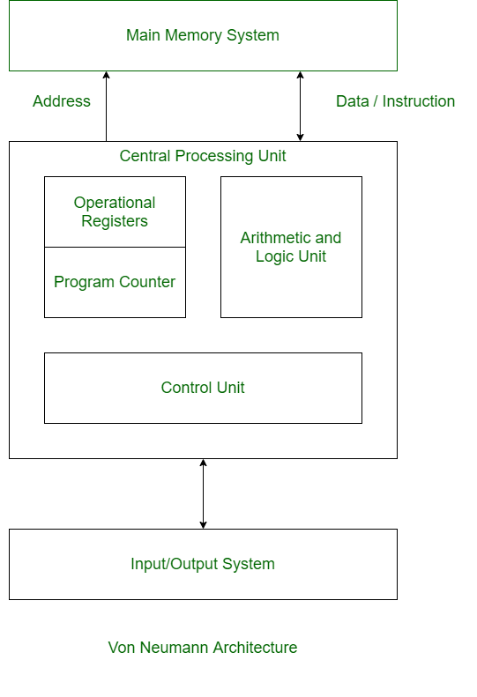

Slide 5
Harvard Architecture:
Harvard Architecture is the digital computer architecture whose design is based on the concept where there are separate storage and separate buses (signal path) for instruction and data. It was basically developed to overcome the bottleneck of Von Neumann Architecture.

Slide 6
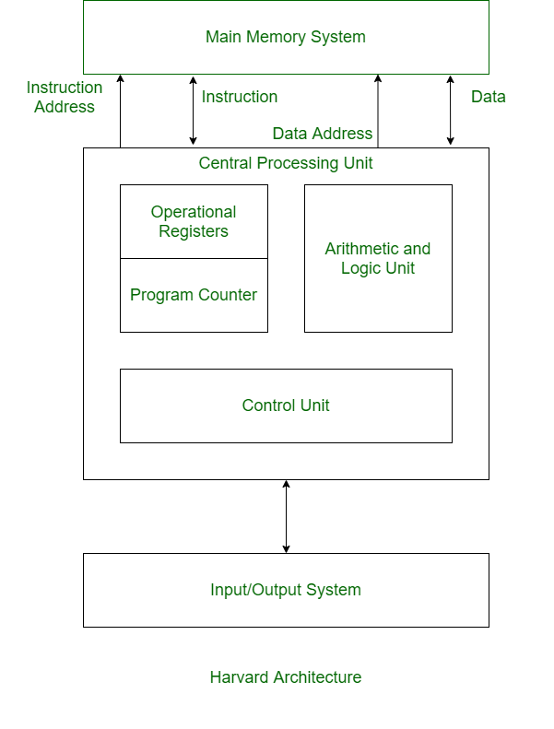

Slide 7
VON NEWMANN ARCHITECTURE
It is ancient computer architecture based on stored program computer concept.
Same physical memory address is used for instructions and data.
There is common bus for data and instruction transfer.
Two clock cycles are required to execute single instruction.
It is cheaper in cost.
CPU can not access instructions and read/write at the same time.
It is used in personal computers and small computers.

Slide 8
HARVARD ARCHITECTURE
It is modern computer architecture based on Harvard Mark I relay based model.
Separate physical memory address is used for instructions and data.
Separate buses are used for transferring data and instruction.
An instruction is executed in a single cycle.
It is costly than von neumann architecture.
CPU can access instructions and read/write at the same time.
It is used in micro controllers and signal processing.

Slide 9
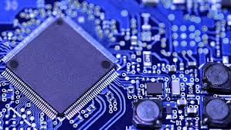

Slide 10
introduction
Computer architecture is the conceptual design and fundamental operational structure of a computer system.

Slide 11
Computer architecture can be classified into three main categories:
Instruction Set Architecture, or ISA, is the image of a computing system that is seen by a machine language programmer. It includes the instruction set, word size, memory address modes, processor registers, and address and data formats.
Computer Organization is a lower level and detailed description of the system that involves how the different parts of the system are interconnected and how they interoperate in order to implement the ISA.
System Design which includes all of the other hardware components within a computing system such as:
  Computer buses and switches
  Memory controllers
  Direct Memory Access (DMA)
  Issues like multi-processing

Slide 12
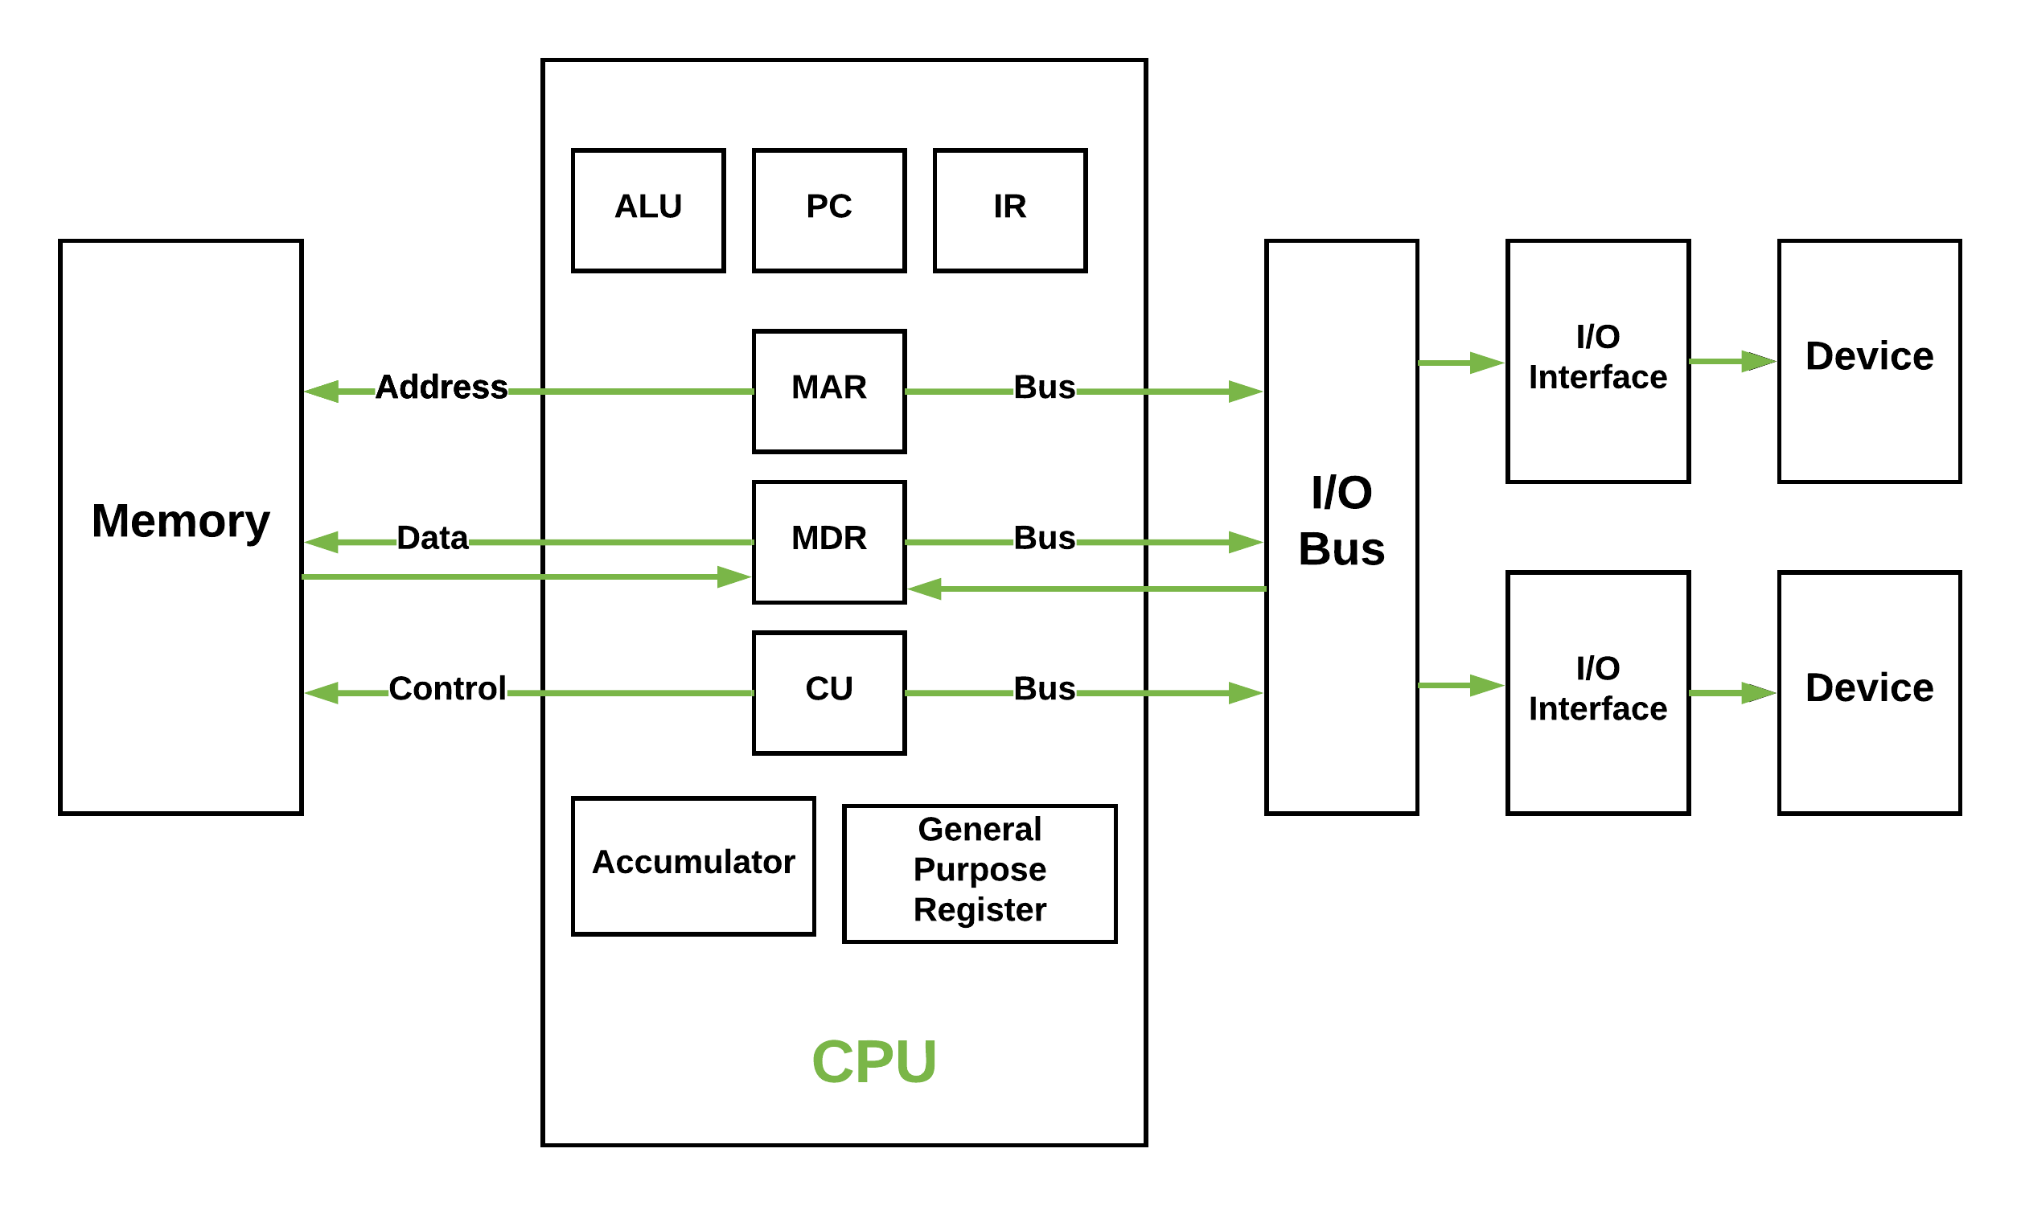

Slide 13
EXAMPLE
int a,b,c;
scanf(“%d %d,&a,&b);
c = a + b
printf (“%d”,c);

Slide 14
The Central Processing Unit (CPU)
The Main Memory Unit
The Input/Output Device
Control Unit –A control unit (CU) handles all processor control signals. It directs all input and output flow, fetches code for instructions and controlling how data moves around the system.
Arithmetic and Logic Unit (ALU) –The arithmetic logic unit is that part of the CPU that handles all the calculations the CPU may need, e.g. Addition, Subtraction, Comparisons. It performs Logical Operations, Bit Shifting Operations, and Arithmetic Operation.

Slide 15
Main Memory Unit (Registers)
  Accumulator: Stores the results of calculations made by ALU.
  Program Counter (PC): Keeps track of the memory location of the next instructions to be dealt with. The PC then passes this next address to Memory Address Register (MAR).
  Memory Address Register (MAR): It stores the memory locations of instructions that need to be fetched from memory or stored into memory.
  Memory Data Register (MDR): It stores instructions fetched from memory or any data that is to be transferred to, and stored in, memory.
  Current Instruction Register (CIR): It stores the most recently fetched instructions while it is waiting to be coded and executed.
  Instruction Buffer Register (IBR): The instruction that is not to be executed immediately is placed in the instruction buffer register IBR.
.

Slide 16
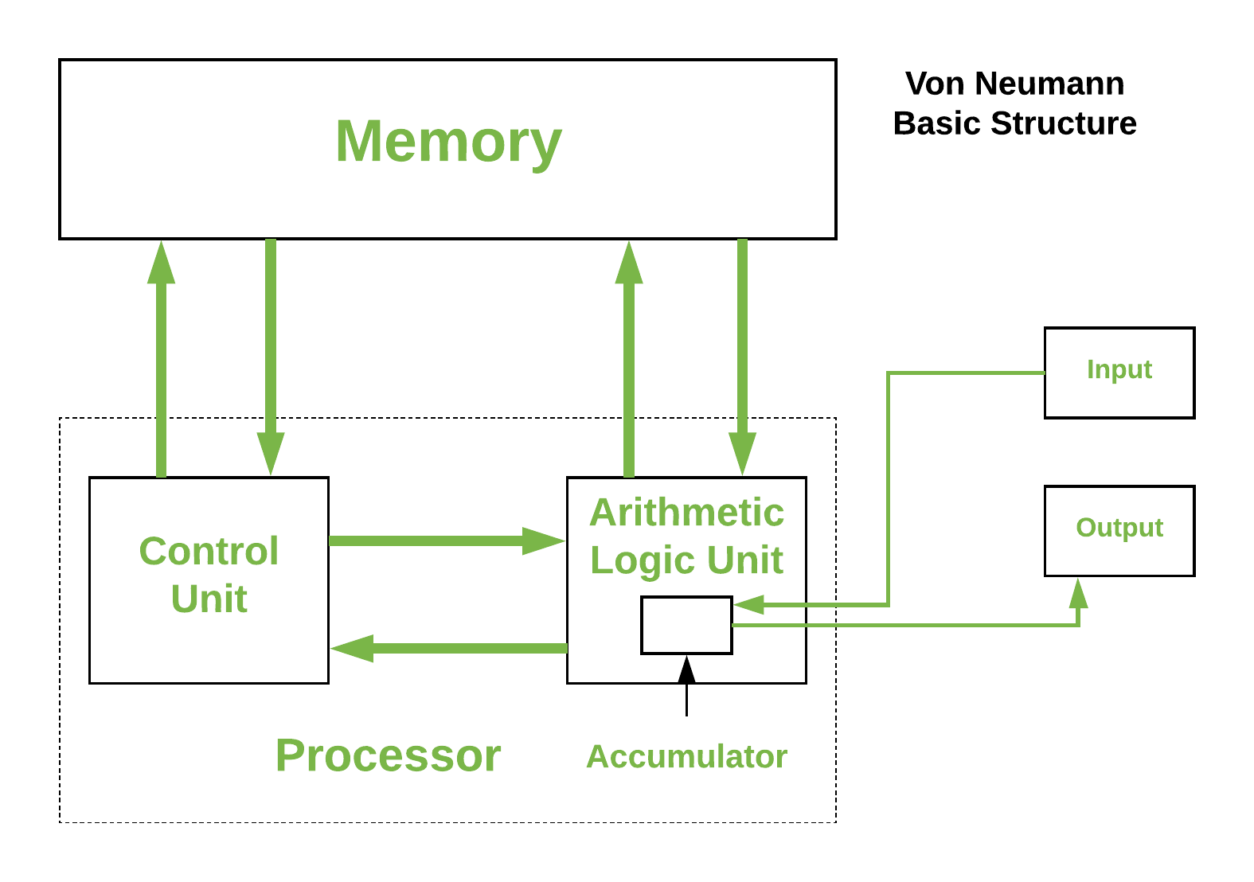

Slide 17
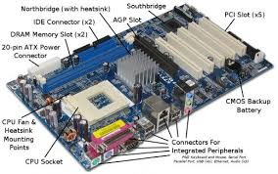

Slide 18
Input/Output Devices – Program or data is read into main memory from the input device or secondary storage under the control of CPU input instruction. Output devices are used to output the information from a computer. If some results are evaluated by computer and it is stored in the computer, then with the help of output devices, we can present it to the user.

Slide 19
Buses – Data is transmitted from one part of a computer to another, connecting all major internal components to the CPU and memory, by the means of Buses. Types:
  Data Bus: It carries data among the memory unit, the I/O devices, and the processor.
  Address Bus: It carries the address of data (not the actual data) between memory and processor.
  Control Bus: It carries control commands from the CPU (and status signals from other devices) in order to control and coordinate all the activities within the computer.

Slide 20
BOOLEAN RULES AND THEIR DUALS
Rule 1a : A+ 0 = A | 1b : A.1 =A
Rule 2a : A+1 = 1 | 2b : A.0 =0
Rule 3a : A+A =A | 3b : A.A = A
Rule 4a : A+Ā = 1 | 4b : A.Ā = 0
Rule 5a : A | 5a : A
Rule 6a : A + AB =A | 6a : A (A+B) = A
Rule 7a : A+ = A+B | 7a : A( + B) = A.B
Rule 8a : A + BC = (A+B) (A+C) | 8b : A(B+C) = AB +BC
Rule 9a : AB + +BC = AB + | 9b : (A+B)( +C)(B+C) = (A+B) ( +C)

Slide 21
ACTIVITY
BINARY,DECIMAL,OCTAL and HEXA NUMBER SYSTEM,BCD,EXCESS – 3 CODE,GRAY CODE.
RAM
ROM
SRAM
DRAM

Slide 22
THANK YOU

