Slide 1
Bresenham Line Drawing Algorithm
Given the starting and ending coordinates of a line,
Bresenham Line Drawing Algorithm attempts to generate the points between the starting and ending coordinates.
Procedure-
Given-
Starting coordinates = (X₀, Y₀)
Ending coordinates = (X_{n}, Y_{n})
The points generation using Bresenham Line Drawing Algorithm involves the following steps

Slide 2
Step-01:
Calculate ΔX and ΔY from the given input.
These parameters are calculated as-
ΔX = X_{n} – X₀
ΔY =Y_{n} – Y₀
Step-02:
Calculate the decision parameter P_{k}.
It is calculated as-
P_{k} = 2ΔY – ΔX
Step-03:
Suppose the current point is (X_{k}, Y_{k}) and the next point is (X_{k+1}, Y_{k+1}).
Find the next point depending on the value of decision parameter P_{k}.
Follow the below two cases-

Slide 3
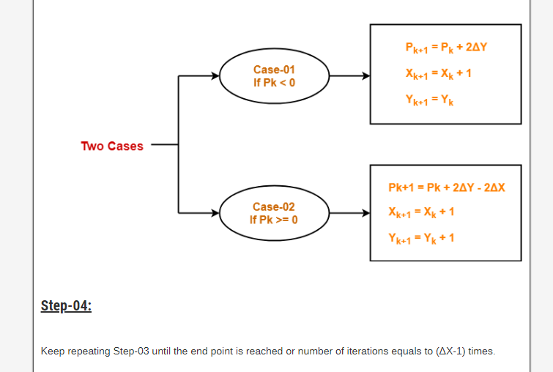

Slide 4
Problem-01:
Calculate the points between the starting coordinates (9, 18) and ending coordinates (14, 22).
Solution
Given
Starting coordinates = (X₀, Y₀) = (9, 18)
Ending coordinates = (X_{n}, Y_{n}) = (14, 22)
Step-01:
Calculate ΔX and ΔY from the given input.
ΔX = X_{n} – X₀ = 14 – 9 = 5
ΔY =Y_{n} – Y₀ = 22 – 18 = 4
Slope = ΔY / ΔX = 4/5=0.8 <1

Slide 5
Step-02:
Calculate the decision parameter.
P₀ = 2ΔY – ΔX
= 2 x 4 – 5
= 3
So, decision parameter P_{k} = P₀ = 3
Step-03:
As P_{k} >= 0, so case-02 is satisfied.
Thus,
P_{k+1} = P_{k} + 2ΔY – 2ΔX = 3 + (2 x 4) – (2 x 5) = 1
X_{k+1} = X_{k} + 1 = 9 + 1 = 10
Y_{k+1} = Y_{k} + 1 = 18 + 1 = 19

Slide 6
Similarly, Step-03 is executed until the end point is reached or number of iterations equals to 4 times.
As P_{k} >= 0, so case-02 is satisfied.
Thus,
P_{k+1} = P_{k} + 2ΔY – 2ΔX = 1 + (2 x 4) – (2 x 5) = -1
X_{k+1} = X_{k} + 1 = 10+ 1 = 11
Y_{k+1} = Y_{k} + 1 = 19 + 1 = 20
As P_{k} <0, so case-01 is satisfied.
Thus,
P_{k+1} = P_{k} + 2ΔY = -1 + (2 x 4) = 7
X_{k+1} = X_{k} + 1 = 11 + 1 = 12
Y_{k+1} = 20

Slide 7
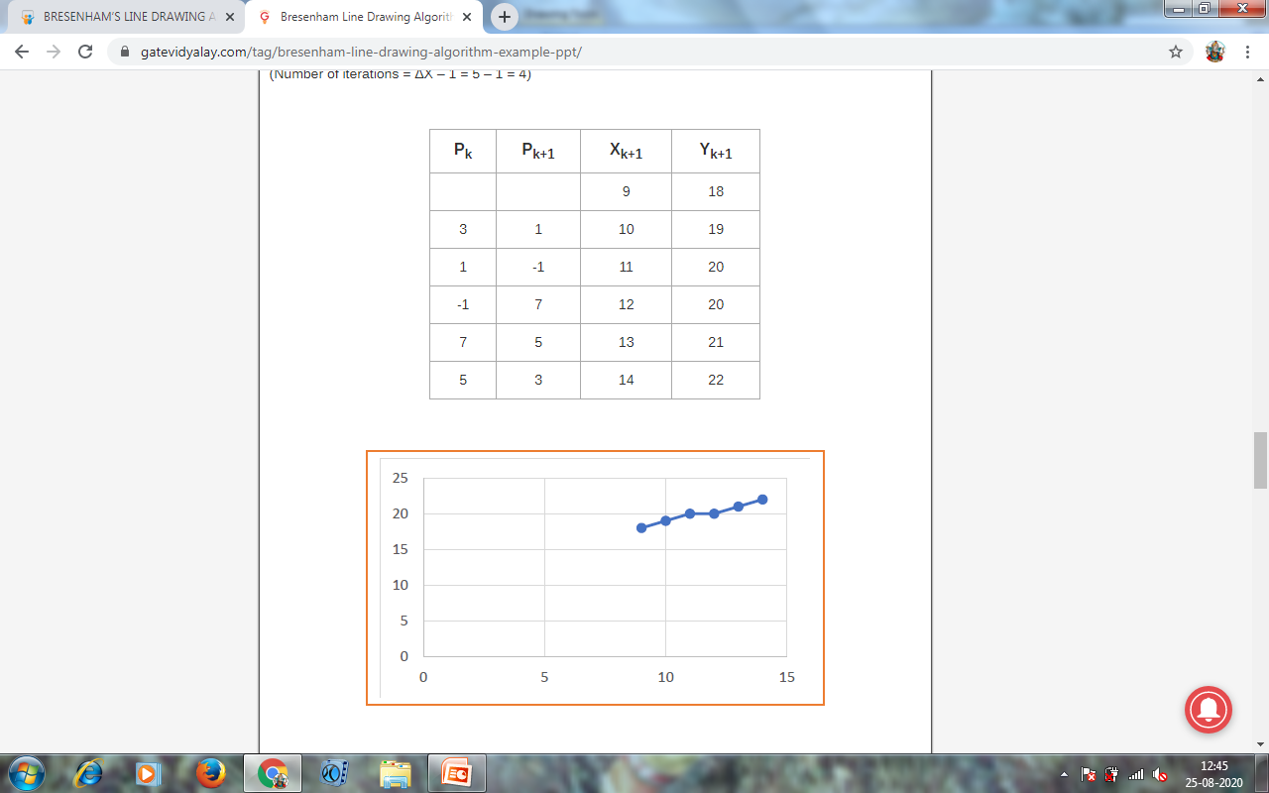

Slide 8
Problem 2:
Calculate the points between the starting coordinates (20, 10) and ending coordinates (30, 18).

