Slide 1
Bresenham Line Drawing Algorithm
Given the starting and ending coordinates of a line,
Bresenham Line Drawing Algorithm attempts to generate the points between the starting and ending coordinates.
Procedure-
Given-
Starting coordinates = (X₀, Y₀)
Ending coordinates = (X_{n}, Y_{n})
The points generation using Bresenham Line Drawing Algorithm involves the following steps

Slide 2
Step-01:
Calculate ΔX and ΔY from the given input.
These parameters are calculated as-
ΔX = X_{n} – X₀
ΔY =Y_{n} – Y₀
Step-02:
Calculate the decision parameter P_{k}.
It is calculated as-
P_{k} = 2ΔY – ΔX
Step-03:
Suppose the current point is (X_{k}, Y_{k}) and the next point is (X_{k+1}, Y_{k+1}).
Find the next point depending on the value of decision parameter P_{k}.
Follow the below two cases-

Slide 3
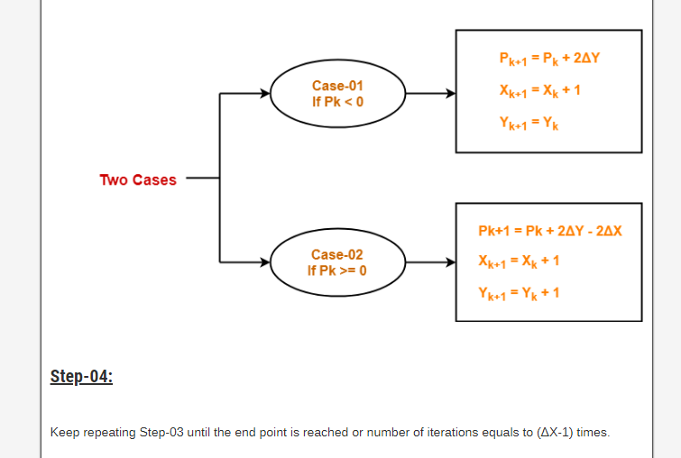

Slide 4
Problem-01:
Calculate the points between the starting coordinates (9, 18) and ending coordinates (14, 22).
Solution
Given
Starting coordinates = (X₀, Y₀) = (9, 18)
Ending coordinates = (X_{n}, Y_{n}) = (14, 22)
Step-01:
Calculate ΔX and ΔY from the given input.
ΔX = X_{n} – X₀ = 14 – 9 = 5
ΔY =Y_{n} – Y₀ = 22 – 18 = 4
Slope = ΔY / ΔX = 4/5=0.8 <1

Slide 5
Step-02:
Calculate the decision parameter.
P₀ = 2ΔY – ΔX
= 2 x 4 – 5
= 3
So, decision parameter P_{k} = P₀ = 3
Step-03:
As P_{k} >= 0, so case-02 is satisfied.
Thus,
P_{k+1} = P_{k} + 2ΔY – 2ΔX = 3 + (2 x 4) – (2 x 5) = 1
X_{k+1} = X_{k} + 1 = 9 + 1 = 10
Y_{k+1} = Y_{k} + 1 = 18 + 1 = 19

Slide 6
Similarly, Step-03 is executed until the end point is reached or number of iterations equals to 4 times.
As P_{k} >= 0, so case-02 is satisfied.
Thus,
P_{k+1} = P_{k} + 2ΔY – 2ΔX = 1 + (2 x 4) – (2 x 5) = -1
X_{k+1} = X_{k} + 1 = 10+ 1 = 11
Y_{k+1} = Y_{k} + 1 = 19 + 1 = 20
As P_{k} <0, so case-01 is satisfied.
Thus,
P_{k+1} = P_{k} + 2ΔY = -1 + (2 x 4) = 7
X_{k+1} = X_{k} + 1 = 11 + 1 = 12
Y_{k+1} = 20

Slide 7
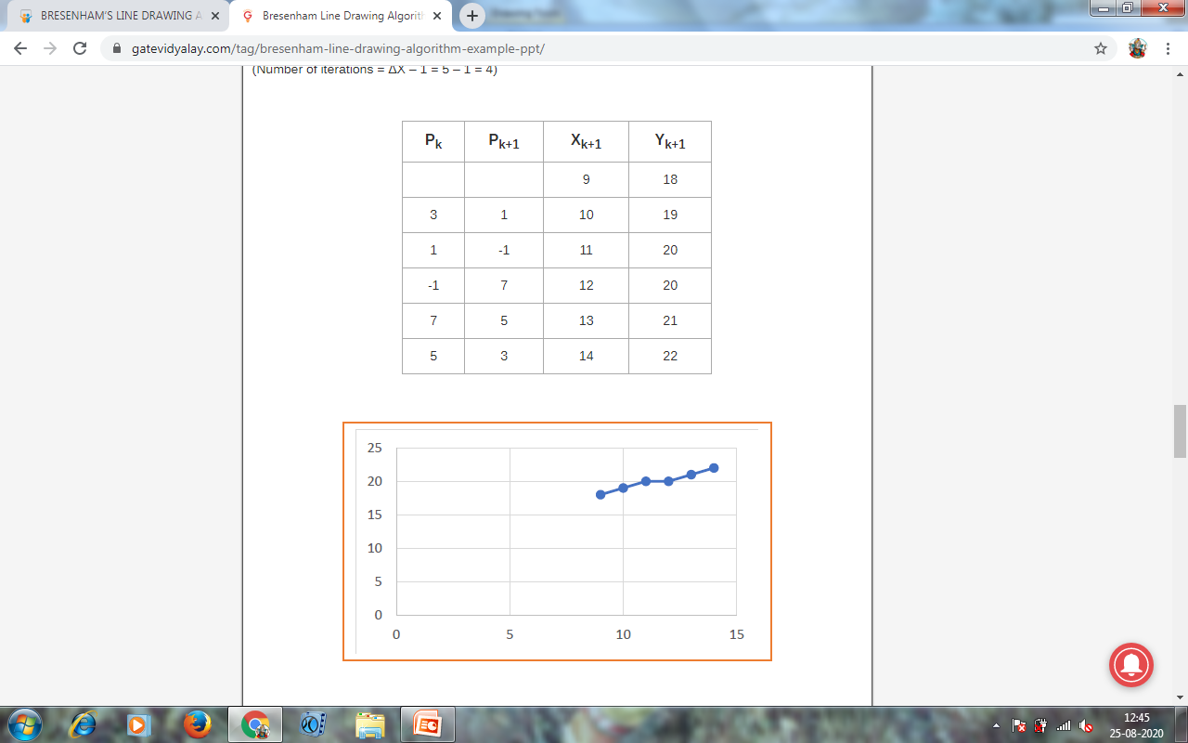

Slide 8
Problem 2:
Calculate the points between the starting coordinates (20, 10) and ending coordinates (30, 18).

Slide 9
Loading the frame buffer:
Straight line segments and other objects are scan converted for display with a raster system frame buffer position must be calculated.
Scan conversion algo. Generate pixel position at successive unit intervals.
This allows us to use incremental methods to calculate frame buffer addresses.
In row major order that pixel position
1. (0,0) Lower left corner
2. (X_{max,} Y_{max}) top right corner

Slide 10
The frame buffer it address for pixel position(x,y) is calculated as
addr(x,y)=addr(0,0)+(, Y_{max} +1)+X
To calculate the frame buffer address for the pixel at(x+1,y)
addr(x+1,y)=addr(x,y)+1
Frame buffer address of (x+1,y+1) with the calculation
addr(x+1,y+1)=addr(x,y)+x_{max}+2
set pixel which stores intensity values for the pixels at corresponding addr within the frame buffer.

Slide 11
Line function:
In PHIGS,GKS and some other packages, the 2D line function is Polyline(n,wcPoints)
n is assigned an integer value equal to the no of coordinate position to be input.
Wcpoints is the array of input world coordinate values for line segment endpoints.
Polyline the following segments generate two connected line segments with endpoints at (50,100) (150,250) (250,100)
wcPoint[1].x=50;
wcPoint[1].y=100;
wcPoint[2].x=150;
wcPoint[2].y=250;
wcPoint[3].x=250;
wcPoint[3].y=100;
Polyline(3,wcPoints);

