Slide 1
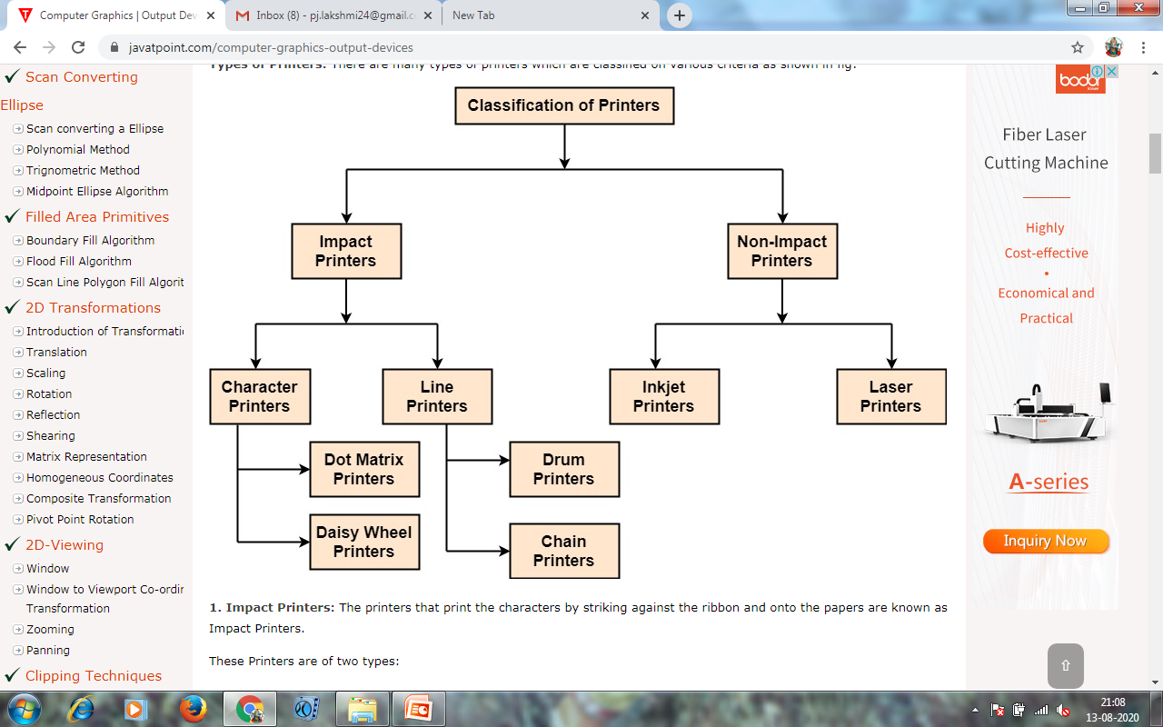
HARD-COPY DEVICES
Types of Printers: There are many types of printers which are classified on various criteria as shown in fig:

Slide 2
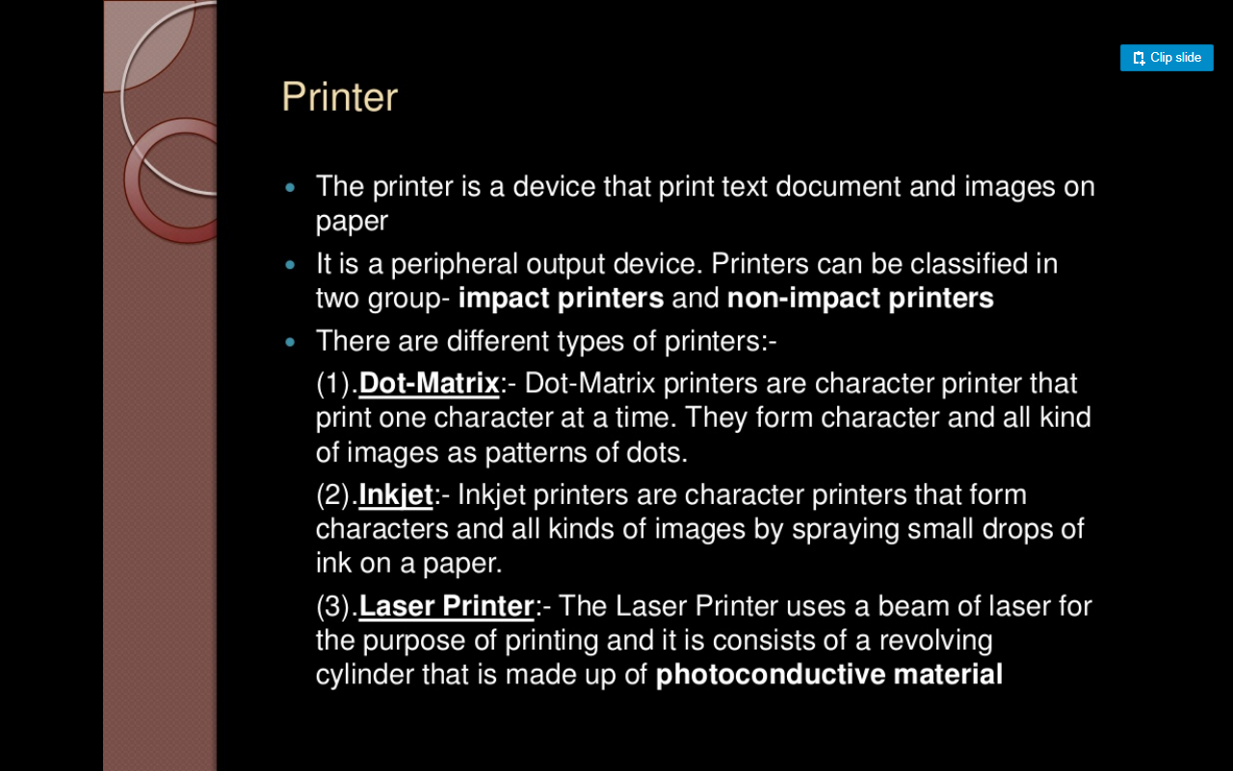

Slide 3
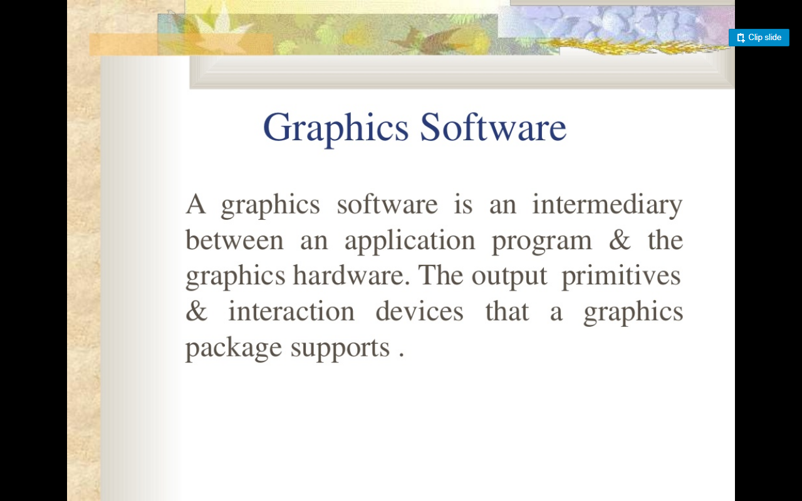

Slide 4
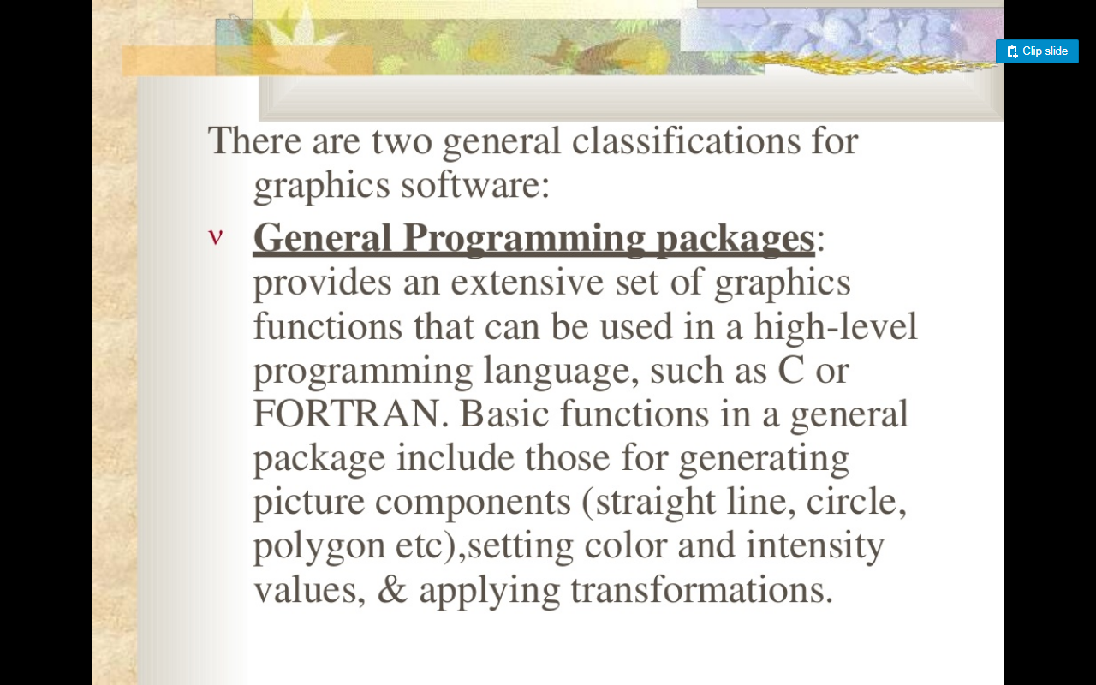

Slide 5
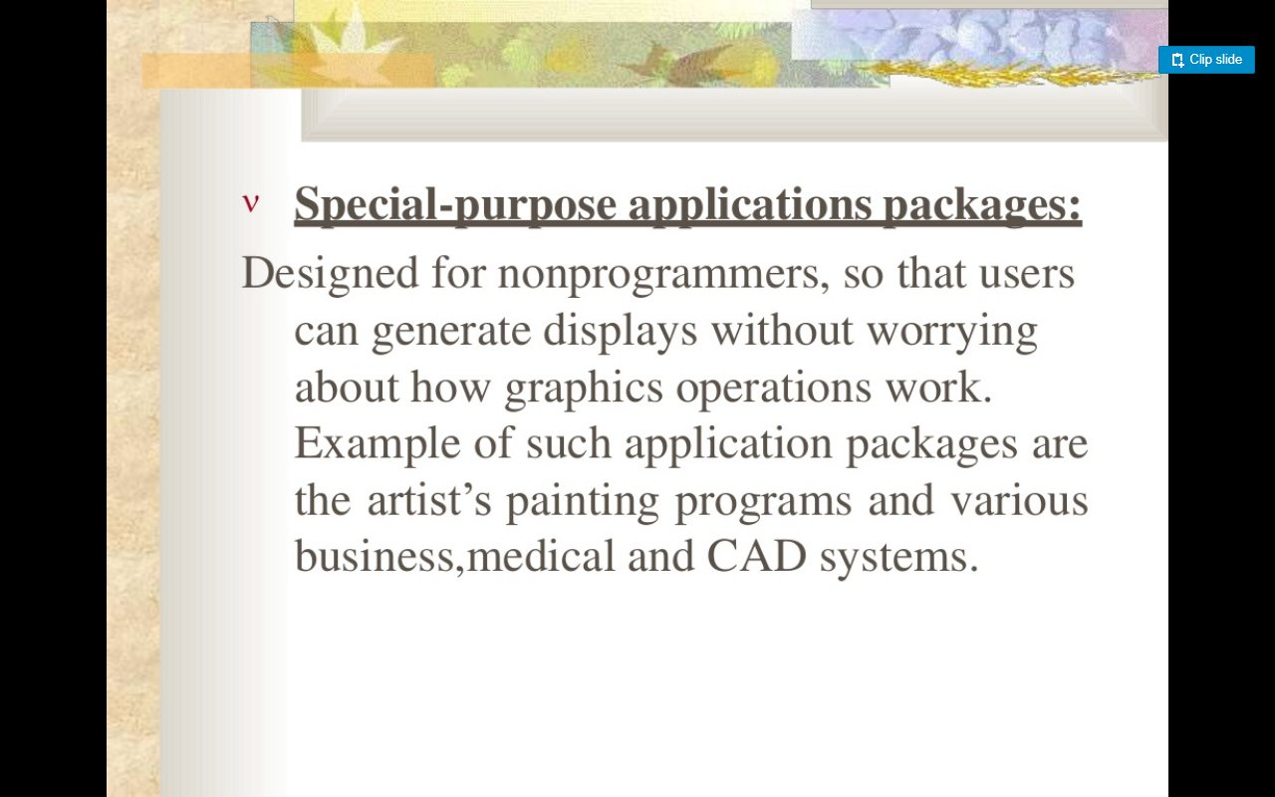

Slide 6
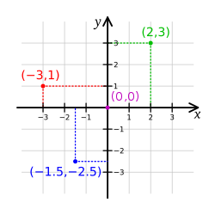
Coordinate Representation:
General graphics packages are designed to be used with Cartesian co ordinates.
Several different Cartesian reference frames are used to construct & display a scene.
Modeling transformation
World Coordinates
Normalized coordinates
Device Coordinates

Slide 7
Graphics Function:
These packages provides users with a variety of function for creating and manipulating pictures.
Output Primitives:
Basic building blocks (points, straight lines, curved lines, filled areas & shapes)
Attributes:
Properties of the output primitives (line styles, text styles, color specification and area filling patterns)
Geometric Transformation:
Changing size, position and orientation.

Slide 8
Modeling transformation:
Construct scene using object descriptions.
Viewing transformations:
Used to specify the view that is to be presented.
Input function:
Used to control & Process the data flow from the interactive devices(Mouse, joystick)
Control Orientations:
It contains the task such as clearing a display screen and initializing parameters.

Slide 9
SOFTWARE STANDARDS:
A standard graphics package such as
GSK – Graphical Kernel system.
PHIGS – Programmers Hierarchical Interactive Graphics Standards.

Slide 10
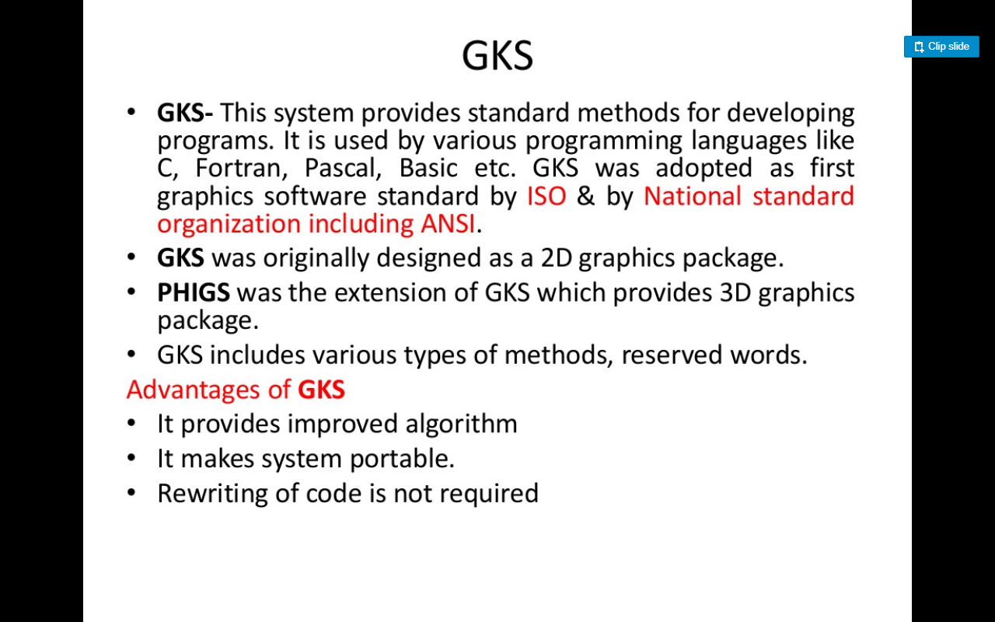

Slide 11
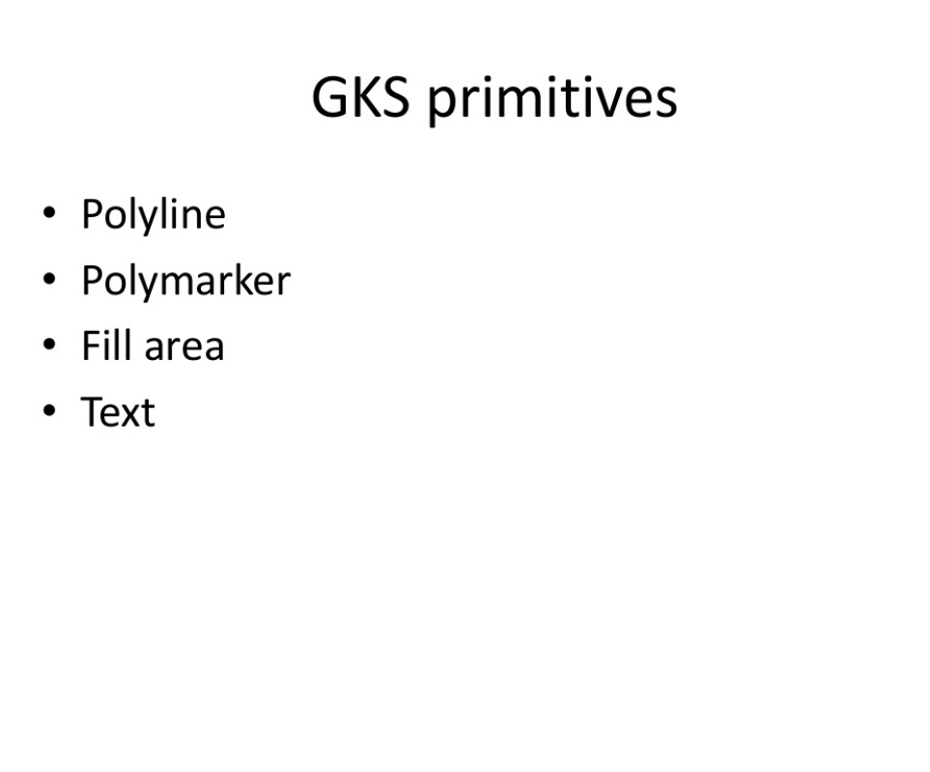

Slide 12
POLYLINES
The GKS function for drawing line segments is called ‘POLYLINE’
The ‘POLYLINE’ command takes an array of X-Y coordinates and creates line segments joining them. The elements that organize the look of a ‘POLYLINE’
Line type : solid, dashed or dotted.
Line width scale factor : thickness of the line.
Polyline color index : color of the line.

Slide 13
POLYMARKERS
The GKS POLYMARKER function permits to draw symbols of marker centered at coordinate points. The features that control the look of ‘POLYMARKERS’
Marker characters - dot, plus, asterisk, circle or cross.
Marker size scale factor - size of marker
· Polymarker color index - color of the marker.

Slide 14
FILLAREA
The GKS ‘FILL AREA’ function permits to denote a polygonal shape of a zone to be filled with various interior shapes. The features that control the look of fill areas.
FILL AREA interior style : solid colors, hatch patterns.
FILL AREA style index : horizontal lines; vertical lines; left slant lines; right slant lines; horizontal and vertical lines; or left slant and right slant lines.
Fill area color index : color of the fill patterns / solid areas.

Slide 15
TEXT:
The GKS TEXT function permits to sketch a text string at a specified coordinate place. The features that control the look of text are:
Text font and precision : text font should be used for the characters
Character expansion factor : height-to-width ratio of each character.
Character spacing : additional white space should be inserted between characters
Text color index : color the text string
Text path : direction the text should be written (right, left, up, or down).

Slide 16
