Slide 1
Data Mining: Concepts and Techniques — Chapter 9 —
1
Notes:
1

Slide 2
Chapter 9. Classification: Advanced Methods
Bayesian Belief Networks
Classification by Backpropagation
Support Vector Machines
Classification by Using Frequent Patterns
Lazy Learners (or Learning from Your Neighbors)
Other Classification Methods
Additional Topics Regarding Classification
Summary
2
Notes:
2

Slide 3
Bayesian Belief Networks
Bayesian belief networks (also known as Bayesian networks, probabilistic networks): allow class conditional independencies between subsets of variables
A (directed acyclic) graphical model of causal relationships
Represents dependency among the variables
Gives a specification of joint probability distribution
Nodes: random variables
Links: dependency
X and Y are the parents of Z, and Y is the parent of P
No dependency between Z and P
Has no loops/cycles
X
Y
Z
P
3
Notes:
3

Slide 4
Bayesian Belief Network: An Example
Family
History (FH)
Smoker (S)
CPT: Conditional Probability Table for variable LungCancer:
(FH, S)
(FH, ~S)
(~FH, S)
(~FH, ~S)
LC
0.8
0.5
0.7
0.1
LungCancer
(LC)
Emphysema
~LC
0.2
0.5
0.3
0.9
shows the conditional probability for each possible combination of its parents
PositiveXRay
Dyspnea
Derivation of the probability of a particular combination of values of X, from CPT:
Bayesian Belief Network

Slide 5
Training Bayesian Networks: Several Scenarios
Scenario 1: Given both the network structure and all variables observable: compute only the CPT entries
Scenario 2: Network structure known, some variables hidden: gradient descent (greedy hill-climbing) method, i.e., search for a solution along the steepest descent of a criterion function
Weights are initialized to random probability values
At each iteration, it moves towards what appears to be the best solution at the moment, w.o. backtracking
Weights are updated at each iteration & converge to local optimum
Scenario 3: Network structure unknown, all variables observable: search through the model space to reconstruct network topology
Scenario 4: Unknown structure, all hidden variables: No good algorithms known for this purpose
D. Heckerman. A Tutorial on Learning with Bayesian Networks. In Learning in Graphical Models, M. Jordan, ed.. MIT Press, 1999.

Slide 6
Chapter 9. Classification: Advanced Methods
Bayesian Belief Networks
Classification by Backpropagation
Support Vector Machines
Classification by Using Frequent Patterns
Lazy Learners (or Learning from Your Neighbors)
Other Classification Methods
Additional Topics Regarding Classification
Summary
6
Notes:
6

Slide 7
Classification by Backpropagation
Backpropagation: A neural network learning algorithm
Started by psychologists and neurobiologists to develop and test computational analogues of neurons
A neural network: A set of connected input/output units where each connection has a weight associated with it
During the learning phase, the network learns by adjusting the weights so as to be able to predict the correct class label of the input tuples
Also referred to as connectionist learning due to the connections between units

Slide 8
Neural Network as a Classifier
Weakness
Long training time
Require a number of parameters typically best determined empirically, e.g., the network topology or “structure.”
Poor interpretability: Difficult to interpret the symbolic meaning behind the learned weights and of “hidden units” in the network
Strength
High tolerance to noisy data
Ability to classify untrained patterns
Well-suited for continuous-valued inputs and outputs
Successful on an array of real-world data, e.g., hand-written letters
Algorithms are inherently parallel
Techniques have recently been developed for the extraction of rules from trained neural networks

Slide 9
A Multi-Layer Feed-Forward Neural Network
Output vector
Output layer
Hidden layer
w_{ij}
Input layer
Input vector: X
Notes:
MK: Note – different notation than used in book. Will have to standardize notation.

Slide 10
How A Multi-Layer Neural Network Works
The inputs to the network correspond to the attributes measured for each training tuple
Inputs are fed simultaneously into the units making up the input layer
They are then weighted and fed simultaneously to a hidden layer
The number of hidden layers is arbitrary, although usually only one
The weighted outputs of the last hidden layer are input to units making up the output layer, which emits the network's prediction
The network is feed-forward: None of the weights cycles back to an input unit or to an output unit of a previous layer
From a statistical point of view, networks perform nonlinear regression: Given enough hidden units and enough training samples, they can closely approximate any function

Slide 11
Defining a Network Topology
Decide the network topology: Specify # of units in the input layer, # of hidden layers (if > 1), # of units in each hidden layer, and # of units in the output layer
Normalize the input values for each attribute measured in the training tuples to [0.0—1.0]
One input unit per domain value, each initialized to 0
Output, if for classification and more than two classes, one output unit per class is used
Once a network has been trained and its accuracy is unacceptable, repeat the training process with a different network topology or a different set of initial weights

Slide 12
Backpropagation
Iteratively process a set of training tuples & compare the network's prediction with the actual known target value
For each training tuple, the weights are modified to minimize the mean squared error between the network's prediction and the actual target value
Modifications are made in the “backwards” direction: from the output layer, through each hidden layer down to the first hidden layer, hence “backpropagation”
Steps
Initialize weights to small random numbers, associated with biases
Propagate the inputs forward (by applying activation function)
Backpropagate the error (by updating weights and biases)
Terminating condition (when error is very small, etc.)

Slide 13
Neuron: A Hidden/Output Layer Unit
bias
μ_{k}
x₀
w₀
x₁
w₁
∑
f
output y
x_{n}
w_{n}
Input
vector x
weight
vector w
weighted
sum
Activation
function
An n-dimensional input vector x is mapped into variable y by means of the scalar product and a nonlinear function mapping
The inputs to unit are outputs from the previous layer. They are multiplied by their corresponding weights to form a weighted sum, which is added to the bias associated with unit. Then a nonlinear activation function is applied to it.
13
Notes:
13

Slide 14
Efficiency and Interpretability
Efficiency of backpropagation: Each epoch (one iteration through the training set) takes O(|D| * w), with |D| tuples and w weights, but # of epochs can be exponential to n, the number of inputs, in worst case
For easier comprehension: Rule extraction by network pruning
Simplify the network structure by removing weighted links that have the least effect on the trained network
Then perform link, unit, or activation value clustering
The set of input and activation values are studied to derive rules describing the relationship between the input and hidden unit layers
Sensitivity analysis: assess the impact that a given input variable has on a network output. The knowledge gained from this analysis can be represented in rules

Slide 15
Chapter 9. Classification: Advanced Methods
Bayesian Belief Networks
Classification by Backpropagation
Support Vector Machines
Classification by Using Frequent Patterns
Lazy Learners (or Learning from Your Neighbors)
Other Classification Methods
Additional Topics Regarding Classification
Summary
15
Notes:
15

Slide 16
Classification: A Mathematical Mapping
Classification: predicts categorical class labels
E.g., Personal homepage classification
x_{i} = (x₁, x₂, x₃, …), y_{i} = +1 or –1
x₁ : # of word “homepage”
x₂ : # of word “welcome”
Mathematically, x ∈ X = ℜ^{n}, y ∈ Y = {+1, –1},
We want to derive a function f: X → Y
Linear Classification
Binary Classification problem
Data above the red line belongs to class ‘x’
Data below red line belongs to class ‘o’
Examples: SVM, Perceptron, Probabilistic Classifiers
x
x
x
x
x
x
x
x
x
o
o
x
o
o
o
o
o
o
o
o
o
o
o
16
Notes:
16

Slide 17
Discriminative Classifiers
Advantages
Prediction accuracy is generally high
As compared to Bayesian methods – in general
Robust, works when training examples contain errors
Fast evaluation of the learned target function
Bayesian networks are normally slow
Criticism
Long training time
Difficult to understand the learned function (weights)
Bayesian networks can be used easily for pattern discovery
Not easy to incorporate domain knowledge
Easy in the form of priors on the data or distributions
17
Notes:
17

Slide 18
SVM—Support Vector Machines
A relatively new classification method for both linear and nonlinear data
It uses a nonlinear mapping to transform the original training data into a higher dimension
With the new dimension, it searches for the linear optimal separating hyperplane (i.e., “decision boundary”)
With an appropriate nonlinear mapping to a sufficiently high dimension, data from two classes can always be separated by a hyperplane
SVM finds this hyperplane using support vectors (“essential” training tuples) and margins (defined by the support vectors)

Slide 19
SVM—History and Applications
Vapnik and colleagues (1992)—groundwork from Vapnik & Chervonenkis’ statistical learning theory in 1960s
Features: training can be slow but accuracy is high owing to their ability to model complex nonlinear decision boundaries (margin maximization)
Used for: classification and numeric prediction
Applications:
handwritten digit recognition, object recognition, speaker identification, benchmarking time-series prediction tests

Slide 20
SVM—General Philosophy
Small Margin
Large Margin
Support Vectors

Slide 21
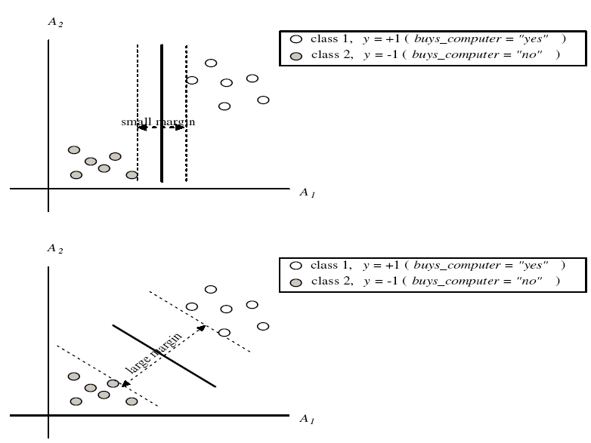
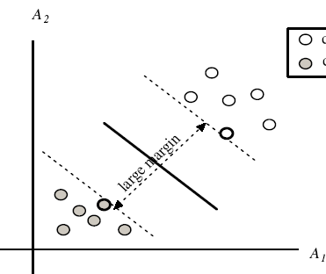
SVM—Margins and Support Vectors

Slide 22
SVM—When Data Is Linearly Separable
m
Let data D be (X₁, y₁), …, (X_{|D|}, y_{|D|}), where X_{i} is the set of training tuples associated with the class labels y_{i}
There are infinite lines (hyperplanes) separating the two classes but we want to find the best one (the one that minimizes classification error on unseen data)
SVM searches for the hyperplane with the largest margin, i.e., maximum marginal hyperplane (MMH)

Slide 23
SVM—Linearly Separable
A separating hyperplane can be written as
W ● X + b = 0
where W={w₁, w₂, …, w_{n}} is a weight vector and b a scalar (bias)
For 2-D it can be written as
w₀ + w₁ x₁ + w₂ x₂ = 0
The hyperplane defining the sides of the margin:
H₁: w₀ + w₁ x₁ + w₂ x₂ ≥ 1 for y_{i} = +1, and
H₂: w₀ + w₁ x₁ + w₂ x₂ ≤ – 1 for y_{i} = –1
Any training tuples that fall on hyperplanes H₁ or H₂ (i.e., the sides defining the margin) are support vectors
This becomes a constrained (convex) quadratic optimization problem: Quadratic objective function and linear constraints → Quadratic Programming (QP) → Lagrangian multipliers

Slide 24
Why Is SVM Effective on High Dimensional Data?
The complexity of trained classifier is characterized by the # of support vectors rather than the dimensionality of the data
The support vectors are the essential or critical training examples —they lie closest to the decision boundary (MMH)
If all other training examples are removed and the training is repeated, the same separating hyperplane would be found
The number of support vectors found can be used to compute an (upper) bound on the expected error rate of the SVM classifier, which is independent of the data dimensionality
Thus, an SVM with a small number of support vectors can have good generalization, even when the dimensionality of the data is high

Slide 25
SVM—Linearly Inseparable
Transform the original input data into a higher dimensional space
Search for a linear separating hyperplane in the new space

Slide 26
SVM: Different Kernel functions
Instead of computing the dot product on the transformed data, it is math. equivalent to applying a kernel function K(X_{i}, X_{j}) to the original data, i.e., K(X_{i}, X_{j}) = Φ(X_{i}) Φ(X_{j})
Typical Kernel Functions
SVM can also be used for classifying multiple (> 2) classes and for regression analysis (with additional parameters)

Slide 27
Scaling SVM by Hierarchical Micro-Clustering
SVM is not scalable to the number of data objects in terms of training time and memory usage
H. Yu, J. Yang, and J. Han, “Classifying Large Data Sets Using SVM with Hierarchical Clusters”, KDD'03)
CB-SVM (Clustering-Based SVM)
Given limited amount of system resources (e.g., memory), maximize the SVM performance in terms of accuracy and the training speed
Use micro-clustering to effectively reduce the number of points to be considered
At deriving support vectors, de-cluster micro-clusters near “candidate vector” to ensure high classification accuracy

Slide 28
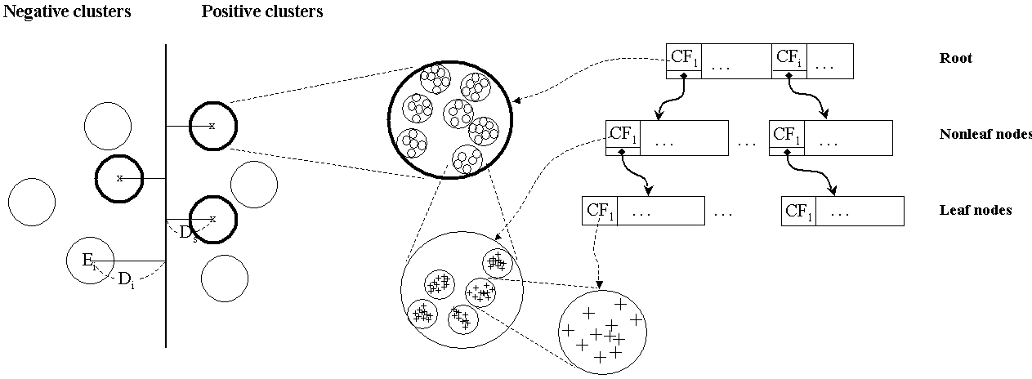
CF-Tree: Hierarchical Micro-cluster
Read the data set once, construct a statistical summary of the data (i.e., hierarchical clusters) given a limited amount of memory
Micro-clustering: Hierarchical indexing structure
provide finer samples closer to the boundary and coarser samples farther from the boundary

Slide 29
Selective Declustering: Ensure High Accuracy
CF tree is a suitable base structure for selective declustering
De-cluster only the cluster E_{i} such that
D_{i} – R_{i} < D_{s}, where D_{i} is the distance from the boundary to the center point of E_{i} and R_{i} is the radius of E_{i}
Decluster only the cluster whose subclusters have possibilities to be the support cluster of the boundary
“Support cluster”: The cluster whose centroid is a support vector

Slide 30
CB-SVM Algorithm: Outline
Construct two CF-trees from positive and negative data sets independently
Need one scan of the data set
Train an SVM from the centroids of the root entries
De-cluster the entries near the boundary into the next level
The children entries de-clustered from the parent entries are accumulated into the training set with the non-declustered parent entries
Train an SVM again from the centroids of the entries in the training set
Repeat until nothing is accumulated

Slide 31
Accuracy and Scalability on Synthetic Dataset
Experiments on large synthetic data sets shows better accuracy than random sampling approaches and far more scalable than the original SVM algorithm

Slide 32
SVM vs. Neural Network
SVM
Deterministic algorithm
Nice generalization properties
Hard to learn – learned in batch mode using quadratic programming techniques
Using kernels can learn very complex functions
Neural Network
Nondeterministic algorithm
Generalizes well but doesn’t have strong mathematical foundation
Can easily be learned in incremental fashion
To learn complex functions—use multilayer perceptron (nontrivial)

Slide 33
Chapter 9. Classification: Advanced Methods
Bayesian Belief Networks
Classification by Backpropagation
Support Vector Machines
Classification by Using Frequent Patterns
Lazy Learners (or Learning from Your Neighbors)
Other Classification Methods
Additional Topics Regarding Classification
Summary
33
Notes:
33

Slide 34
Associative Classification
Associative classification: Major steps
Mine data to find strong associations between frequent patterns (conjunctions of attribute-value pairs) and class labels
Association rules are generated in the form of
P₁ ^ p₂ … ^ p_{l} → “A_{class} = C” (conf, sup)
Organize the rules to form a rule-based classifier
Why effective?
It explores highly confident associations among multiple attributes and may overcome some constraints introduced by decision-tree induction, which considers only one attribute at a time
Associative classification has been found to be often more accurate than some traditional classification methods, such as C4.5
34
Notes:
34

Slide 35
Typical Associative Classification Methods
CBA (Classification Based on Associations: Liu, Hsu & Ma, KDD’98)
Mine possible association rules in the form of
Cond-set (a set of attribute-value pairs) → class label
Build classifier: Organize rules according to decreasing precedence based on confidence and then support
CMAR (Classification based on Multiple Association Rules: Li, Han, Pei, ICDM’01)
Classification: Statistical analysis on multiple rules
CPAR (Classification based on Predictive Association Rules: Yin & Han, SDM’03)
Generation of predictive rules (FOIL-like analysis) but allow covered rules to retain with reduced weight
Prediction using best k rules
High efficiency, accuracy similar to CMAR
35

Slide 36
Frequent Pattern-Based Classification
H. Cheng, X. Yan, J. Han, and C.-W. Hsu, “Discriminative Frequent Pattern Analysis for Effective Classification”, ICDE'07
Accuracy issue
Increase the discriminative power
Increase the expressive power of the feature space
Scalability issue
It is computationally infeasible to generate all feature combinations and filter them with an information gain threshold
Efficient method (DDPMine: FPtree pruning): H. Cheng, X. Yan, J. Han, and P. S. Yu, "Direct Discriminative Pattern Mining for Effective Classification", ICDE'08
36
Notes:
36

Slide 37
Frequent Pattern vs. Single Feature
The discriminative power of some frequent patterns is higher than that of single features.
(a) Austral
(b) Cleve
(c) Sonar
Fig. 1. Information Gain vs. Pattern Length
37
Notes:
37

Slide 38
Empirical Results
(a) Austral
(b) Breast
(c) Sonar
Fig. 2. Information Gain vs. Pattern Frequency
38
Notes:
38

Slide 39
Feature Selection
Given a set of frequent patterns, both non-discriminative and redundant patterns exist, which can cause overfitting
We want to single out the discriminative patterns and remove redundant ones
The notion of Maximal Marginal Relevance (MMR) is borrowed
A document has high marginal relevance if it is both relevant to the query and contains minimal marginal similarity to previously selected documents
39
Notes:
39

Slide 40
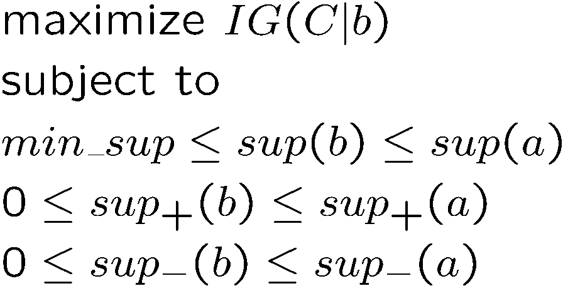
DDPMine: Branch-and-Bound Search
a
b
a: constant, a parent node
b: variable, a descendent
Association between information gain and frequency
40
Notes:
40
Explore the bound in mining

Slide 41
DDPMine Efficiency: Runtime
PatClass
Harmony
PatClass: ICDE’07 Pattern Classification Alg.
DDPMine
41
Notes:
41
One fig

Slide 42
Chapter 9. Classification: Advanced Methods
Bayesian Belief Networks
Classification by Backpropagation
Support Vector Machines
Classification by Using Frequent Patterns
Lazy Learners (or Learning from Your Neighbors)
Other Classification Methods
Additional Topics Regarding Classification
Summary
42
Notes:
42

Slide 43
Lazy vs. Eager Learning
Lazy vs. eager learning
Lazy learning (e.g., instance-based learning): Simply stores training data (or only minor processing) and waits until it is given a test tuple
Eager learning (the above discussed methods): Given a set of training tuples, constructs a classification model before receiving new (e.g., test) data to classify
Lazy: less time in training but more time in predicting
Accuracy
Lazy method effectively uses a richer hypothesis space since it uses many local linear functions to form an implicit global approximation to the target function
Eager: must commit to a single hypothesis that covers the entire instance space

Slide 44
Lazy Learner: Instance-Based Methods
Instance-based learning:
Store training examples and delay the processing (“lazy evaluation”) until a new instance must be classified
Typical approaches
k-nearest neighbor approach
Instances represented as points in a Euclidean space.
Locally weighted regression
Constructs local approximation
Case-based reasoning
Uses symbolic representations and knowledge-based inference

Slide 45
The k-Nearest Neighbor Algorithm
All instances correspond to points in the n-D space
The nearest neighbor are defined in terms of Euclidean distance, dist(X₁, X₂)
Target function could be discrete- or real- valued
For discrete-valued, k-NN returns the most common value among the k training examples nearest to x_{q}
Vonoroi diagram: the decision surface induced by 1-NN for a typical set of training examples
_
.
.
_
_
+
_
.
.
+
.
_
x_{q}
+
_
.
+

Slide 46
Discussion on the k-NN Algorithm
k-NN for real-valued prediction for a given unknown tuple
Returns the mean values of the k nearest neighbors
Distance-weighted nearest neighbor algorithm
Weight the contribution of each of the k neighbors according to their distance to the query x_{q}
Give greater weight to closer neighbors
Robust to noisy data by averaging k-nearest neighbors
Curse of dimensionality: distance between neighbors could be dominated by irrelevant attributes
To overcome it, axes stretch or elimination of the least relevant attributes

Slide 47
Case-Based Reasoning (CBR)
CBR: Uses a database of problem solutions to solve new problems
Store symbolic description (tuples or cases)—not points in a Euclidean space
Applications: Customer-service (product-related diagnosis), legal ruling
Methodology
Instances represented by rich symbolic descriptions (e.g., function graphs)
Search for similar cases, multiple retrieved cases may be combined
Tight coupling between case retrieval, knowledge-based reasoning, and problem solving
Challenges
Find a good similarity metric
Indexing based on syntactic similarity measure, and when failure, backtracking, and adapting to additional cases

Slide 48
Chapter 9. Classification: Advanced Methods
Bayesian Belief Networks
Classification by Backpropagation
Support Vector Machines
Classification by Using Frequent Patterns
Lazy Learners (or Learning from Your Neighbors)
Other Classification Methods
Additional Topics Regarding Classification
Summary
48
Notes:
48

Slide 49
Genetic Algorithms (GA)
Genetic Algorithm: based on an analogy to biological evolution
An initial population is created consisting of randomly generated rules
Each rule is represented by a string of bits
E.g., if A₁ and ¬A₂ then C₂ can be encoded as 100
If an attribute has k > 2 values, k bits can be used
Based on the notion of survival of the fittest, a new population is formed to consist of the fittest rules and their offspring
The fitness of a rule is represented by its classification accuracy on a set of training examples
Offspring are generated by crossover and mutation
The process continues until a population P evolves when each rule in P satisfies a prespecified threshold
Slow but easily parallelizable

Slide 50
Rough Set Approach
Rough sets are used to approximately or “roughly” define equivalent classes
A rough set for a given class C is approximated by two sets: a lower approximation (certain to be in C) and an upper approximation (cannot be described as not belonging to C)
Finding the minimal subsets (reducts) of attributes for feature reduction is NP-hard but a discernibility matrix (which stores the differences between attribute values for each pair of data tuples) is used to reduce the computation intensity

Slide 51
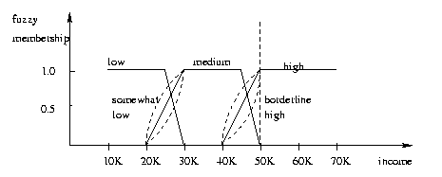
Fuzzy Set Approaches
Fuzzy logic uses truth values between 0.0 and 1.0 to represent the degree of membership (such as in a fuzzy membership graph)
Attribute values are converted to fuzzy values. Ex.:
Income, x, is assigned a fuzzy membership value to each of the discrete categories {low, medium, high}, e.g. $49K belongs to “medium income” with fuzzy value 0.15 but belongs to “high income” with fuzzy value 0.96
Fuzzy membership values do not have to sum to 1.
Each applicable rule contributes a vote for membership in the categories
Typically, the truth values for each predicted category are summed, and these sums are combined

Slide 52
Chapter 9. Classification: Advanced Methods
Bayesian Belief Networks
Classification by Backpropagation
Support Vector Machines
Classification by Using Frequent Patterns
Lazy Learners (or Learning from Your Neighbors)
Other Classification Methods
Additional Topics Regarding Classification
Summary
52
Notes:
52

Slide 53
Multiclass Classification
Classification involving more than two classes (i.e., > 2 Classes)
Method 1. One-vs.-all (OVA): Learn a classifier one at a time
Given m classes, train m classifiers: one for each class
Classifier j: treat tuples in class j as positive & all others as negative
To classify a tuple X, the set of classifiers vote as an ensemble
Method 2. All-vs.-all (AVA): Learn a classifier for each pair of classes
Given m classes, construct m(m-1)/2 binary classifiers
A classifier is trained using tuples of the two classes
To classify a tuple X, each classifier votes. X is assigned to the class with maximal vote
Comparison
All-vs.-all tends to be superior to one-vs.-all
Problem: Binary classifier is sensitive to errors, and errors affect vote count
53

Slide 54
Error-Correcting Codes for Multiclass Classification
Originally designed to correct errors during data transmission for communication tasks by exploring data redundancy
Example
A 7-bit codeword associated with classes 1-4
Class | Error-Corr. Codeword
C₁ | 1 | 1 | 1 | 1 | 1 | 1 | 1
C₂ | 0 | 0 | 0 | 0 | 1 | 1 | 1
C₃ | 0 | 0 | 1 | 1 | 0 | 0 | 1
C₄ | 0 | 1 | 0 | 1 | 0 | 1 | 0
Given a unknown tuple X, the 7-trained classifiers output: 0001010
Hamming distance: # of different bits between two codewords
H(X, C₁) = 5, by checking # of bits between [1111111] & [0001010]
H(X, C₂) = 3, H(X, C₃) = 3, H(X, C₄) = 1, thus C₄ as the label for X
Error-correcting codes can correct up to (h-1)/h 1-bit error, where h is the minimum Hamming distance between any two codewords
If we use 1-bit per class, it is equiv. to one-vs.-all approach, the code are insufficient to self-correct
When selecting error-correcting codes, there should be good row-wise and col.-wise separation between the codewords
54

Slide 55
Semi-Supervised Classification
Semi-supervised: Uses labeled and unlabeled data to build a classifier
Self-training:
Build a classifier using the labeled data
Use it to label the unlabeled data, and those with the most confident label prediction are added to the set of labeled data
Repeat the above process
Adv: easy to understand; disadv: may reinforce errors
Co-training: Use two or more classifiers to teach each other
Each learner uses a mutually independent set of features of each tuple to train a good classifier, say f₁
Then f₁ and f₂ are used to predict the class label for unlabeled data X
Teach each other: The tuple having the most confident prediction from f₁ is added to the set of labeled data for f₂, & vice versa
Other methods, e.g., joint probability distribution of features and labels
55

Slide 56
Active Learning
Class labels are expensive to obtain
Active learner: query human (oracle) for labels
Pool-based approach: Uses a pool of unlabeled data
L: a small subset of D is labeled, U: a pool of unlabeled data in D
Use a query function to carefully select one or more tuples from U and request labels from an oracle (a human annotator)
The newly labeled samples are added to L, and learn a model
Goal: Achieve high accuracy using as few labeled data as possible
Evaluated using learning curves: Accuracy as a function of the number of instances queried (# of tuples to be queried should be small)
Research issue: How to choose the data tuples to be queried?
Uncertainty sampling: choose the least certain ones
Reduce version space, the subset of hypotheses consistent w. the training data
Reduce expected entropy over U: Find the greatest reduction in the total number of incorrect predictions
56

Slide 57
Transfer Learning: Conceptual Framework
Transfer learning: Extract knowledge from one or more source tasks and apply the knowledge to a target task
Traditional learning: Build a new classifier for each new task
Transfer learning: Build new classifier by applying existing knowledge learned from source tasks
Traditional Learning Framework
Transfer Learning Framework
57

Slide 58
Transfer Learning: Methods and Applications
Applications: Especially useful when data is outdated or distribution changes, e.g., Web document classification, e-mail spam filtering
Instance-based transfer learning: Reweight some of the data from source tasks and use it to learn the target task
TrAdaBoost (Transfer AdaBoost)
Assume source and target data each described by the same set of attributes (features) & class labels, but rather diff. distributions
Require only labeling a small amount of target data
Use source data in training: When a source tuple is misclassified, reduce the weight of such tupels so that they will have less effect on the subsequent classifier
Research issues
Negative transfer: When it performs worse than no transfer at all
Heterogeneous transfer learning: Transfer knowledge from different feature space or multiple source domains
Large-scale transfer learning
58

Slide 59
Summary
Effective and advanced classification methods
Bayesian belief network (probabilistic networks)
Backpropagation (Neural networks)
Support Vector Machine (SVM)
Pattern-based classification
Other classification methods: lazy learners (KNN, case-based reasoning), genetic algorithms, rough set and fuzzy set approaches
Additional Topics on Classification
Multiclass classification
Semi-supervised classification
Active learning
Transfer learning

