Slide 1
THERMO ANALYTICAL METHODS
what is thermal analysis?
In thermal analysis substances are heated they undergo physical and chemical changes . These changes are recorded as a function of time or temperature.
The two important thermal analyses are
1. Thermogravimetric analysis
2. Differential thermal analysis.

Slide 2
principle involved in thermo gravimetric analysis
The substance is heated or cooled in a given environment at a controlled rate. The weight of the substance is recorded as a function of time or temperature.
A graph is plotted between weight change and temperature or time
We get a thermogravimetric curve or TG curve or thermogram.
on heating a substance various physical and chemical bonds are formed or broken resulting in a change in weight .
A weight loss indicates the formation and a subsequent escape of a volatile product or the formation of some other product.

Slide 3
principle involved in differential thermal analysis
The substance to be analysed and an inert reference material like α-alumina are heated or cooled in a given environment and at a controlled rate.
whenever the substances to be analysed undergoes an endothermic change , like when it melts or when it is dehydrated the temperature of the substances will be lower than that of the reference material.
If the substance to be analysed undergoes an exothermic change its temperature will be higher than that of the reference material.
When the substance under observation doesnot undergo any heat change, there will be no difference in temperature between the sample and reference material.
These temperature difference ∆TS are plotted against temperature.
we get a DTA curves.

Slide 4
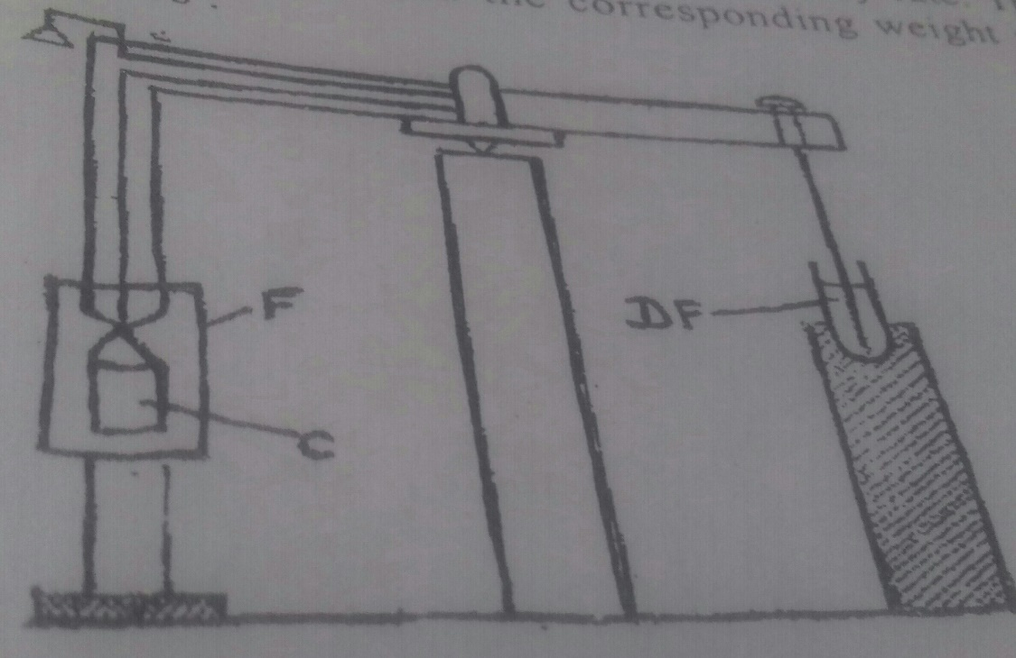
TGA INSTRUMENTATION
THERMOBALANCE
A platinum crucible is suspended from one arm of the balance . The other arm of the balance is prevented from oscillating by attaching it with a dewar flask through a spiral so that it act as a damper.
a known weight of the sample taken in crucible C
C is enclosed by furnace F
Furnace temperature is raised at slow and steady rate
The temperature and corresponding weight are moniterd
Platinum / platinum rodium thermocouple couple is used to measure the sample temperature
It monitors the temperature continuously and sends signals to the reorder.

Slide 5
Changes in weight are recorded from the beam deflection with the help of detectors
Detectors contain a sensing element which detects deviation of the balance beam from its null position.
Detectors consists of photocells , a slotted flag connected to the balance arm and lamp.
Any change in sample weight causes balance to rotate .
This moves the flag so that light falling on each photo cell is no longer equal.
The resulting signal is amplified and fed as current to motor to restore the balance to equilibrium.
This current is proportional to the weight change which is recorded by the recoder.

Slide 6
In another type of detector , a helical spring is used to detect the weight change . The spring undergoes contraction or elongation with weight change
This movement is detected by movement of an attached core in a linear variable differential transformer.
RECODER
It is device with a pen and graph sheets. It records the weight change in y-axis. It records signals from the thermocouple, on the x- axis , we get a thermogram.

Slide 7
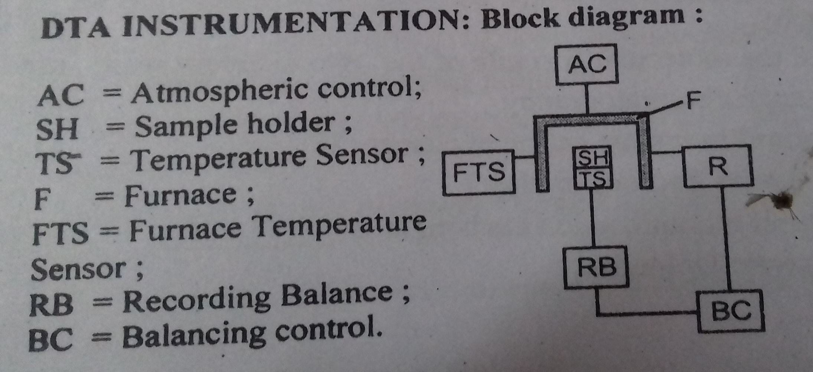

Slide 8
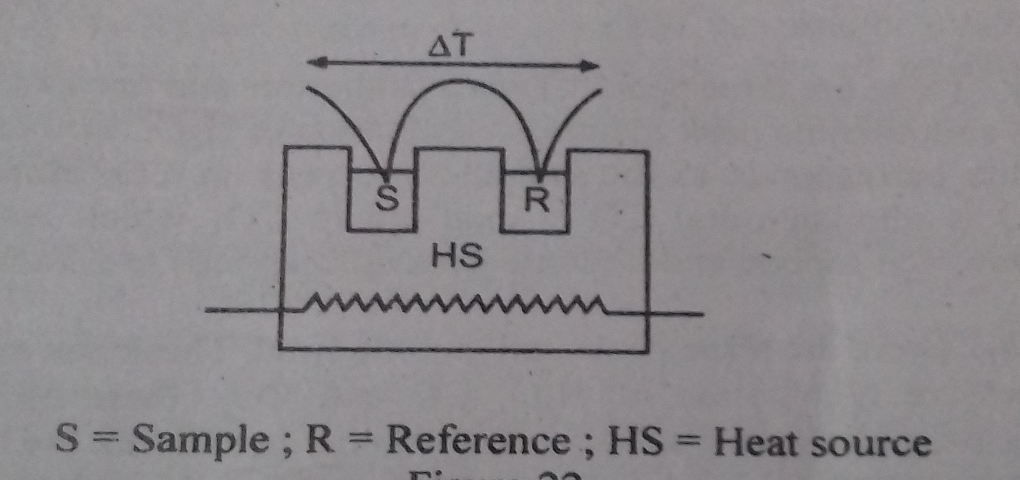
DTA- INSTRUMENTATION
COMPONENTS:
Furnace – to heat the sample
Holder –hold the sample and reference
Furnace programmer and controller- to increase the furnace and sample block temperature at a linear rate (per minute) . This is done either by increasing the voltage through the heater element by motor a driven, variable transformer or by a thermocouple actuated feed back type of controller.
Detectors or temperature sensors- these are the thermocouple assemblies inserted separately in the sample and the reference material
These continuously measure the difference in temperature between the sample and the reference .
Microvolt level signals are got. These are sent to the amplifier.
Recoder – the signals got from the thermocouple is amplified by about 1000 times and the difference signal is recorded on the y- axis of millivolt recoder.
The temperature of the furnace is measured by a separate thermo-couple and is recorded on the x- axis

Slide 9
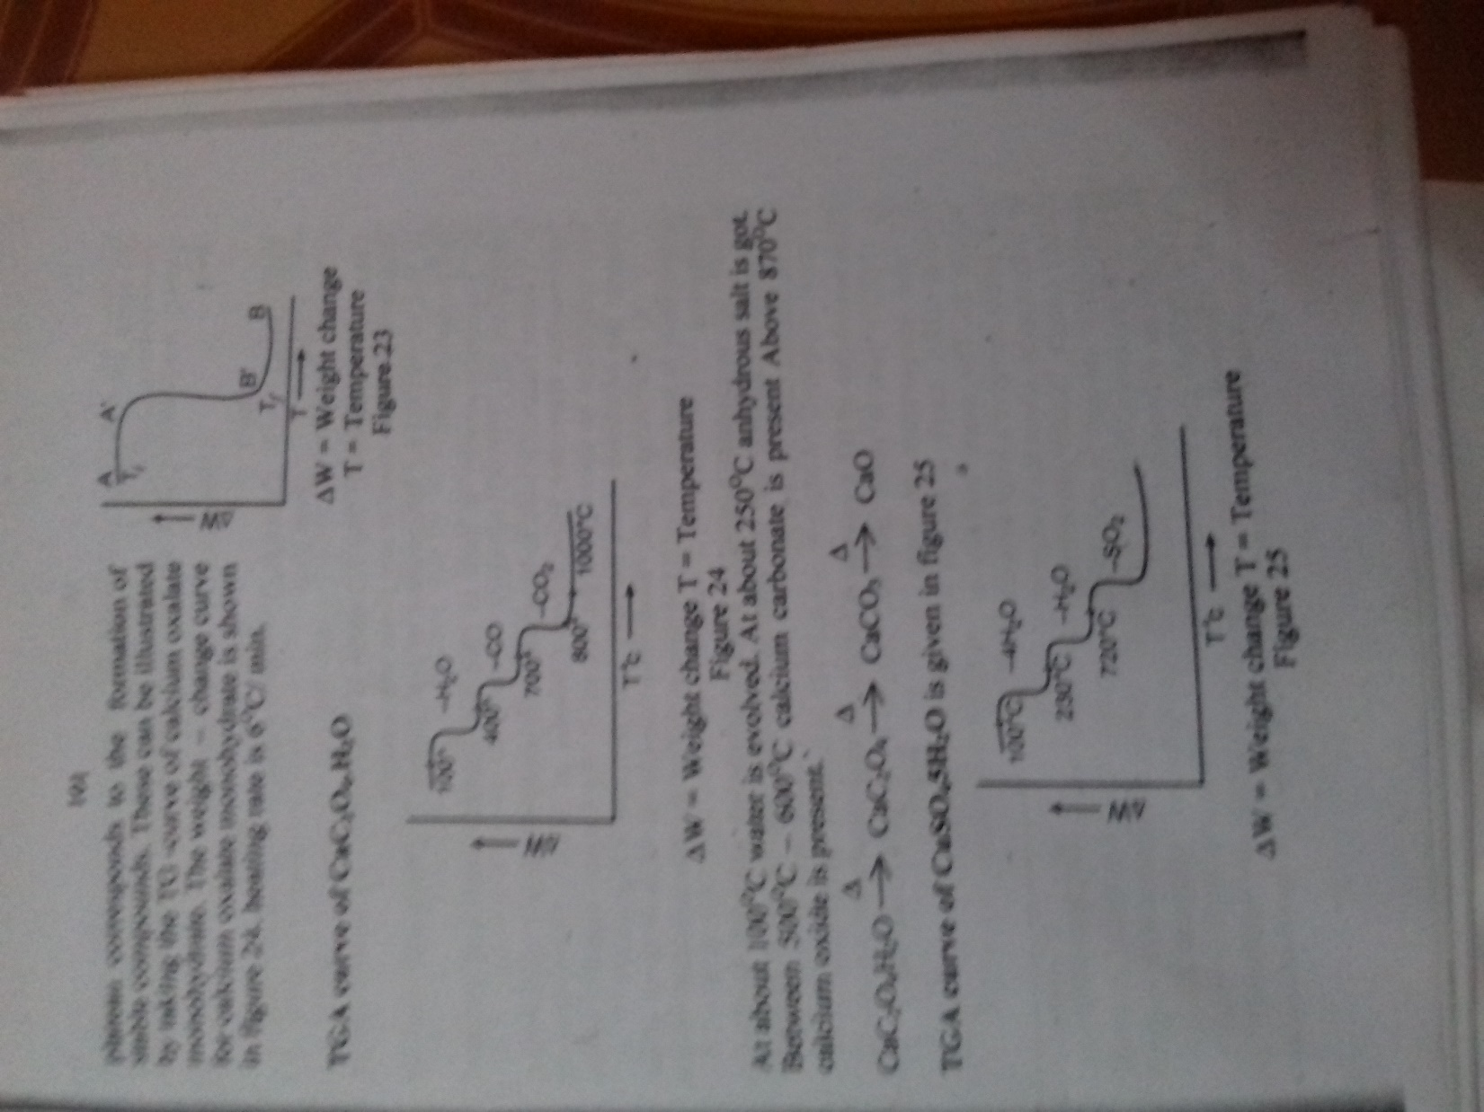

CHARACTERISTICS OF -TGA
TG curves are charecterised by breaks (A’ B’) plateaus (A’ A’) and (B’ B’) as shown in figure.
Each breaks corresponds to some loss in weight, due to evaluation of H₂O, CO, CO₂ etc and each plateau corresponds to the formation of stable compounds.

Slide 10

CHARACTERISTICS OF -TGA CaC₂O₄.H₂O
At about 100℃ water is evolved.
At about 250℃ an hydrous salt is got
Between 500℃- 600℃
calcium carbonate is present
Above 800℃ calcium oxide is present
CaC₂O₄.H₂O → CaC₂O₄ → CaCO₃ → CaO
∆W-Weight change
T- temperature

Slide 11
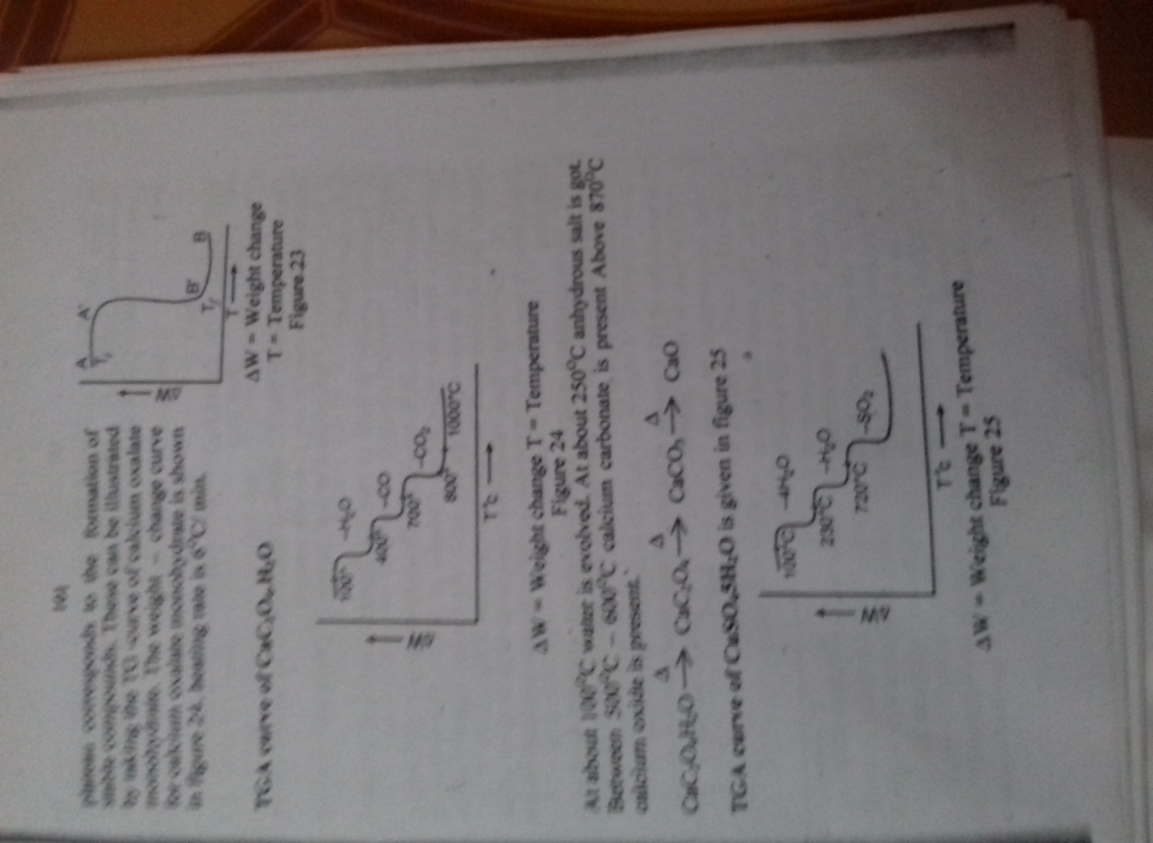
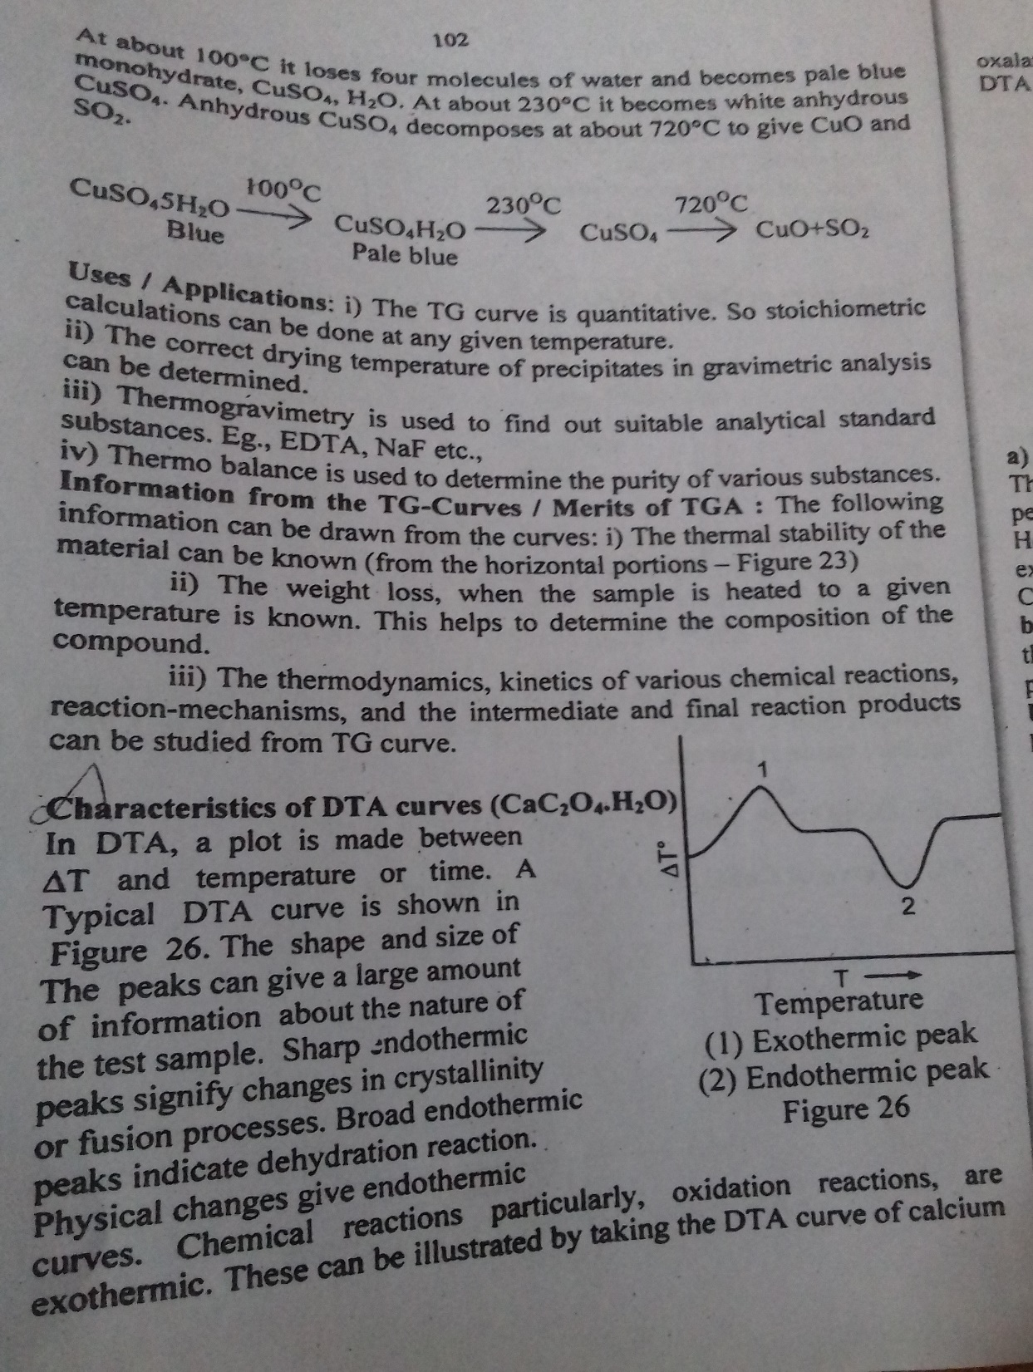
TGA curve of CuSO₄.5H₂O
At about 100℃ it loses its four molecules of water and becomes pale blue monohydrate CUSO₄ ,
At about 230℃ it becomes white an hydrous CUSO₄ ,
An hydrous CUSO₄ , decomposes at about 720 ℃ to give CUO and SO₂

Slide 12
APPLICATIONS OF TG - CURVE
The TG curve is quantitative so stoichiometric calculations can be done at any given temperature .
The correct drying temperature of preciptates in gravimetric analysis can be determined.
Thermogravimetry is used to find out suitable analytical standard substances. Eg., EDTA, NaF etc
Thermobalance is used to determine the purity of various substances
The following information can be drawn from the TG Curves
The thermal stability of the material can be known . ( from the horizontal portions)
The weight loss, when the sample is heated to a given temperature Is known. This helps to determine the composition of the compound
The thermodynamics kinetics of various chemical reactions , reaction mechanisms and the intermediate and final reaction products can be studied from TG – curve.

Slide 13
DTA curves of CaC₂O₄.H₂O
In DTA a plot is made between ∆T and temperature or time
The shape and size of the peaks can give a large amount of information about the nature of the test sample .
Sharp endothermic peaks signify changes in crystallinity or fusion processes.
Broad endothermic peaks indicate dehydratation reaction.
Physical changes can give endothermic curves.
chemical reactions particularly oxidation reactions are exothermic.
These can be illustrated by taking the DTA curve of calcium oxalate mono hydrate.

Slide 14
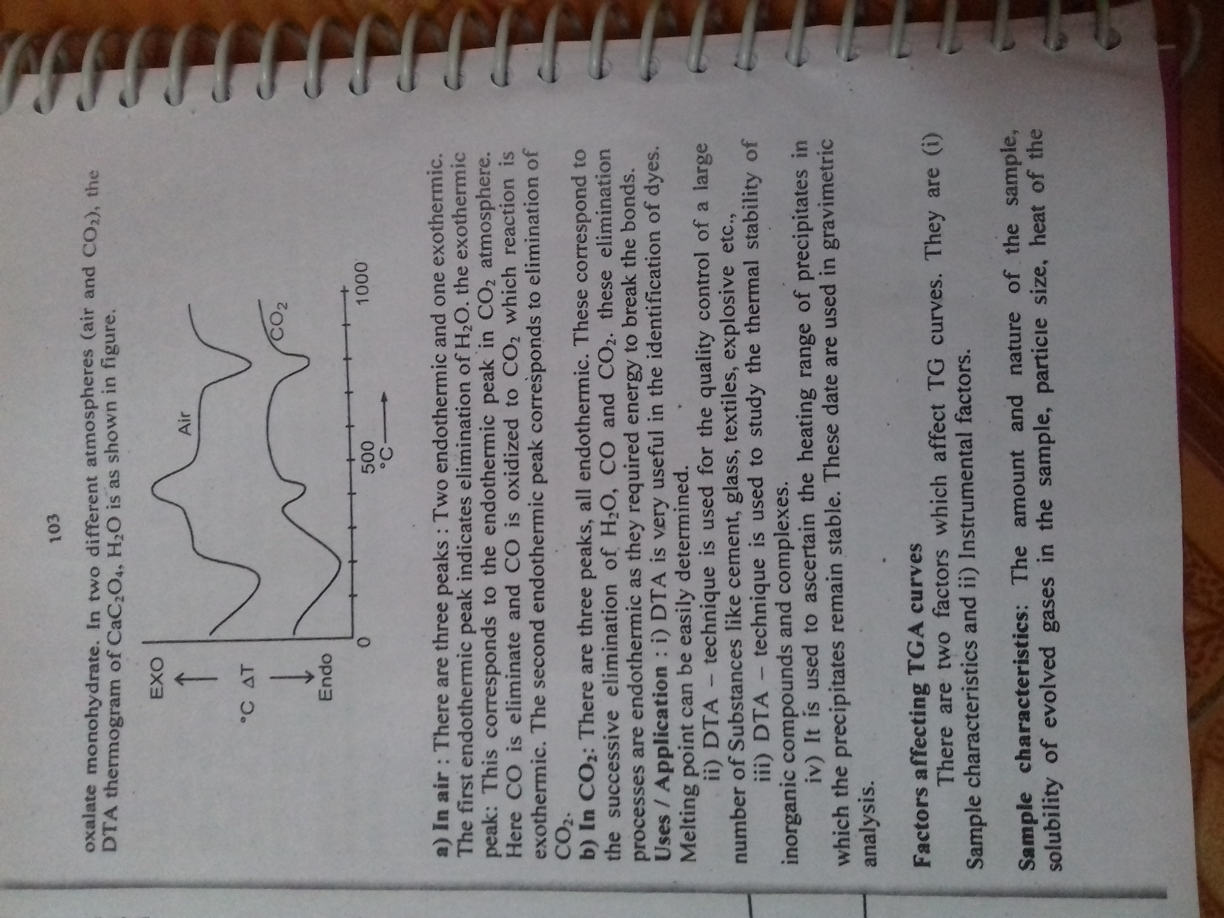
In two different atmosphere (air and CO₂) the DTA thermogram of CaC₂O₄.H₂O is as shown in figure.

Slide 15

APPLICATIONS OF DTA

Slide 17
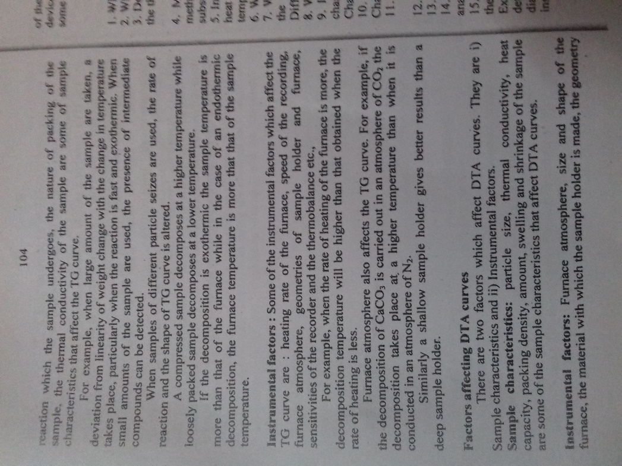

Slide 20
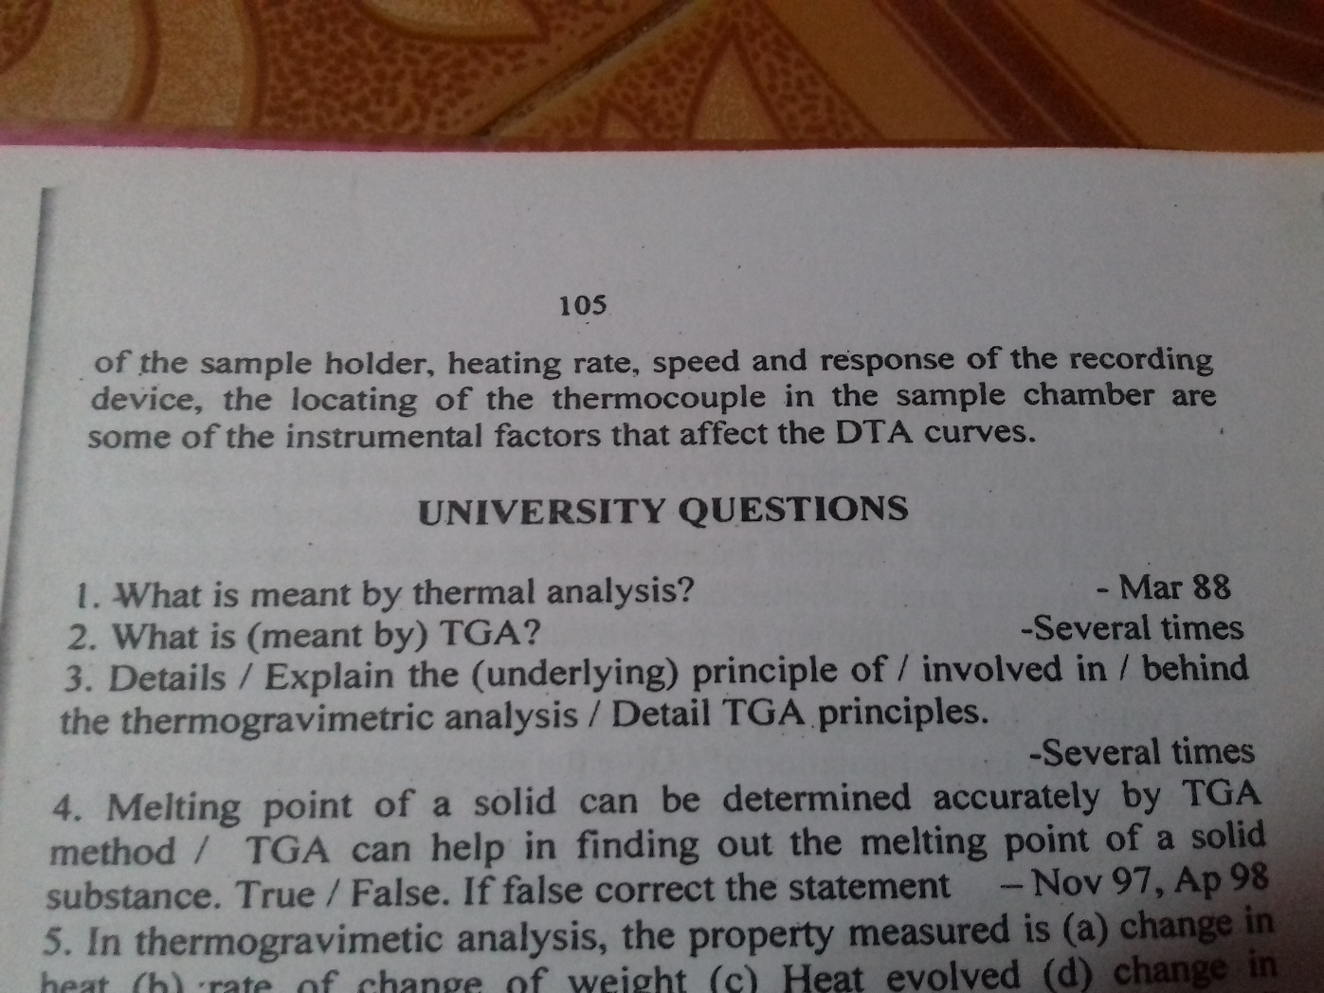

Slide 21
THERMOMETRIC TITRATION
Thermometric titration
In which the change in temperature of the reaction mixture is observed and plotted against the volume of the titrant added and thereby the analyte is estimated.
Principle
All chemical reactions are accompanied by heat changes .
These will be accompanied by temperature changes.
So the course of a titration may be followed by measuring the changes in T.
At the equivalence point the temperature changed will be maximum. Example : Titration of HCL against NaOH

Slide 22
Need for thermometric titrations
other method of titrations are based on decrease in free energy ie negative G and hence an equilibrium constant K .
There are reactions in which G is very low or even zero or in some case positive.
example: For the neutralisation reaction of boric acid ∆G= -6
For such reactions ordinary titration which depend on PH are not useful, for such reaction thermometric titrations are useful, here ∆H is measured in terms of ∆T.

Slide 23
Conditions for thermometric titrations
1. The heat change accompanying the reaction to be studied by thermometric titrations
3.The reaction must be simple, one step reaction .
Heat exchange between the titration.vessel must be and its surrounding avoided. i.e., The titration should be conducted under adiabatic conditions.

Slide 24
The apparatus for Thermometric Titration:
i) Motor driven burette,
ii) An adiabatic titration chamber,
Iii) Small Dewar flask .
Iv) Thermistor assembly and a recorder.

Slide 25
The titrant is added from burette in to a thermally insulated vessel. The temprature change after every addition is recorded. A sharp break in the curve gjves the end point.
Example:Titrationof HCI Vs NaOH: A known volume of HCI to be estimated is taken in an adiabatic chamber (Dewar flask).NaOH is added from a burette.
The temperature change afer each addition is recorded. A sharp break in the curve gives the end point.
The thermometric titration curve between HCl and NaOH is as shown below

Slide 27
A- Before titrant is added.
ABC Titrant (base) is being added,
C-The titration is complete (end point)
Applications: i) Determination of the concentration of an unknown
Substance. 1i) Determination of thermodynamic quantities like ∆H
etc.

Slide 28
ANALYTICAL ELECTROCHEMISTRY

Slide 29
ELECTROLYTIC SEPARATIONS
When the applied EMF at cach electrode is equal to the reversible polential of the electrode, discharge of ions takes place.
When a constant current is passed through a solution
Containing two or more electroytes, the clectrochemical process with the most positive reduction potential will occur first at the cathode followed by the next most positive electrochemical process etc. Thus we can etfect electrolytic separations. Depending on the nature of the constitutents of the mixture of electrotytes to be separated, we adopt different techniques.

Slide 30
To separate two electrolytes having electrode potentials with
opposite signs : (Constant current electrolysis technique)
E.g. Separation of Cu 2+ and Cd2+ ions. The reduction potential of Cu2+ is 0.340 v while that of Cd2+ is - 0.402 v.
Thus if a constant current is passed through a solution
containing copper, hydrogen and cadmium ions, copper will be deposited first at the cathode. As the copper deposits, the electrode

Slide 31
potential decreases, When the potential is cqual to that of hydrogen
ions hydrogen gas will form at the cathode. The potential at the
cathode will remain-constant as long as hydrogen is evolved. This
takes place until all the water is electrolysed.
The potential of the cathode cannot become sufficienty
negative to cause the deposition of cadmium ions. Thus metal ions
with positive reduction potential may be separated from metal ions
having negative reduction potentials.

Slide 32
In this technique cathode potential during electroysis need
not be measured.
After Cu gets deposited, only hydrogen will be evolved. There is no possibility ofthe second metal getting deposited over the first. So a constant current is pased during electrolysis by adjusting the applied voltage.

Slide 33
To separate two electrolytes having electrode potentials with
same signs : (Constant cathode potential electrolysis technique To
separate two electrolytes having electrode potentials with same sign
their initial deposition potentials should differ by atleast.25v

Slide 34
Eg .Separation of Ag2+ and Cu2+ ions.
The reduction potential of Ag is O.79 v while that of Cu 2+ is 0.340 v. Thus if a current is passed through a solution containing Agt and Cu? silver will be deposited first at the cathode quantitatively. Then copper deposition commences. Thus they may be separted.
In this method, as two metals are going to be deposited at two different electrode potentials, measurement of cathode potential becomes necessary.
This is done by connecting the cathode to a reference electrode like calomel electrode. Thus the cathode potential is continuously measured.

Slide 35
The potential is first adjusted to a value
corresponding to the deposition potential of the metal with higher
reduction potential so that it is first deposited. The cathode potential
is maintained at the same value till one metal is deposited completely.
Then the cathode is changed and the potential is also changed
suitably to deposit the second metal

Slide 36
To separate two electrolytes having electrode potentials that are
very close to each other : (Constant cathode potential electrolysis
technique): When the standard potentials of the two metals differ only slightly, the electrolytic separation is more difficult.
The obvious method is to alter the electrode potential of one of the metals in some way. This is achieved by decreasing the ionic concentration of the ion being discharged by incorporating it in a complex ion of large stability constant.

Slide 37
The deposition potential of the metal forming a complex ion is thus raised. Further, the overpotential at the small ionic concentration is also increased. As a result of the change in potential the metal which is in simple ionic solution is liberated at a lower voltage.E.g. Separation of copper and bismuth. These two metals cannot be separated electrolytically from a solution of their salts.
If cyanide is added, the copper ion forms a cyano complex,
and bismuth remains unchanged. So, bismuth deposits first.

Slide 38
ELECTRO DEPOSITION
When the applied EMF at each electrode is equal to the reversible electrode , discharge of ions take place . ie depositions ocuur .
The electro depositions is governed by the Faraday’s Laws of electrolysis .
The amount of substance deposited or evolved at electrode is proportional to the quantity of electricity passed through the solution.

Slide 39
1t Can be mathematically expressed as
WαQ or W α l tiLe., W = Z. 1t where W = Weight of the
Aubstance deposited; I= Current strength: t= Time ofpassage
Of current and Z=Electrochemical equivalent.
The amounts of different substances deposited or evolved
At the electrodes by the same quantity of electricity are proportional
to their chemical equivalents".

Slide 40
One equivalent of a substance is liberated by the passage of
one faraday of electricity. One faraday=96,500 coulombs. The second
law may be expressed by the equation.
Weight of A deposited Equivalent weight o! A
------------------------------- = -------------------------------
Weight of B deposited Equivalent weight B

Slide 41
Conditions for electro deposition of metals : i)
a) For current to flow through a solution, i.e., to cause continous electrolysis, a minimum voltage is required.
This is called the decomposition potential. The applied EMF should exceed this decomposition potential.
b) The cathodic potential should exceed the reversible reduction potential of the metal to be deposited.

Slide 42
The metal should be above hydrogen in electrochemical series,
i.e., with a positive value for its reduction potential or if the metal has a negative value for its reduction potential,
if must have a high value for its hydrogen over voltage so that the metal is deposited without causing evolution of hydrogen.

Slide 43
ELECTROGRAVIMETRY
What is it ? It is a technique used to determine the amount of a metal present in its solution by electrodepositing it and weighing it.
Principle: It is based on quantitative electro deposition ofmetals
from their solutions on a cathode. The cathode is weighed before
and after electrolysis. From the increase in weight, the concentration
Of metal ion in solution is calculated. The process of deposition is

Slide 45
Conditions:
The depositions of the substance to be analysed should be complete
The deposited metal should not undergo any change in its weight during the process of electrolysis.
The deposited metal must be attached to the electrode firmly so that there is no weightr loss during rising drying and weighing.

Slide 46
Estímation of copper
Principle: Copper may be deposited from either sulphuric acid or nitric acid solution But, usually, a mixture of the two acids is used
If such 2 solution is electrolysed with an emf of 2 to 3 volts.
following reactions occur.

Slide 47
Cathode: Cu+2e -----˃Cu
2H + 2e -----˃ H2
Anode: 40H -----˃ 02 +2H20+4e-

Slide 48
The acid concentration of the soution should not be too much
Otherwise, the deposition of copper may be incomplete or the deposit will not adhere satisfactorily to the cathode.
The beneficial effect of nitrate ion is due to depolarising
action at the cathode.
NO3-+1OH+ 8e- -----˃ NH4+ + 3H2O

Slide 49
The reduction potential of the nitrate ion is lower than the
dishcharge potential of hydrogen. Therefore, hydrogen is not liberated in the free state.
Procedure: 100ml of theCu(ll) solution containing 0.2 to 0.3 g of
Cu (11) is taken. 2 ml of conc. H2SO4 and 1 ml of conc. HNO, (free
from nitrous acid) are added to it. It is then transferred to the cell.

Slide 50
platinum gauze is used as cathode and the anode is a gauze cylinder
The cathode is cleaned by heating it in 1: I nitric acid. It is washea
horoughly with distilled water and then with pure acetone. 1ne
cathode is then dried at 100-110'C for 3 to 4 minutes, cooled in the
air for about 5 minutes and weighed, The circuit is arranged.A
potential of2 to 2.5 volts is applied for overnight, The solution is
tested for complete deposition of copper after the blue colour of the
solution has disappeared.
The beaker is lowered very slowly and at the same time a

Slide 51
continuous stream of distilled water is directed against the upper
edge of the cathode. This washing is done immediatley after the
cathode is removed out of the solution and the circuit should not be
broken during the process. After washing the cathode thoroughly,
the circuit is broken and the cathode is dipped into a beaker of
distilled water. It is then rinsed with pure acetone. The electrode is
then dried at 100 to 110°C for 3 to 4 minutes, weighed after cooling
in air for about 5 minutes. From the increase in weight ofthe cathode,
the copper content of the solution is calculated

Slide 52
ESTIMATION OF SILVER
Principle: Silver may be determined by electrolysis in nitrate,
ammonical or cyanide solutions. In cyanide solution, the silver is
present largely as the complex ion
[Ag(CN)2 - -----˃ Ag+ 2CN-
By this method, an excellent plate is obtained and separation from
other elements for e.g., copper and lead mnay be effected.
Procedure: A neutral or faintly acidic solution of silver nitrate
containing 0.2 g of silver is taken.

Slide 53
To this solution A.R. potassium
cyanide is added until the precipitate ofsilver cyanide is dissolved.
Then an excess potassium cyanide is added such that about 2 g of potassium cyanide is prescnt to in the solution. It is then diluted to 100 120 ml. The solution is electrolysedwith 0.2to.5 amperesat 3.7 to 4.8 volts at 20 to 30°C.About 0.1g ofAgis deposited in 3 hour
s.

Slide 54
Completion of deposition is tested as follows.
A few drops of the clectrolyte is transferred intoa test tube, acidified with alittle nitric acid, the HCN boiled off. Ammonium hydroxide and a few drops of
Ammonium sulphide are added. No brown precipitate is obtained.
The determination is completed as under copper.

