Slide 1
ANTIBIOTICS
I Introduction:
  Antibiotic is drug derived derived from living micro- organism which either prevents the growth of other micro-organism or destroy them.
  Antibiotics are obtained from micro- organism such as fungi, actinomycetes, bacteria etc.,
  All the substances obtained from living cells cannot be considered as antibiotics as the have to satisfy certain conditions such as

Slide 2
It should be effective at low concetration
It should antagonise or kill one or more micro spices of the micro-organism.
It should not have significant toxic side effects
It must be effective against a pathogen
It should be stored for a long time without appreciable loss of its activity
The antibiotic should be completely eliminated from the body after its administration has been stopped.
It should be highly stable so that it can be isolated and processed into suitable forms of dosages
which are readily absorbed

Slide 3
Antibiotics are very important therapeutic agent and have been found to be clinically effective in
many protozoan beacterial and fungal infections.

Slide 4
CLASSIFICATION OF ANTIBIOTICS
Based on the specturm of biological action
Antibiotics mainly effective against gram-positive bacteria.
(a)Antibiotics used for systemic infection e.g. Penicillins, Fucidin ctc
(b)Those employed topically eg Bacitracian

Slide 5
Antibiotic mainly effective against gram-negative bacteria c.g. Streptomycin, Antibiotics effective against both gram-positive and gram-negative bacteria
. Ampici
Antibiotics effective against gram-positive, ricketisae, chlamydia and also
gram-r -Tnegal
Neomycin etc.
bacteria e.g. Tetracyclines, Choloramphenicol etc.
Antibiotics effective against acid fast bacilli (M. tuberculosis) e.g. Streptomycin, Canre
Capreomy
. Antibiotics effective against protozoa e.g. Tetracycline, Paromomycin.
etc.
Antibiotics effective against fungi e.g. Nystatin, Amphotericin B etc.
Antimalignancy antibiotics e.g. Actinomycin D, Mitomycin etc.
..

Slide 6
Antibiotic mainly effective against gram-negative bacteria E.g. Streptomycin,
Antibiotics effective against both gram-positive and gram-negative bacteria example: Ampiclin, neomycin
Antibiotics effective against gram-positive, ricketisae, chlamydia and also gram-negative bacteria- e.g. Tetracyclines, Choloramphenicol etc.

Slide 7
Antibiotics effective against acid fast bacilli (M. tuberculosis) e.g. Streptomycin, Capreomycin, etc
Antibiotics effective against protozoa e.g. Tetracycline, Paromomycin.
etc.
Antibiotics effective against fungi e.g. Nystatin, Amphotericin B etc.
Antimalignancy antibiotics e.g. Actinomycin D, Mitomycin etc.
..

Slide 8

Classification According to Their Chemical Structures
Antibiotics can be distinguished as Antibiotics having acyclic structure.. This group of antibiotics comprises cylopentane, cyclohexane and cyclohep deravatives, eg. sarcomycin, actidione .

Slide 9
Tetracyclines: This group includes compounds similar in their structure . The main representative is tetracycline.

Slide 10
Aromatic antibiotics: Antibiotics included in this group are bezene derivtives e.g gallic acid , chloramphenicols etc.,

Slide 11
Hetrocyclic oxy antibiotics:
This group includes many antibiotics containing either five membered –O- heterocyclic compounds or six membered- O- heterocyclic compounds example: carlina oxide , penicillic acid, kojic acid , Novabiocin, cintrinin etc.

Slide 12
Antibiotics with several- O- heterocyclic rings : Example: tricothecin.

Slide 13
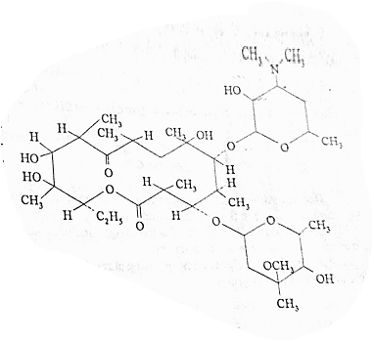
Macrolides: In which macrocyclic lactone ring connected with one
or several carbohydrate residue such as amino sugar etc.,
Eg: erythromycin, methymycin , etc.,

Slide 14
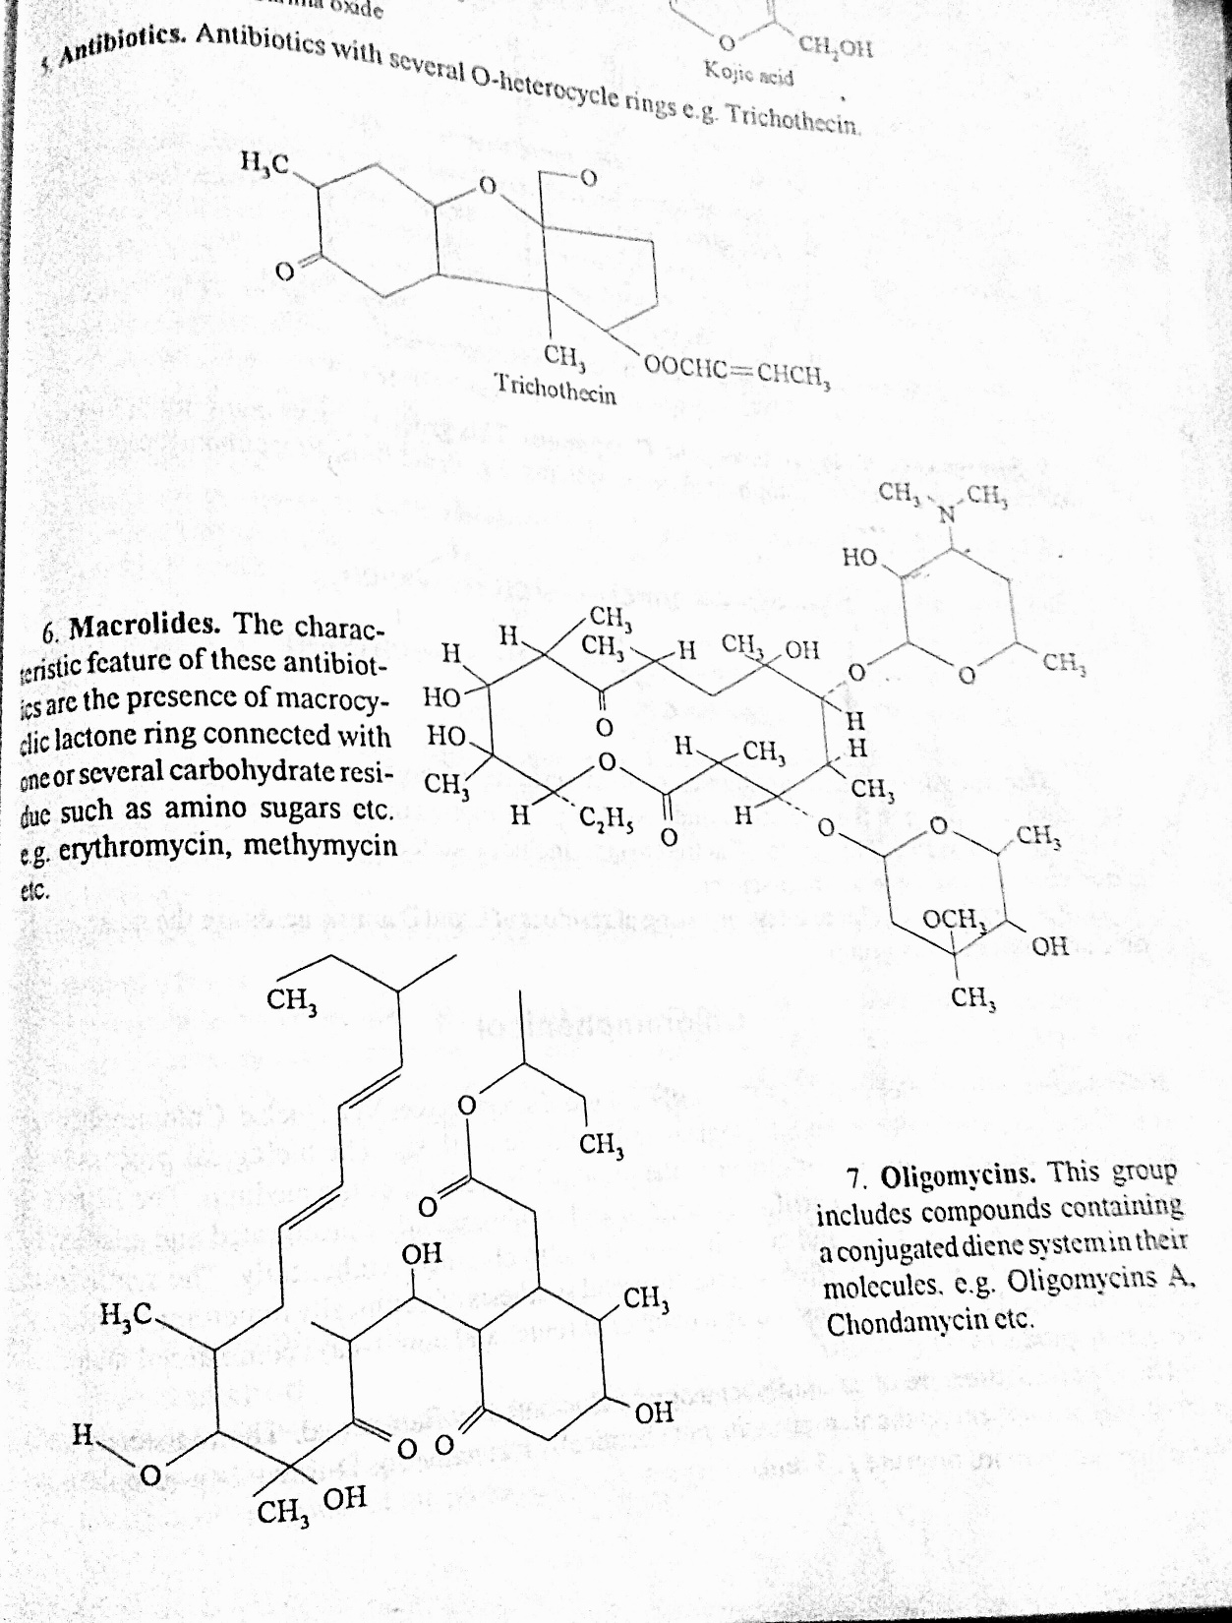
Oligomycins
This group includes compounds containing aconjugated system in their molecules example
Oligomycins A, chondamycin etc.,
Oligomycins: This group includes compounds containing a conjugated diene system
in their molecules.
Example oligomycins A, Chondamycin etc

Slide 15
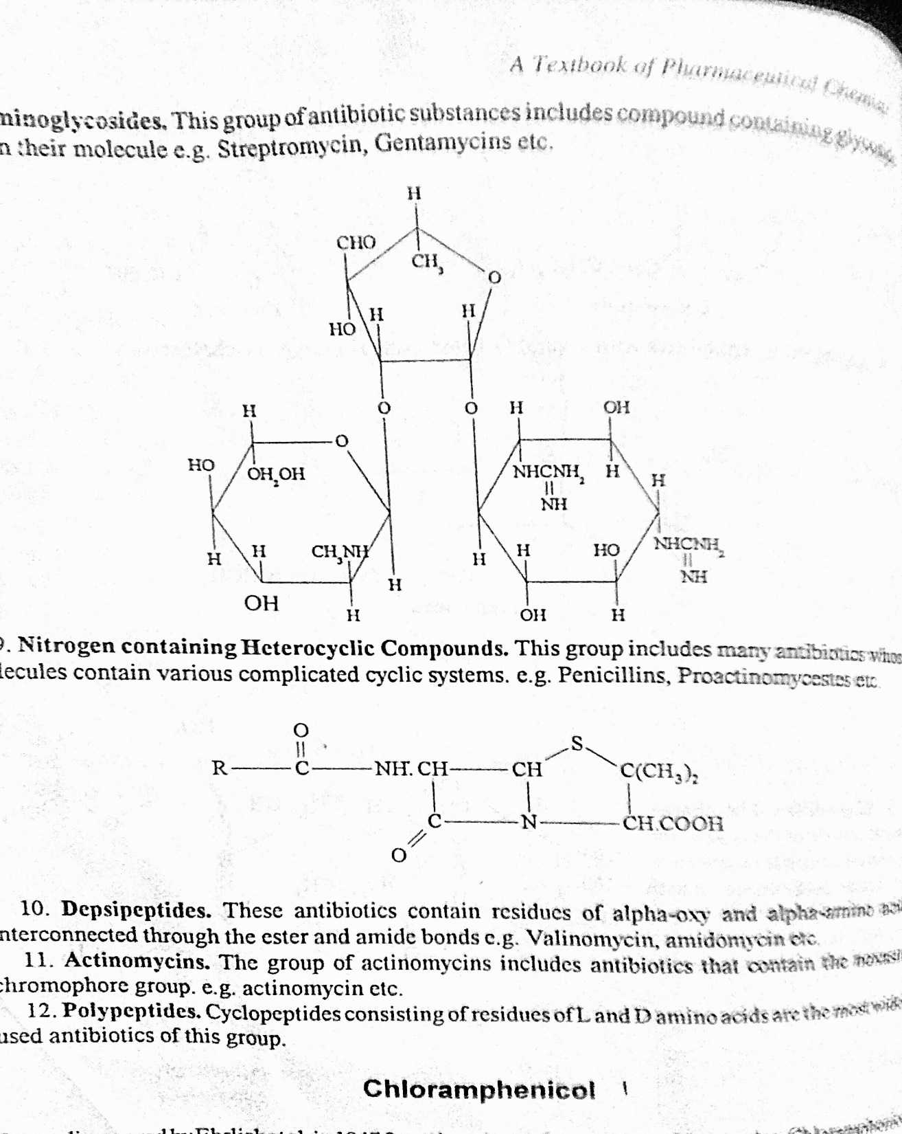
Aminoglycosides : This group of antibiotic subtances includes compound containing glycoside bonds in their molecule Eg: streptomycin, Gentamycin.

Slide 17
Depsipeptides : These antibiotics contains residues of alpha –oxy and alpha amino acids interconnected through the ester and amide bonds Ex: valinomycin amidomycin etc
Actinomycins: The group of actinomycins includes antibiotics that contain the noxsaine chromophore group eg:sactinomycin etc.,
Polypeptides:
Cyclopeptides: Consisting of residues of L and D amino acids are the most widely used antibiotics of this group.

Slide 18
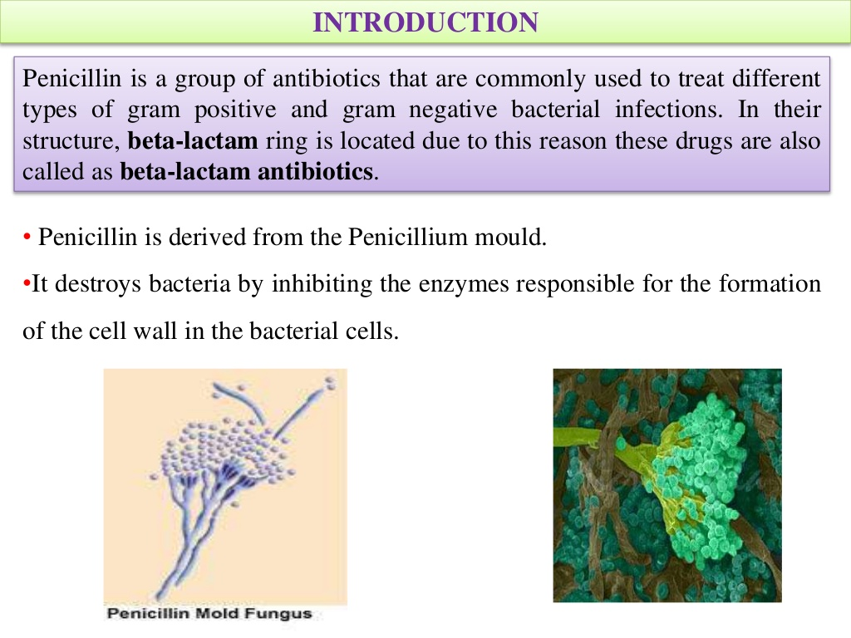
PENICILLIN

Slide 19
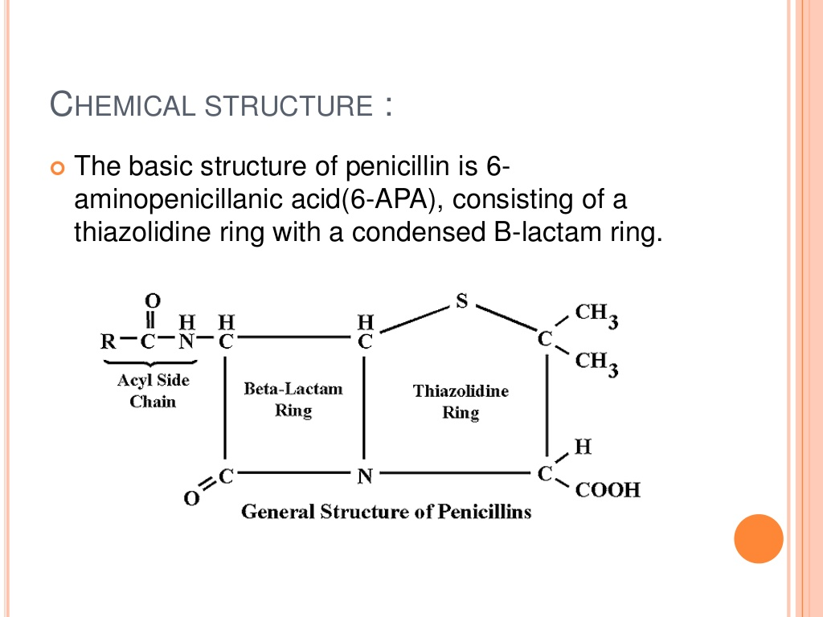

Slide 20
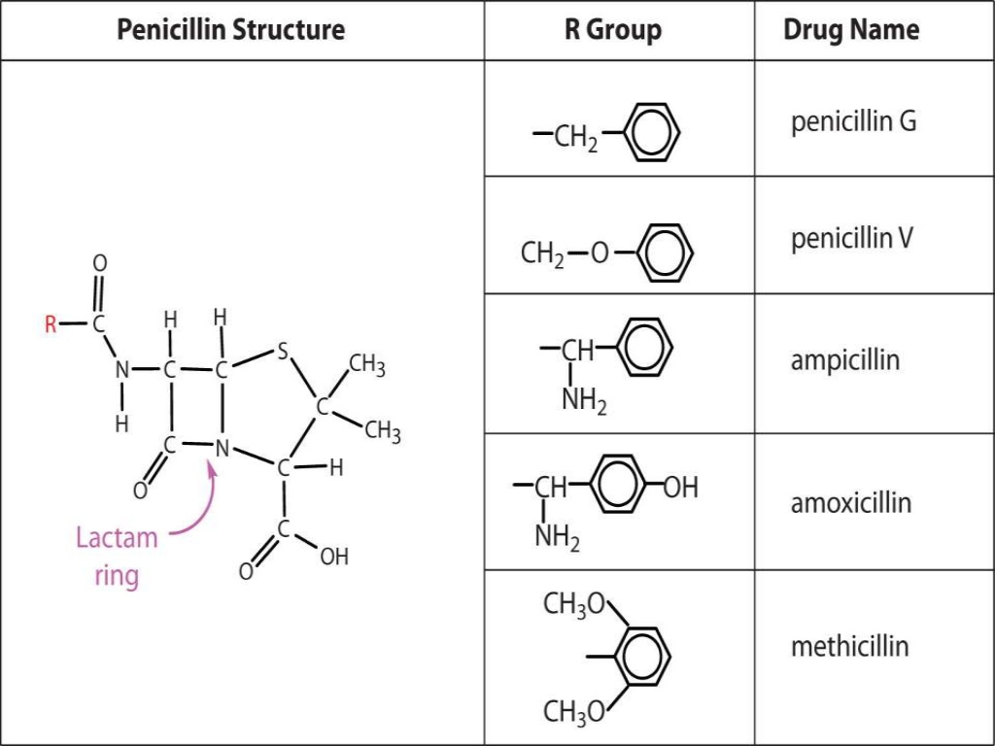

Slide 21
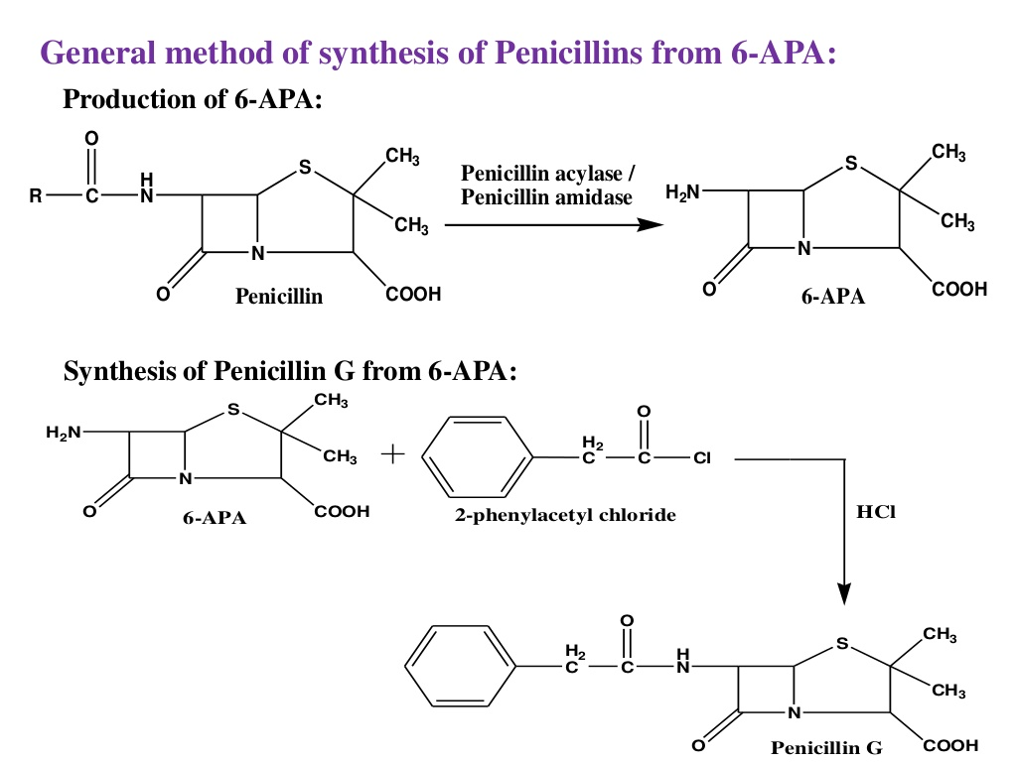

Slide 22
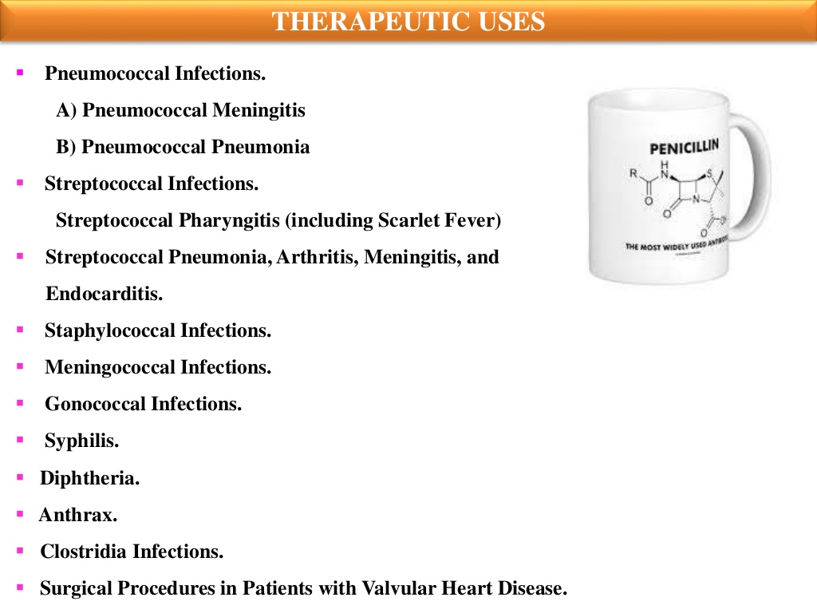

Slide 23
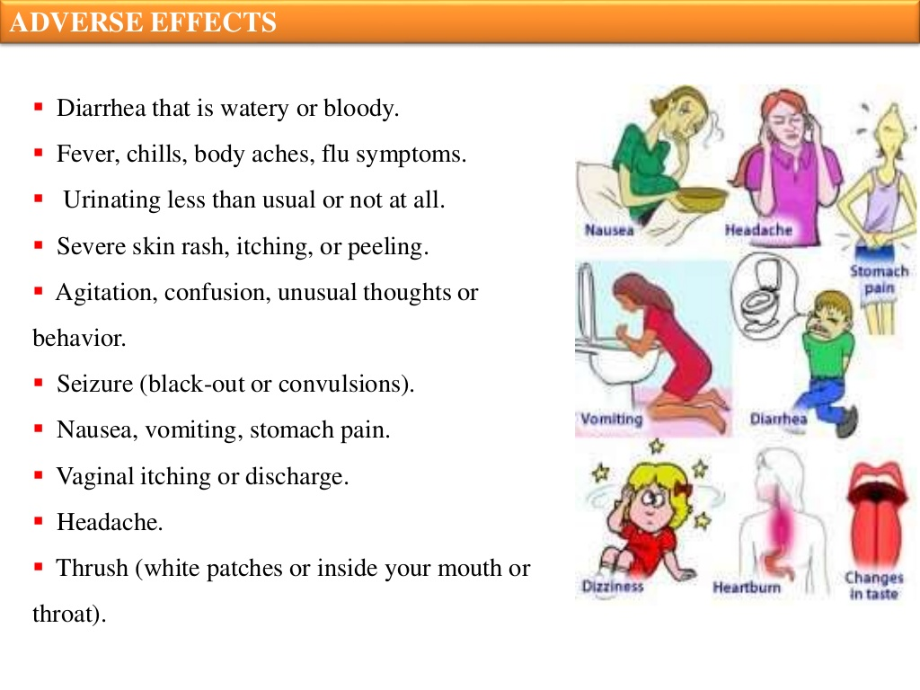

Slide 24
