Slide 1
REGIONAL PLANNING
GOVERNMENT COLLEGE FOR WOMEN (AUTONOMOUS) KUMBAKONAM
DEPARTMENT OF GEOGRAPHY
II – M.Sc - Geography, Elective course (EC)
  Mrs.B.ANUSUYA,
  Assistant Professor & Head,
  Department of Geography,
  Government College for Women, Kumbakonam.

Slide 2
Nationalization and Sectionalism
Definition:
Nationalization, or Nationalisation, is the process of Transforming private assets into public assets by bringing them under the public ownership of a national government or state.

Slide 3
What Is Nationalization?
Nationalization refers to the action of a government taking control of a company or industry, which generally occurs without compensation for the loss of the net worth of seized assets and potential income. The action may be the result of a nation's attempt to consolidate power, resentment of foreign ownership of industries representing significant importance to local economies or to prop up failing industries.

Slide 4
Nationalization is the process of taking privately-controlled companies, industries, or assets and putting them under the control of the government.
Nationalization often happens in developing countries and can reflect a nation's desire to control assets or to assert its dominance over foreign-owned industries.
Nationalization is different from privatization, in which government-run companies are moved into the private business sector.

Slide 5
Benefits of Nationalization:
External benefits for the economy of broadband provision. ...
Low borrowing costs. ...
Equity and basic utility. ...
National infrastructure is a natural monopoly. ...
Captures monopoly profit/Increases consumer surplus. ...
Loss of profit motive.

Slide 6
Reasons for Nationalization:
Common reasons for nationalization include:
(1) prevention of unfair exploitation and large-scale labor layoffs,
(2) fair distribution of income from national resources, and
(3) to keep means of generating wealth in public control.

Slide 7
The Disadvantages of Nationalization:
The major problems that the industries faced were:
They were being managed ineffectively and inefficiently. ... For example, if a particular nationalised industry made operating losses, the government would simply cover those loses with subsidies.

Slide 8
Nationalization Bad for Economy:
Nationalised industries are safeguarded against their negative consequences or management because the government can bail them out financially. It removes the organisation's 'survival instinct' to generate a profit to allow the company to feasibly operate without incurring millions of debt.

Slide 9
REGIONALISM:
In the sense Urban Planning. Its based on the relationships to the Centres and Peripheres.
“The theory or practice of regional rather than central systems of administration or economic, cultural, or political affiliation”.
REGION & REGIONALISM:
In international relations, regionalism is the expression of a common sense of identity and purpose combined with the creation and implementation of institutions that express a particular identity and shape collective action within a geographical region. ... The European Union can be classified as a result of regionalism.

Slide 10
MEANING OF REGIONALISM:
Local color or regional literature is fiction and poetry that focuses on the characters, dialect, customs, topography, and other features particular to a specific region. The characters are marked by their adherence to the old ways, by dialect, and by particular personality traits central to the region.
THE ROLE OF REGIONALISM TO THE WORLD:
Regionalism has responded to cultural globalization through an increase in cultural identity and the rise of regionalist parties. ... Although it could be argued that regionalism is simply placing the international system on a larger scale, the amount of stability and regulation that comes with regionalism is incomparable.

Slide 11
Examples of economic regionalism include free-trade areas, customs unions, common markets, and economic unions.
IMPORTANCE OF REGIONALISM:
Regionalism is important to you because it has been proven to increase the efficiency and effectiveness of local governments. More efficient government helps keep taxes and fees lower.

Slide 12
Meaning of Sectionalism:
Sectionalism is a partiality for a particular place, Sectionalism is a practically provincial devotion to one particular place, and it's usually a little bit irrational in its partiality.
Sectionalism is a Localism.
Sectionalism is loyalty to one's own region or section of the country, rather than to the country as a whole.

Slide 13
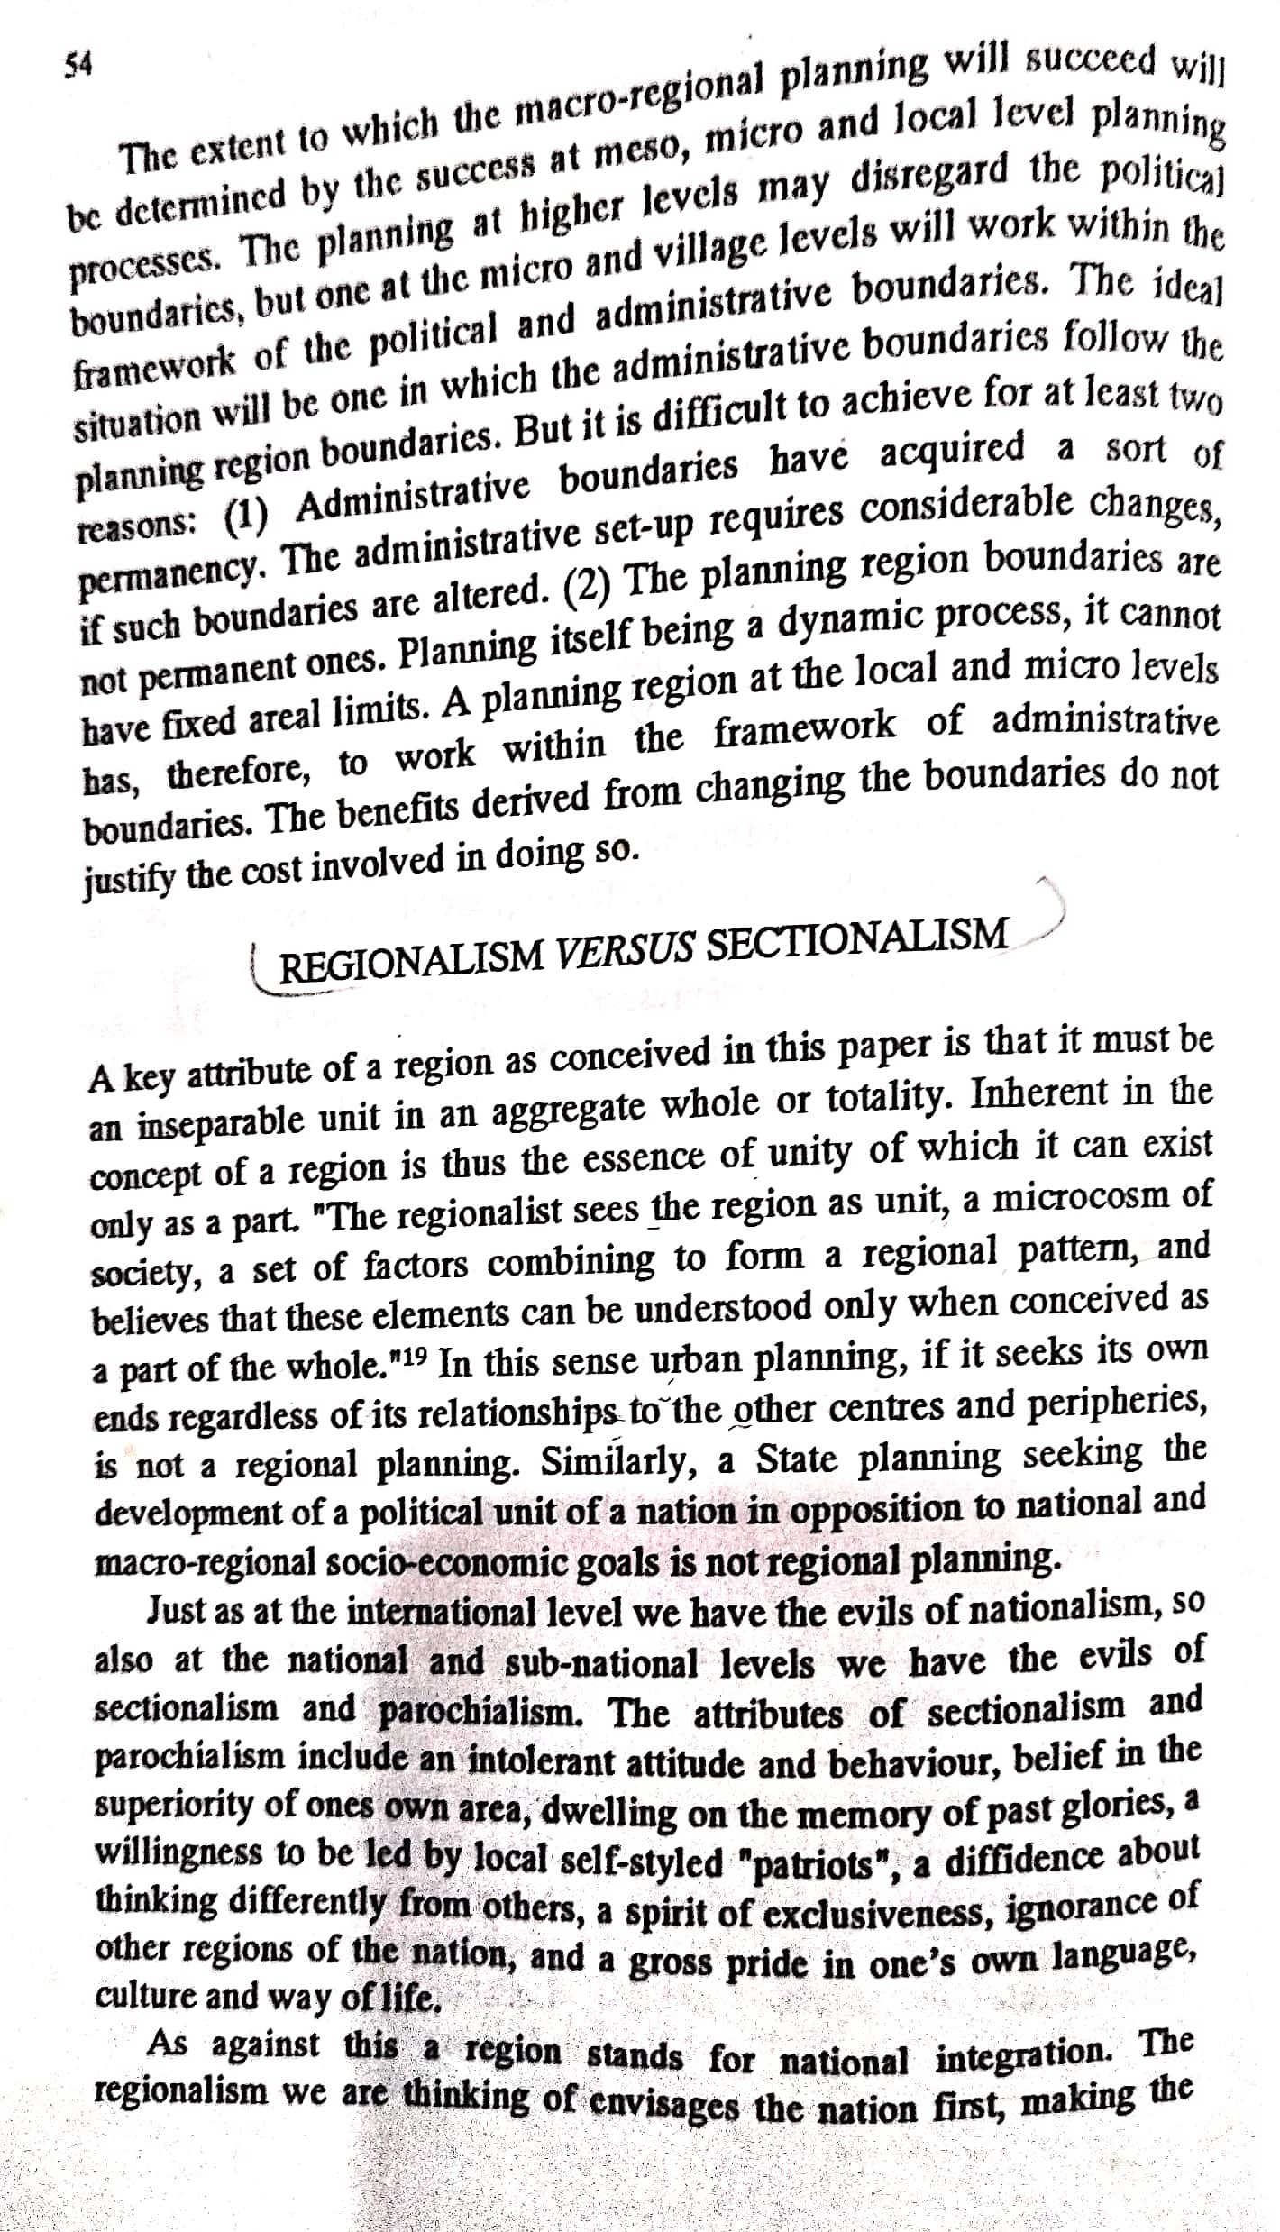
Scanned by CamScanner

Slide 14
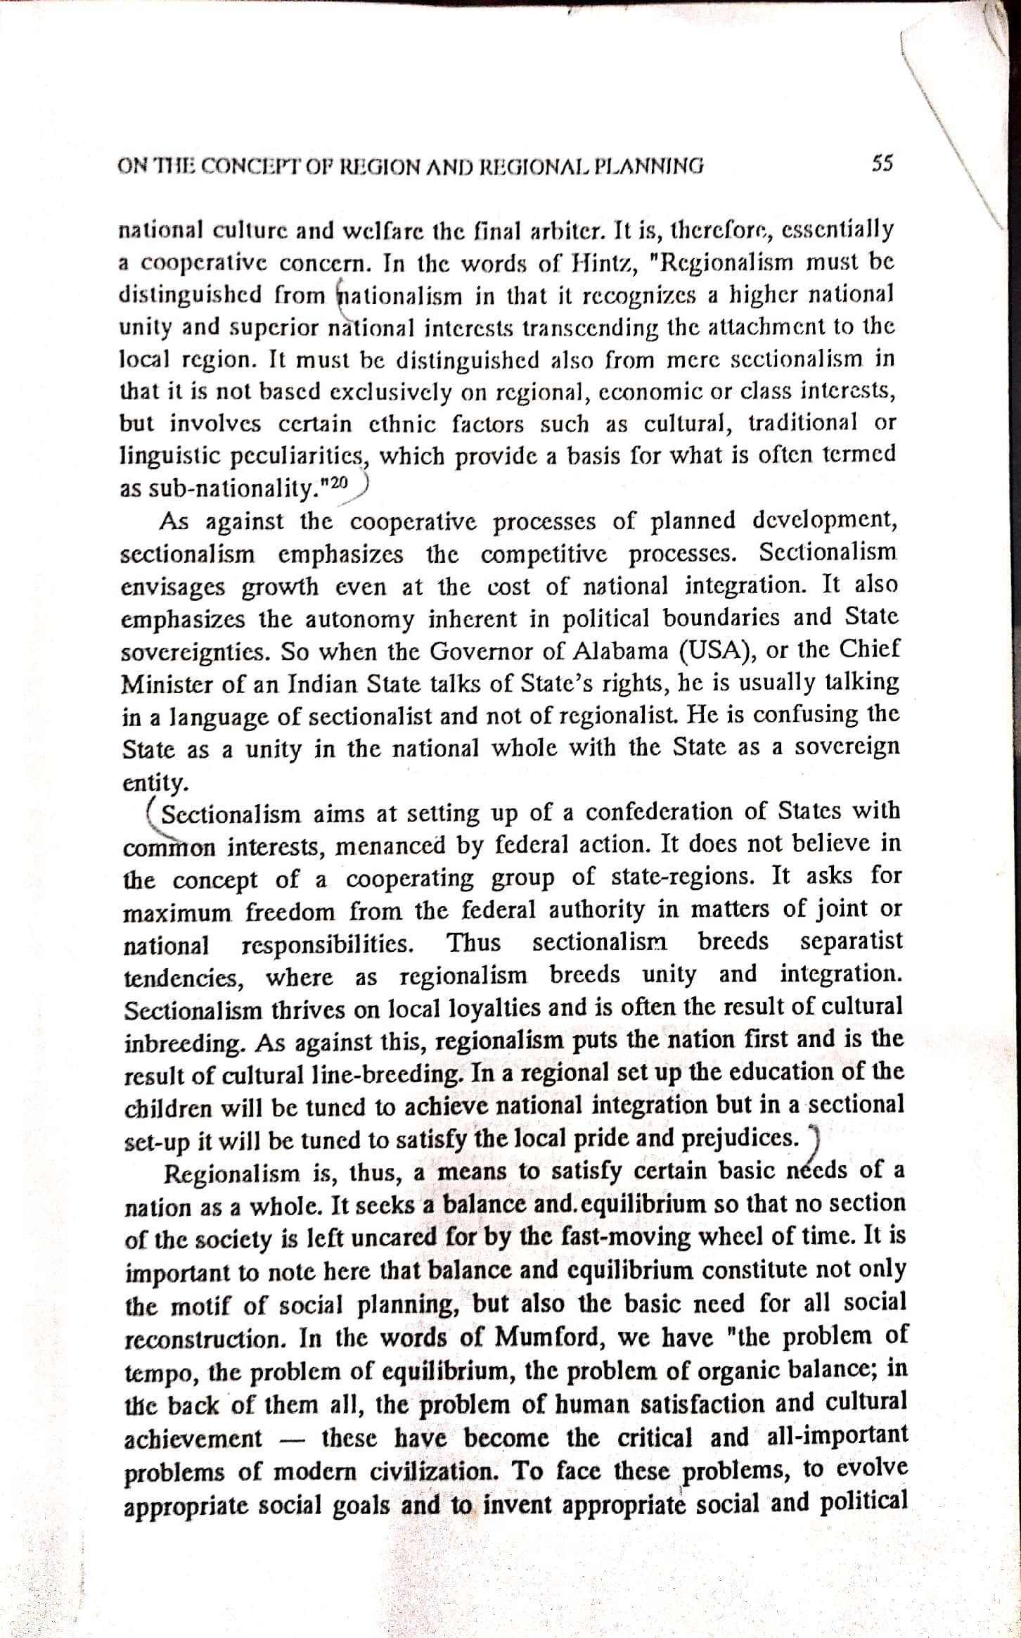
Scanned by CamScanner

Slide 15
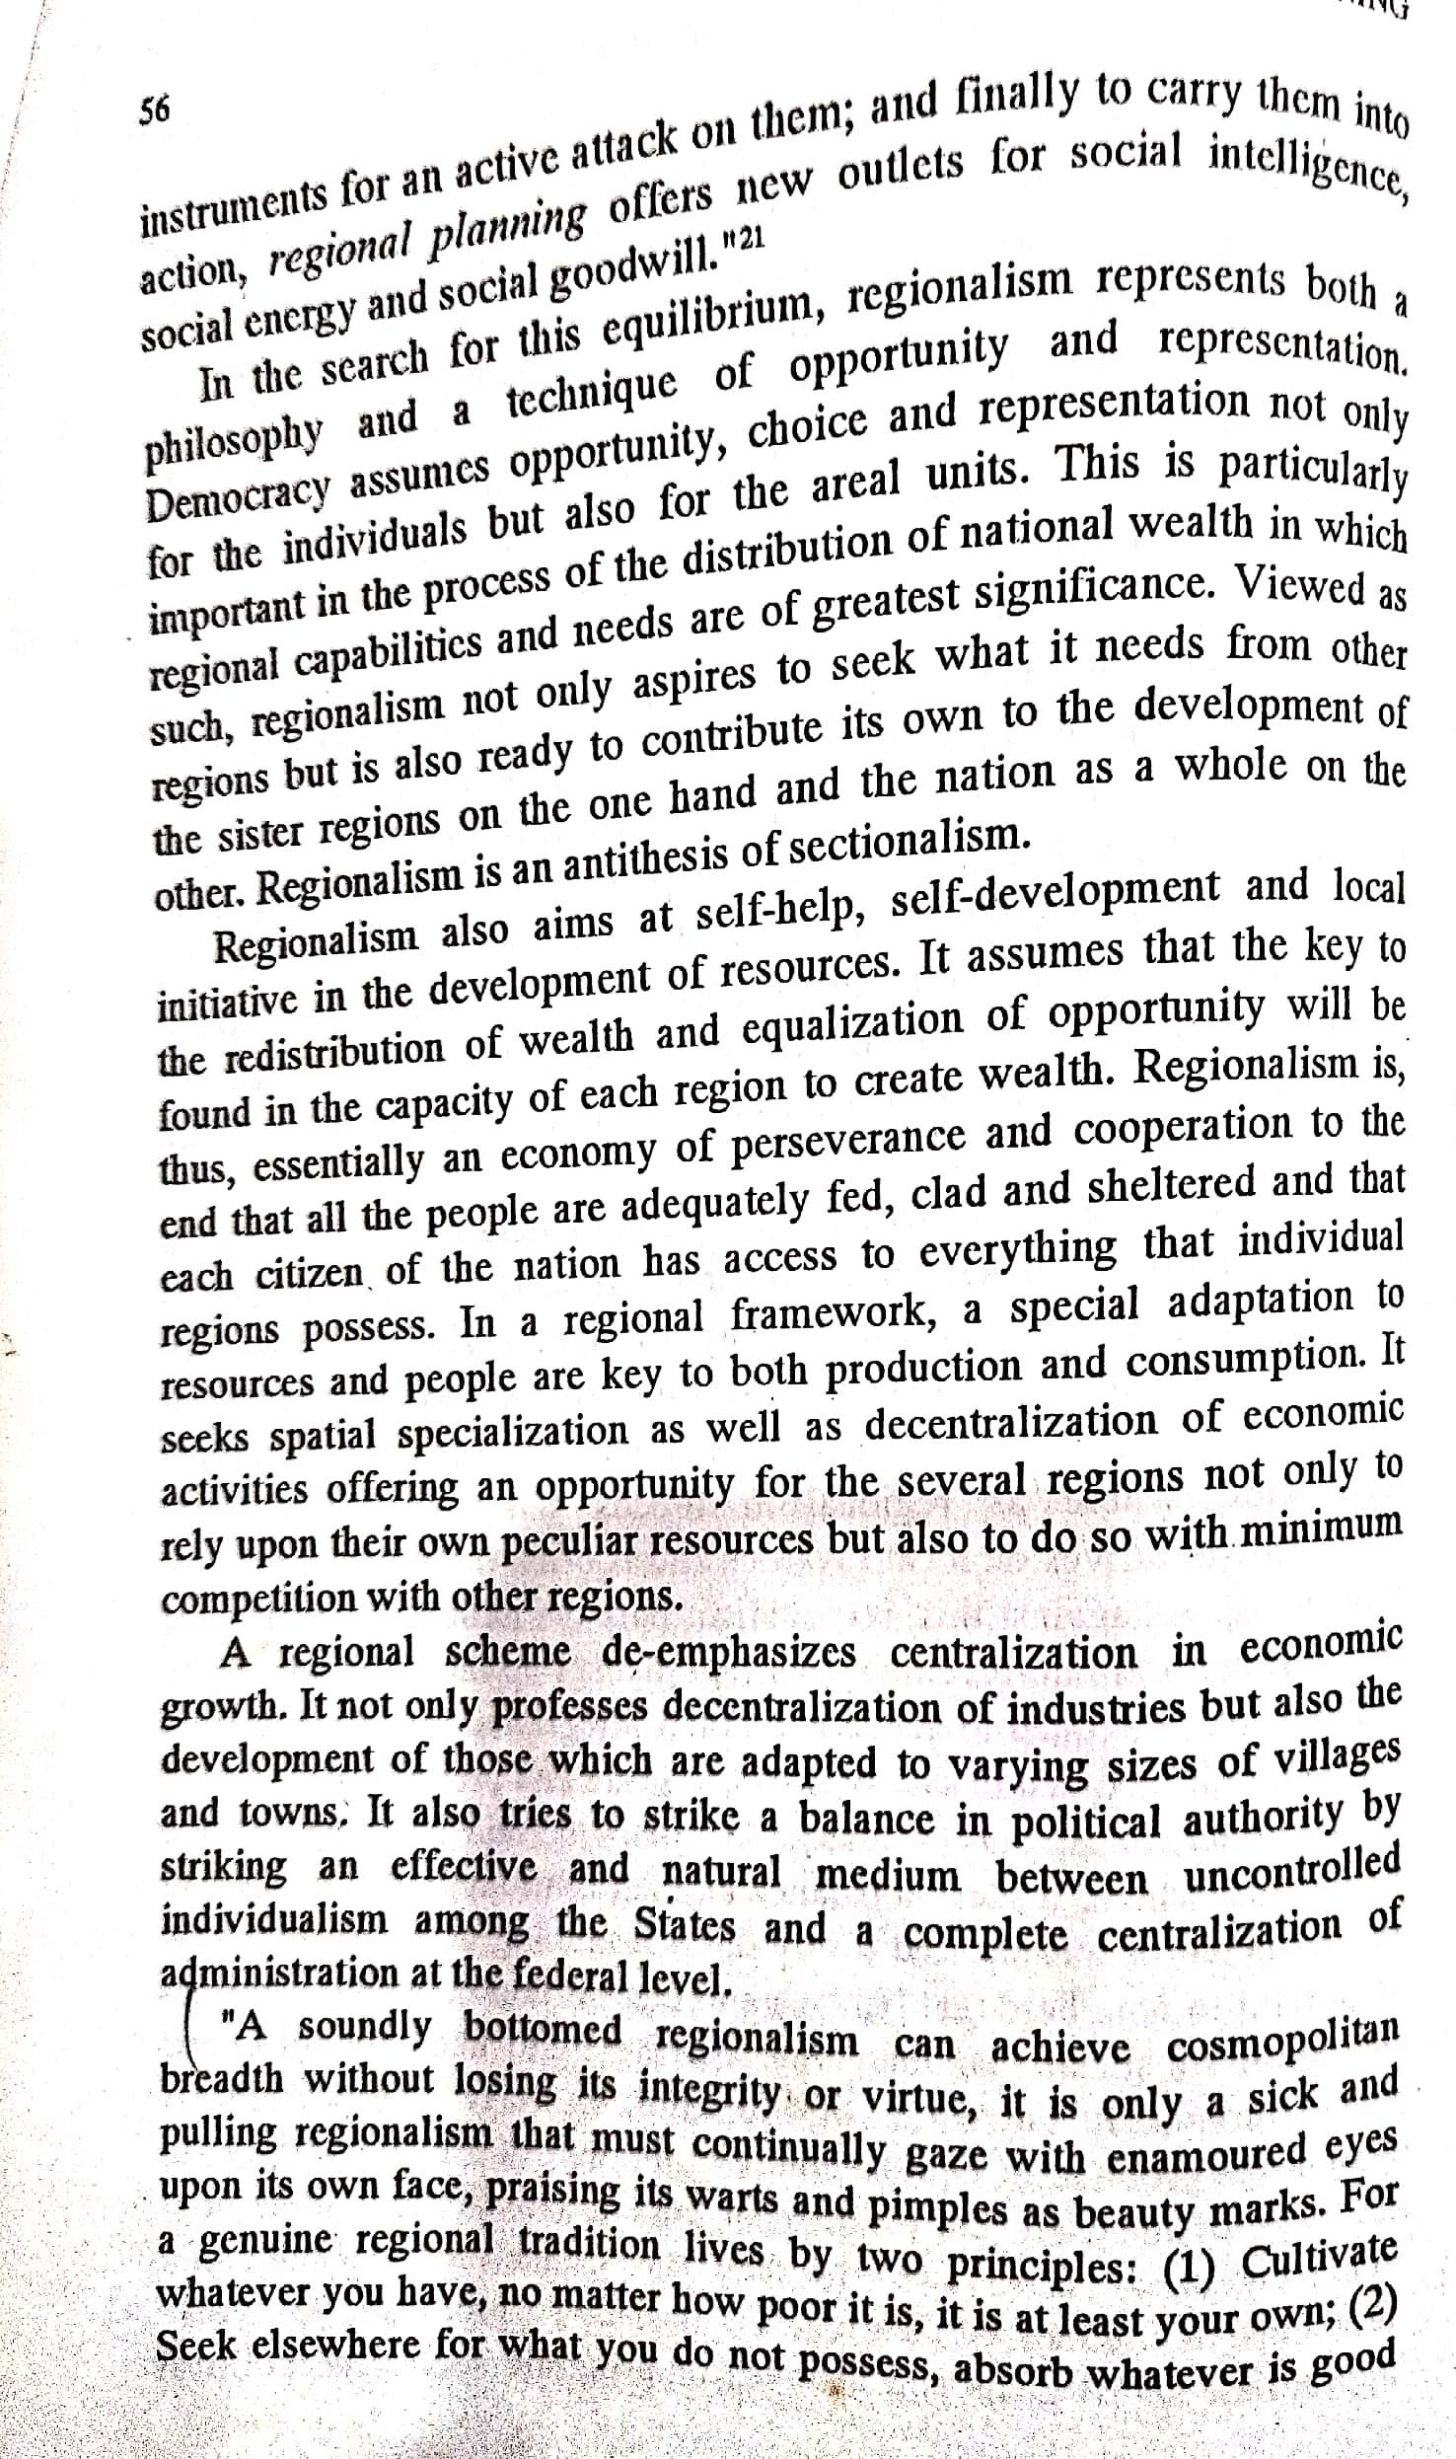
Scanned by CamScanner

Slide 16
THANK YOU

