Slide 1
APPLIED GEOMORPHOLOGY
GOVERNMENT COLLEGE FOR WOMEN (AUTONOMOUS) KUMBAKONAM
DEPARTMENT OF GEOGRAPHY
I – M.Sc - Geography
  Mrs.B.ANUSUYA,
  Assistant Professor & Head,
  Department of Geography,
  Government College for Women (A),
  Kumbakonam.

Slide 2
UNIT: I
APPLIED GEOMORPHOLOGY
Meaning - Definition
Introduction:
Geomorphology is the scientific study of the origin and evolution of topographic and bathymetric features created by physical, chemical or biological processes operating at or near the Earth's surface.
Who is known as Father of Geomorphology?
James Hutton (1726–97) was the first great fluvialist and the real founder of Modern Geomorphology.

Slide 3
What do you mean by geomorphology?
Geomorphology is the study of landforms, their processes, form and sediments at the surface of the Earth (and sometimes on other planets). Study includes looking at landscapes to work out how the earth surface processes, such as air, water and ice, can mould the landscape.
The importance of geomorphology for physical geographers is not only important in understanding Earth's physical changes but also in preparing for hazards. ... Geomorphology, as a critical component of physical geography, is needed to understand natural landform changes and potential hazards for populations.

Slide 4
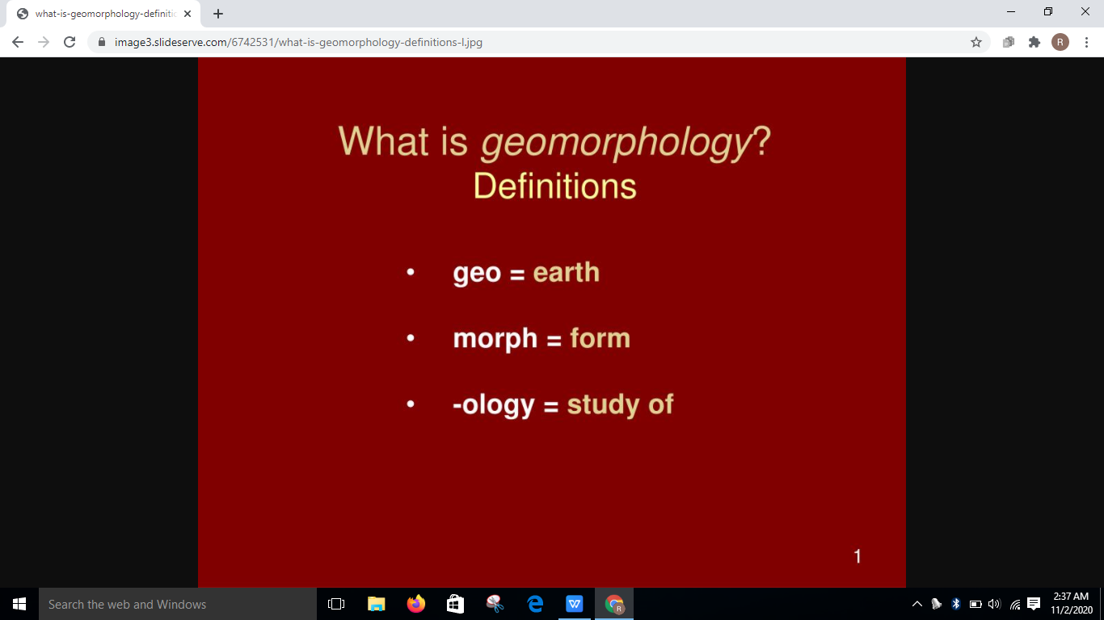
What are the types of geomorphology?
There are many sub disciplines in geomorphology including tectonic, fluvial, storm, aeolian, floodplain, glacial, groundwater, climate, tsunami, and many others. These sub disciplines are mainly driven by distinctions in the mechanics and dynamics involved in the processes.

Slide 5
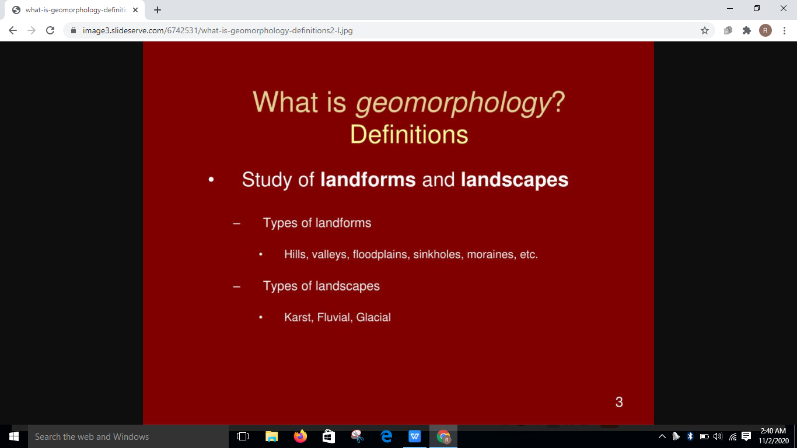

Slide 6
Landforms are the result of the interactions among the geosphere, atmosphere and hydrosphere.
Weathering.
Erosion.
Superficial Deposits.
Landslides.
Fluvial Processes.
Coastal Processes.

Slide 7
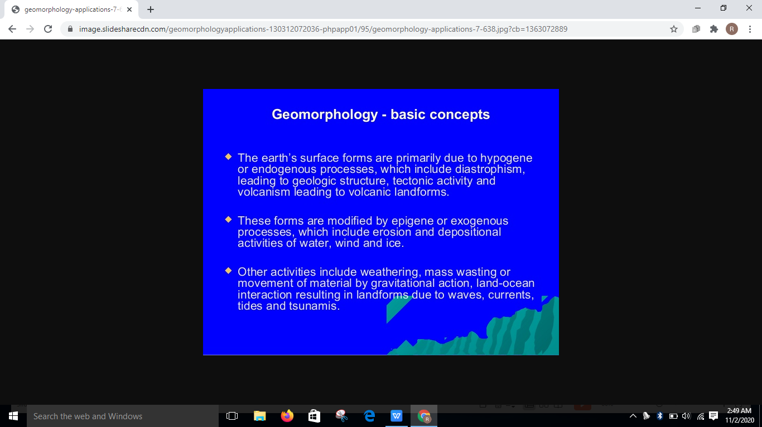

Slide 8
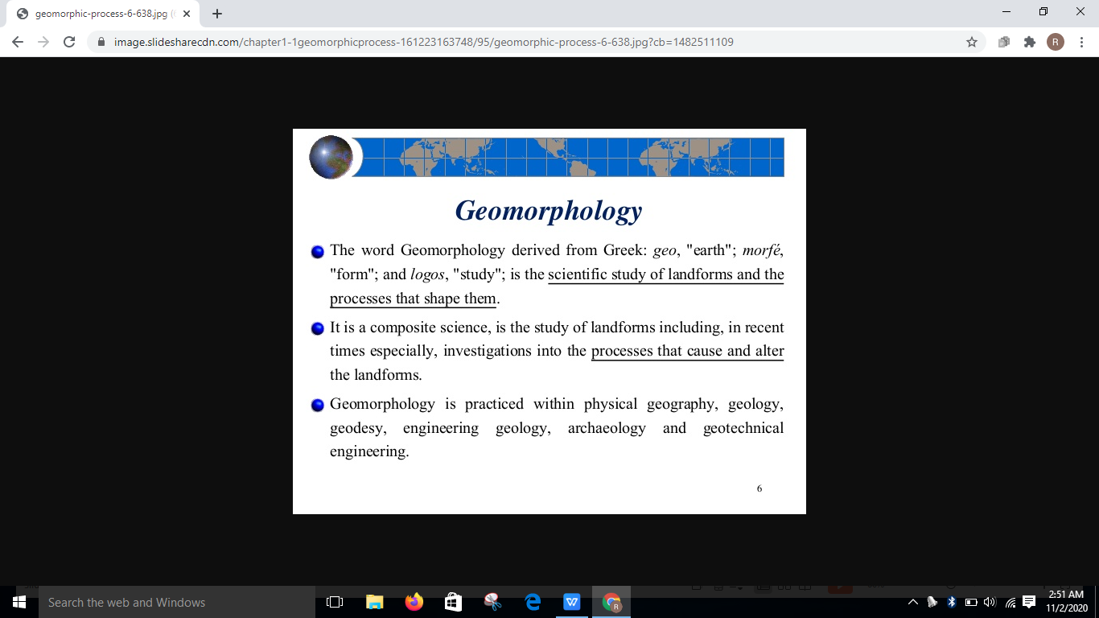

Slide 9
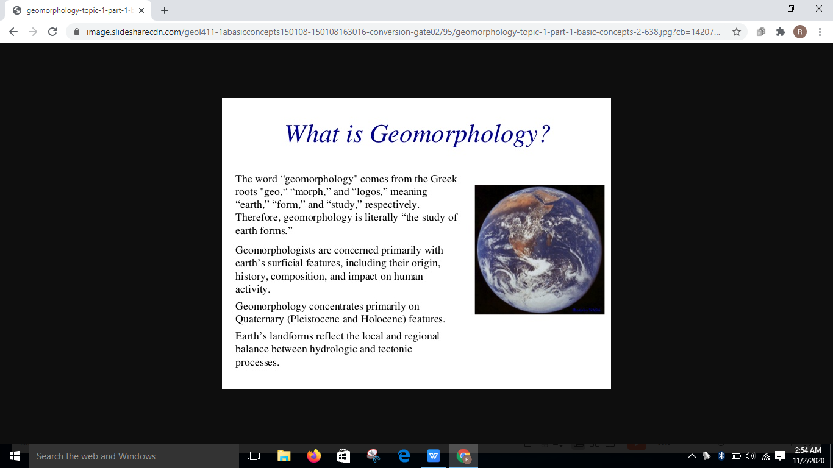

Slide 10
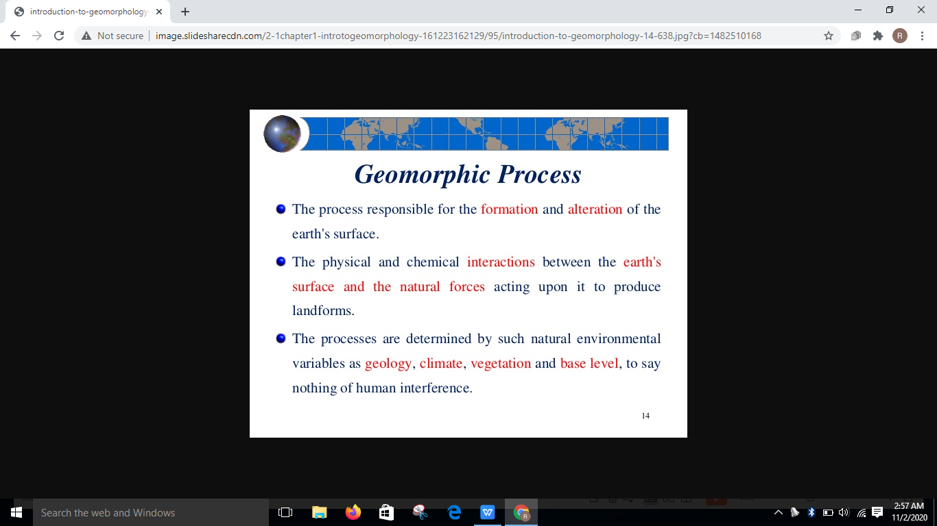

Slide 11
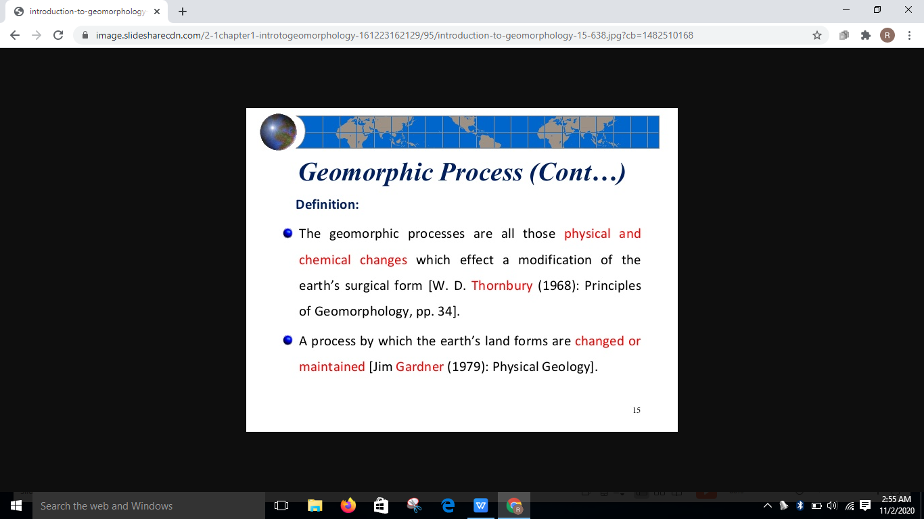

Slide 12
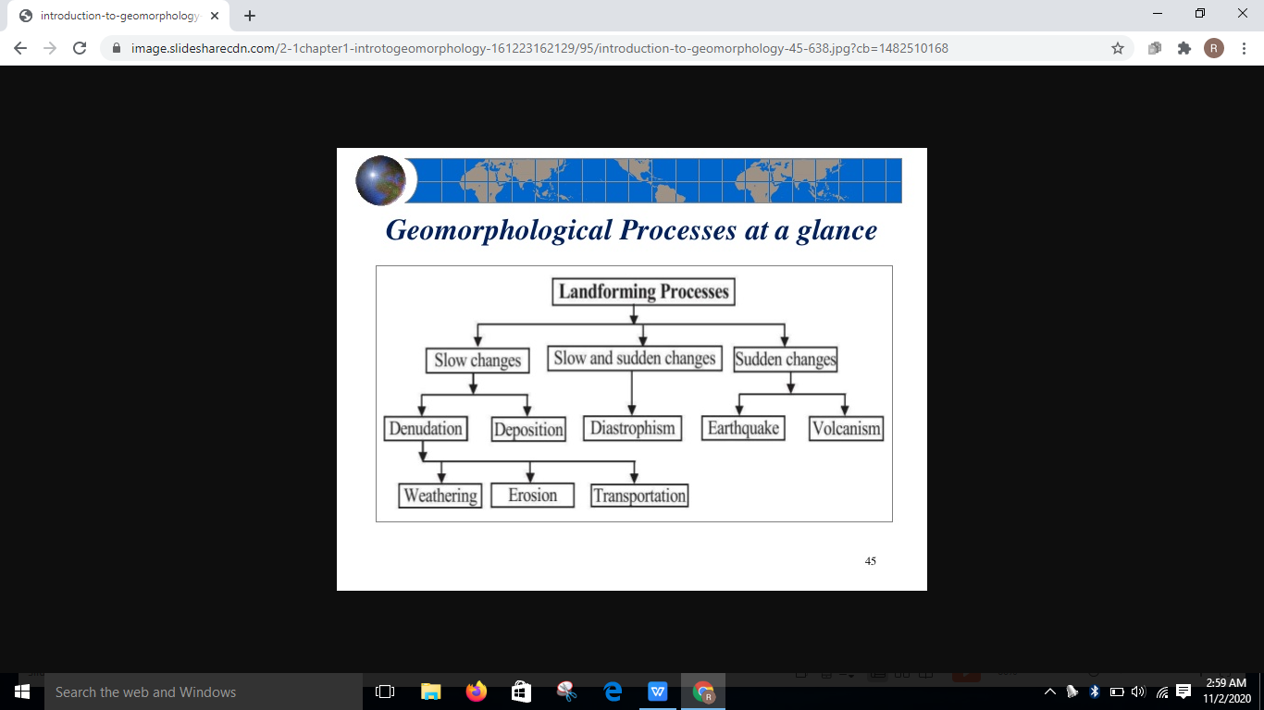

Slide 13
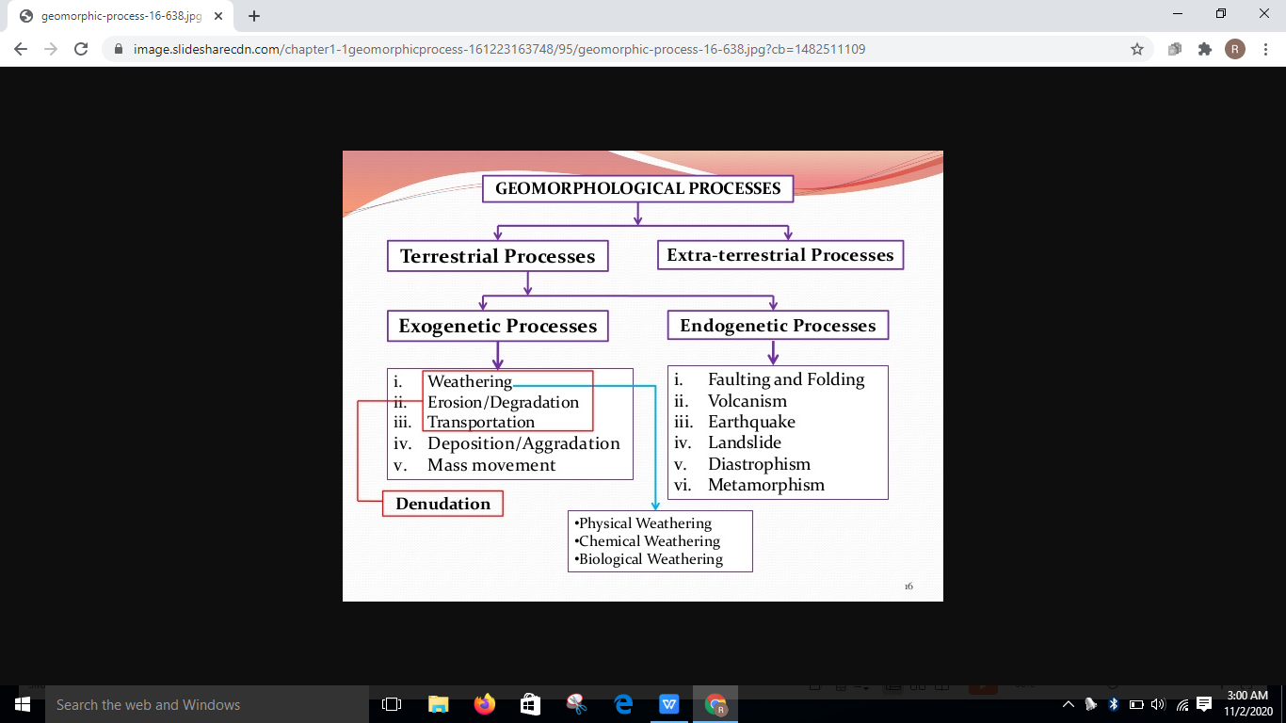

Slide 14
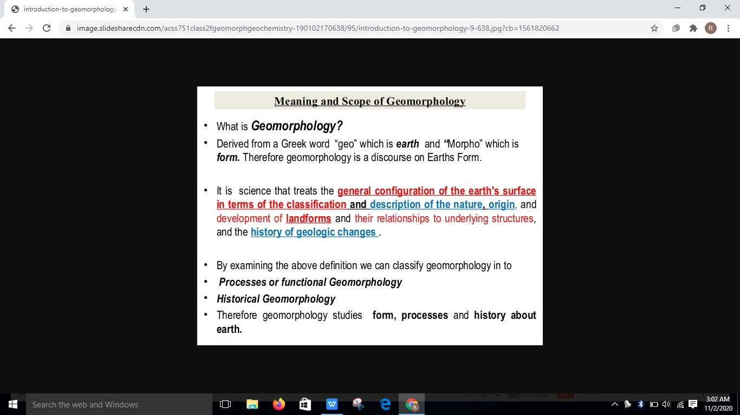

Slide 15
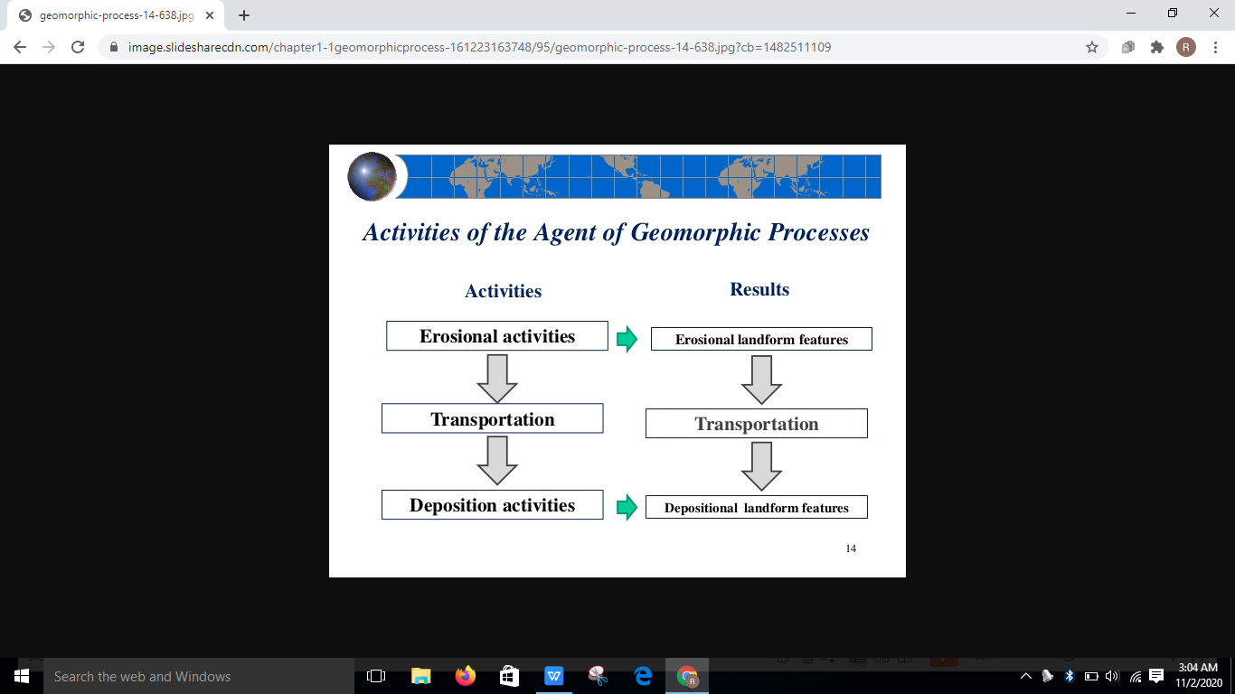

Slide 16
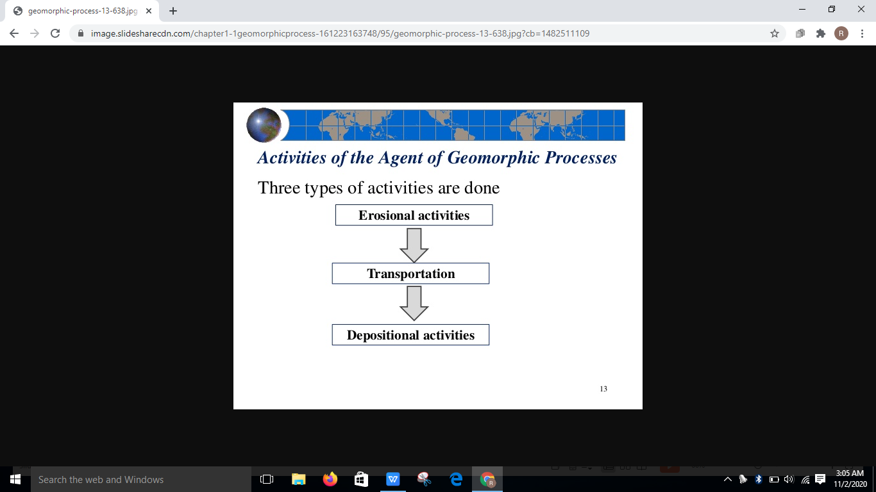

Slide 17
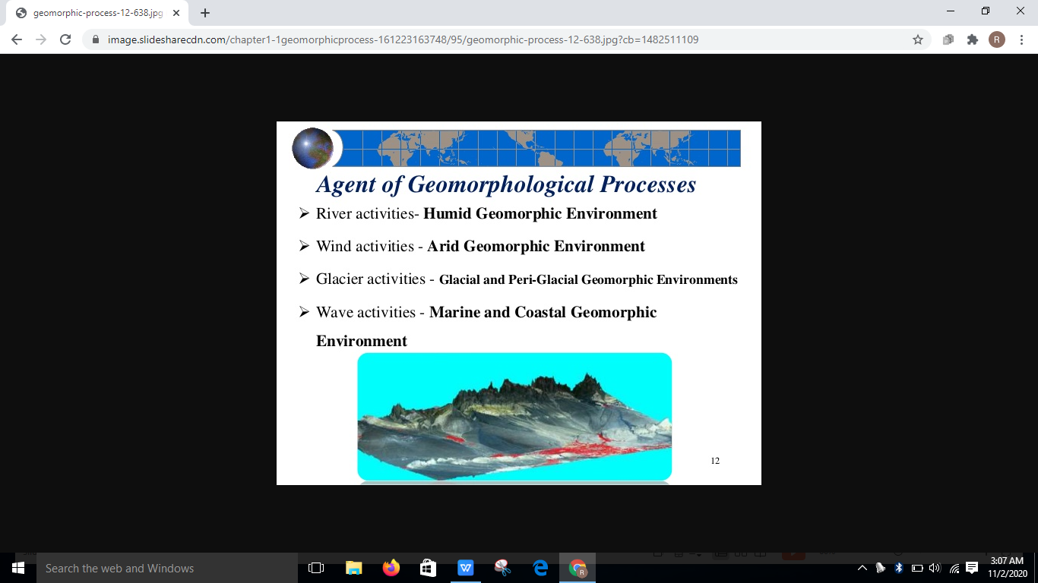

Slide 18
Thank you

