Slide 1
APPLIED GEOMORPHOLOGY
GOVERNMENT COLLEGE FOR WOMEN (AUTONOMOUS) KUMBAKONAM
DEPARTMENT OF GEOGRAPHY
  Dr. B.ANUSUYA,
  Assistant Professor & Head,
  Department of Geography,
  Government College for Women (A),
  Kumbakonam.
I – M.Sc - GEOGRAPHY

Slide 2
UNIT: II
APPLIED GEOMORPHOLOGY - P18GC101
Meaning - Definition of Diastrophism
Definition of Geomorphology:
Geomorphology is the scientific study of the origin and evolution of topographic and bathymetric features created by physical, chemical or biological processes operating at or near the Earth's surface.
What do you mean by geomorphology?
Geomorphology is the study of landforms, their processes, form and sediments at the surface of the Earth (and sometimes on other planets). Study includes looking at landscapes to work out how the earth surface processes, such as air, water and ice, can mould the landscape.

Slide 3
Is Diastrophism part of Geotectonics?
Also called tectonism. the action of the forces that cause the earth's crust to be deformed, producing continents, mountains, changes of level, etc.
The process of movement and deformation of the earth's crust that gives rise to large-scale features such as continents, ocean basins, and mountains. Also called: tectonism See also orogeny, epeirogeny he action of the forces that cause the earth's crust to be deformed, producing continents, mountains, etc.

Slide 4
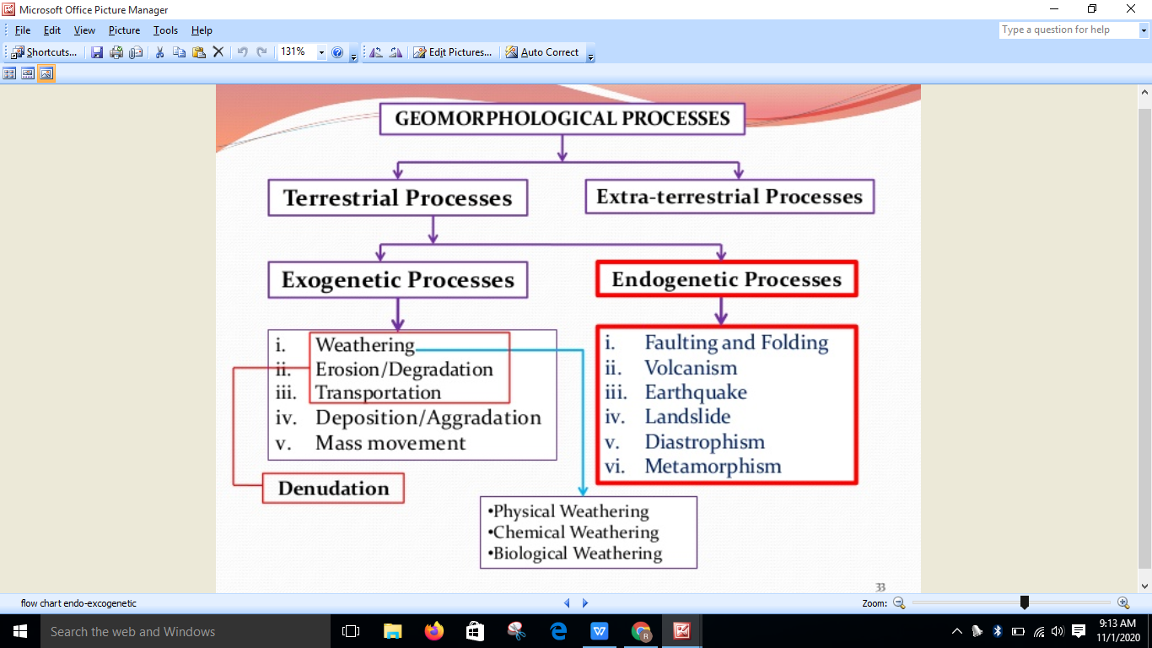

Slide 5
The process of movement that causes the earth’s crust to form continents, mountains, etc. — diastrophic, diastrophism - the process of deformation that produces continents and ocean basins in the earth's crust. The geologic process, geological process - (geology) a natural process whereby geological features are modified

Slide 6
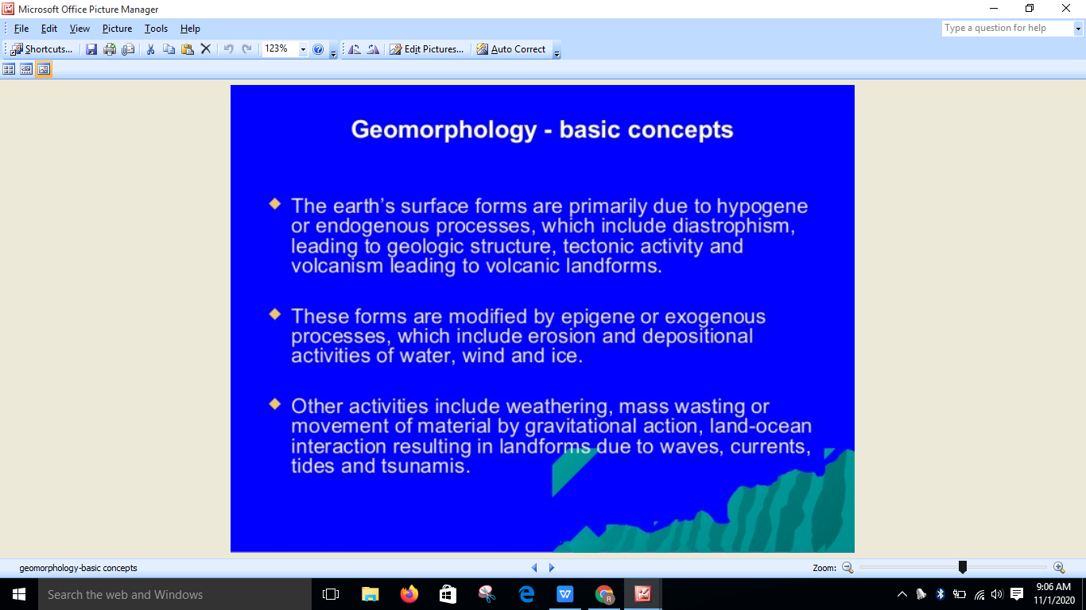

Slide 7
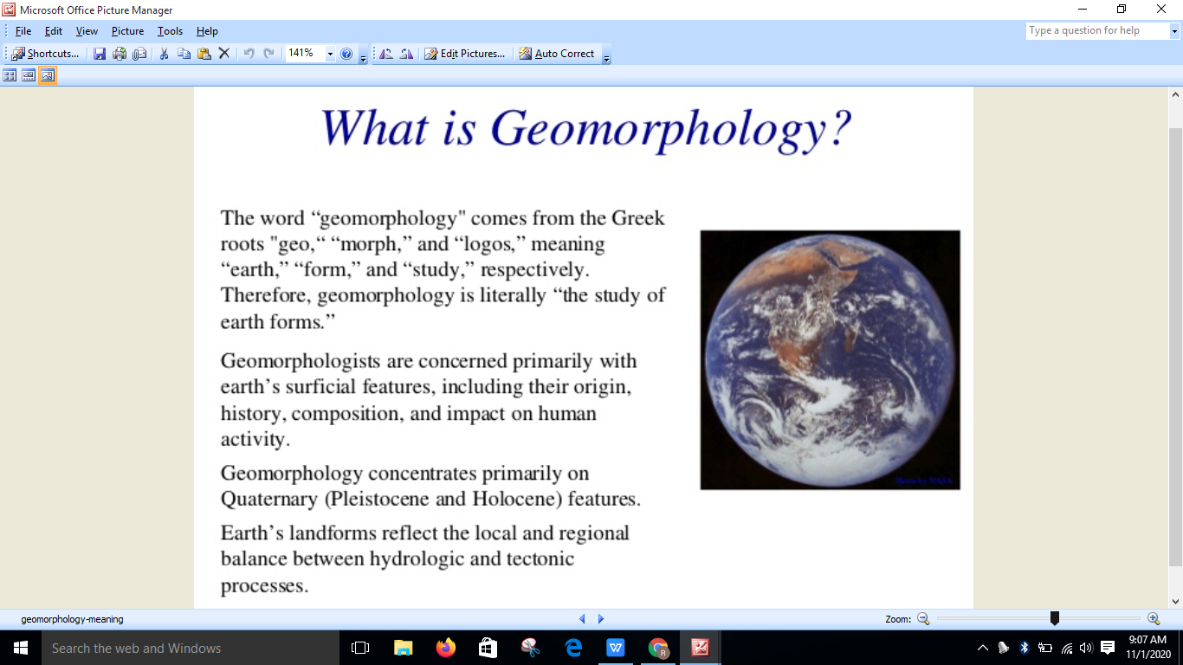

Slide 8
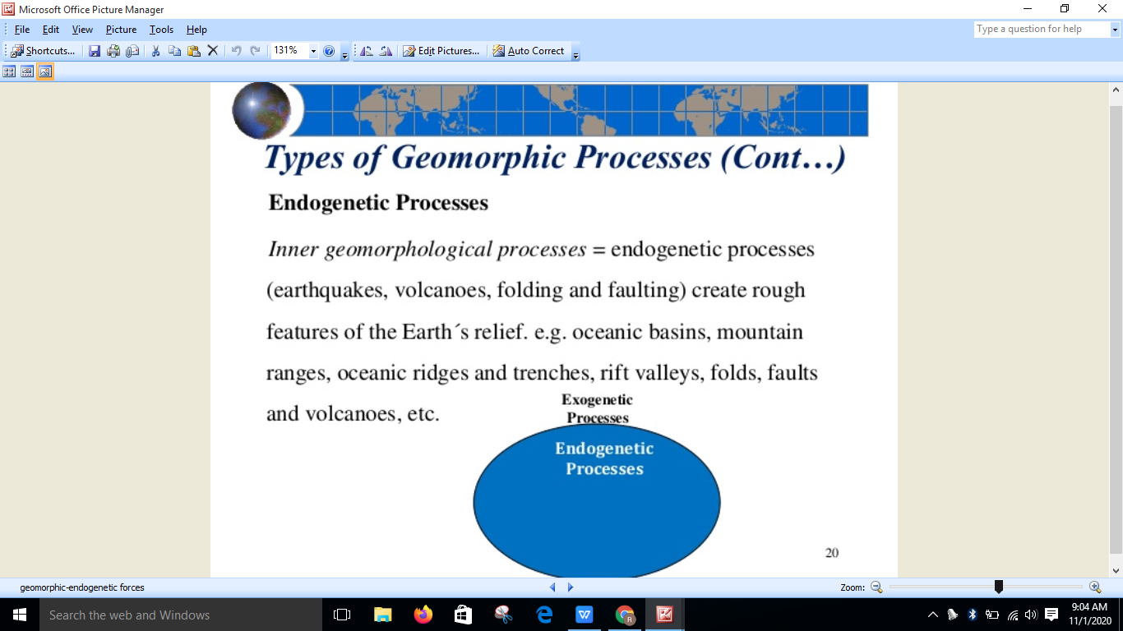

Slide 9
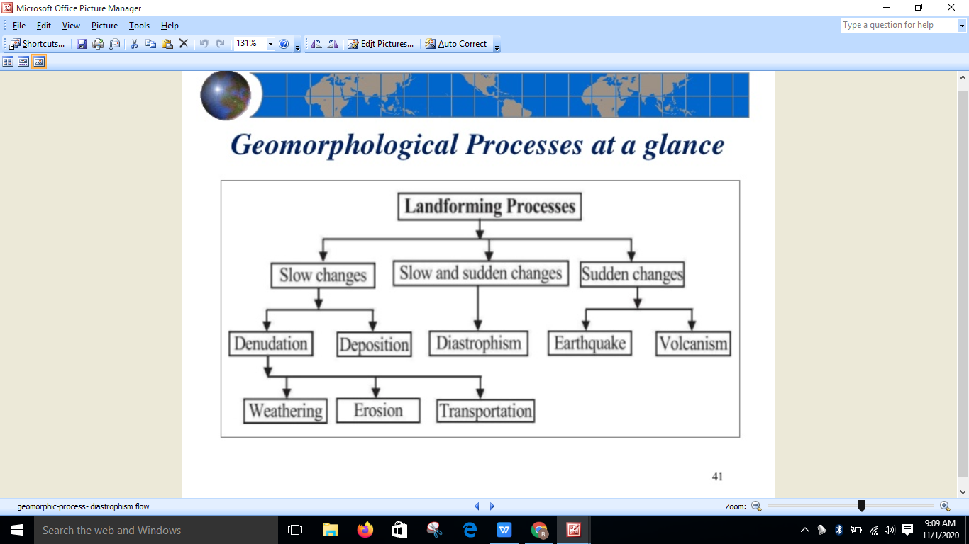

Slide 10
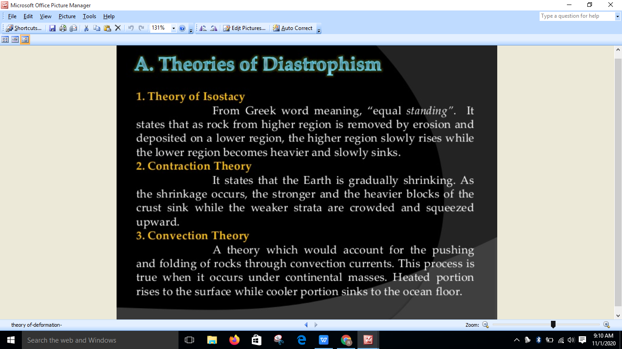

Slide 11
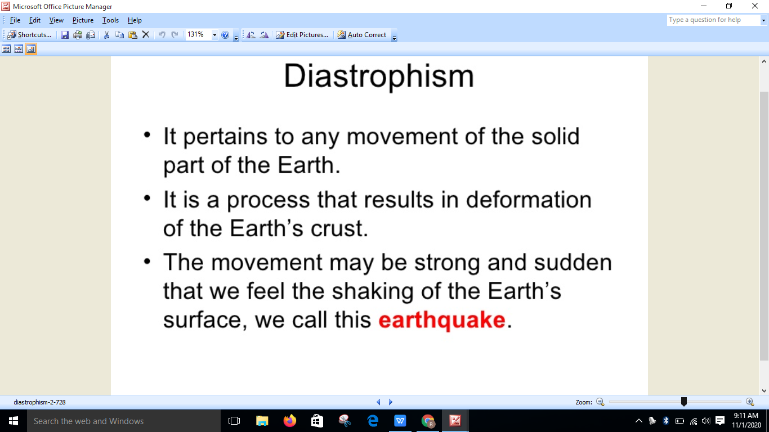

Slide 12
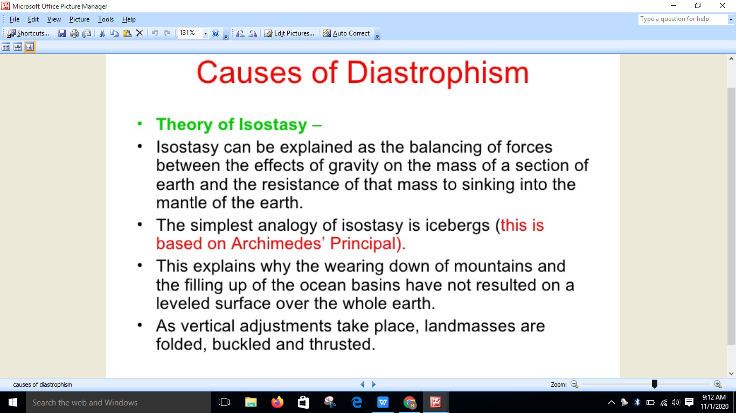

Slide 13
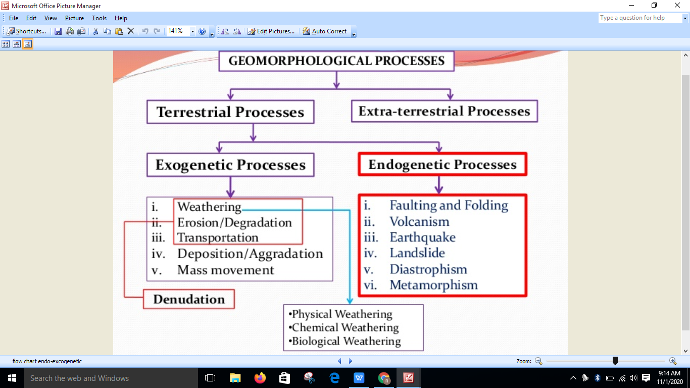

Slide 14
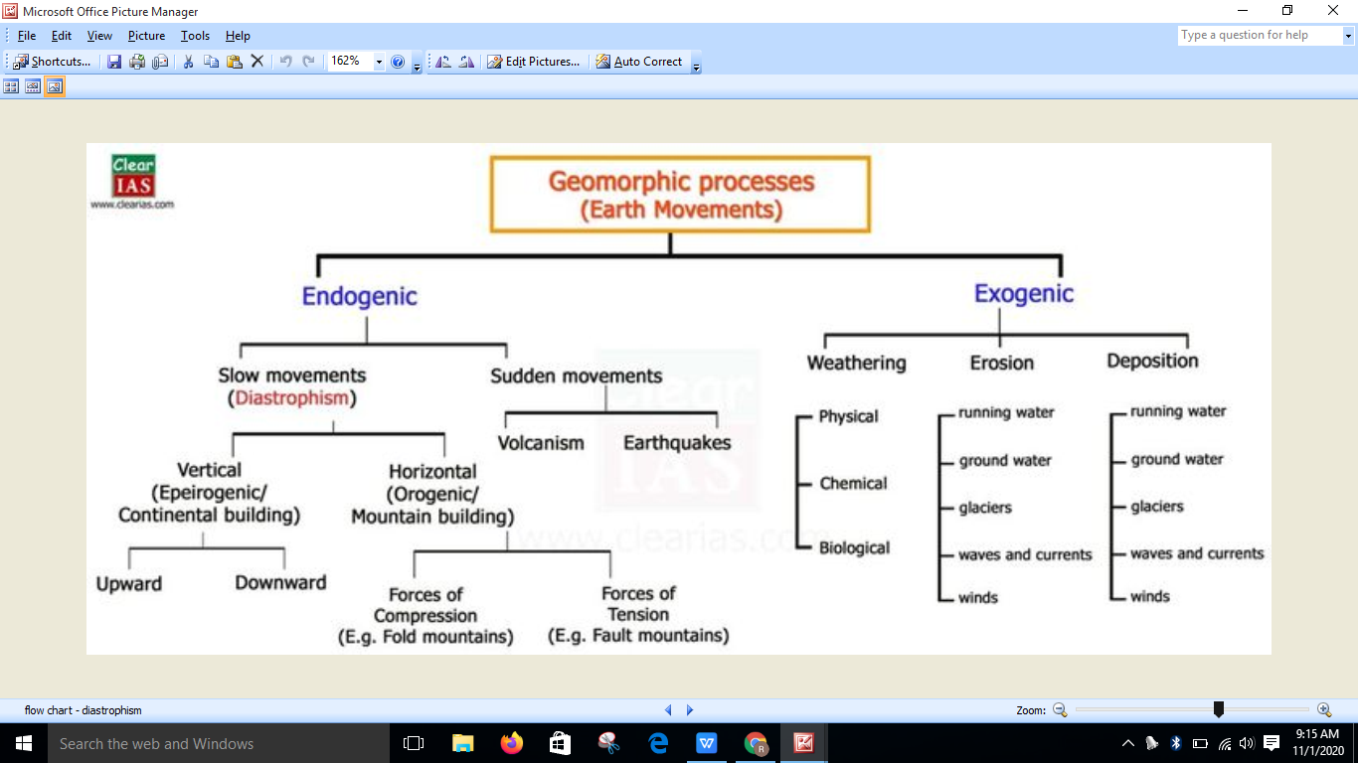

Slide 15
Thank you

