Slide 1
APPLIED GEOMORPHOLOGY
GOVERNMENT COLLEGE FOR WOMEN (AUTONOMOUS) KUMBAKONAM
DEPARTMENT OF GEOGRAPHY
Dr. B.ANUSUYA,
Assistant Professor & Head,
Department of Geography,
Government College for Women (A),
Kumbakonam.
I – M.Sc - GEOGRAPHY

Slide 2
UNIT: II APPLIED GEOMORPHOLOGY FOLDS AND FAULTS
Definition of FOLDS:
Fold verb (BEND) to bend something such as paper or cloth so that one part of it lies on the other part, or to be able bend.
Geological folds are the curvatures in rocks or strata containing them. Most visible stratified rocks are located in the rivers, quarries or coasts were, originally, sediment layers deposited in horizontal or near horizontal beds. However, when we observe today they are not only solidified but usually inclined in one direction or another.

Slide 3
What Are Folds?
Fold occurs when rock deforms in such a way that it bends instead of breaking. The Rocks, like any other material, deform to the action of external efforts. We do not grasp this deformation, but we know when a rock is deformed. Folds come from pressure on the rocks that occur over very long periods of time and vary in size from microscopic crinkles to mountain-sized folds.
Any material can be deformed in three ways:
What are the Geological Folds?
Geological folds are the curvatures in rocks or strata containing them. Most visible stratified rocks are located in the rivers, quarries or coasts were, originally, sediment layers deposited in horizontal or near horizontal beds. However, when we observe today they are not only solidified but usually inclined in one direction or another.

Slide 6
In the upright folds, the axial planes are vertical, while in the reclined tilt or dip and are sub horizontal. In the latter, the upper side can detach pushing the bottom and form a structure known as mantle, common in the Alps or the Pyrenees.
“A geological fold occurs when one or a stack of originally flat and planar surfaces, such as sedimentary strata, are bent or curved as a result of permanent deformation. Synsedimentary folds are those due to slumping of sedimentary material before it is lithified. Folds in rocks vary in size from microscopic crinkles to mountain-sized folds.”

Slide 8
Rock layers in Folds
The rock layers in folds can be folded in two ways: as a result of transverse bending and by longitudinal bending.
Transversal flexure
The layer is bent under the action of forces applied perpendicular to the layer plane direction. For this slouch, various forces must exist. The folds that arise in this case are caused by the transverse bending folds. The most characteristic among them arise as a result of the action of vertical forces applied to the horizontal layers.
For example, the bending folds transversal firm layers that cover the crystalline basement, elevated above the block bounded by the fractures. The forces that form pairs are directed from the bottom up to meet the latter and are caused by the gravitational force, which holds the layers in its original level outside the boundaries of the block that rises.

Slide 9
Longitudinal flexure
It arises under the action of the compressive force parallel to the direction layers. The latter, during the longitudinal compression, loses its stability and deforms rather than uniformly thickening, they are curved. The role of the layered structure of the rocks during the transverse and longitudinal deflections is not the same.
During transverse bending, even if there are no mechanical dividing determined by stratification, the deformation end with the formation of a fold. For example, if the layers are drawn simply in the side wall of a plastic test tube and, therefore, they cannot play any mechanical role. A result of the first deformation will turn out to be in a curved fold transverse bending.

Slide 10
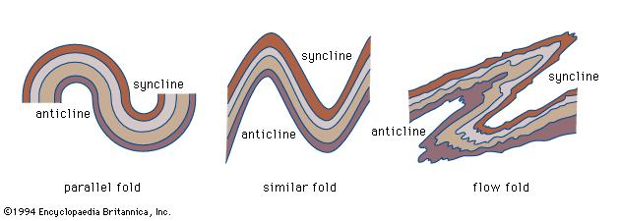

Slide 12
The longitudinal bending plays a different stratification geological folds in principle: without the latter in any way that may form folds, since one of the conditions for their formation necessary during bending is longitudinal slip between possible layers. The slouching packet divided by folds of strata slips relieved surfaces, all sliding layer to the underlying, towards the dome and anticlinal respect to the overlying, towards the hook syncline.
Due to friction, to bend the strata, all inside layer is under the action of a pair of forces, one of which (on the roof of the layer) is directed towards the anticlinal dome. The other (in the wall layer) is directed to the hook of the syncline. This torque tends to cause a deformation in the displacement layer.

Slide 13
Types of Geological Folds:
They can be classified according to various factors independently.
Anticline: the oldest materials are located in the core of the fold.
Syncline: are the most modern materials which are located in the core or center fold
Monocline: or a fold in knee that only has one flank.
Symmetrical: the angle between the two flanks with the horizontal is approximately the same.
Asymmetrical: the two sides have distinctly different inclinations.
Inclined: the axial plane forms an angle with the vertical.
Recumbent: axial plane is almost horizontal.
Isoclinal: the thickness of each layer does not vary along the fold. Origin to bending stresses attributed type.
Antiform: it is a linear type of folds. The strata dip is not close to the axial center and there is no information of its age.

Slide 14
Anticlines
Anticlines have an arch appearing strata.
Syclines
Syclines are the opposite of anticlines with a saucer shaped strata.
Anticlines and synclines are symmetrical in shape. Asymmetrical folds both have an anticline and syncline strata. Most folds are asymmetrical.
Assymetrical fold
Monoclines
Monoclines have one raised limb on one side and a gently sloping dip on the other e.g Isle of Wight, UK.
Recumbent folds
In recumbent folds, the strata is extremely folded over creating a “Z like” appearance. They’re a result of prolonged compressional forces in one direction.
Isoclinal folds
These folds have limbs that run parallel to the same direction.
Domes
Domes are formed from prolonged compressional forces along anticlines.
Basins
Basins are saucer shaped formed from prolonged compressional forces along a syncline.

Slide 15
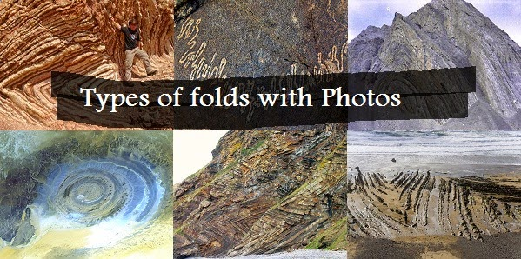

Slide 16
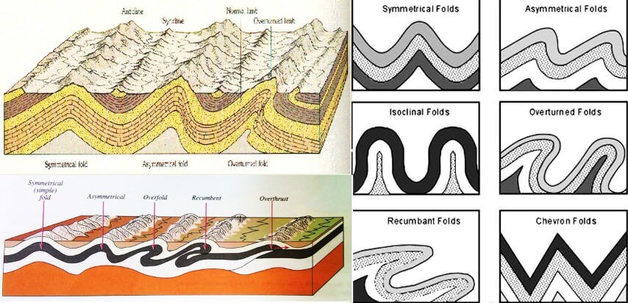

Slide 19
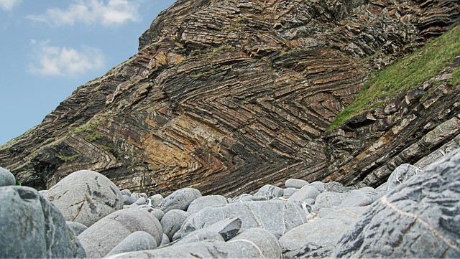
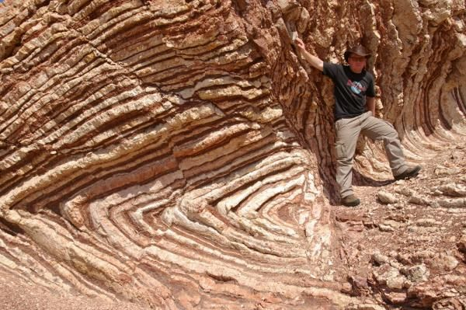

Slide 20
Thank you

