Slide 1
APPLIED GEOMORPHOLOGY
GOVERNMENT COLLEGE FOR WOMEN (AUTONOMOUS) KUMBAKONAM
DEPARTMENT OF GEOGRAPHY
  Dr. B.ANUSUYA,
  Assistant Professor & Head,
  Department of Geography,
  Government College for Women (A),
  Kumbakonam.
I – M.Sc - GEOGRAPHY

Slide 2
UNIT: II
APPLIED GEOMORPHOLOGY
EARTHQUAKES
Definition of EARTHQUAKES:
An earthquake is caused by a sudden slip on a fault. The tectonic plates are always slowly moving, but they get stuck at their edges due to friction. ... When the shearing stresses induced in the rocks on the fault planes exceed the shear strength of the rock, rupture occurs.
What is an earthquake short definition?
Earthquake, any sudden shaking of the ground caused by the passage of seismic waves through Earth's rocks.

Slide 3
What is the geomorphic process of an earthquake?
Earthquakes are usually caused when rock underground suddenly breaks along a fault. This sudden release of energy causes the seismic waves that make the ground shake. When two blocks of rock or two plates are rubbing against each other, they stick a little. They don't just slide smoothly; the rocks catch on each other.
What is meant by earthquake?
Earthquake is a term used to describe both sudden slip on a fault, and the resulting ground shaking and radiated seismic energy caused by the slip, or by volcanic or magmatic activity, or other sudden stress changes in the earth.

Slide 4
What is an earthquake Why is it called as seismic activity?
In its most general sense, the word earthquake is used to describe any seismic event—whether natural or caused by humans—that generates seismic waves. Earthquakes are caused mostly by rupture of geological faults but also by other events such as volcanic activity, landslides, mine blasts, and nuclear tests.
Causes of Earthquakes in General:
Induced Earthquakes. Induced quakes are caused by human activity, like tunnel construction, filling reservoirs and implementing geothermal or fracking projects.
Volcanic Earthquakes. Volcanic quakes are associated with active volcanism. ...
Collapse Earthquakes.

Slide 5
Things that cause earthquakes
Groundwater extraction – decrease in pore pressure.
Groundwater – increase in pore pressure.
Heavy rain.
Pore fluid flow.
High CO2 pressure.
Building dams.
Earthquakes.
No earthquakes (Seismic quiescence)
What are the main causes of earthquake?
An earthquake is caused by a sudden slip on a fault. The tectonic plates are always slowly moving, but they get stuck at their edges due to friction.

Slide 6
The condition for an earthquake to occur is as follows: the tectonic force exceeds the sum of the fracture strength of rock, the friction force of fault boundary and the resistance from obstacles. Therefore, the shallow earthquake is characterized by plastic sliding of rocks that break through the obstacles.
What causes tectonic plates to move?
The heat from radioactive processes within the planet's interior causes the plates to move, sometimes toward and sometimes away from each other. This movement is called plate motion, or tectonic shift.

Slide 7
What is the example of earthquake?
The San Andreas fault has been the cause behind a number of significant earthquakes, such as the San Francisco Earthquake in 1906, and the Loma Prieta Earthquake in 1989. A shaking in San Francisco that measures 3.2 on the Richter scale is an example of an earthquake.
Where is the origin of an earthquake?
The location below the earth's surface where the earthquake starts is called the hypocenter, and the location directly above it on the surface of the earth is called the epicenter. Sometimes an earthquake has foreshocks. These are smaller earthquakes that happen in the same place as the larger earthquake that follows.

Slide 8
What are two kinds of earthquake?
There are two main types of earthquakes: natural and man-made. Naturally occurring(tectonic) earthquakes occur along tectonic plate lines(fault lines) while man-made earthquakes are always related to explosions detonated by man.
What is epicenter in earthquake?
The epicenter is the point on the earth's surface vertically above the hypocenter (or focus), point in the crust where a seismic rupture begins.
What is the most dangerous type of earthquake?
S waves are more dangerous than P waves because they have greater amplitude and produce vertical and horizontal motion of the ground surface. The slowest waves, surface waves, arrive last. They travel only along the surface of the Earth. There are two types of surface waves: Love and Rayleigh waves.

Slide 9
What are the classification of earthquake?
ClassMagnitude
Major7 - 7.9 Strong 6 - 6.9 Moderate 5 - 5.9 Light 4 - 4.9
What are the 3 major earthquake zones?
The Earth has three major earthquake zones. The first large area known as the Pacific Ring of Fire. The second major earthquake zone is along the mid-ocean ridges. The third major earthquake zone is the Eurasian-Melanesian mountain belt.
What is intensity of earthquake?
The intensity is a number (written as a Roman numeral) describing the severity of an earthquake in terms of its effects on the earth's surface and on humans and their structures. Several scales exist, but the ones most commonly used in the United States are the Modified Mercalli scale and the Rossi-Forel scale.

Slide 10
What are earthquake zones?
A seismic zone is used to describe an area where earthquakes tend to focus; for example, the New Madrid Seismic Zone in the Central United States. A seismic hazard zone describes an area with a particular level of hazard due to earthquakes.
What country has the most earthquakes in the world?
Japan
For which country do we locate the most earthquakes? Japan. The whole country is in a very active seismic area, and they have the densest seismic network in the world, so they are able to record many earthquakes.
How many earthquakes has Japan had?
Japan has a notorious earthquake history. About 1,500 earthquakes strike the island nation every year. Minor tremors occur on a nearly daily basis. Deadly quakes are a tragic part of the nation's past.

Slide 11
What is the most recent earthquake in the world?
USGS Magnitude 2.5+ Earthquakes, Past Day
8 km ENE of Pāhala, Hawaii. ...
3 km ESE of Maria Antonia, Puerto Rico. ...
36 km S of Cantwell, Alaska. ...
136 km SSE of Sand Point, Alaska. ...
4 km W of Monroe, Washington. ...
23 km WSW of Masjed Soleymān, Iran. ...
7 km SW of Guánica, Puerto Rico. ...
92 km SSE of Sand Point, Alaska.

Slide 12
What are the 5 effects of earthquakes?
The primary effects of earthquakes are ground shaking, ground rupture, landslides, tsunamis, and liquefaction. Fires are probably the single most important secondary effect of earthquakes.
What is the cause and effect of earthquakes?
Earthquakes are caused by sudden tectonic movements in the Earth's crust. The main cause is that when tectonic plates, one rides over the other, causing orogeny collide (mountain building), earthquakes. ... The stress increases when they stick, relative motion between the plates.

Slide 13
Distribution of Earthquakes in India:
The regions of Kashmir, the Western and Central Himalayas, North and Middle Bihar, the North-East Indian region, the Rann of Kutch and the Andaman and Nicobar group of islands fall in this zone. Generally, the areas having trap rock or basaltic rock are prone to earthquakes.
Which are the earthquake prone areas in India?
Of all these four zones, Zone-V is the most seismic active region whereas Zone-II is the least. Zone-V covers entire northeastern India, some parts of Jammu and Kashmir, some parts of Ladakh, Himachal Pradesh, Uttarakhand, Rann of Kutch in Gujarat, some parts of North Bihar and Andaman & Nicobar Islands.
How many earthquake zones are there in India?
four seismic zones
Seismic Zones in India
There are four seismic zones (II, III, IV, and V) in India based on scientific inputs relating to seismicity, earthquakes occurred in the past and tectonic setup of the region.

Slide 14
What are the 3 major earthquake zones?
The Earth has three major earthquake zones. The first large area known as the Pacific Ring of Fire. The second major earthquake zone is along the mid-ocean ridges. The third major earthquake zone is the Eurasian-Melanesian mountain belt.
We bring you 5 most earthquake prone cities in India.
Guwahati. The city is a part of the zone 5 of the seismic zones in India, making it prone to earthquakes. ...
Srinagar. Jammu and Kashmir's capital is another earthquake prone city in India. ...
Delhi. ...
Mumbai. ...
Chennai.

Slide 15
Which is the biggest earthquake in India?
Here is a look at the five major earthquakes to have struck India in the past.
BIHAR. Magnitude: 8.1. Date: January 15, 1934. ...
GUJARAT. Magnitude: 7.7. Date: January 26, 2001. ...
MARASHTRA. Magnitude: 6.4. Date: September 30, 1993. ...
ASSAM. Magnitude: 8.6. Date: August 15, 1950. ...
UTTARKASHI. Magnitude 6.1. Date: October 20, 1991.
Where do most earthquakes occur in India?
The regions of Kashmir, the Western and Central Himalayas, North and Middle Bihar, the North-East Indian region, the Rann of Kutch and the Andaman and Nicobar group of islands fall in this zone. Generally, the areas having trap rock or basaltic rock are prone to earthquakes.

Slide 16
When did the last earthquake occur in India?
4.2 magnitude earthquake hits Arunachal Pradesh's Changlang
"Earthquake of Magnitude 4.2, Occurred on October 21, 2020, 01:25:42 IST, Lat: 27.43 & Long: 96.56, Depth: 15 Km, Location: 35km SSW of Changlang, Arunachal Pradesh," the NCS' tweet read.
Is there a big earthquake coming in India?
Earthquake experts have warned of a major tremor in the "coming days" in the Delhi national capital region (NCR) after 10 low to moderate events over one-and-a-half months. Some geologists have interpreted the earthquakes as a potential sign of a bigger quake brewing.

Slide 17
Where was the first earthquake in India?
The Assam earthquake of 1897 occurred on 12 June in Assam at 17:15 local time, India, and had an estimated moment magnitude of 8.0.
Which was the last earthquake in India?
A 6.8-magnitude earthquake with its epicentre in the Hindu Kush region of Afghanistan jolted several parts of north India including Delhi-NCR on Friday, December 20, 2019.
What is the biggest earthquake recorded?
Valdivia Earthquake
The most powerful quake was the 9.5-magnitude Valdivia Earthquake that struck in Chile in 1960, according to the U.S. Geological Survey (USGS). That quake created a tsunami, which together killed an estimated 5,700 people. The 2004 Indian Ocean tsunami registered a 9.3 magnitude.

Slide 18
Which place is today's earthquake?
Mild earthquake strikes West Bengal, tremors in Odisha
A mild earthquake struck Hooghly in West Bengal late evening today. Earthquake tremors were felt in several areas of West Bengal, including capital Kolkata, and some parts of Odisha and Jharkhand.

Slide 19
How much damage can a 6.5 earthquake cause?
MagnitudeEarthquake EffectsEstimated Number Each Year2.5 to 5.4Often felt, but only causes minor damage.30,0005.5 to 6.0Slight damage to buildings and other structures.5006.1 to 6.9May cause a lot of damage in very populated areas.1007.0 to 7.9Major earthquake. Serious damage.20
Why earthquakes are increasing?
As a result of the improvements in communications and the increased interest in natural disasters, the public now learns about earthquakes more quickly than ever before. According to long-term records (since about 1900), we expect about 16 major earthquakes in any given year.

Slide 20
Where did earthquake came from?
Earthquakes are usually caused when rock underground suddenly breaks along a fault. This sudden release of energy causes the seismic waves that make the ground shake. When two blocks of rock or two plates are rubbing against each other, they stick a little.
What are the 10 causes of earthquake?
Things that cause earthquakes
Groundwater extraction – decrease in pore pressure.
Groundwater – increase in pore pressure.
Heavy rain.
Pore fluid flow.
High CO2 pressure.
Building dams.
Earthquakes.
No earthquakes (Seismic quiescence)

Slide 21
What happen after earthquake?
Earthquakes can cause a lot more damage after the first shock. They are often followed by aftershocks, causing even more damage to already weakened buildings and roads. Land, especially hills, can also be damaged by earthquakes and result in devastating landslides and mudslides.
What are the cause and effects of earthquakes?
It not only affects the health of the people but emotionally also make weak. Some environmental effects occur due to the earthquake are surface faulting, tectonic uplift and subsidence, tsunamis, soil liquefaction, ground resonance, landslides, etc. are linked to the tremblors or due to the shaking of the ground.

Slide 22
What should I NOT do during an earthquake?
DO NOT turn on the gas again if you turned it off; let the gas company do it.
DO NOT use matches, lighters, camp stoves or barbecues, electrical equipment, appliances UNTIL you are sure there are no gas leaks. ...
DO NOT use your telephone, EXCEPT for a medical or fire emergency.
What should I NOT do during an earthquake?
DO NOT turn on the gas again if you turned it off; let the gas company do it.
DO NOT use matches, lighters, camp stoves or barbecues, electrical equipment, appliances UNTIL you are sure there are no gas leaks. ...
DO NOT use your telephone, EXCEPT for a medical or fire emergency.

Slide 23
What are the three steps to prepare for an earthquake?
Six Ways to Plan Ahead
Check for Hazards in the Home. Fasten shelves securely to walls. ...
Identify Safe Places Indoors and Outdoors. Under sturdy furniture such as a heavy desk or table. ...
Educate Yourself and Family Members. ...
Have Disaster Supplies on Hand. ...
Develop an Emergency Communication Plan. ...
Help Your Community Get Ready.
How do humans cause earthquakes?
Mining, dam building, and fracking are among the causes.
Just like earthquakes caused by nature, human-induced earthquakes have the potential to be dangerous, even deadly. And geologists are only just beginning to understand the repercussions these quakes could have on people and the environment.

Slide 24
What are the disadvantages of earthquake?
Earthquakes can be very dangerous, if you are in the wrong place. They can make buildings fall down and set off landslides, as well as having many other deadly effects. ... The higher the number on the scale, the more powerful the quake. The more powerful a quake is, the more damage it can cause.
What are the 4 types of earthquakes?
There are four different types of earthquakes: Tectonic, volcanic, collapse and explosion. A tectonic earthquake is one that occurs when the earth's crust breaks due to geological forces on rocks and adjoining plates that cause physical and chemical changes.

Slide 25
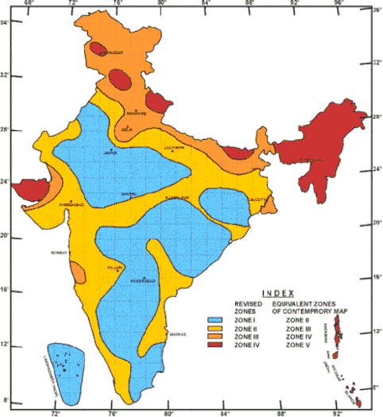
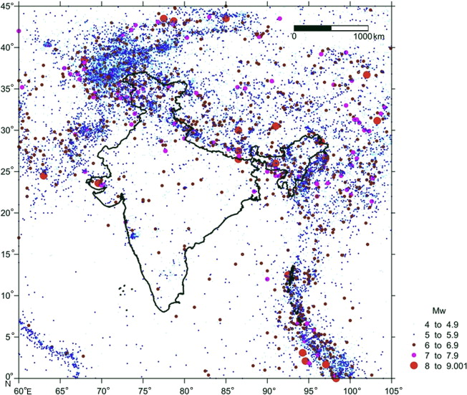

Slide 26
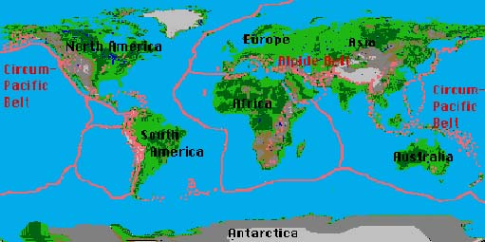
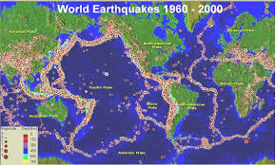

Slide 27
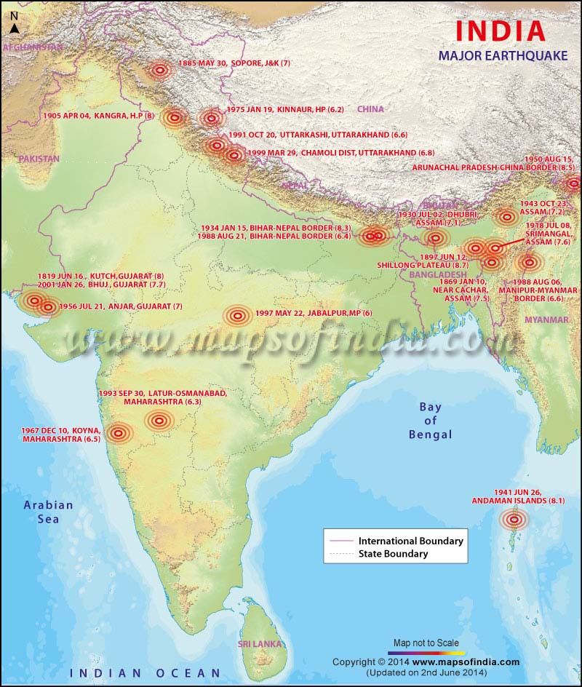
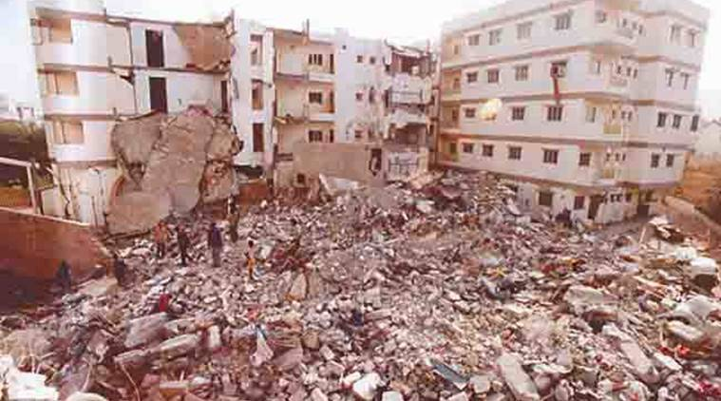

Slide 28
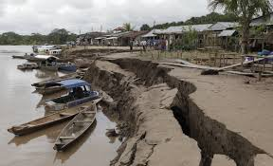
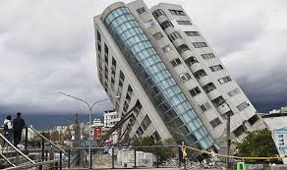
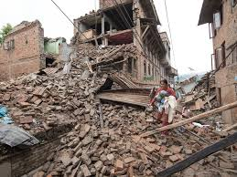
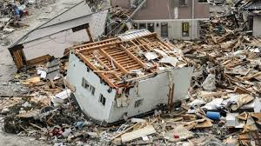
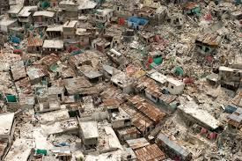
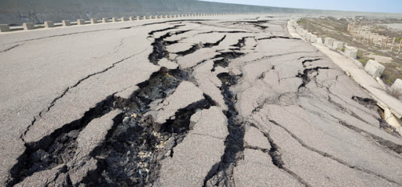

Slide 29
Thank you

