Slide 1
APPLIED GEOMORPHOLOGY – External Processes - WEATHERING
GOVERNMENT COLLEGE FOR WOMEN (AUTONOMOUS) KUMBAKONAM
DEPARTMENT OF GEOGRAPHY
  Dr. B.ANUSUYA,
  Assistant Professor & Head,
  Department of Geography,
  Government College for Women (A),
  Kumbakonam.
I – M.Sc - GEOGRAPHY

Slide 2
UNIT: II
APPLIED GEOMORPHOLOGY
External Processes - WEATHERING
Definition of External Processes:
Geological agents and processes are classified as internal and external. Internal geological agents and processes are drive by the heat that is stored in the Earth's interior. They usually occur far from the surface. The main internal geological agent is the movement of the lithospheric plates.
External Processes. Some of the external processes that have an impact on landforms are: Denudation: Denudation is a process where the wearing away of the surface of the earth is caused due to moving water, by ice, by wind, and by waves, leading to a reduction in elevation and in relief of landforms and of landscapes.

Slide 3
Geomorphology is the science of landforms, with an emphasis on their origin, evolution, form, and distribution across the physical landscape. Understanding geomorphology is therefore essential to understanding one of the most popular divisions of geography. Studying geomorphological processes provides significant insight into the formation of the various structures and features in landscapes worldwide,
It is time to know in detail about the surface of the earth on which we live. We know that the surface of the earth is not a plain platform. It is distributed unevenly with a variety of landforms like mountains, hills, plateaus, plains, ravines, cliffs etc. Why is the surface of the earth uneven? What make changes in the earth’s surface? What process makes mountains and hills? The answer to all the questions above – Geomorphic Processes.

Slide 4
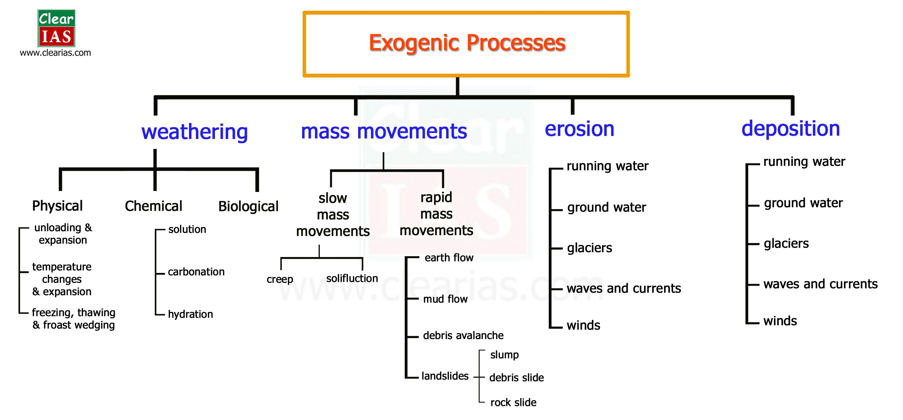

Slide 5
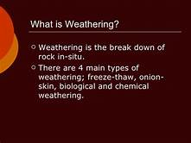
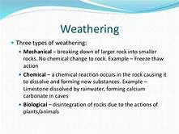
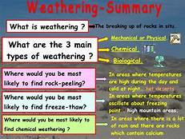
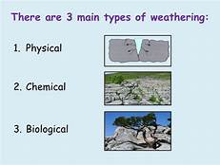

Slide 6
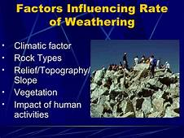
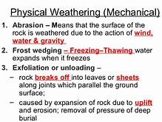
Geomorphic Process
The formation and deformation of landforms on the surface of the earth are a continuous process which is due to the continuous influence of external and internal forces. The internal and external forces causing stresses and chemical action on earth materials and bringing about changes in the configuration of the surface of the earth are known as geomorphic processes.

Slide 7
Endogenetic Forces:
Endogenetic Forces are those internal forces which derive their strength from the earth’s interior and play a crucial role in shaping the earth crust.
Examples – mountain building forces, continent building forces, earthquakes, volcanism etc.
The Eendogenetic forces are mainly land building forces.
The Energy emanating from within the earth is the main force behind Endogenetic geomorphic processes. This energy is mostly generated by radioactivity, rotational and tidal friction and primordial heat from the origin of the earth.

Slide 8
Exogenic Forces: are those forces which derive their strength from the earth’s exterior or are originated within the earth’s atmosphere.
Examples of forces – the wind, waves, water etc.
Examples of exogenic processes – weathering, mass movement, erosion, deposition.
Exogenic forces are mainly land wearing forces.
Exogenic forces can take the form of weathering, erosion, and deposition. Weathering is the breaking of rocks on the earth’s surface by different agents like rivers, wind, sea waves and glaciers. Erosion is the carrying of broken rocks from one place to another by natural agents like wind, water, and glaciers.
The processes by which the rocks on the earth’s surface are broken into pieces through the application of external physical forces and the debris are transported elsewhere is known as denudation. This denudation work is performed through three processes such as weathering, erosion and transportation.

Slide 9
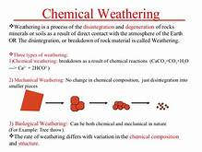
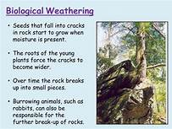
Weathering is the breaking down of rocks, soils, and minerals as well as wood and artificial materials through contact with the Earth's atmosphere, water, and biological organisms.
Weathering, disintegration or alteration of rock in its natural or original position at or near the Earth’s surface through physical, chemical, and biological processes induced or modified by wind, water, and climate. During the weathering process the translocation of disintegrated or altered
Weathering describes the breaking down or dissolving of rock s and mineral s on the surface of the Earth. Water, ice, acids, salts, plants, animals, and changes in temperature are all agents of weathering. Once a rock has been broken down, a process called erosion transports the bits of rock and mineral away.

Slide 10
Weathering breaks down and loosens the surface minerals of rock so they can be transported away by agents of erosion such as water, wind and ice. There are two types of weathering: mechanical and chemical. Mechanical weathering is the disintegration of rock into smaller and smaller fragments.
weathering The process by which rocks are broken down into small grains and soil. Weathering can happen through rainfall, ice formation, or the action of living things, such as algae and plant roots. It is part of the geological cycle.
Weathering is an important natural process where rocks, soils, and minerals are broken down by the various forces such as contact with waters, biological organisms, and the earth's atmosphere. Weathering takes place without involving movement, and therefore it is on site, and there is little to no movement, unlike erosion.

Slide 11
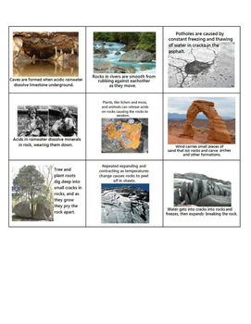
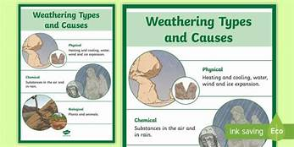
Weathering is thus the process where rocks or soils are dissolved or worn away into smaller and smaller pieces due to particular environmental factors such as the examples given above. In geological terms, weathering is defined as the disintegration of rocks influenced by animal and plant life, water, and the atmospheric forces in general.
The Different Processes Of Weathering
There exist two important classifications of weathering processes namely; chemical and physical weathering which might involve a biological component.
Physical Weathering
Physical weathering also known as mechanical weathering involves the disintegration of soils and rocks as a result of direct contact with atmospheric conditions such as water, pressure, ice, and heat.

Slide 12
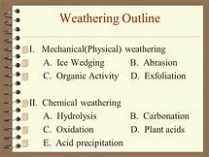
Which of these causes physical weathering?
Physical Weathering Physical weathering is caused by the effects of changing temperature on rocks, causing the rock to break apart. The process is sometimes assisted by water. Physical weathering happens especially in places places where there is little soil and few plants grow, such as in mountain regions and hot deserts.

Slide 13
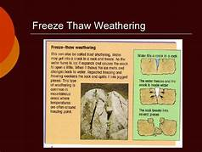
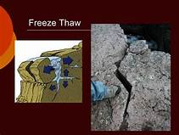
What is Physical Weathering?
Physical weathering is also referred to as mechanical weathering. It is the weakening of rocks followed by disintegration due to the physical or mechanical forces including the actions on the rocks by abrasion, frost chattering, temperature fluctuations and salt crystal growth.
External environmental forces such as wind, water waves, and rain also consistently exert pressure on the rock structures resulting in accelerated disintegration. Physical weathering does not involve any chemical changes because the chemical composition of the rocks is never altered. Below is how the process occurs and the types of mechanical/physical weathering.

Slide 14
“Physical weathering, also known as mechanical weathering, is the class of processes that causes the disintegration of rocks without chemical change. The primary process in physical weathering is abrasion (the process by which clasts and other particles are reduced in size). However, chemical and physical weathering often go hand in hand. Physical weathering can occur due to temperature, pressure, frost etc. For example, cracks exploited by physical weathering will increase the surface area exposed to chemical action, thus amplifying the rate of disintegration.”
Processes of Physical/Mechanical Weathering
Mechanical or physical weathering is a process that constantly takes place since nature influences it. The process usually happens near the surface of the earth influenced by wind, water, and temperature.

Slide 15
Wind
The physical forces of wind act on the loose rocks, leaving them sculptured and denudated. Wind forces carry small particles and rocks that collide with the rocks, in turn, wearing then away. The forces of wind on physical/mechanical weathering are common in sandstorms in deserts.
Water and Glacial Materials
Water, on the other hand, gets into the rocks and once inside the rocks and freezes. The frozen water expands and causes the rocks to weaken and widens the cracks. In the long-run, the bigger rocks are broken into smaller and smaller fragments. Moving ice in glacial areas also washes away rock fragments and disintegrates them into smaller pieces as the rocks interact with the forces and pressure of the frozen materials.
Temperature Fluctuations
Fluctuations in temperature contribute to thermal stress. This is the contraction and expansion effect on the rocks because of temperature changes. Because of the uneven expansion and contraction, the rocks crack and disintegrate into smaller pieces. Eventually, these processes make the rock break down into finer and finer pieces.

Slide 16
Types of Physical Weathering
The various categories of physical/mechanical weathering are determined by the natural processes and physical forces. They include:
Thermal Pressure
Changes in temperature contribute to expansion and contraction of the rocks. When the temperature of the rock rises, the rock expands and when the temperature of the rocks decreases, the rock contracts. Because the outer surface is more exposed than the inner surface, there is uneven contraction and expansion of the rock’s constituent minerals. This process results in physical stress, also termed as thermal pressure, which can crack or break the rock apart.
Rocks in the desert are highly affected by this process because during the day the temperatures are very high while in the night the temperatures are low. The continuous contraction and expansion during the day and night exert stress of two main types, thermal fatigue, and thermal shock, on the rocks which makes them to crack and eventually break into pieces. Wildfires can as well cause considerable weathering of the rocks as the intense heat rapidly expands the rock’s constituent minerals than normal.
Freeze-thaw
Freeze-thaw
Freeze-thaw also refers to frost chattering or frost weathering. When water enters the rocks through the pores and cracks, it freezes. Once the frozen water is within the rocks, it expands by about 10% thus opening the cracks a bit wider. The pressure acting within the rocks is estimated at 30,000 pounds per square inch at -7.6°F.
Over time, the repeated frost cycles of ice formation and ice melt alongside the changes in weather make the rock split off, and bigger rocks are broken into smaller fragments. Frost weathering is common in mountain areas and very cold regions where the temperatures are about the freezing point of water.

Slide 17
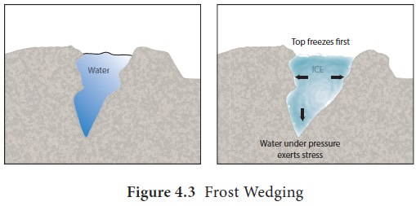
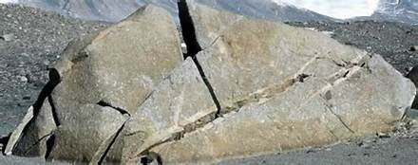
Release of Pressure or Exfoliation
When the overlying rock materials are stripped by abrasion or other erosion processes, it gives rise to cracking, fractures and expansion of the underlying rocks parallel to the surface. This makes the underlying rocks to release the pressure in them.
Over time, sheets of rock separate from the stripped rocks and break into smaller pieces along the fractures through a process termed as exfoliation. Exfoliation happens when cracks form parallel to the land surface as an effect of the pressure release during abrasion, retreat of an overlying glacier, or rock uplifts.
Salt-crystal Growth or Salt Weathering
Salt-crystal growth is also referred to as salt weathering or haloclasty. It occurs when saline solutions enter the rock pores or cracks and evaporates, leaving behind salt crystals. The accumulated salts crystals are heated up when environmental temperatures are high, and they expand thus releasing pressure on the rock, causing the rocks to disintegrate.

Slide 18
Salt crystallization may also happen when rocks such as limestone form salt solutions like sodium carbonate or sodium sulfate. The salt solutions form salt crystals when the moisture in them evaporates. These salts can expand three-fold or even more, and this phenomenon mainly takes place in drier and high-temperature areas. A prime example of salt-crystal growth is witnessed in honeycombed stones in the sea wall.
Plant Growth and Animal Action
Trees and other plants can wear away rocks when their roots penetrate into the cracks in the rocks. As the roots get bigger, they exert pressure on rocks and make the cracks wider and deeper, eventually breaking the rocks apart. Burrowing animals such as moles, squirrels and rabbits loosen and disintegrate the rocks in the soil.
Abrasion
Abrasion is the wearing down of rock particles by friction due to water, wind or ice. The continued vulnerability to these elements gradually breaks down the exposed surfaces of the rocks. It is the action on the rocks by wind, ice, rain, and waves combined.

Slide 19
. Chemical weathering changes the composition of rocks, often transforming them when water interacts with minerals to create various chemical reactions. Chemical weathering is a gradual and ongoing process as the mineralogy of the rock adjusts to the near surface environment. ”
Chemical weathering happens because the processes are gradual and ongoing, therefore changing the mineralogy of the rocks over time that makes them to wear away, dissolve, or disintegrate. The rock’s chemical transformations are highly influenced by the interaction of water and oxygen through processes such as hydrolysis and oxidation.
The ultimate end-result is the formation of new materials that contributes to the creation of pores and fissures in the rocks, in turn, accelerating the disintegration action. Chemical weathering involves various processes and types of weathering. Here are the detailed aspects.
What is Chemical Weathering?
Chemical weathering pertains to the changes in rock structure under the action or influence of chemical reactions. There are hundreds of natural chemical processes and reactions within the rocks the change the composition and the structure of the rocks over time. Temperature and, especially, moisture are critical for chemical weathering. Chemical weathering, therefore, occurs more quickly in hot, humid climatic regions.
When rain falls, the water is slightly acidic because carbon dioxide from the air dissolves in it. The rock may become weathered because of the minerals present in it that may react with the rainwater to form new minerals (clays) and soluble salts.

Slide 20
Processes of Chemical
Weathering
Stormwater, acid rain, bio-chemical processes and mountain movements or rock uplifts are some of the processes determining chemical weathering.
Stormwater
Stormwater plays an important role in the hydrolysis and oxidation processes within the rocks. Stormwater can become a bit acidic by absorbing carbon dioxide in the atmosphere and as such this activates chemical action with the mineral granular particles in the rock producing chemical compounds such as salts and minerals that dissolve or eats away the rocks.
Acid Rain
Acid rain occurs when rainwater becomes acid by mixing with acidic depositions in the atmosphere. The combustion of fossil fuels such as coal, gasoline, and gas releases oxides of nitrogen, sulfur, and carbon into the air which reacts with moisture to form rainwater that is more acidic than normal. The resulting acid rain then reacts with the rock’s mineral particles to produce new minerals and salts that can easily dissolve or wear away the rock grains.

Slide 21
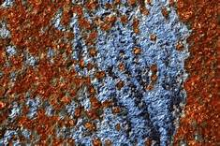
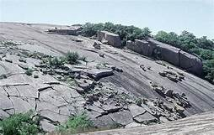
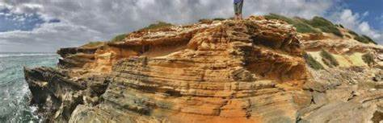
Bio-chemical Processes
Various plants and animals can create chemical weathering by emitting acidic compounds. As such, microscopic organisms such as moss, lichens, bacteria, and algae can speed up chemical weathering especially on the rock surfaces where they grow. They release what are termed as acidifying molecules (organic acids and protons) and chelating compounds (siderophores and organic acids). These compounds have the potential of breaking down iron and aluminum minerals in the rocks that are then dissolved by water, resulting in chemical weathering.
Rock Uplifts or Mountain Movement
The process of rock uplifts or mountain movements exposes new rocks to the atmospheric conditions such as moisture and extreme temperatures, allowing chemical weathering to take place. For instance, exposure of the rocks to surface waters or rainfall accelerates chemical weathering by hydrolysis and acidic reactions that eat away calcium ions and other minerals.
Types of Chemical Weathering
The various types of chemical weathering arise since it is driven by gradual and ongoing chemical reactions, mineralogy changes, the dissolving of the particles, and then the final wearing away or disintegration of the rocks. These reactions include hydrolysis, carbonation, dissolution, and oxidation. Temperature and most importantly moisture are vital for chemical weathering.

Slide 22
Hydrolysis
Hydrolysis is the chemical reactions caused by water. Water reacts with the rock and alters the size and chemical compositions of the minerals, lessening their resistance to weathering. Whenever minerals are hydrolyzed, crystal rocks and clay minerals such as calcium, potassium, and sodium ions are produced.
This type of chemical reaction is highly common in igneous rocks. The reaction takes either the form of hydration or dehydration. Absorption of water into the rock pertains to hydration while the removal of water from the rock pertains to dehydration. Hydration expands the rock’s volume resulting in size alteration.
This is how gypsum is formed. Dehydration, on the other hand, reduces the volume of the rock. A good example is the formation of hematite from the removal of water from limestone.

Slide 23
Carbonation
Carbonation is the mixing of water with carbon dioxide to make carbonic acid. Carbonation takes place when the rock minerals react with weak carbonic acid formed when water combines with carbon dioxide in the atmosphere. Carbonic acid acts on the rock by breaking down and dissolving its mineral contents. The dissolved materials are washed away by ground water, and the soluble ions are stored in the groundwater supply. Rocks such as limestone and feldspar experience this type of chemical weathering more. This type of weathering is important in the formation of caves.
Dissolution
Dissolution equally means leaching. It the process by which the rocks are dissolved when exposed to rainwater. Limestone and rock salts are particularly the rocks that form solvent solutions when exposed to rainwater, surface waters, or even ground water. Upon dissolving, the minerals in the rocks become ion solutions in the water which are then washed away. Karst features are a common example of this phenomenon.

Slide 24
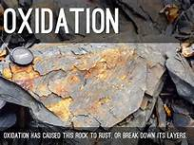
Oxidation: Oxidation is another type of chemical weathering. Oxidation is also known as rusting. It is the process whereby the rock minerals lose one or more ions or atoms in the presence of oxygen. When minerals in the rock oxidize, they become less resistant to weathering. Oxygen combines with other substances via the oxidation process giving rise to the ion or atom lose.

Slide 25
For instance, iron metal rusts because its ions change from one form to another by losing one electron. It becomes red or rust colored when oxidized. In a similar manner, iron-bearing minerals in rocks go through such a process by losing ions that alter its structure and size from one form to another. The wearing away of the rocks is thus sped up by oxidation/rusting as the resultant oxides are weaker than the original materials. Change of rock color is a prime example of rock disintegration by oxidation.
What are three types of biological weathering?
On the other hand, burrowing animals can break down rocks while some eats away the rock’s minerals. Here are the three main types of biological weathering. Growing Plant Roots. It is common to see some roots growing within the face of a rock. Well, such plant activity contributes to biological weathering.
What is the importance of biological weathering?
Biological Weathering: Many organisms play important roles in the weathering of rocks through physical and chemical means important organisms concerned with the decomposition of rocks are lichens, bacteria, fungi, higher plants, nematodes and other soil microbes.

Slide 26
What is Biological Weathering?
Biological weathering also means organic weathering. It is the disintegration of rocks as a result of the action by living organisms. Plant and animals have a significant effect on the rocks as they penetrate or burrow into the soil respectively. Biological weathering can work hand in hand with physical weathering by weakening rock or exposing it to the forces of physical or chemical weathering.
For instance, some plants and trees grow within the fractures in the rock formation. As they penetrate into the soil, and their roots get bigger, they exert pressure on rocks and make the cracks wider, and deeper that weaken and eventually disintegrate the rocks. Microscopic organisms can also produce organic chemicals that can contribute to the rock’s mineral weathering.
Biological weathering is a very common type of weathering that we see around us. There are many small animals that bore hole in the rock and live inside it. Over the time, they burrow and widen cracks and end up breaking rocks apart. Then there are bacteria, algae and lichens produce chemicals that help break down the rock on which they survive, so they can get the nutrients they need. They produce weak acids which convert some of the minerals to clay. We, humans, are also responsible for biological weathering. As we construct more homes, industries, dams, power plants, roads, we rip the rocks apart.
“Biological weathering is weathering caused by plants and animals. Plants and animals release acid forming chemicals that cause weathering and also contribute to the breaking down of rocks and landforms.”

Slide 27
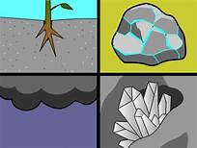
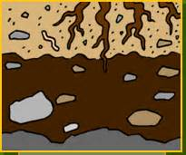
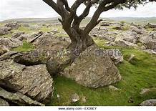
Process and Types of Biological Weathering
Bio-chemical processes, root penetration, and animal burrowing are some of the processes determining biological weathering. Bio-chemical action plays an important role by emitting organic compounds. The organic compounds have acidifying molecules that corrode rock minerals and as such, makes them weak and prone to disintegration.
This biological action usually results in chemical weathering. The process of root penetration during plant growth exerts pressure on the rocks that subsequently breaks them apart. On the other hand, burrowing animals can break down rocks while some eats away the rock’s minerals.
Here are the three main types of biological weathering
Growing Plant Roots
It is common to see some roots growing within the face of a rock. Well, such plant activity contributes to biological weathering. The roots of plants and trees penetrate into the soil in search of nutrients and water. As the roots penetrate the soil, they go through cracks or joints in the rocks and as they grow they progressively crack the rock apart. Bigger growing roots can also exert pressure on the adjacent rocks. Some plant roots also emit organic acids that aid to dissolve the rock’s minerals.

Slide 28
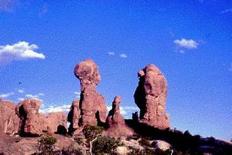
Microbial Activity
Some plant microbial activity releases organic acidic compounds. These compounds can break down iron and aluminum minerals in the rocks. Microscopic organisms like algae, moss, lichens and bacteria are such kind of plants. They grow on the surface of the rocks and produce organic chemicals that are capable of breaking down the outer layer of the rock by altering the rock’s chemical composition. They release what are termed as acidifying molecules (organic acids and protons) and chelating compounds (siderophores and organic acids). The amount of biological activity that breaks down minerals depends on how much life is in that area.
arise out of bio-chemical reactions which accelerate chemical and physical weathering. Nonetheless, the process is categorized as biological weathering since it is biological in nature. Besides, these microscopic organisms also bring about moist chemical micro-environments which encourage the chemical and physical breakdown of the rock surfaces.
Burrowing Animals
Burrowing animals such as moles, squirrels and rabbits can speed up the development of fissures. Many animals such as the Piddock shells drill into rocks for protection either by releasing acids to dissolve the rocks or fragment away the rock grains. These animal activities can create fissures in the rocks and also eats away the rock’s minerals.
As this process continues, gaps and holes develop within the rock, further exposing the rocks to chemical, biological and physical weathering. Burrowing animals can as well move the broken rock pieces to the surface and so indirectly increasing the processes of rock weathering.

Slide 29
Human Activities
Human activities equally dig, crash, and widen the cracks and wind up fragmenting the rocks apart. These activities include mining, road construction, and housing developments.

Slide 30
Thank you

