Slide 1
APPLIED GEOMORPHOLOGY
SLOPE DEVELOPMENT THEORIES
WOOD
GOVERNMENT COLLEGE FOR WOMEN (AUTONOMOUS) KUMBAKONAM
DEPARTMENT OF GEOGRAPHY
  Dr. B.ANUSUYA,
  Assistant Professor & Head,
  Department of Geography,
  Government College for Women (A),
  Kumbakonam.
I – M.Sc - GEOGRAPHY

Slide 2
UNIT: IV
APPLIED GEOMORPHOLOGY - P18GC101
SLOPE DEVELOPMENT THEORIES
WOOD
How are Slopes Formed?
According to WOOD:
Slope profiles can have several manifestations depending on the factors discuss above. Below are two popular examples of slope models.
Four Unit Slope Model
Four unit slope model (Wood, 1942)
The four unit slope is best developed on a high initial (primary) slope composed of strong rock and the absence of local undercutting. As the steep fall face retreats the base is covered by a straight talus slope.
. Four Unit slope model modified from Wood (1942)

Slide 3
9-Unit Slope Model of Dalrymple et al, 1968
interfluve: divide area characterized by largely vertical subsurface water and soil movement
seepage slope: gently dipping portion dominated by downward percolation
convex creep slope: upper convex zone characterized by creep and terracette formation
fall face: Cliff face characterized by rapid detachment of material or bedrock (weathering limited) exposure.
transportational mid-slope: Active region characterized by mass movement, terracette formation, slope wash and subsurface water action
colluvial foot slope: Depositional region. Material is further transported down slope by creep, slopewash and subsurface flow.
Alluvial toe-slope: region of alluvial deposition (e.g. levee deposits)
Channel wall: removal by corrasion, slumping, fall etc.
Channel bed: Down stream transport of material

Slide 4
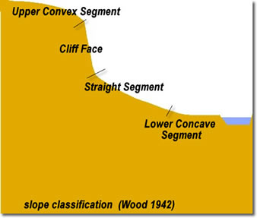
Transport-limited slope in the California Coastal Range underlain by poorly consolidated sedimentary rocks and melange. These slopes have a thick active regolith.

Slide 5
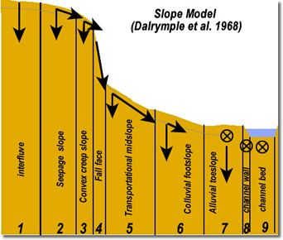
Merrimack Butte Utah. This arid climate produces weathering-limited slopes that typically lack unit 3.
Merrimack Butte Utah. This arid climate produces weathering-limited slopes that typically lack unit 3.

Slide 6
Terminology related to the plan view of the hillslope:
Slopes can be divided laterally into sections based on surface flow. Imagine drawing flowlines from the highest contour to the base of the slope. Diverging flowlines define diverging sections, parallel flowlines parallel sections, and converging flowlines converging sections. These are further outlined below:
Parallel: straight section
Diverging: ridge, interfluve, etc.
Converging: valley, hillside depression or embayment
When defining a model for a slope profile it's best to do so along a straight section.

Slide 7
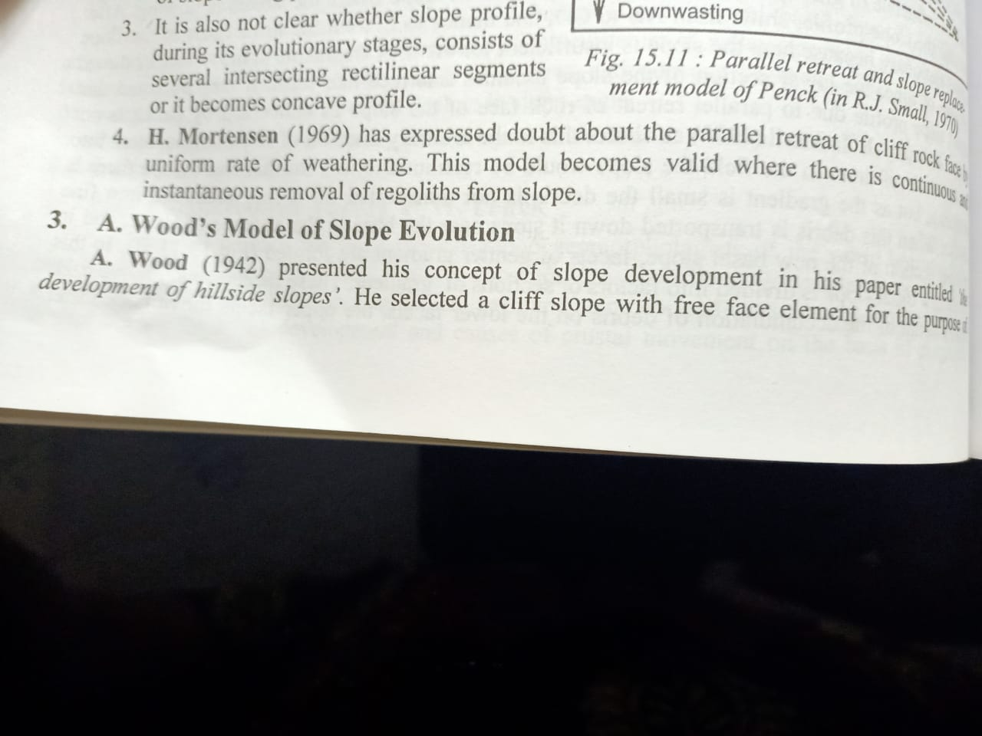

Slide 8
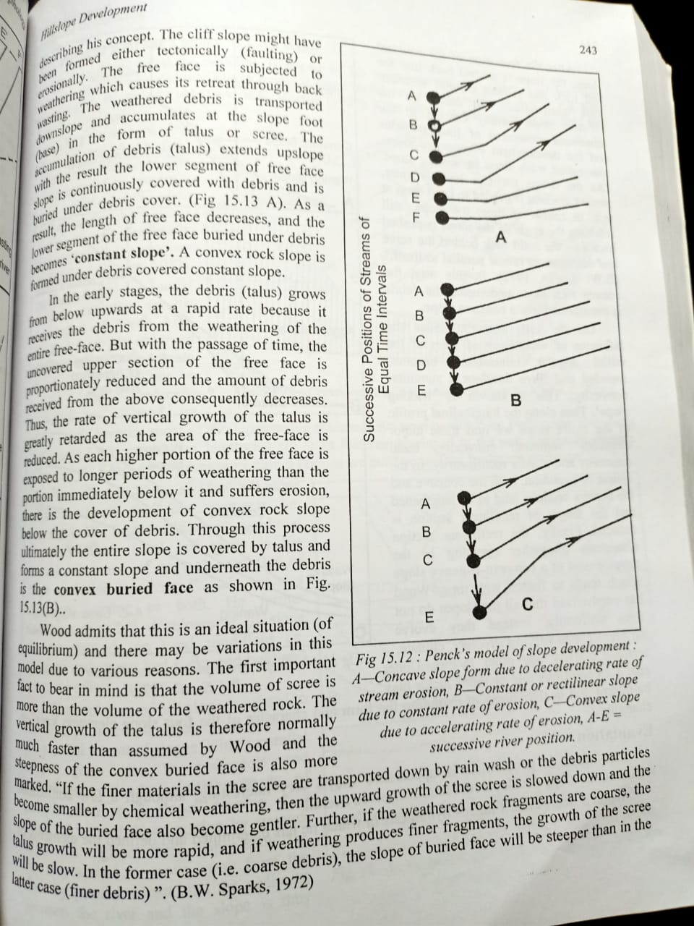

Slide 9
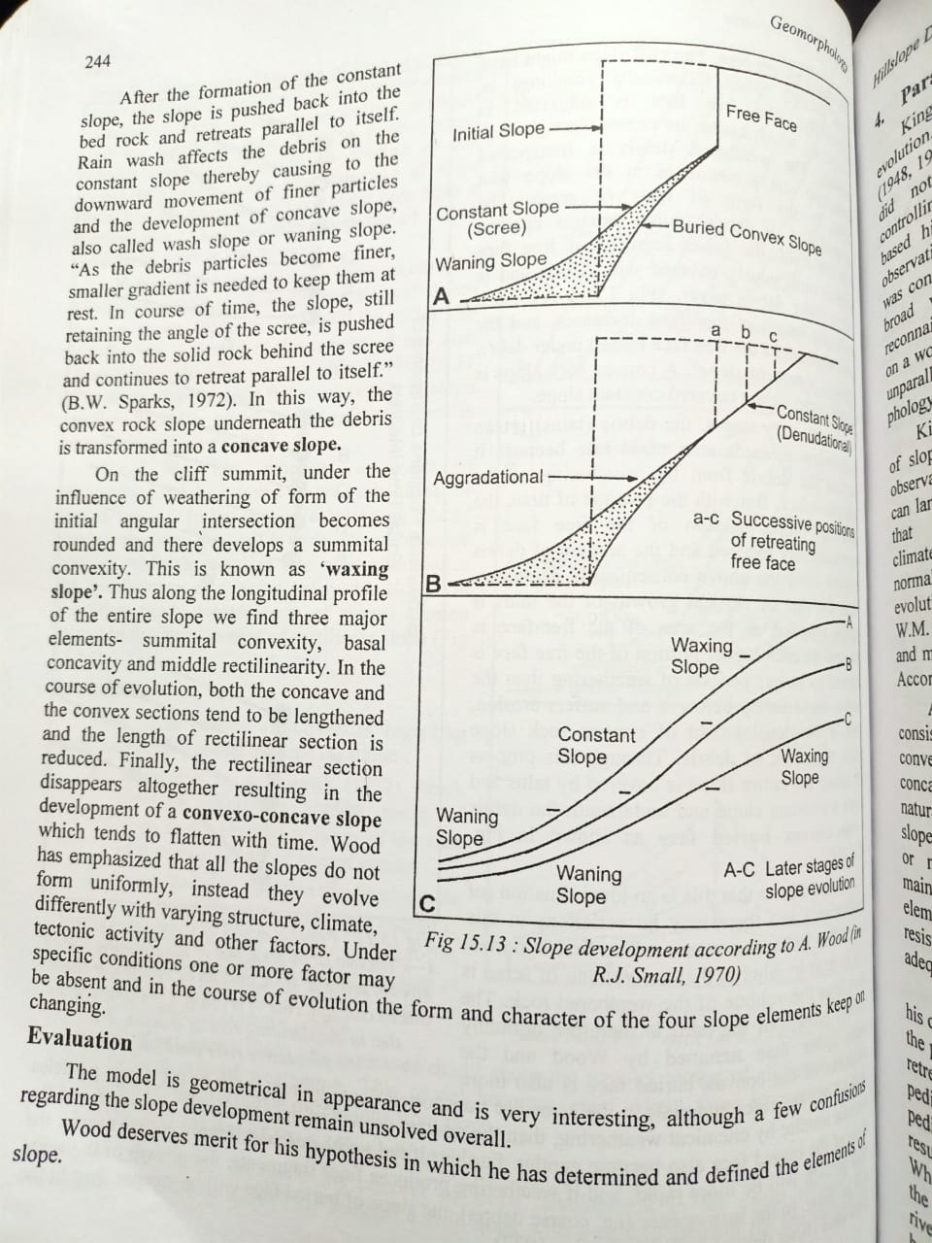

Slide 10
Thank you

