Slide 1
Cultural Regions
Essential Questions
How do different cultural regions around the world compare to one another?
Where can you find the main countries and major cities of the world?

Slide 2
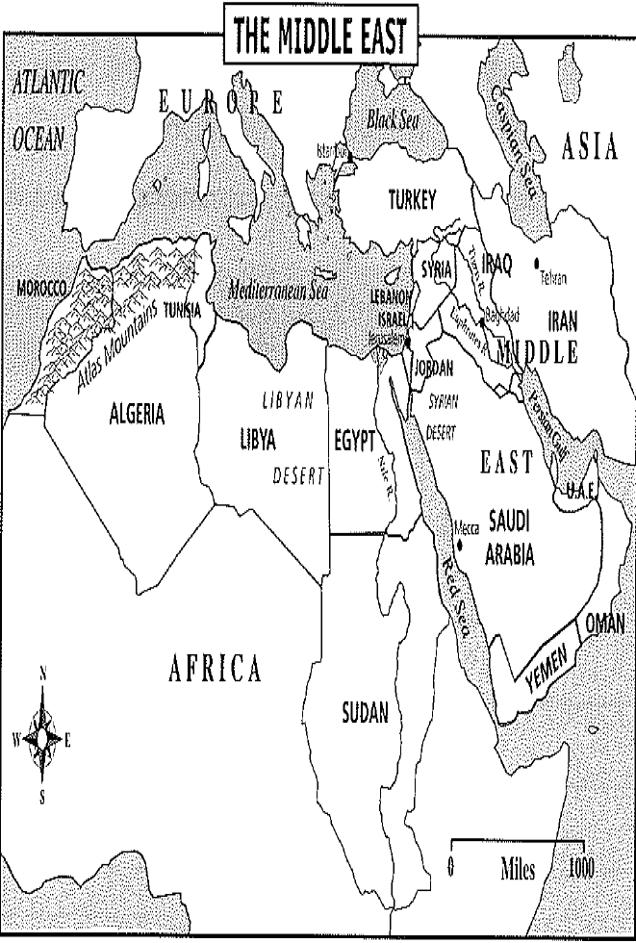
Types of Regions
Cultural Regions: based on common cultural characteristics, such as language, religious beliefs, customs, and art forms.
Example: The Middle East

Slide 3
Types of Regions
Functional Regions: based on a function they serve, such as an area of connected rivers that serves as a drainage basin.
Example: Dallas-Fort Worth Metroplex
Formal Region: have a common human or physical characteristic and clear boundaries.
Example: Common government or political unit
Perceptual Region: Based on people’s feelings about an area
Example: Big Apple, Dixie, Deep South, Midwest

Slide 5
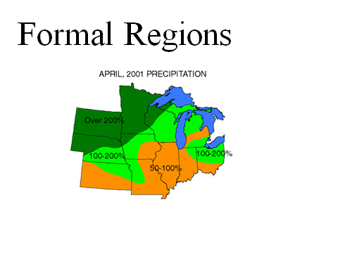

Slide 7
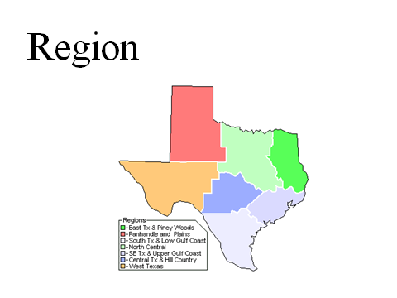

Slide 8
World Cultural Regions
North America: Consists of Canada and the United States; strongly influenced by Europe
Latin America: Mexico, Central America, West Indies, and South America
Most people speak Spanish or Portuguese
Mainly follow the Catholic religion

Slide 9
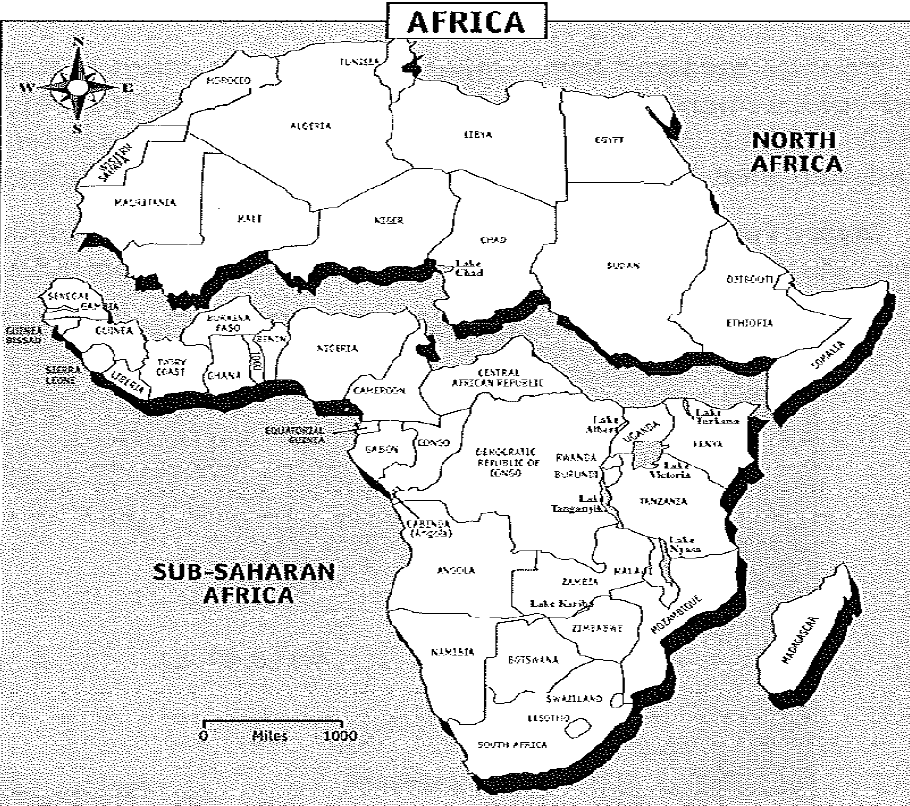
World Cultural Regions
Middle East: This is both a physical and cultural region
Mostly Islamic and Arabic
Sub-Saharan Africa: Many different ethnic groups with animistic, Christian, and Islamic religions.
Many affected by the slave trade or European colonization

Slide 10
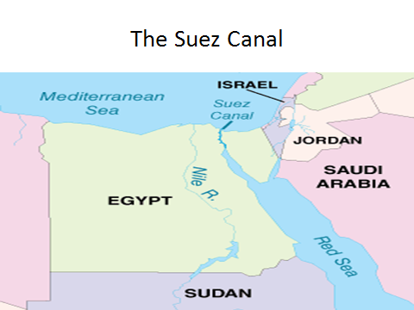

Slide 11
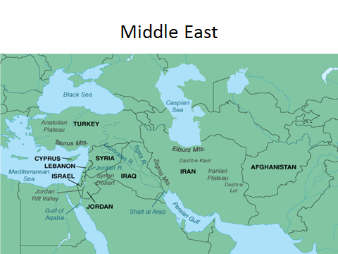

Slide 12
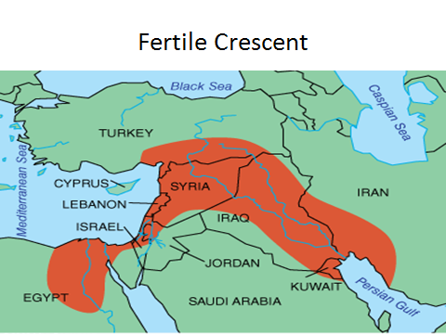

Slide 13
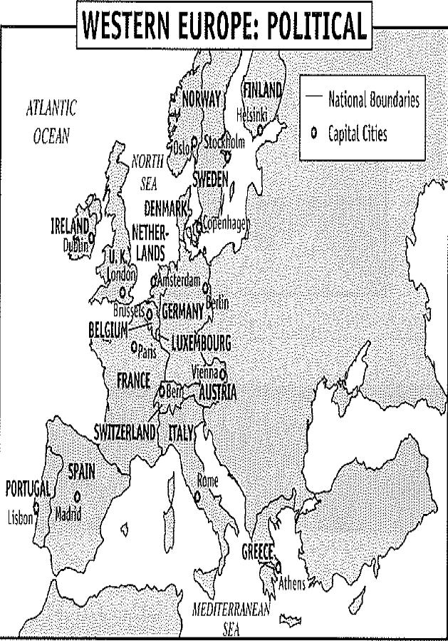
World Cultural Regions
Europe: Superior technology from 1500 to 1900; high standards of living; mainly Christian, many ethnic groups

Slide 14
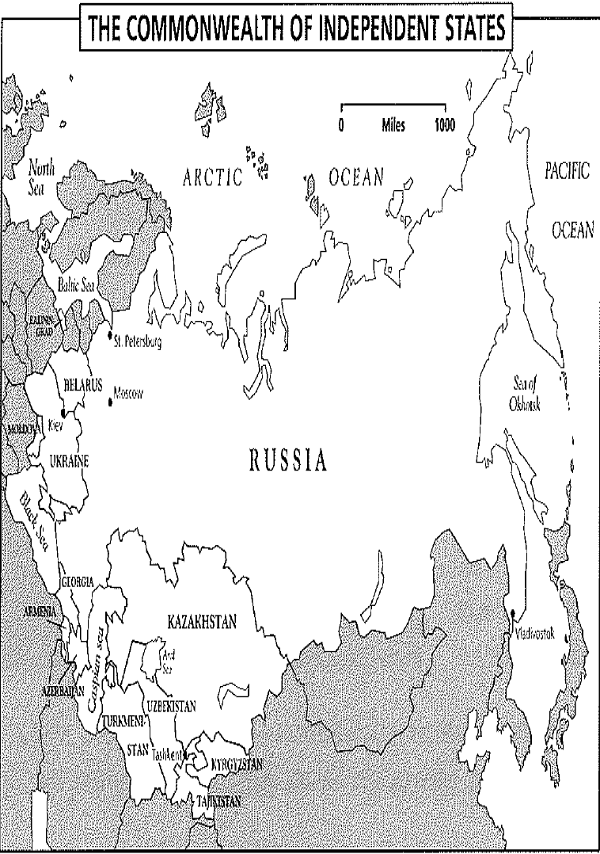
World Cultural Regions
Russia: Separated from rest of Europe by vast differences.
Influenced by Orthodox Christianity, Mongol conquests from Central Asia, absolute power of Tsars, and experiences under Communist rule

Slide 15
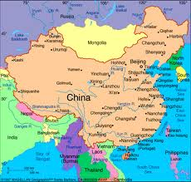
World Cultural Regions
China: Most populous country; isolated from other cultures by physical barriers.
United by written language and an all powerful emperor; today ruled by Communist Party.
Becoming an economic power

Slide 16
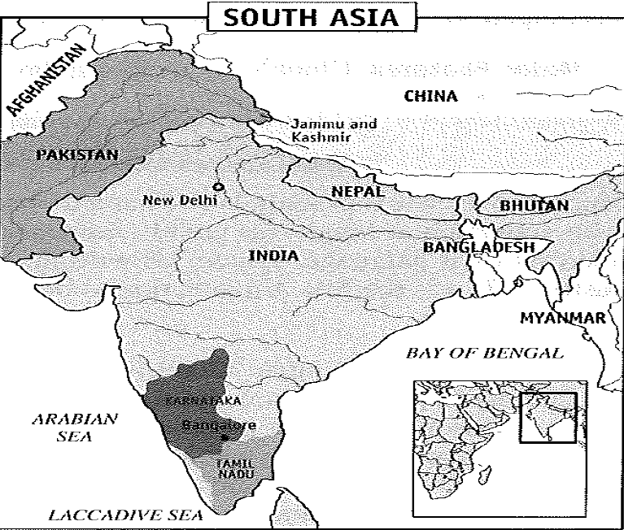
World Cultural Regions
South Asia: India, because of the Himalayan Mountains, developed its own separate language, customs, and culture.
India is the world’s 2nd most populous country
Area once colonized by Britain, independence granted in 1947.
Today, India is Hindu and Pakistan and Bangladesh are Muslim.

Slide 17
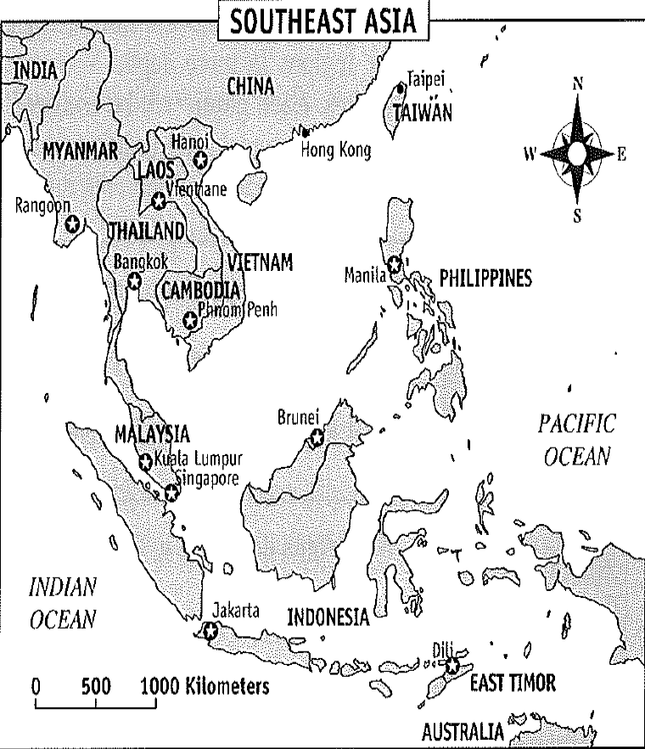
World Cultural Regions
Southeast Asia: Peninsular and island nations subject to many influences – China, India, Arabia, and Europe.

Slide 18
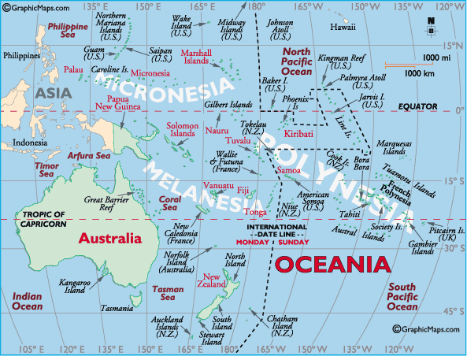
World Cultural Regions
Australia: Small, dry continent colonized by the British
Life-styles similar to those of the US and Europe.
Oceania: Includes New Zealand and other smaller island nations (Tahiti) located throughout the Pacific

Slide 19
Review
How do formal, functional and perceptual regions differ from one another?
Formal – clear boundaries w/1 common characteristic (physical/human)
Functional – 1 function which crosses political boundaries, organized around a focal point
Perceptual – based on attitudes and emotions about a place

Slide 20
Review
Why do geographers divide Africa into 2 separate major cultural regions?
Sahara Desert divides Africa into distinct cultures.
North Africa – Islam and Arab based, similar climate
South Africa – different languages, religion, ethnic groups, climate and topography from North Africa.

Slide 21
Review
Which statement about culture is the most accurate?
Most members of a culture has the same social status.
Culture is characterized by democratic government.
The people in a culture always practice the same form of religion
Culture includes a people’s language, religion, land uses and customs.
Answer: D

Slide 22
Review
Which identifies one cultural factor that unites the people of Latin America?
They are citizens of the same country.
Most are Roman Catholics.
Most speak English or Arabic.
They were once ruled by the same powerful Emperor.
Answer: B

