Slide 1
Physiography of india
V.Kalyani
Assistant Professor of Geography
Government College for Women (A), Kumbakonam.

Slide 2
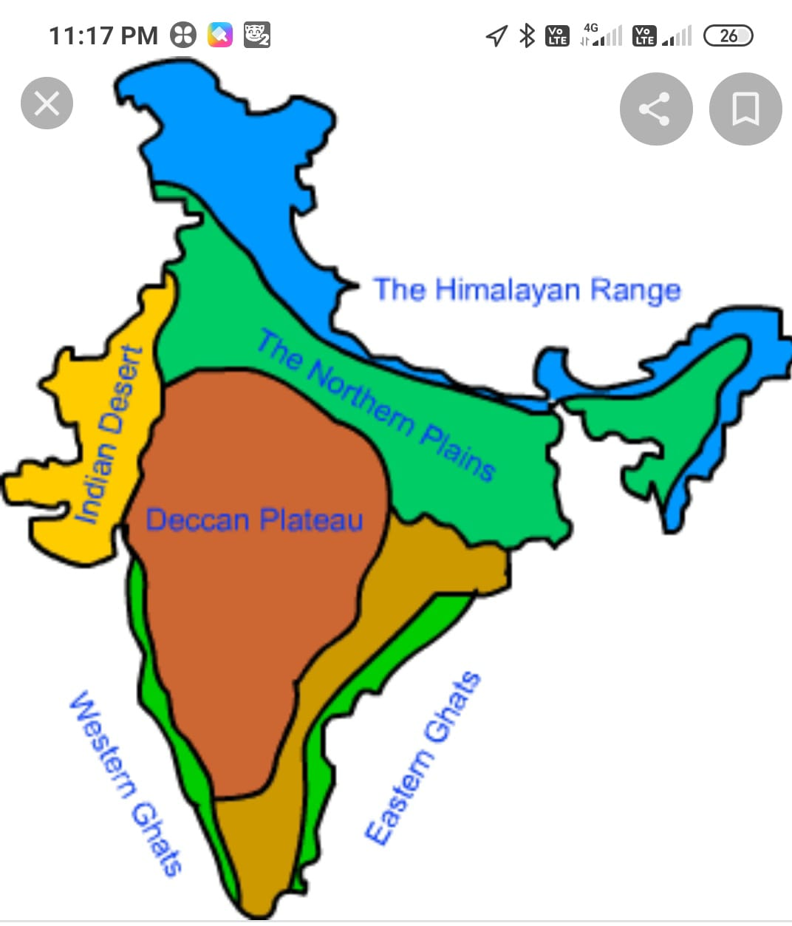

Slide 6
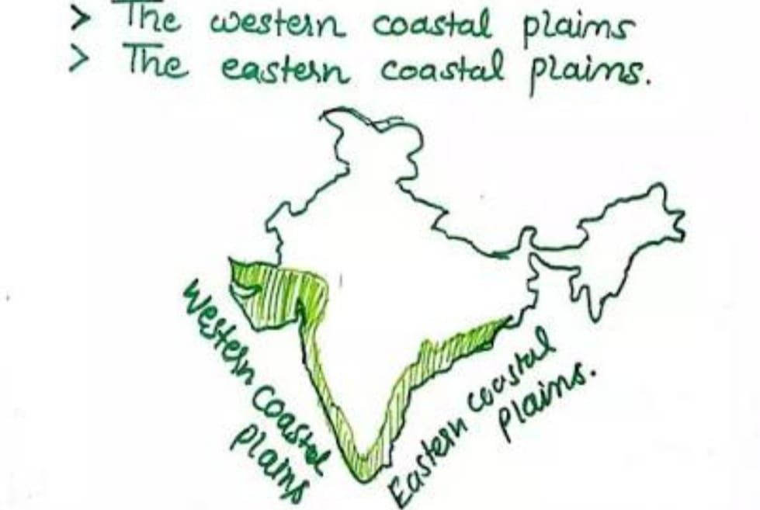

Slide 7
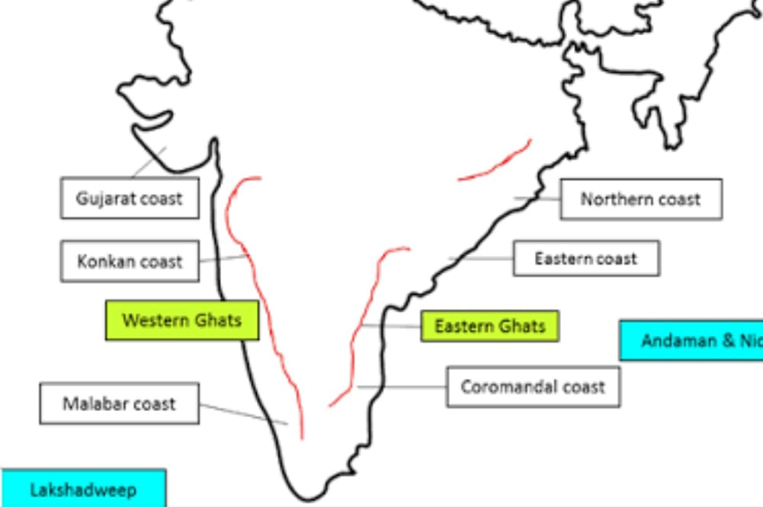

Slide 9
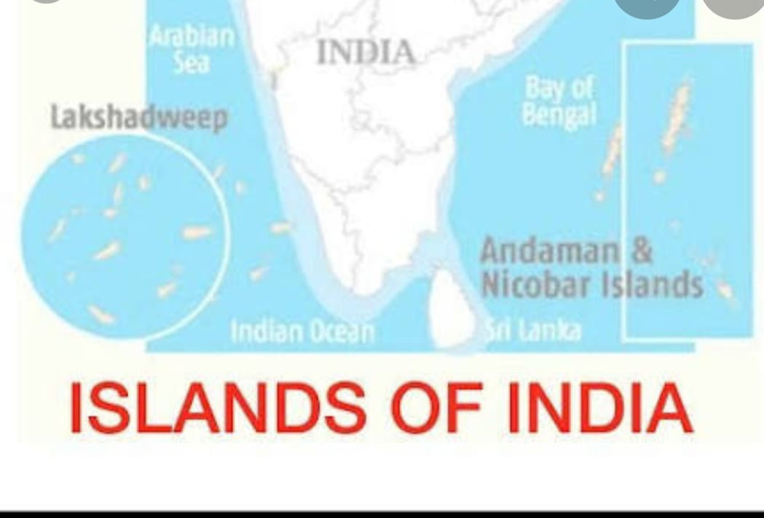

Slide 10
Thank you

