Slide 1
Methods of Data Collection
Secondary data
V.Kalyani
Assistant Professor of Geography
Government College for Women (A), Kumbakonam.

Slide 2
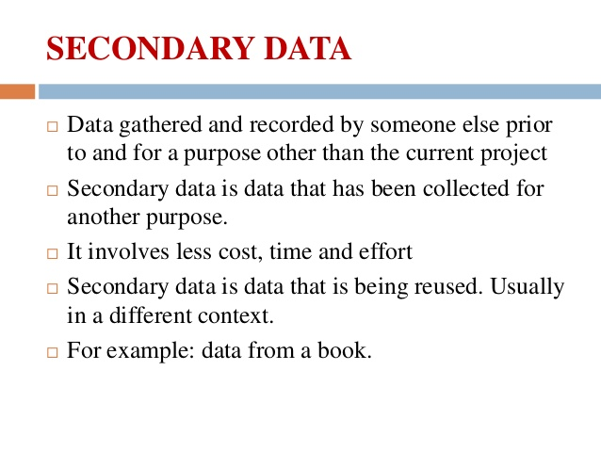

Slide 3
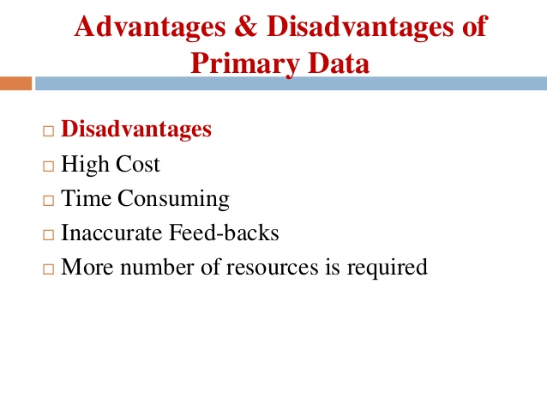

Slide 4
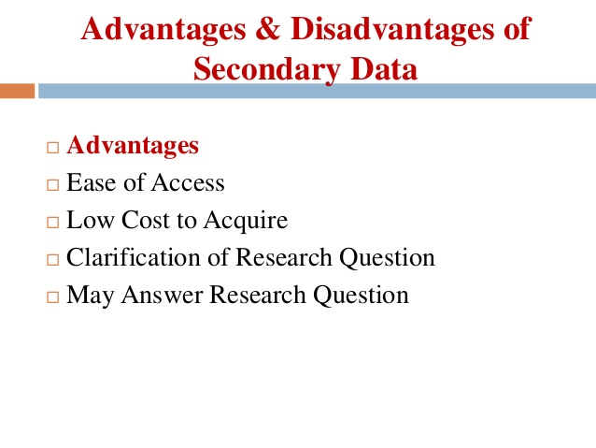

Slide 5
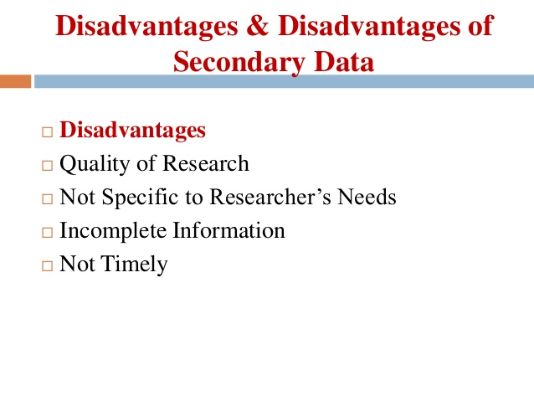

Slide 6
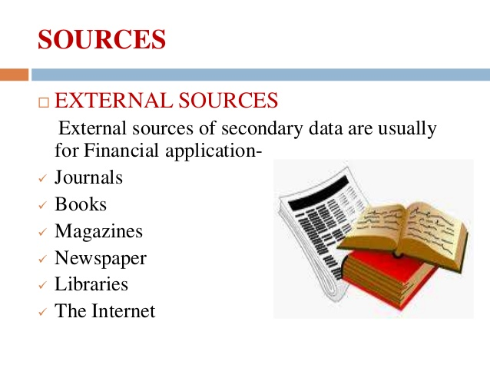

Slide 7


